Slide 1
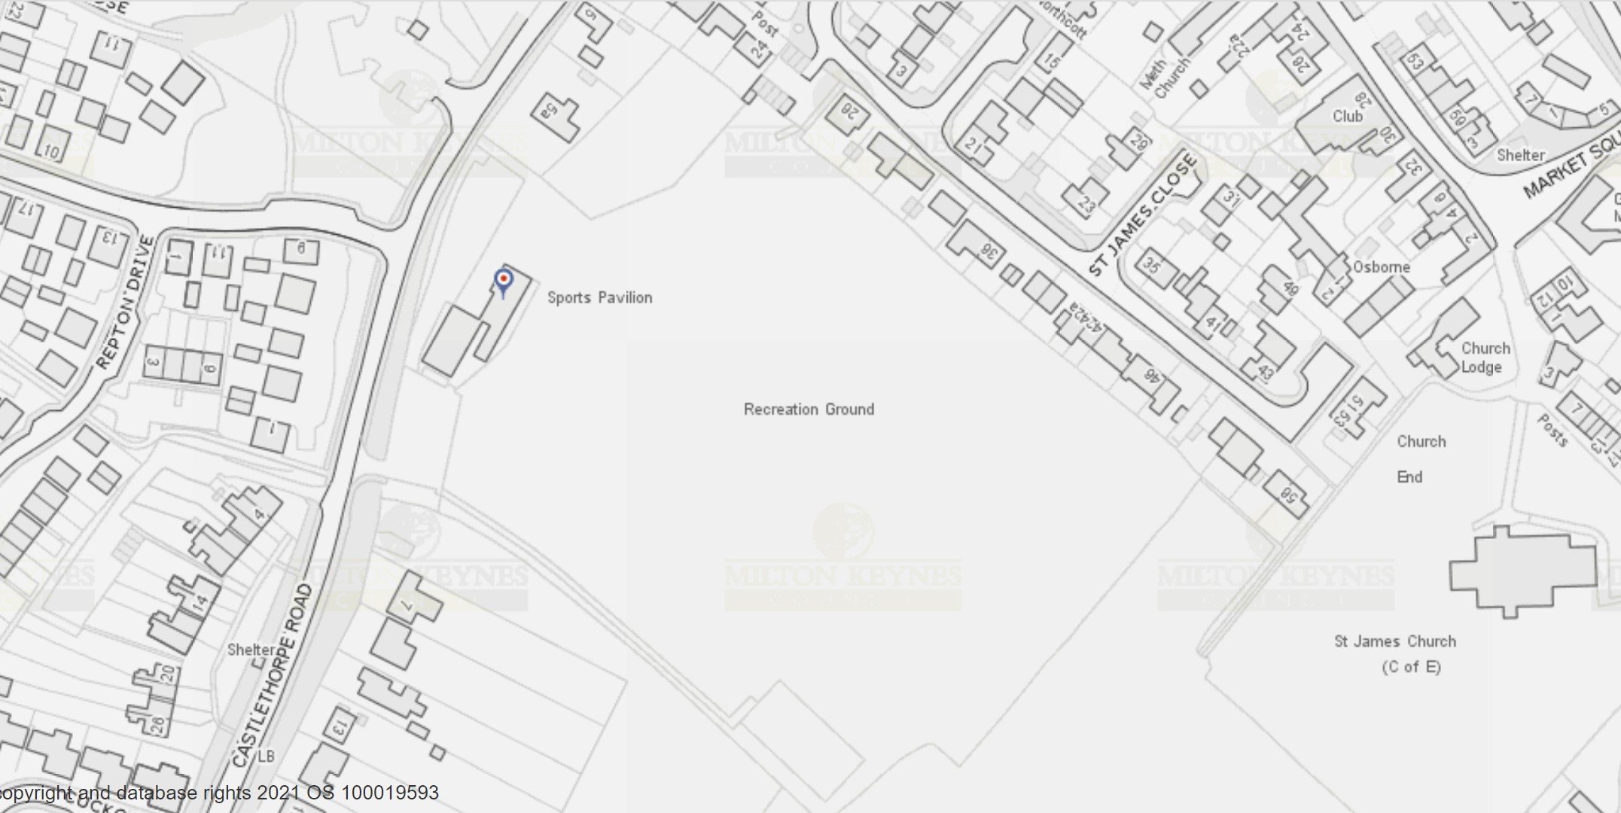
Hanslope Rec Outdoor Gym
A

