Slide 1
Tuesday 19/05/2020
Update to the information in this slide is included on Slide 11.
Strategic Crime Intelligence, Security and Welfare Framework – Supplier Engagement Event

Slide 2
Housekeeping
Please be advised that this session is being recorded and will be shared as part of the PQQ pack released to all suppliers to formally express an interest.
You have been invited to this event as you responded to the public invitation issued on Contracts Finder and Bravo NR.
You have responded to accepting an invite to this event – you have NOT formally expressed an interest in being included in the PQQ phase of this tender.

Slide 3
Tuesday 19/05/2020
Strategic Crime Intelligence, Security and Welfare Framework– Supplier Engagement Event

Slide 4
Agenda
Introductions
The Southern Region
Description of Requirements
Overview of Sourcing Process
3.1 Anticipated Timeline
3.2 Contract Outline
General Procurement Insights
4.1 Process
4.2 Principles
4.3 Common Pitfalls
Questions

Slide 5
1. The Team
Sourcing Team:
Zeeshan Sadiq – Senior Buyer, Southern Region
Sasha Bradford – Senior Procurement Manager, Southern Region
Commercial Team:
Zoe McMahon – Senior Commercial Manager, Kent and Sussex
Technical Team:
Jon Ruch – Head of Crime, Security and Resilience, Southern Region
Jason Bridges – Industry Programme Director, Wessex Route
ALL CONTACT REAGRDING THIS OPPORTUNITY SHOULD BE DIRECTED VIA THE SOURCING LEAD.
Once the PQQ is published, this contact must be through the BravoNR system.

Slide 6
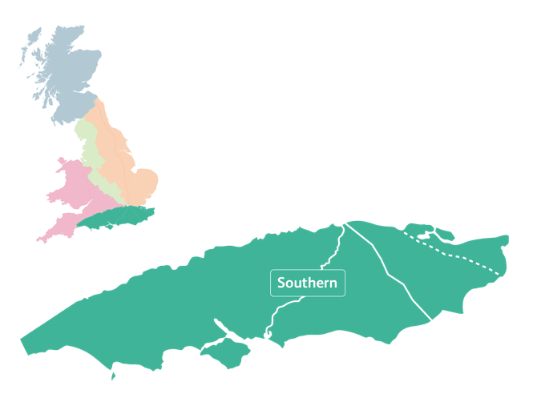
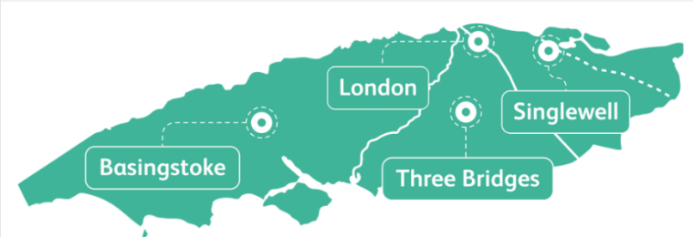
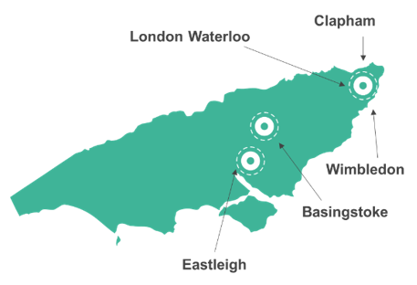
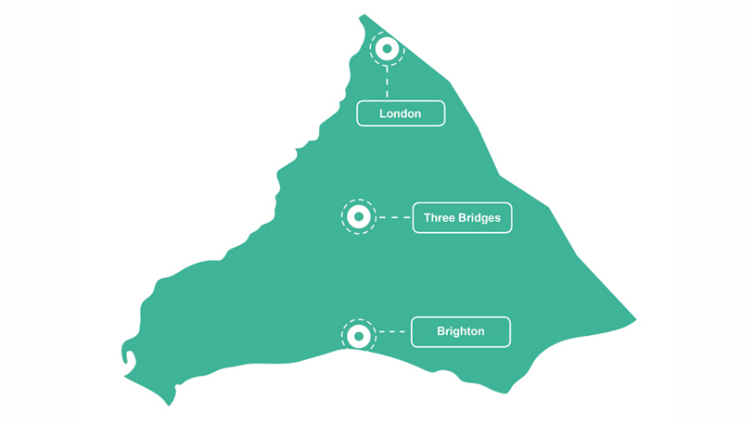
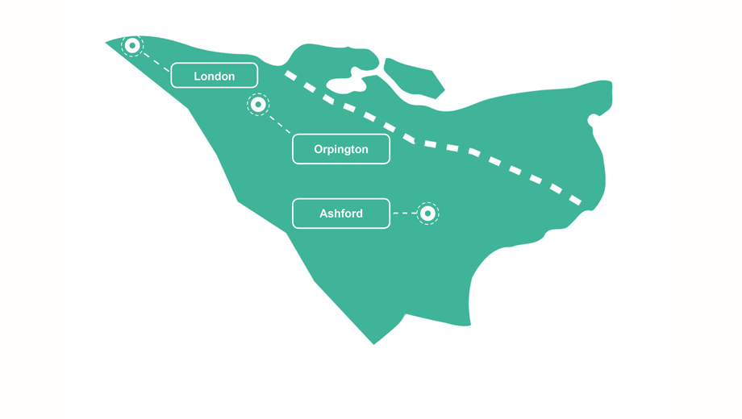
1. The Southern Region
Wessex
Sussex
Kent
Notes:
Kent
2,600 services each day
169 stations
1,354 miles of track
231 level crossings
During the period 2019/2020 the following incidents occurred on Kent Route:
839 delays causing trespass incidents
101 delays causing vandalism incidents
22 fatalities
Sussex
3,800 services each day
184 Stations
542 miles of track
341 level crossings
During the period 2019/2020, the following incidents occurred on Sussex Route:
615 delays causing trespass incidents
71 delays causing vandalism incidents
22 fatalities
Wessex
212 million passenger journeys across the network and extends from London Waterloo south west to Reading, Exeter St Davids, Portsmouth and Weymouth
2000 Train Operator and Freight Operator journeys
1300 miles of track
4394 signals
323 level crossings
1983 bridges
200+ stations
During the period of 2019/2020 the following incidents occurred on Wessex:
941 delay causing trespass incidents
114 delay causing vandalism incidents

Slide 7
3. The Requirements
The core services shall be delivered as Lineside Services (mobile) and Station Services (static) . Different approaches shall be deployed depending on location and route crime intelligence.
Lot 1 – Lineside Services:
Lot 1 encompasses predominantly mobile operatives patrolling a defined geographical area to achieve and provide the following (Will primarily take place in the Kent and Sussex Routes):
Deter crime, trespass and reduce anti-social behaviour on and around NR infrastructure;
Identify potentially suicidal persons and make interventions;
Maintain intelligence reports
Maintain intelligence reports
Assist other parties (TOCs, BTP etc)
Assist with major incident response;
Provide support to other stakeholders in joint operations and major incident response;
Support railway staff in keeping the infrastructure and railway environment safe and secure;
Temporary repairs to fencing and/or other access points.
Ad-Hoc Services may also be required to deliver additional services.
Lot 2 – Stations Services:
Lot 2 encompasses predominantly static and mobile operatives patrolling railway stations to achieve and provide the following (Will primarily take place in the Wessex Route):
Identify potentially suicidal persons and make interventions;
Assist with disorderly persons on the railway;
Reduce acts of anti-social behaviour;
Maintain intelligence reports
Respond to potential acts of trespass;
Assist with major incident response;
Provide support to other stakeholders in joint operations and major incident response;
Support railway staff in keeping the infrastructure and railway environment safe and secure;
Potential to deliver an enhanced customer service experience at stations.
Assist with major incident response;
Provide support to other stakeholders in joint operations and major incident response;
Support railway staff in keeping the infrastructure and railway environment safe and secure;
Potential to deliver an enhanced customer service experience at stations.
The Supplier(s) will be required to possess the relevant equipment required to fulfil the above requirements.

Slide 8
3. The Requirements
The additional services shall be required in both lots.
Provision of additional mobile patrols and static staff to maintain security at major engineering sites and blockades
Provision of additional staff to assist with security at key locations should there be a rise in the terrorism threat level
Provision of additional staff to provide assistance should there be a significant rise in rail related crime at a specific location or route wide
Provide additional staff to maintain safety and security should there be a significant failure of rail infrastructure
Provision of staff to maintain security at key locations in the event of an access control failure
Crowd Safety - Crowd Control This role is to facilitate movement of large crowds during specific events
Crowd Safety - Safety Officer This role acts as a source of information in and around the station directing passengers and users to key locations and infrastructure during periods of high footfall
DU & Operational Sites Patrol Officer This role is to be called on to patrol our operational sites should a risk assessment highlight the need
Minor Repairs – to be decided on a case-by-case basis with approval from local NR representative
Minor repairs such as fencing repairs and securing of access gates could be required following incidents of trespass, fly tipping, graffiti and/or vandalism.
Remedial Works – to address identified security risks – approval must be sought from NR and/or BTP before actioning remedial works, which may include the following: - Temporary fence repairs to prevent access being gained to the Railway - Traffic and pedestrian diversion assistance - Ensuring security is maintained in the event of the failure of access control system
The Supplier(s) will be required to possess the relevant equipment required to fulfil the above requirements.

Slide 9
3. The Sourcing Process

Slide 10
3.1 Anticipated Timeline
Phase | Start date | Completed date
EOI/PQQ Live | 18-Jan-21 | 18-Feb-21
PQQ Evaluation | 18-Feb-21 | 09-Mar-21
ITT Live | 10-Mar-21 | 5-Apr-21
ITT Evaluation | 5-Apr-21 | 24-May-21
Standstill 10 days | 25-May-21 | 4-Jun-21
Contract Signed | 8-Jun-21
Contact Mobilisation | 8-Jun-21 | 6-Jul-21
Contact Start | 6-Jul-21
The PQQ will be issued via Bravo NR for all suppliers to self-invite. A notice will also be issued on Contracts Finder with a link to the Bravo PQQ.
Please continue to monitor the current opportunities in this platform to ensure you don’t miss out.
To ensure you are eligible to participate, please make sure you are registered on BravoNR.
Suppliers not registered WILL NOT be able to participate as this is Network Rail’s eTendering platform.
Registration is easy and can be completed on the website. For any issues or queries please contact Bravo Solutions directly.
https://networkrail.bravosolution.co.uk/web/login.html
Notes:
PQQ- Eligibility to participate
ITT – Full tender stage

Slide 11
3.2 Contract Outline
Dual Lot Framework – Suppliers able to bid for both lots if they wish.
Contract Length: 2 Years (with 2 optional extension years (1 + 1))
Anticipated Value: £5m -£9m per annum
Lot 1:
Y1 – £2.28m (60% committed, commitment will be to deliver services in Kent and Sussex Routes)
Y2 - £2m – £4.5m (20% commitment of Year 1 spend)
Lot 2:
Y1 – £3.25m (60% committed, commitment will be to deliver services in the Wessex Route)
Y2 - £2m – £4.5m (20% commitment of Year 1 spend)
A minimum annual turnover requirement will be set at £3.2m. Due to Covid 19 we will allow this to be an average over the last 3 years.
UPDATE: The methodology of commitment has been amended slightly since this presentation. Please see clause 4.8 of the Instructions to Participants which states the levels of committed spend which will be implemented as a contractual requirement in these Framework Agreements.

Slide 12
3.2 Contract Outline
Region of works: Southern Region
Regular security and welfare services will be required as per Route plans, to be shared with the winning supplier. Indicative route plans will be shared as part of the scope.
Additional services instructed via Contract Order
The contract form will be NRs Standard NR2(MT) contract. Templates on these can be found on our website. https://www.networkrail.co.uk/industry-and-commercial/supply-chain/supply-of-works-services-or-products/standard-suite-of-contracts/

Slide 13
4. General Procurement Insights

Slide 14
4.1 Process
Please don’t register multiple accounts on Bravo – this gets confusing
Any technical difficulties, call the Bravo helpdesk on 0800 069 8630
All tender documents are published at the same time – you don’t have to wait until being told the results of the PQQ to start looking at the ITT (although you can’t fill it in)
Make sure you download and read all the documents
If you find an error, tell us – don’t second-guess what we wanted
All communications must be put through the messaging system in BravoNR
Keep to the word/page limit specified (Page counts are stated in the question)
Give yourself plenty of time to complete the questions

Slide 15
4.2 Principles
Answer what we ask, not what you want to tell us
Do not attach irrelevant marketing material – we either won’t read it or may miss critical aspects
We can only mark what you tell us – assume we have no knowledge of your business
Do not think the more you write makes a better answer – keep it concise and address the question
Don’t change any of the templates unless specifically told to or following agreement
If in doubt, ask for clarification
Any clarifications you do ask may be shared with all tenderers if relevant to them
If there’s a list of things to include, it’s helpful if you follow the same structure. Take notice of whether a list is ‘including’ or exhaustive

Slide 16
4.3 Common Pitfalls
Make sure the accounts attached are for the entity tendering (or for the company on which the tenderer is relying if applicable)
The scoring and criteria document includes some information that the Bravo questions don’t nb. ‘evidence’ = evidence(!)
Familiarise yourself with the closing date and time – it closes to the
second
Make sure you answer all the mandatory questions and be sure you have answered all the other questions that you can
Look at the weightings – this is an indication of the comparative importance of the questions. Be particularly mindful where there is a pass/fail or minimum pass mark

Slide 17
Questions:
Please ask any questions you may have.

Slide 18
Feedback
Could you please take some time to share the following:
Name and position within the organisation
Feedback on this event (What was useful? what wasn’t? How can it be improved?)
Please send this to the following email address:
Zeeshan.sadiq@networkrail.co.uk
Your feedback is important and will help us plan and improve events in future.

