Slide 1


Extra Care Recommissioning Project (ECRP) Contract Overview

Slide 2
Meet the Team
Andrea Bushell – Service Manger Strategic Commissioning
andrea.bushell@westnorthants.gov.uk
Lisa Waggott - Commissioning and Quality Outcomes Manager
lisa.waggott@westnorthants.gov.uk
West Northants Council Strategic Commissioning team:
WNCComissioning@westnorthants.gov.uk

Slide 3
Overview
Budget update…
These slides will provide potential bidders with an overview of:
▪ Current provision
Broad outline of the proposed model
Indicative timelines for the recommissioning of care and support
Estimated volumes of activity within West Northamptonshire
Quality Improvement offer
How you can register to tender and prepare for the recommissioning

Slide 4
Current Demand
WNC is funding care and support to around people ​: 75
This equates to approximately: 1,098.5 per week
​
Total spend on Care and Support within Extra Care is c. £1,166,867 per annum​

Slide 5
Current Provision – Balmoral Place
Budget update…
Scheme 1 –
Balmoral Place : Kingsthorpe, Northampton, Northamptonshire, NN2 6LA
Landlord: Plexus UK Limited : ( LEASE HOLDER ) Mears UK ( MANAGING AGENT )
80 self-contained 1 bedroom apartments for over 55s
24 hour emergency alarm response service
24/7 On-site services and support
Access to affordable rent for all
Mears housing Management is responsible for the day to day running and maintenance of the scheme.
Number of weekly hours currently commissioned is 523 (38 customers)

Slide 6
Current Provision - Foxfields
Scheme – 2
Foxfields : Upton, Northampton, Northamptonshire, NN5 4FR
Landlord: Housing 21
77 self-contained 1 and 2 bedroom apartments for over 55s
24 hour emergency alarm response service
24/7 On-site services and support
Access to affordable rent for all
Housing 21 housing Management is responsible for the day to day running and maintenance of the scheme.
Number of weekly hours currently commissioned is 401.5 (26 customers)

Slide 7
Current Provision – St Crispins
Scheme - 3
St Crispin’s Retirement Village : Upton, Northampton, Northamptonshire, NN5 4RA
Landlord: Midland Heart
270 self-contained 1- and 2-bedroom apartments and bungalows for over 55s
24-hour emergency alarm response service
24/7 On-site services and support
Access to affordable rent for all
Midland Heart housing Management is responsible for the day to day running and maintenance of the scheme.
Number of weekly hours currently commissioned is 174 (11 Customers)

Slide 8
Feedback and Engagement
Budget update…
Engagement undertaken to date:
Benchmarking
Resident's surveys
Residents & carers meetings
External Stakeholders
Internal stakeholders
Provider engagement
Feedback themes:
Home for life
Safety
Independence/ having own space/ live my own life
Social interaction/activities
Peace of mind knowing someone is able to help when needed
Provides assurance to family and friends
Identified need for improved training
Continuity of staff/staff availability
Communication

Slide 9
Proposed Model
Overarching Contract
Contract duration 5 years with option to extend by two individual 12-month periods
2 Local Area Partnership based Lots
Northampton West: St Crispins & Foxfields
Northampton North: Balmoral
Removal of the age restriction of 55+
Outcomes focussed
WNC seek to invest in this model over the life of the contract
Fee model:
1:1 care package to meet individual needs
Wellbeing service (24hr low level care and support) – self funded

Slide 10
Quality Assurance
Budget update…
As a Framework Provider you can expect:
A dedicated and experienced Contract Monitoring Officer to support your service
Welcome visit as a new service provider to explain the expectations of the council and their customers
A full monitoring visit annually to identify areas where support may be required, if required
An action plan that Contract Monitoring Officers (CMO) will work through with your service to provide support in identified areas and timescales for improvement
Experienced team with lived experience of working in and managing services commissioned by WNC and knowledge of services to be commissioned

Slide 11
How do you Tender….
All Providers will be required to be signed up to InTend our Procurement Portal In-Tend Electronic Tendering Site - Home (in-tendhost.co.uk)
We advise that all interested providers register on InTend now, in preparation for the opportunity coming out. Registration is simple and takes around 10 minutes
We will not be commenting on;

Slide 12
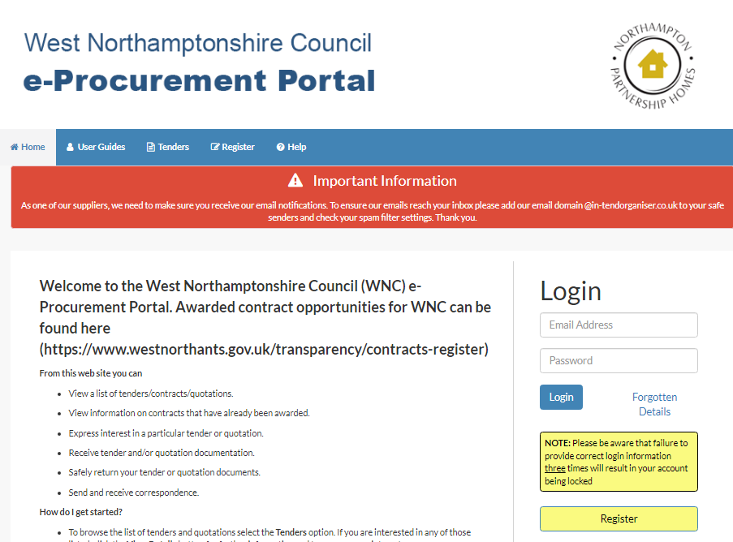
Procurement Process
Once registered you will be able to browse all of the opportunities that WNC is currently advertising, you can also set up alerts for areas that you are particularly interested in such as Social care opportunities, so that you get emails telling you when something new is being advertised.

Slide 13
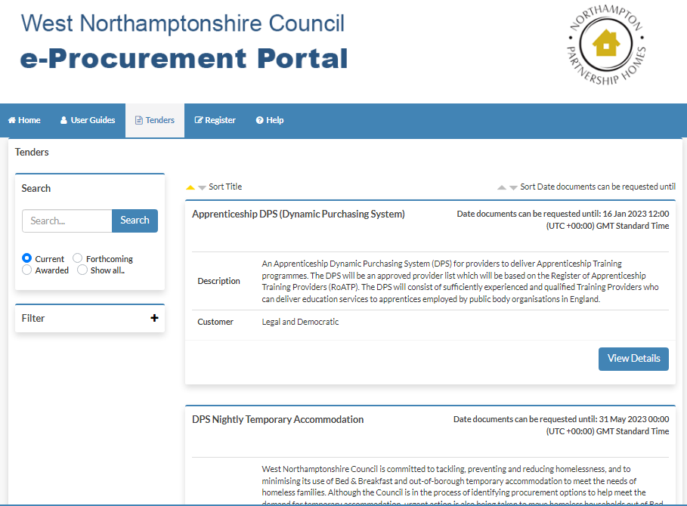
Procurement Process Cont.
Budget update…

