Slide 1
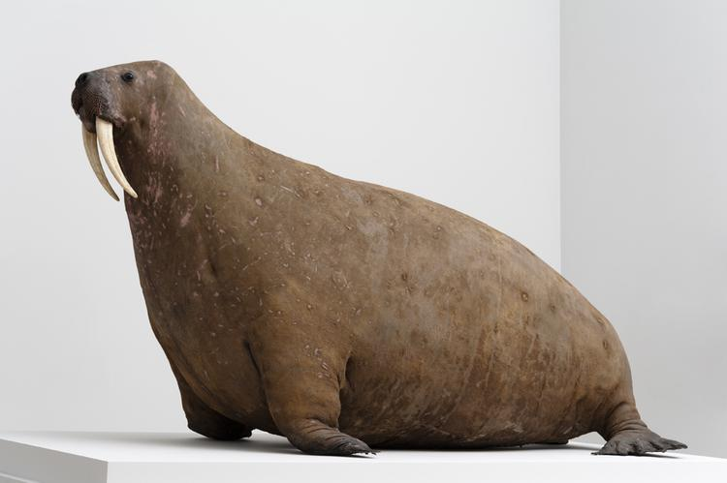
Horniman Museum and Gardens
Nature + Love
ITT: Object Movement & Storage, and freezing services
Information about NH.H.44 Walrus

Slide 2
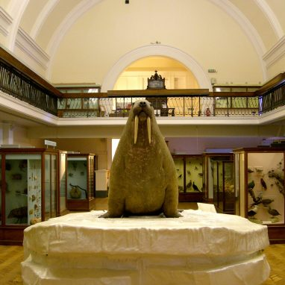
Walrus
Accession Number: NH.H.44
Approx Dimensions: H 1630mm x L 2700mm x W1410mm Weight: Approximately 1 tonne

Slide 3
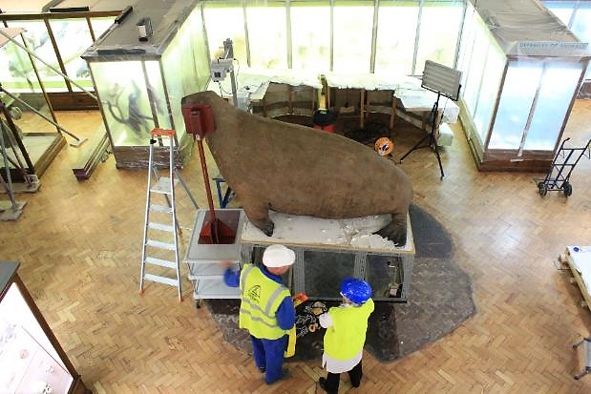
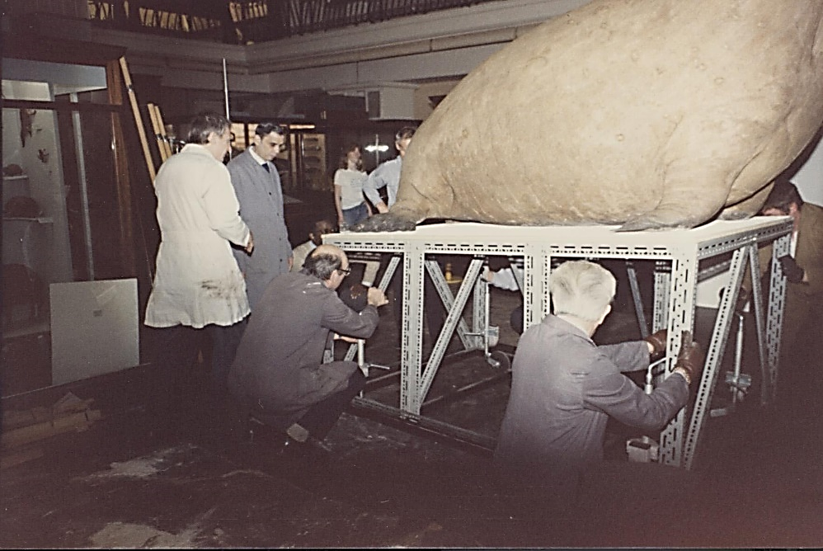
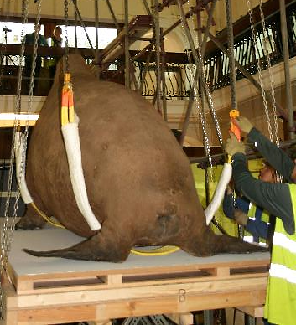
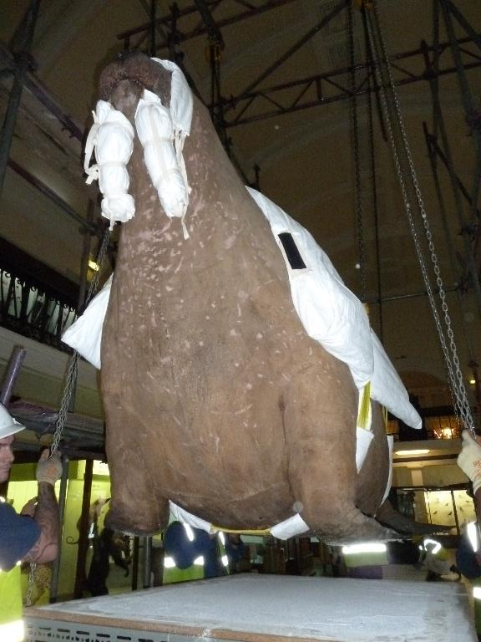
Walrus sits on a steel structure that it will need to be lifted from.

Slide 4
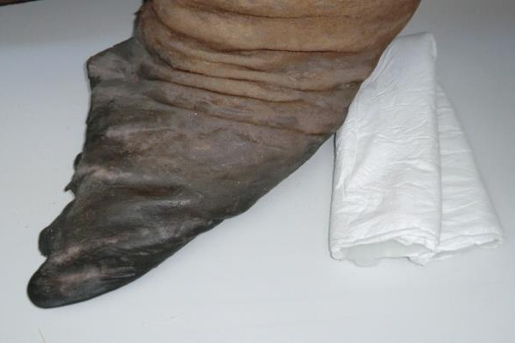
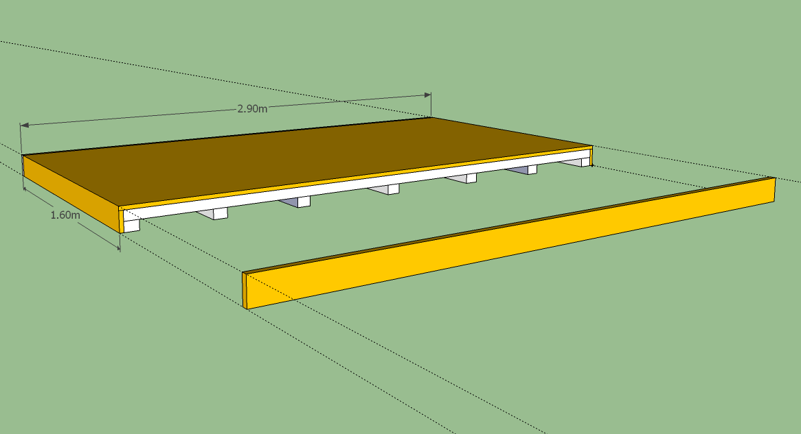
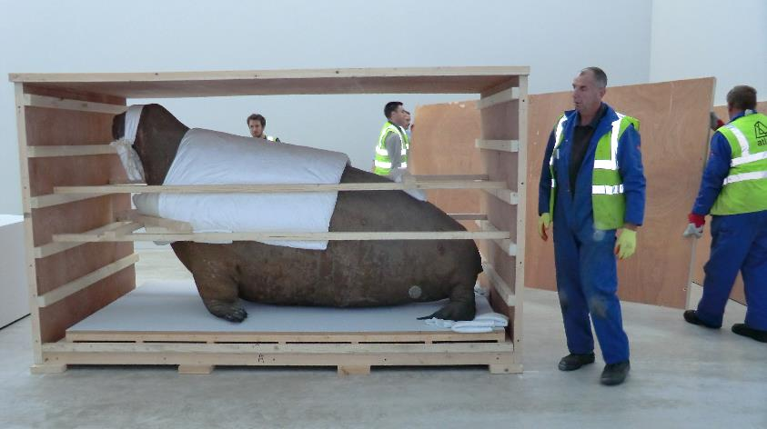
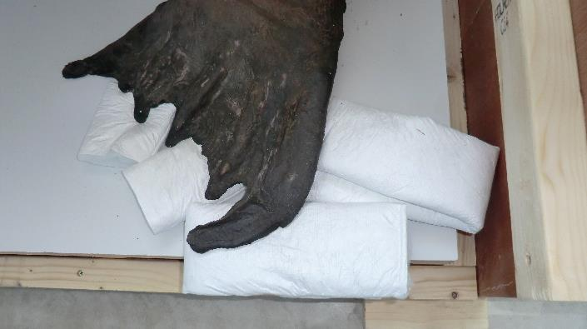
Example of prior crate and indicative measurements for internal base plinth for crate.
Previous approx. dims of internal base that walrus sits on: 160cm x 290cm

