Slide 1
I-Venture
An 18 month challenge

Slide 2
A project of partners
Working collaboratively is practised not just preached, therefore the expedition leader will work closely with and be supported by:
Contract lead – Bolsover District Council/Bolsover Partnership
Project Manager – DEBP – ongoing contact throughout the duration of the 18 month programme
Family liaison support - DEBP
Fundraising lead –Snap development
Experienced expedition leader – Dr Steve Lloyd
6 school lead staff members
Making the project achievable for the participants and their families.

Slide 3
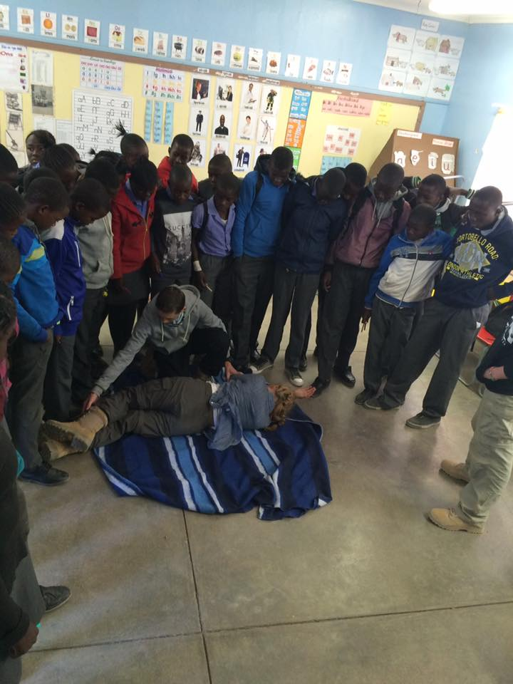
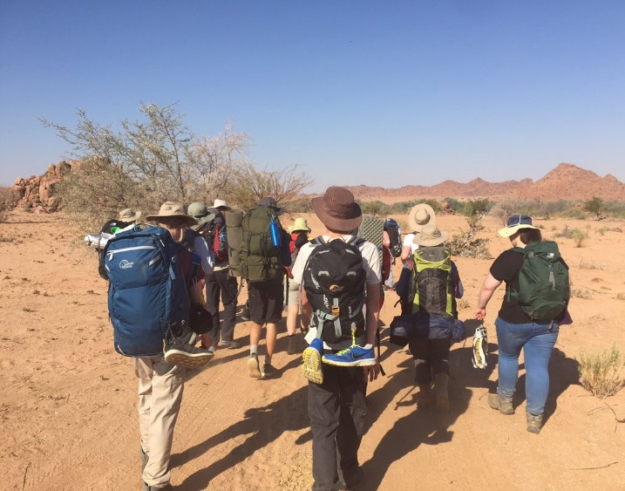
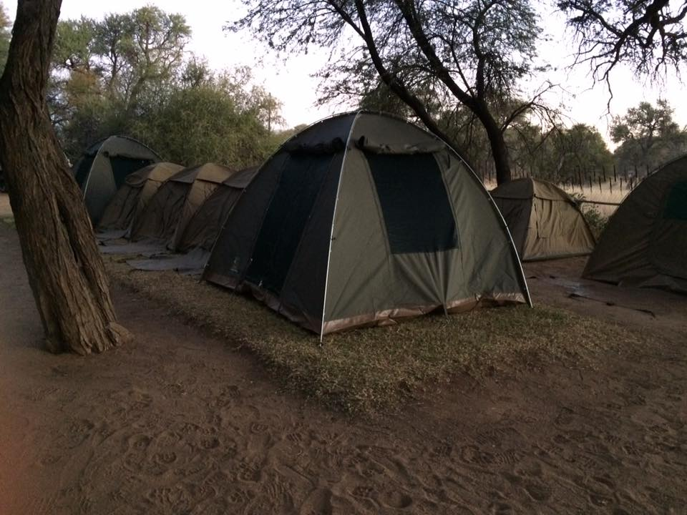
Key elements
Deliver a meaningful project with a rural community
2. Trek and wild camp
*Please note there are to be no hotels, no areas of high population, no open water, no showers and no proper facilities, no unsupervised time – this is a wilderness expedition!

Slide 4
From the start to depart – an 18 month mission
To secure a place each student undergoes a rigorous selection process:
Application
Interview (students and parents/carers)
Conditional offer* – abiding by a strict code of conduct and contribution to the team
(for parents/carers as well as students)
Pass the training weekend – delivered by the expedition leader organisation
The 18 month programme for students includes:
Weekly meetings in school
Parent/carer evening meetings
Fundraising activity delivered weekly
Review meetings with project manager
Constant review of behaviour against the code of conduct
1:1 support meetings
Team building activities (evenings and weekends)
This is not an easy option project – this is the ultimate commitment challenge!
* Please note that the young people selected have a variety of barriers to undertaking this kind of experience unsupported.

Slide 5
I-Venture: April 2018 to October 2019
October 2019 Expedition is the aim!
Have you:
Got the expertise in leading wilderness expeditions
Got a great proposal that takes this project forward
Can you:
Work collaboratively to deliver a bespoke adventure
Offer a unique experience for disadvantaged young people
If the answer is yes, we look forward to hearing all about it!

