Slide 1
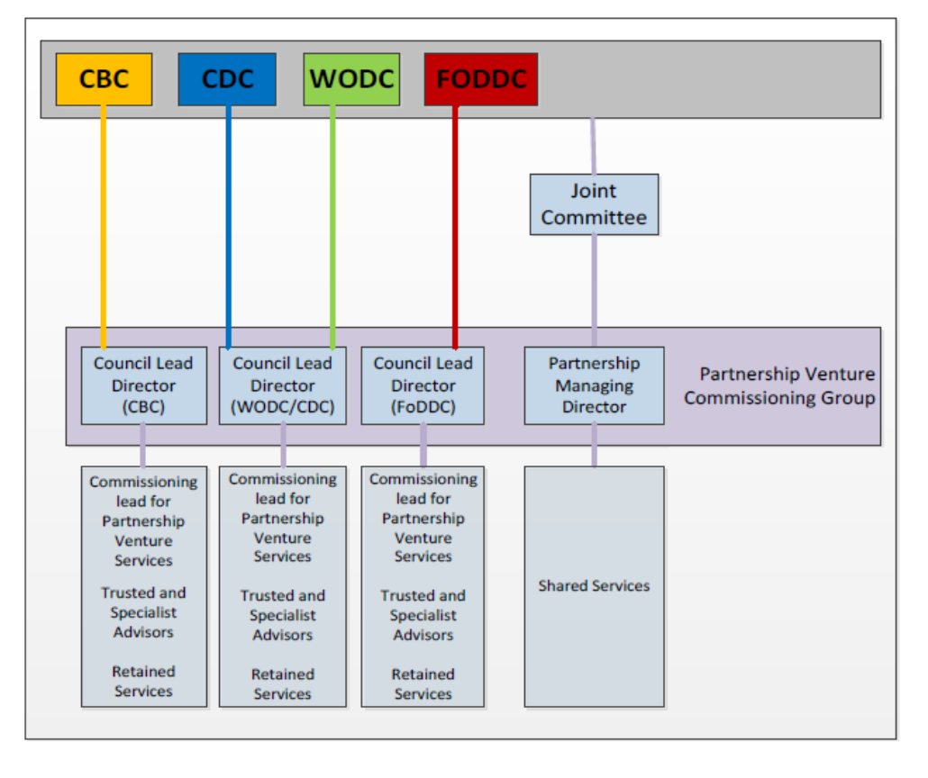
Appendix 2
Current 2020 Partnership Operating Structure
Please note this is an interim structure and will be subject to future changes..

