Slide 1
Early Years Foundation Stage (EYFS) – Nutrition content
Market warming event
21 September 2023

Slide 2
Department for education leads
Laura Lindon: Early Years Foundation Stage, Health and Wellbeing Policy Lead
Robyn Wilson: Policy Advisor, Early Years Safeguarding and Welfare Team
Sahir Iqbal: Commercial Delivery Team

Slide 3
Purpose and agenda
Purpose
To set out our intentions for the development of online nutrition content to be hosted on a government owned platform. This event is to share our current thinking and to outline the process of applying to tender for this work.
Agenda
Explain our current thinking on what we want the nutrition content to achieve
Provide an overview on how the successful supplier will work with DfE and the digital team
Explain the procurement process
Q & A

Slide 4
Protocols:
Please remain on mute and keep cameras turned off
Use the 'raise hand' function if you are struggling to hear
​Please hold your questions for the Q&A at the end using the chat function
Please share in the chat function: ​
Your name​
Your organisation ​
If you would like to share information that is confidential, or ask questions that you consider to be confidential, please share these with us separately
Where we find questions are generic and may be informative to a wider audience and not of a commercially sensitive nature, we may develop a Frequently Asked Questions log. This log would be anonymised and may form part of the competitive process
Please note that we will be recording this event for internal use only. Please indicate in the chat bar if you are not content for the event to be recorded

Slide 5
EYFS Nutrition

Slide 6
The EYFS states: ‘Where children are provided with meals, snacks and drinks, they must be healthy, balanced and nutritious.’ (3.48)
EY practitioners are potential key influencers in promoting healthy eating and preventing obesity.
When a child is in an early years setting for a full day, nearly all of their daily food intake is consumed there.
Many early years practitioners do not fully understand what constitutes healthy and nutritious food for young children.
Research has shown that the cost of living crisis is making it difficult for providers to serve healthy food to children.

Slide 7
Proposed objectives:
Early years practitioners will understand that there is a requirement within the EYFS that states: ‘Where children are provided with meals, snacks and drinks, they must be healthy, balanced and nutritious.’
Early years practitioners will understand the importance of food and drink in relation to the health and wellbeing of children, including children’s oral health.
Early years practitioners will know that there is existing DHSC guidance Example menus for early years settings in England and a practical ‘Eat Better, Start Better’ guide.
Early years practitioners will know which foods to serve children and the recommended portion sizes for their age, to provide them with the appropriate amount of energy and nutrients for healthy growth and development.
Early years practitioners will know about diverse food options in order to represent different cultures.
Early years practitioners will be equipped with some basic recipes for simple, cost-effective children’s meals and snacks.
Early years practitioners will understand what ingredients can ensure they get the best value for money whilst meeting nutritional standards.

Slide 8
Tender opportunity and timeline

Slide 9
Tender opportunity
The DfE will be seeking a subject matter expert to produce nutrition content to support early years practitioners, to be hosted on a government-owned platform.
The supplier will produce content that will:
be engaging and practical for early years practitioners to help them meet the EYFS healthy eating requirement
draw from the current DHSC guidance Example menus for early years settings in England and the ‘Eat Better, Start Better’ practical guide
be government approved and adhere to the latest government dietary recommendations for children ages 0 – 5 years
Meet government food safety standards
include digital media such as videos and images to support the written content

Slide 10
Tender opportunity (cont...)
The procurement route for the supplier will be via the DfE Education and Children & Social Care Professionals Dynamic Purchasing System (ECSC DPS)
A call for competition is expected to be made on 11th October 2023*. We expect the tender to be open until 5pm, Monday, 30th October 2023.
We expect the resulting contract to run from 13th November 2023 – 31st March 2024.
*please note all timings are currently indicative and are subject to change at the Department's discretion.

Slide 11
Tender opportunity (cont…)
To be invited to submit a tender response for this opportunity, all suppliers MUST register in advance on the DfE's e-procurement system Jaggaer and MUST successfully gain membership onto the ESCS DPS in at least one of the categories below by 10th October 2023.
The opportunity will be published under the categories:
ECSC13 Operational development and delivery
ECSC15 Individual who can write content that supports operational delivery in the education sector
ECSC21 Individual(s) with subject specific expertise that can be used to assess, support the creation/development and advise on delivery and operation of National Curriculum Subject Matter Experts for Early Years Foundation through to Key Stage 5, and Further Education settings covering technical and applied qualifications
Please note, it can take 5-7 days to register on Jaggaer. To be eligible to bid, your Jaggaer registration must be fully completed by 10th Oct 2023.

Slide 12
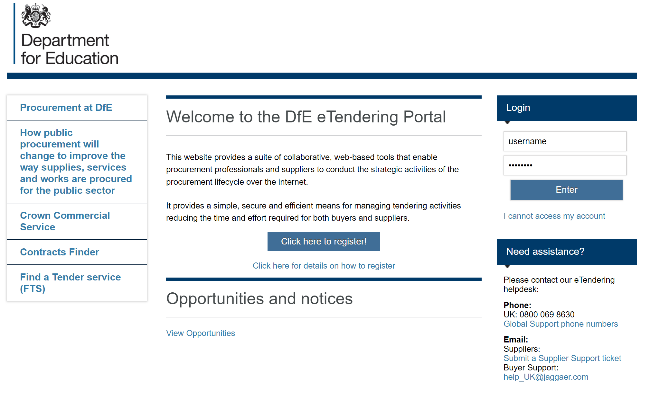
Jaggaer registration (https://education.app.jaggaer.com/)
Guidance on Supplier Registration for the DfE ECSC DPS https://www.contractsfinder.service.gov.uk/Notice/Attachment/eb9ac94d-4d92-473b-ad03-f2f7d668de30

Slide 13
Intended tender and contract timeline*
Date | Activity
21st September – 2nd October 2023 | recommended registration of interested parties on Jaggaer/DPS
2nd October – 10th October 2023 | final tech support with DPS/Jaggaer registration
11th October – COP 30th October 2023 | out to tender
31st October – 3rd November 2023 | bid evaluation and moderation
w/c 6th November 2023 | notification of result and feedback; contract signed with successful bidder
13th November 2023 – 12th February 2024 | content creation
12th February – 18th March 2024 | Quality assurance and clearing process with trusted stakeholders
w/c 25th March 2024 | go live onto gov.uk
*Please note: these timelines are indicative and are subject to change at the Department’s discretion.

Slide 14
For more information
Contact us
Prior to publication -
By email: EOI.EYNUTRITION@education.gov.uk
Contracts finder notice (for any updates until Tuesday 10th October)
Nutrition content for early years practitioners - Contracts Finder
Post publication -
Please raise all queries via Jaggaer.

Slide 15
Department for Education © Crown copyright 2021
Q&A

