Slide 1
Cloud Storage
Session 4:
What do we do with all this data?
Karl Kern
28 February 2020

Slide 2
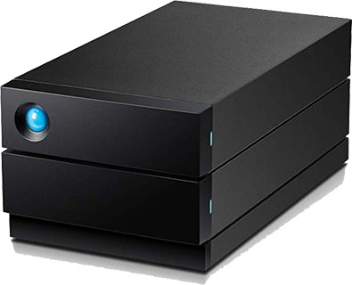
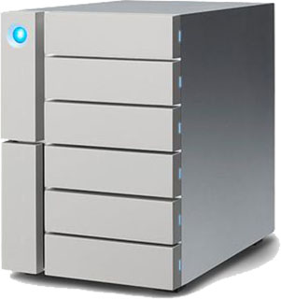
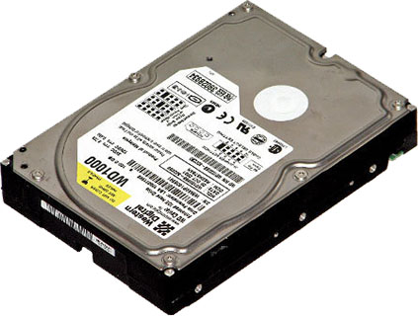
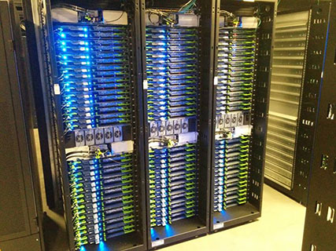
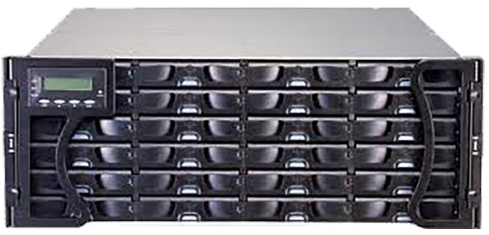
Quick Recap
A simplified data storage evolution:
Single HDD
Small JBOD
Big JBOD
Data Centre
Racks full of NAS
Rack-mountable NAS

Slide 3
Cloud Service Providers
There are many to choose from. Most of them offer similar services. Pricing is competitive.

Slide 4
Everyone has had exposure to cloud storage
You have probably used a cloud based storage service – such as Dropbox, Google Drive etc.
It usually has an interface on top of block storage (similar to your HDD) or object storage (dealing with files as an object).
Running your own cloud storage will require you to manage it yourself.
Dropbox screen

Slide 5
Storage on premise - 99.99% reliability
Failure of hardware is the liability of the organisation and can be time consuming to replace and/or recover.
Backup is an important task.
Increase of capacity needs to be planned in advance to avoid bottlenecks or data loss.
Administrative tasks such as HW setup, user accounts, failure monitoring, backups… are inhouse responsibility.
Defence against hackers and malware.
Quick and reliable access to data, as all resources are local.
Typical Office Desktop computer
Inhouse Computers

Slide 6
Risks – Capacity - Costs of on-prem storage
Solution
Risk
Capacity
Costs
Single HDD
High
1TB – 12TB
£40 - £150
JBOD
2TB – 24TB
£200 - £1500
NAS
12TB – 96TB
£1000 - £15000
Racks
Low
Peta Bytes
£10000 - £££

Slide 7
Cloud Storage – 99.9999999999% reliability
Data safety is very high. HW failure is resolved as part of the service. No inhouse staff required.
Backups are still an important task.
Increase of capacity is instant.
Maintaining user accounts.
Access policies.
Speed to your data depends on your ISP.
Easy sharing globally.
Typical Office Desktop computer
Inhouse Computers

Slide 8
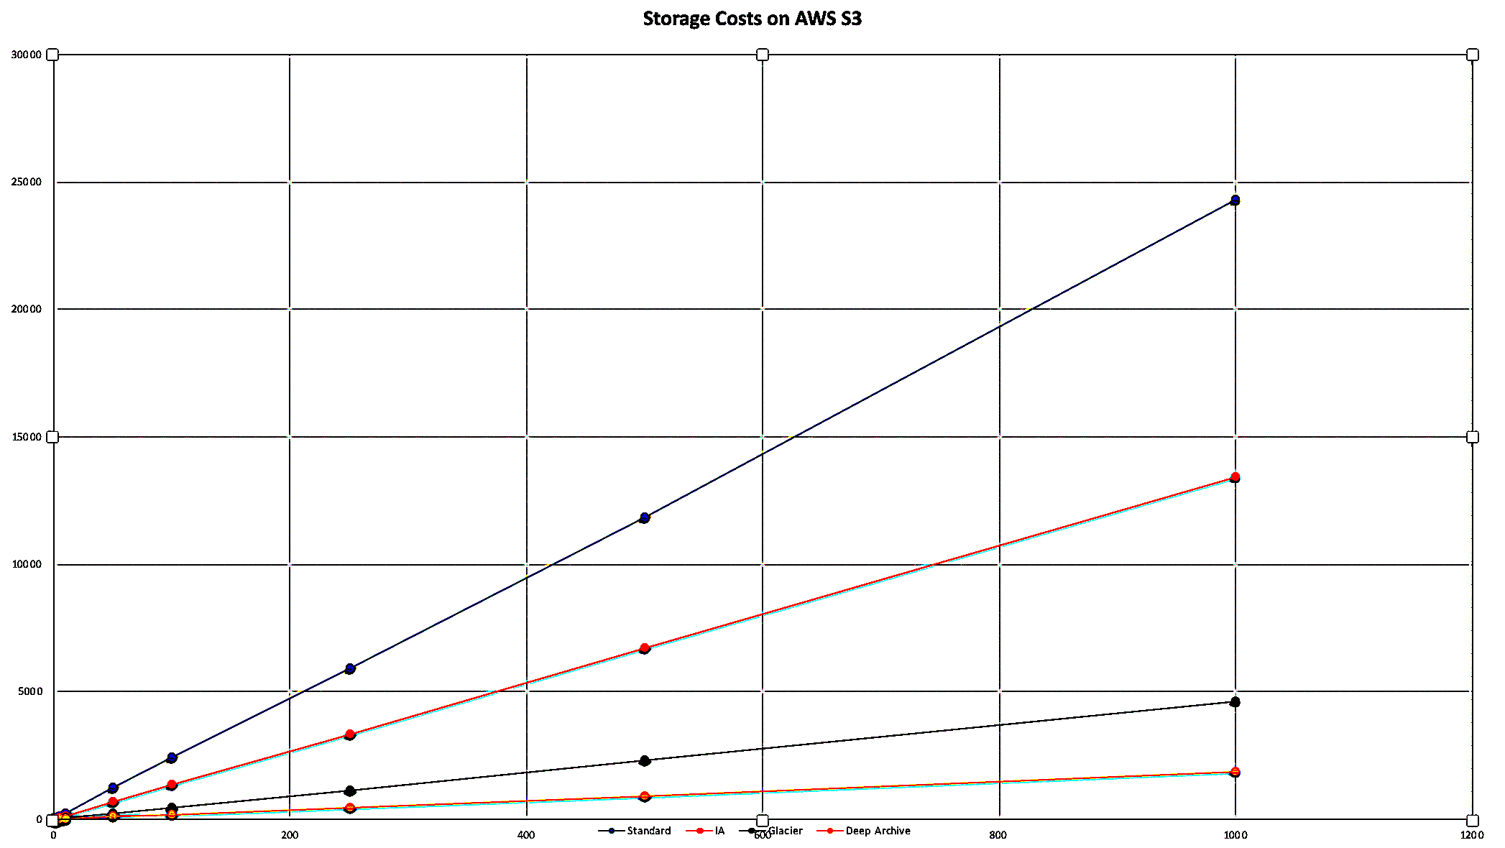
Costs of Cloud Storage
Costs are usually linear and tiered.
You pay for what you use.
Be careful! You might pay extra for transfer of data and additional services.

Slide 9
What can we store in the Cloud?
Databases
Objects
Files
AWS RDS
AWS S3
AWS EBS

Slide 10
S3 - AWS Simple Cloud Storage Service
Objects are files but they don’t behave like the ones we have on our hard disk drives.
We can’t change an object in place and if we want to change a single bit, we need to download the entire file and re-upload it.
We can use versioning.
We can make objects un-deletable.
Share to a global audience.
Throw your data into buckets.
Be careful with permissions! Never allow everyone to write to your buckets. Be selective about who can read your files/objects.

Slide 11
Where is your data stored?
Amazon is global.
There are regions with availability zones (AZs). You can read more about it here:
https://aws.amazon.com/about-aws/global-infrastructure/regions_az
Your data is stored across multiple AZs in discrete data centres.
You can expect high availability, fault tolerance and low latency.
Region Europe/Middle East/Africa

Slide 12
What kind of S3 bucket do you need?
S3 Standard - General purpose storage for any type of data, typically used for frequently accessed data.
S3 Intelligent Tiering - Automatic cost savings for data with unknown or changing access patterns
S3 Infrequent Access - For long lived but infrequently accessed data that needs millisecond access
S3 One Zone IA - For re-creatable infrequently accessed data that needs millisecond access
S3 Glacier - For long-term backups and archives with retrieval option from 1 minute to 12 hours
S3 Glacier Deep Archive - For long-term data archiving that is accessed once or twice in a year and can be restored within 12 hours

Slide 13
An example usage for S3 buckets
Backup your data to S3 Glacier.
If your data rarely changes you can dump it in an S3 Glacier or S3 Glacier Deep Archive bucket.
Make your incremental backups (sync) by adding new files whenever needed.
Frequently changing data could be stored in S3 Standard or S3 Intelligent Tier bucket with rules to change to S3 IA after 30 days and S3 Glacier after 90 days.
Secure
Cheap
Easy

Slide 14
Prerequisite (first hurdles) to use S3
Starting off with S3 can be daunting and requires basic understanding of user account management in AWS. There are many resources from AWS to make it easier.
Create a new account with AWS. https://aws.amazon.com/premiumsupport/knowledge-center/create-and-activate-aws-account https://aws.amazon.com/premiumsupport/plans
Follow best practises for user accounts (IAM) and permissions. https://docs.aws.amazon.com/IAM/latest/UserGuide/best-practices.html
Plan what you want to store in S3 and who you want to give access to.

Slide 15
Colossus electronic digital computer

Slide 16
Colossus electronic digital computer

Slide 17
Colossus electronic digital computer

Slide 18
Colossus electronic digital computer

Slide 19
Colossus electronic digital computer

Slide 20
Colossus electronic digital computer

Slide 21
Any Questions?

Slide 22
Thank you

