Slide 1
Care Home Recommission: Market Engagement
Staffordshire County Council
Date: May 2024

Slide 2
Agenda
Aims
Strategic Objectives
Future Vision
Electronic Systems
Discussion Points for Market Feedback
Tender process & TPSIQ
Next Steps
Proposed Timeline

Slide 3
Aims
Staffordshire County Council are engaging with the Care Home market ahead of publishing a tender opportunity in Autumn 2024.
We are seeking to recommission residential and nursing Care Home Services for both older people (aged 65+) and working age adults (aged 18 - 64) which include people with the following support needs: learning disabilities, Autism/ASD, mental health and physical disabilities.
We are seeking your valuable input as we design our new commissioning model. Our aim is that this recommission will drive a fundamental change in practice which focuses on achieving people's health and wellbeing outcomes for the short and long term.
We want to work with Providers who are committed to enabling people to access all the opportunities available to them to live a rich and meaningful life.
Your input as Care Home Providers is essential. Your expertise and experience of delivering services locally and in other areas will support us to develop a service specification, delivery mechanism and contract monitoring/quality assurance process that is effective, meaningful and puts people at the centre of all we do.

Slide 4
Strategic Objectives and Vision

Slide 5
The Council’s Strategic Objectives
Our strategic objectives for the whole of the Council’s Health and Care Directorate are to:
Promote good health and independence, and encourage and enable people to take personal responsibility for maintaining their well-being
Ensure effective and efficient assessment of needs that offers fair access to services
Maintain a market for care and support that offers services at an affordable price
Ensure best use of resources, people, data and technology
Specifically for commissioning residential and nursing care, our strategic objectives are:
Improving the quality-of-care homes in Staffordshire, primarily measured by the proportion of care homes rated by the Care Quality Commission (CQC) as ‘outstanding’ or ‘good’
Ensuring timely access to care home placements when required, with difference timescales depending on the pathway – ranging from same or next day for Discharge to Assess services commissioned by the NHS, and emergency respite requested by the Council, but with a longer period of time for non-urgent assessments
Ensuring affordability of care home placements, with the Council aiming to pay a fair price, achieving value for money for the Council taxpayers, and remining within budget

Slide 6
Our Vision for the Future
High Quality, Affordable and Sustainable Homes
Strength-based approach's: social work and provider practice
Focus on enablement and remaining healthy, resilient and independent
We work to a clear, shared definition of Care Home provisions
Creative and flexible support from Providers enabling choice and control for people
Stay connected with friends and family and participating
in activities within the
care home and wider
community
Our
Vision

Slide 7
Service Delivery Aims
Social Workers will undertake
a strength-based assessment of
a person's health and wellbeing
needs.
We expect Providers will work co-productively
with people and their representatives,
to design and agree meaningful,
outcome focussed support plans that enable
them to achieve their goals.
Providers will work flexibly, creatively
and innovatively to support people to
achieve their goals and aspirations
We will support people to articulate
what is important to them from
health and care perspectives.
People will be supported to access high
quality care homes which maximise technology
and community connection.
People will be aware of all
opportunities available to them and
supported to live rich and
fulfilled lives

Slide 8
Electronic Systems
Proactis – The Councils Procurement E-Portal
Care Place – A proposed new brokerage system for sourcing care home placements
Bed Booking System – A proposed new vacancy and booking system for care homes
National Capacity Tracker – CQC Mandate

Slide 9
CQC Standards
The fundamental standards state that care homes must, as a minimum:
Provide person-centred care
Treat residents with dignity and respect
Acquire consent before giving any care or treatment
Ensure they do not give unsafe care or treatment, and that staff have the qualifications and skills to keep residents safe
Safeguard residents from any form of abuse or improper treatment
Provide food and drink which keep residents in good health
Keep premises and equipment clean, suitable and looked after
Offer a complaints system, investigate incidents thoroughly and take action
Have plans in place to ensure they can meet above standards and systems to check quality and safety of care
Have enough suitably qualified, competent and experienced staff to meet standards
Only employ staff who can provide care and treatment appropriate to their role
Be open and transparent about care and treatment
Display their CQC rating clearly and make their latest report available to you

Slide 10
Strengths Based Practice

Slide 11
Everyone has a part to play

Slide 12
Benefits of a strengths-based approach
Research suggests that the implementation of strengths-based approaches produces better outcomes for individuals, It recognises personal goals, uses strengths of communities, personal strengths and of others around individuals.
It supports non-reliance upon a purely deficit or service focus.
An agreed framework ensures that all areas within Health and Care have a consistent and clear view of strengths-based practice and how it operates within their team.
Leading to greater collaborative working across Communities, Public Health and Health and Care – a strengths-based approach recognises and utilises strengths within the workplace at an individual level, team and organisational level.

Slide 13
What the strengths-based programme aimed to do -
Aiming to understand existing strengths-based approaches (internally and externally) and how these informed next steps.
Embedding a person-centred approach with a focus on what is right for the person one of which is led and informed by them.
Increasing engagement and autonomy - to inform, empower and be led by our workforce.
Developing a clear understanding of strengths-based practice represented and encouraged by branding, a clear vision and principles and a refreshed practice guidance document.
Informing the review of pathways and documentation, for early support/ intervention and fewest handovers.
Further develop and maximise the use of resources such as supportive communities and assistive technologies and equipment, enabling people to be independent for longer.
Increasing community and individual involvement - to engage and collaborate with partners, providers to provide a consistent experience for the person.

Slide 14
Our newly developed vision

Slide 15
Our new developed principles

Slide 16
How the Programme linked to other areas
Strength Based Approaches Programme
Strengths Based Practice
Linking Supportive Communities
Equipment and Assistive Technology
Outcome Based Home Care
Communications Campaign
Branding
Pathway Development

Slide 17
Strength based isn’t…...
A Process
About giving less support and services
Shifting responsibility to family and carers or only about looking for community resources
Not talking about needs or problems
One size fits all

Slide 18
Strength Based is
An approach
Appropriate to the individual and flexible
Holistic and multi-disciplinary
Focused on ‘what matters to you’
Helping identify the personal strengths, strengths of family/friends and the community.
Supporting community development

Slide 20
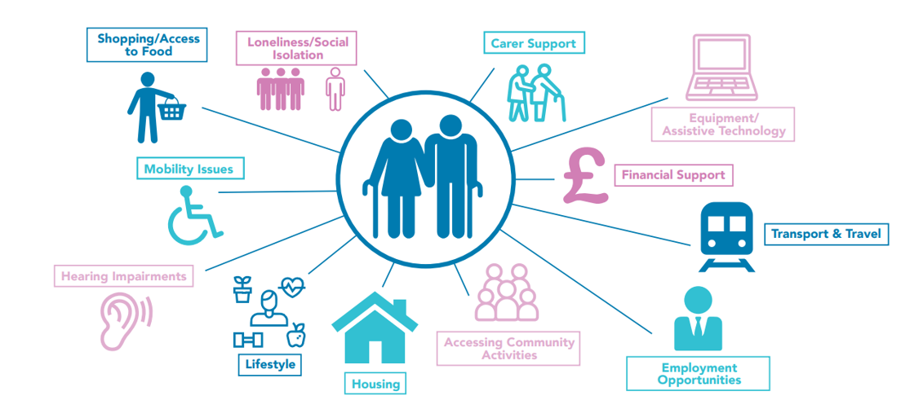
Public Health: Supportive Communities
Objectives:
1. Understand the need and priorities of communities
2. Increase access, use and confidence in voluntary community assets
3. Greater awareness and use of independent living opportunities
People can live independently with support from families & communities
Action areas:
1. Supporting our Workforce
2. Our Communities

Slide 21
Service Specification

Slide 22
Designing the Service Specification
The service specification is the most important document within the procurement and tendering process.
It provides a description of the types of outcomes Service Providers are expected to meet to enable individuals to achieve during the lifetime of the contract.
It should encourage and promote best practice, high quality service provision and effective delivery of policy objectives – both National and local.
A good specification is created through the planning and research undertaken with provider markets – this is why we are asking for your input.

Slide 23
What differences can Providers expect to see?
In the new care home service specification, Providers can expect to see greater clarity in relation to:
✓ The provision of Care and Support and Co-production
✓ Health and Wellbeing Outcomes and Strengths-based Practice
✓ Safeguarding and Positive Risk Taking
✓ Quality Assurance and Contract Management
✓ Staffing and Workforce Development
✓ Organisational Management and Financial Sustainability
✓ Communications and Relationships with SCC and MPFT

Slide 24
Discussion Points: Provider Feedback Needed

Slide 25
Previous Contracted Provider Engagement Summary (May 2023)
Last year contracted providers told us:
Pen Portraits are not consistent and make it difficult to assess without meeting in person
Annual uplift agreements need to be more timely
Block arrangements would be attractive if improvements were made to existing arrangements
Assistive Technology – providers were advised of the Council’s intention to continue to expand the use of Assistive Technology within care settings. Providers said they would like to be involved in any future assistive technology projects.

Slide 26
Questions – does the previous slide resonate with your experiences?
Are the current contracted ‘Lots’ right, are there any gaps? (See current ‘Lots’ on slide 27)
Do you have anything else to add to the contracted provider engagement sessions completed in 2023 (slide 26)?
What currently works well?
What could be improved/what are the gaps?
Do you have any innovation examples or good practice to share?
How would you like to be measured on how you meet people’s needs/achieve individual outcomes?
What tools and resources do you use to help you to measure outcomes and set new goals when people achieve?

Slide 27
Current DPS Lots
Lot 1 – Residential Older People
Lot 2 – Residential Dementia
Lot 3 – Residential Physical Disability
Lot 4 – Residential Learning Disability/ Autistic Spectrum Disorder
Lot 5 – Residential Mental Health
Lot 6 - Nursing Older People
Lot 7 – Nursing Dementia
Lot 8 – Nursing Physical Disability/Sensory Impairment
Lot 9 – Nursing Learning Disability/Autistic Spectrum Disorder
Lot 10 – Nursing Mental Health

Slide 28
Discussion Point – Strength Based Approach & Supportive Communities
Do you have any examples of supportive communities and strength-based practices you can share?
Where have you experienced challenges?
What do service specifications need to provide to enable you to deliver services in outcomes-focused ways?
What information do you require from social work teams to enable you and people you support to co-define outcomes and aspirations?
What tools and resources do you use to help you to measure outcomes, and set new goals when people achieve?

Slide 29
Discussion Point – Delivery Aims
What helps you to achieve good quality care home provision for the people you support?
What are your barriers and/or challenges to achieving this?
What learning and experiences can you share that reduce the impact of these barriers/challenges?
How can we work together to achieve good quality care and support?
Are there any areas in the service specification where we can add further detail, or make things clearer, to help you continue to meet people's needs and achieve outcomes? *Please refer to attachment

Slide 30
Other Information: Staffordshire's Procurement Processes & TPSIQ

Slide 31
Procurement Process
Register on the Councils e-procurement system Proactis:
https://Supplierlive.proactisp2p.com/Account/Login#
Any new tender opportunities will be advertised via the following routes:
Find a Tender Service (FTS) https://www.gov.uk/find-tender and Contract Finder https://www.contractsfinder.service.gov.uk/Search
E Procurement system: Proactis.
The council will inform you should this change
For any technical Issues with the Proactis please contact the Help desk:
desksuppliersupport@proactisservicedesk.com
For any support with using Proactis system this is a SCC E-Tendering Portal User Guide and is available upon request and in any case is uploaded with all Council tenders.

Slide 32
TPSIQ
Requirement:
The Third-Party Security Question has been created to understand from prospective providers the measures they have in place both from Data Protection but also the security of the data being held relating to SCC information.
Process:
It is important to go through and respond back on each of the tabs and supply documentation relating to the relevant areas.
Certification is important therefore please supply all certificates such as DSPT and ICO as well as IT related such as Cyber Essentials, ISO27001 should they be relevant to you.
If your ICT is outsourced, please include this in your responses as well as asking them to respond to the relevant areas within the document especially relating to where the data is to be housed if Cloud Hosted together with detailing locations, backup etc.

Slide 33
Next Steps

Slide 34
Next Steps
Collate feedback
Develop commissioning model
Governance process
Development of contractual terms and conditions
Development of clear and measurable service specification
Development of tender documentation
Bidders event (when tender is live)

Slide 35
Timeline
Approximate timescales listed below and are subject to change:
Cabinet Meeting* – September 2024
Tender Live – October 2024
Tender Closing Date – November 2024
Tender Evaluations – December 2024
Contract Award – January 2025 (may differ for providers/lots)
Service Mobilisation – From January 2025 (may differ for providers/lots)
Contract Start Date – From April 2025 (may differ for providers/lots)
*Require Cabinet approval on this date to tender the opportunity

Slide 36
End Thankyou

