Slide 1
Healthy Urban Places Information Session
- Parkside

Slide 2
Session outline
Overview of Healthy Urban Places
Community Collaboratives
Tender Process
Questions & Answers

Slide 3


Natural environment
Economy and employment prospects
Built environment (indoor and outdoor)
A research programme working to understand: How can we harness the power of the places we live as tools for population health?
What makes a healthy place?
Social and cultural assets
Services (e.g. health, education)
Retail environment

Slide 4




How can we figure out what makes a place healthy?
With communities, we will identify and measure features that contribute to a healthy environment.
How do changes to local places impact health and inequality?
We will investigate how local changes, such as changes to roads and new parks, impact people's health and how changes can consider local needs.
Which parts of our surroundings help keep us healthy?
We will work to understand which things around us, like parks or air quality, are most important for our health.
What are the lasting benefits of improving places on our health and the local economy?
We will demonstrate how healthier places could lead to better health outcomes and economic improvements for everyone.

Slide 5
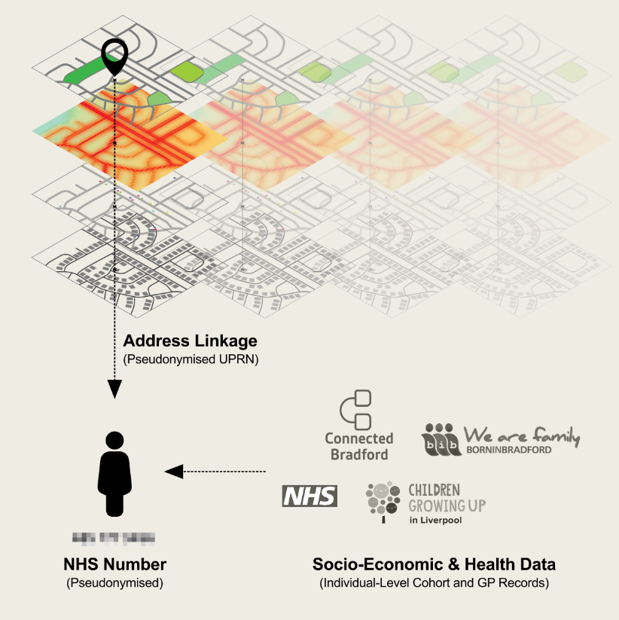
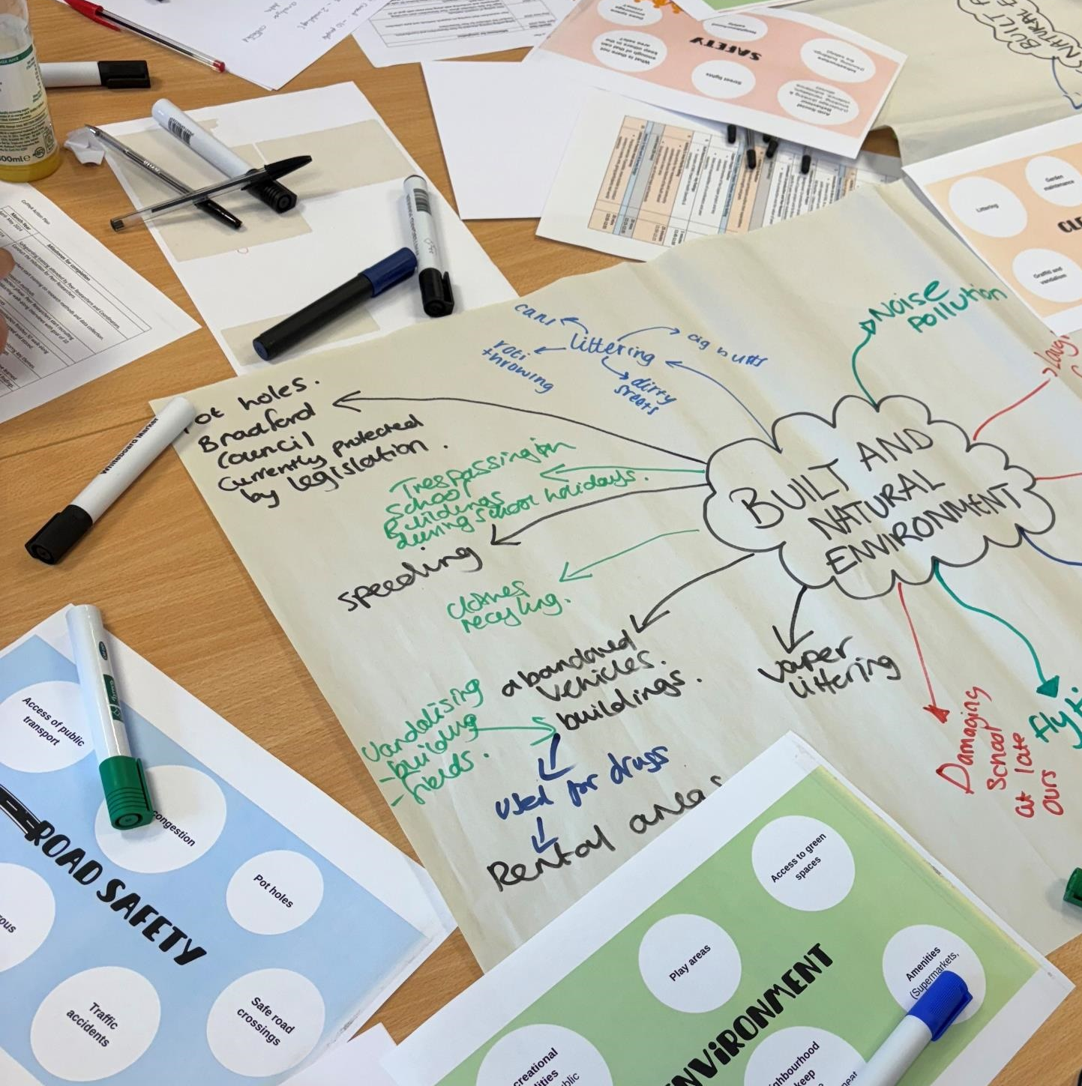
Data Infrastructure: Connected Spatial Environmental-Health Data
Community Collaboratives: Co-produced research

Slide 6
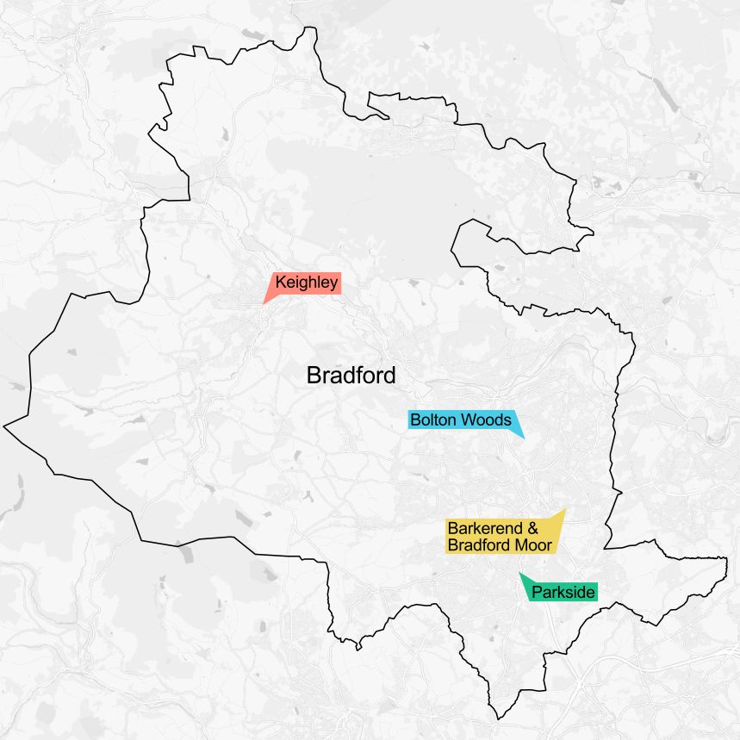
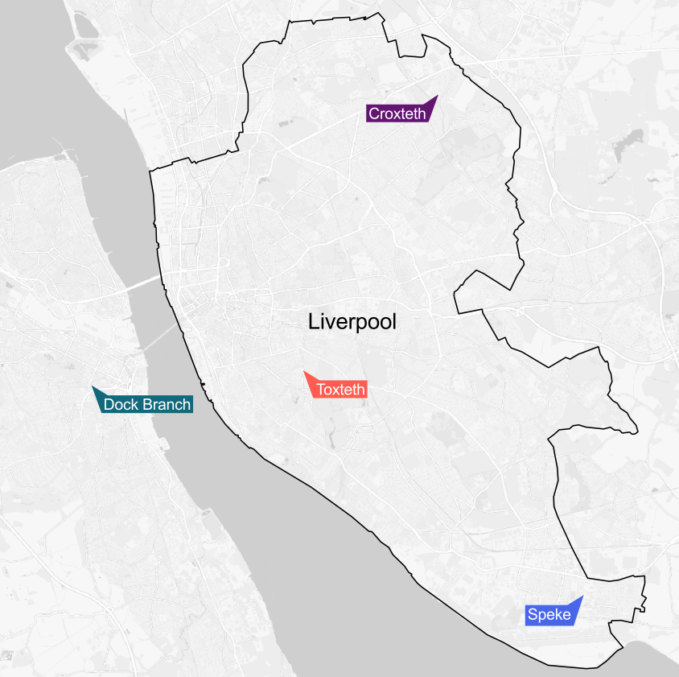

Slide 7

















Funders:
Partners:

Slide 8

Community Collaboratives
Healthy Urban Places research is about wellbeing and place and co-production
The Community Collaboratives are where this co-production will take place.
Community collaboratives = you + us + local residents
CCs work at different scales – in the community, at a Bradford District level and at a project level, combining Bradford and Liverpool
Notes:
The CC is where this coproduction takes place. There is you, the community organisation, us the researcher community, and your local residents, service users, participants. We all bring different skills, knowledge and resources to the table to contribute to the research process. We see this very much as a coproduced initiative, not a consultation exercise. In order to achieve this, we envisage you as an organisation having someone as the key contact working closely with us to help plan the research, giving insight into what may or may not work with the specific communities, access to groups you may already run, recruiting people to be trained to be peer researchers, or creating a community steering group to help plan the research.

Slide 9
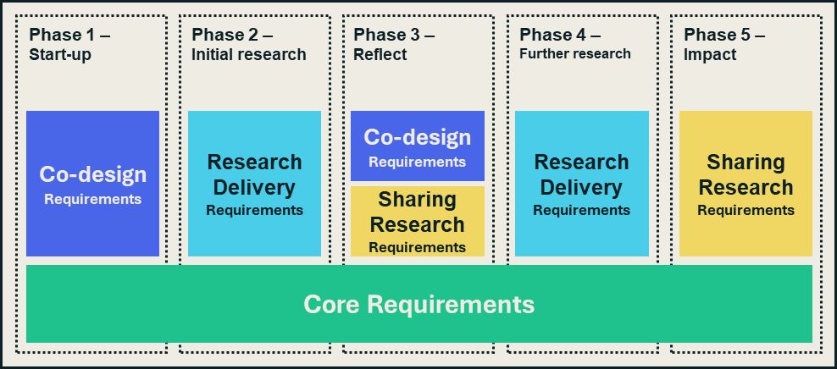

Slide 10
Core requirements
Support the set-up and local coordination of the Community Collaboratives and participate in site-wide and cross-city events.
Recruit and support people interested in being involved in the research within your area.
Support the establishment of a community panel to provide feedback on research activities, including the recruitment of community representatives.
Help the research to be carried out by sharing knowledge on the local area, helping prioritize research topics,
Contribute to the evaluation of the Community Collaboratives, considering how the co-production process went – what was difficult, what was good.

Slide 11
What is the Tender Process?
Run under the Procurement Act 2023 regulations
Pre-Market engagement
Invitation to Tender (ITT) published
ITT to be returned to the Trust by the deadline stated
Suppliers who meet the mandatory requirements invited to do a presentation
Responses evaluated and scored by the Trust
Highest Scoring bidder is awarded the contract

Slide 12
What’s in the Tender Document Pack?
Document | To be completed and returned?
Document 1 - BTH25-204 Instructions and Guidance to Tenderers | No, for reference only
Document 2 - Specification | No, for reference only
Document 3 - Form of Tender and Declarations | Yes
Questionnaire 1 - Technical and Social Value Questions | Yes
Questionnaire 2 – Commercial Schedule | Yes
Appendix A - Further Information on Community Collaboratives | No, for reference only
Appendix B - Further Information regarding Supplier Presentation | No, for reference only
Appendix C – Premarket engagement information | No, for reference only

Slide 13
How will the Responses be Evaluated?
Mandatory questions are pass/fail
Scored questions are marked from 0 to 4
Price scores are calculated in relation to the lowest price submitted
The scores are weighted:
Technical 70%
Price 20%
Social value 10%

Slide 14
Next Steps
Register on Atamis (use CPV code: Research 1310000)
https://atamis-1928.my.site.com/s/Welcome
“the Health Family Single eCommercial System”
Register on Find a Tender Service (aka the Central Digital Platform)
Download the ITT documents when published
Read through the documents
Respond by the deadline

Slide 15


