Slide 1
Supplier guide to registering on the Attain eProcurement Portal
Jaggaer / Bravo Advantage 18
May 2019

Slide 2
Getting started
All procurements being run by Attain will be implemented on the Bravo eProcurement Portal: https://attain.bravosolution.co.uk
Where a Contract Finder Notice and / or a Contract Notice is issued on the Official Journal of European Union (OJEU) is advertised, it will direct you to register at the above portal to obtain the tender documents for the relevant procurement. You must register your organisation if not already registered.
Types of tender issued in Bravo include:
Selection Questionnaire – SQ - this is also used for Market Engagement events and / or Requests for Information (RFI)
Invitation to Tender – ITT - this is also used for Invitations to Quote (ITQ) and Any Qualified Provider (AQP) processes

Slide 3
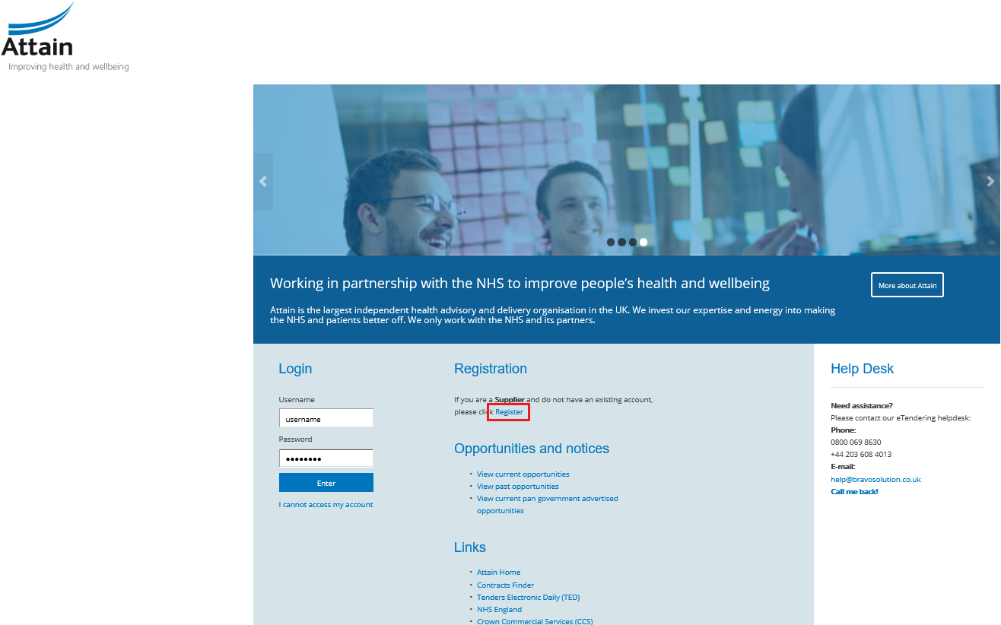
Registration
Go to the eProcurement Portal: https://attain.bravosolution.co.uk and click ‘Register’

Slide 4
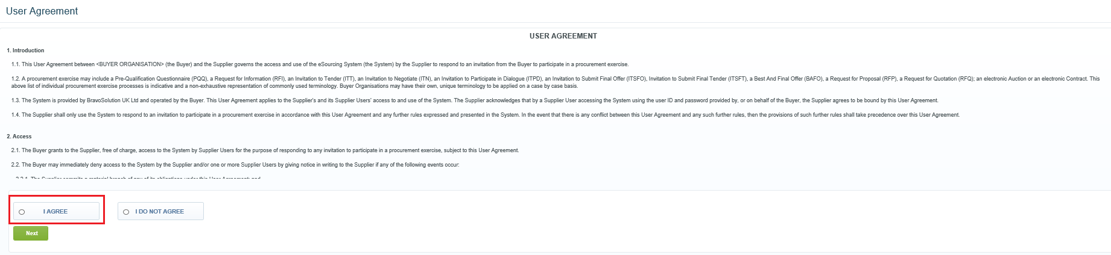
Registration
2. Accept the Terms and conditions of the User Agreement then click ‘Next’

Slide 5
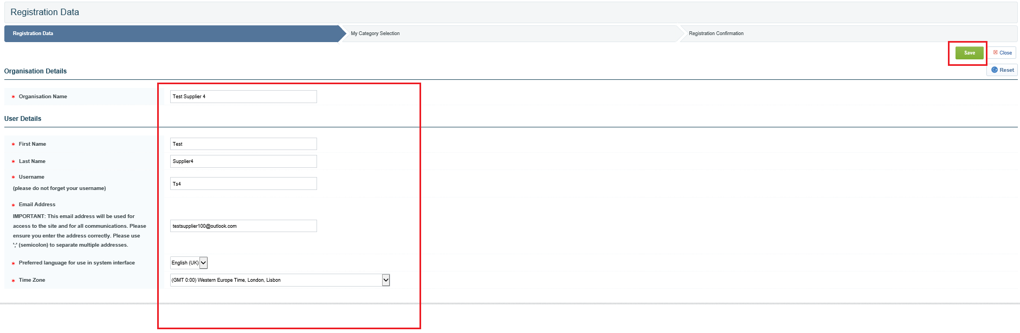
Registration
3. Complete the basic details for your organisation then click ‘Save’

Slide 6
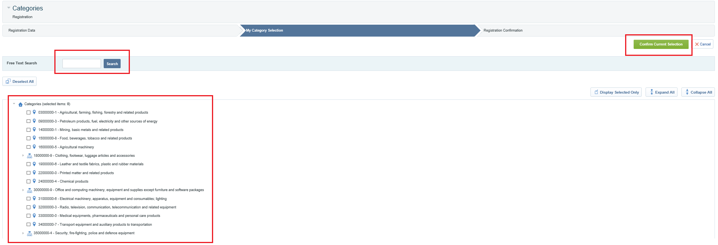
Registration
4. Select the most appropriate category representing your business / organisation and then click ‘Confirm Current Selection’

Slide 7
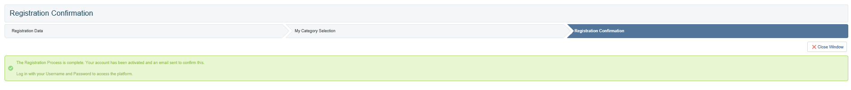
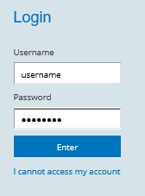
Registration
5. The registration process is now complete and your account is activated. You will receive an email with a temporary password to use to log in. The system will direct you to choose a new password the first time you log – in.
If for any reason you cannot access your account, for example, you lose your password, there is a link under the log-in details on the Home Screen.
Click ‘I cannot access my account’ and follow
the onscreen instructions.

Slide 8

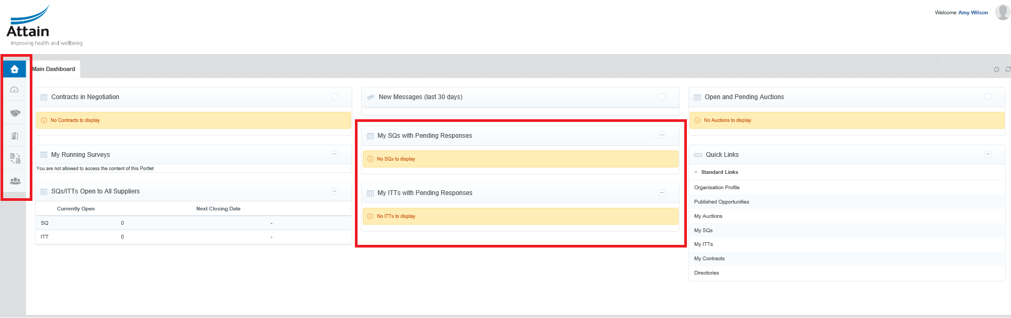
Home screen
6. Once logged in, you will see your Home Screen. The Main Dashboard is accessible by clicking on the ‘Home’ icon.
Here you can access all the SQs and ITTs that you have been invited to or registered interest in.

Slide 9
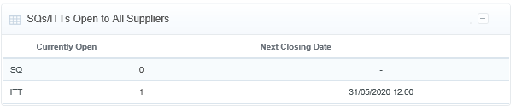
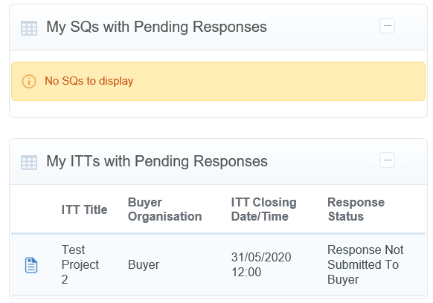
Accessing SQs and ITTs
7. To access tenders, navigate to SQs / ITTs that are Open to All Suppliers
Once you have expressed interest in a tender or started a response to one, you will also see it appear in your lists on your main dashboard, for easy future access.

Slide 10
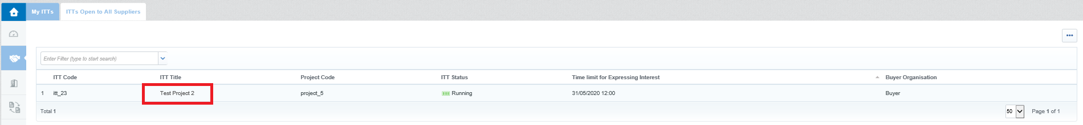

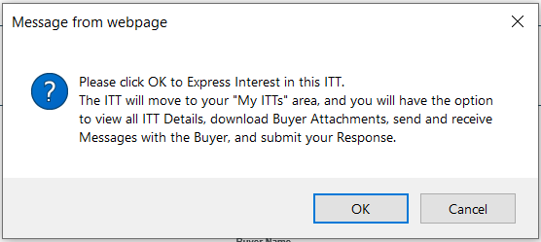
Expressing and Interest in a tender
8. To Express Interest in a tender, click on the name of the tender you wish to access in the list
9. On the next screen you will see the details of the SQ or ITT. Click on Express Interest
10. You will see a pop up notification. Click ‘OK’

Slide 11
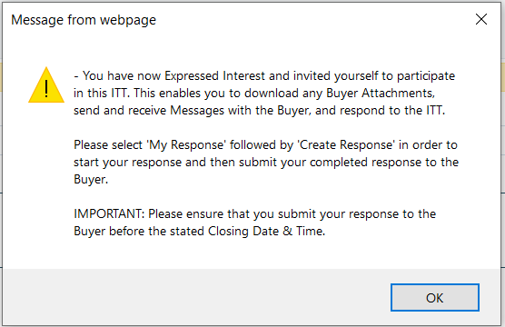
Expressing an interest in a tender
11a. There will be a second pop up notification with some useful information. Click ‘OK’

Slide 12

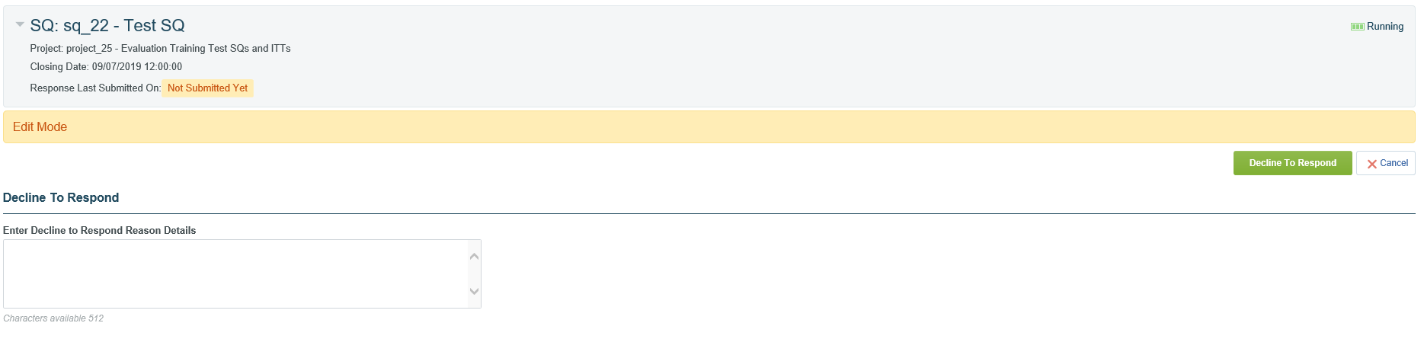
Declining to Bid
11b. Within the Project you will see an icon in the top right hand corner
Should you not with to participate in the tender, click this button and it will allow you to add a reason for declining (should you wish) – then click the green button ‘Decline to Respond’ to confirm. You must do this before you begin to respond to the SQ or ITT. If you have already Created a Response, you will need to confirm you no longer wish to participate via email instead using the Messaging Facility.

Slide 13
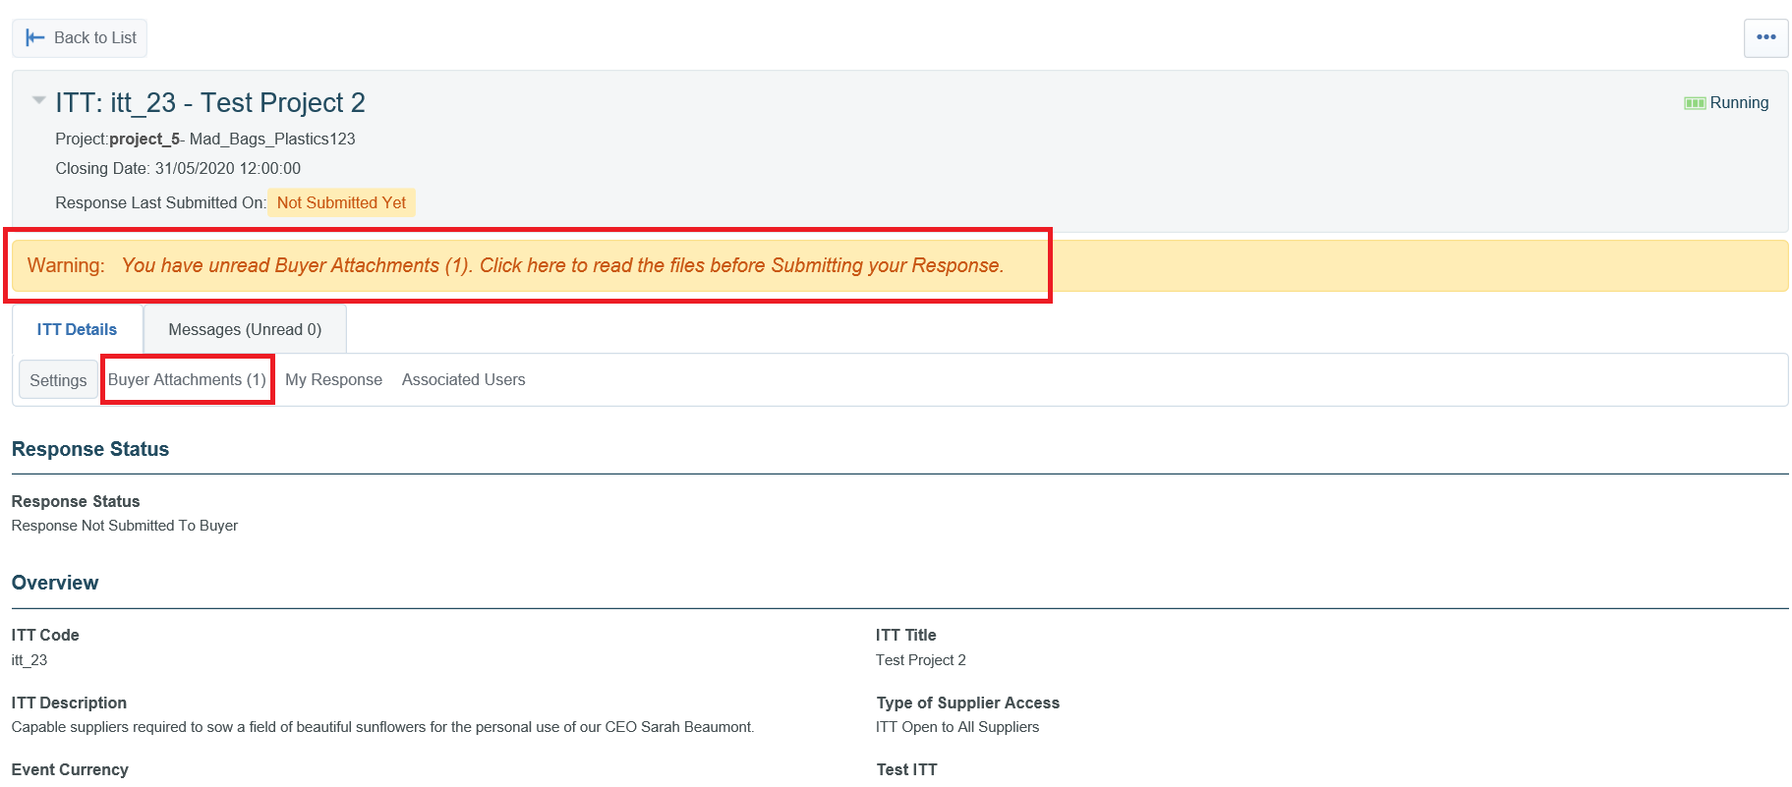
Buyer attachments
12. Once you have successfully expressed interest in a tender you will have access to the procurement documentation made available by the Buyer. You can download the documents by clicking on the message or clicking on “Buyer Attachments”

Slide 14
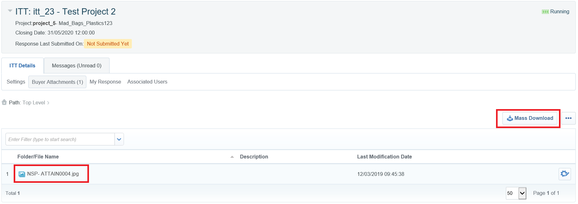

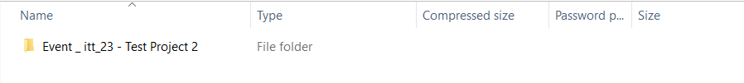
Mass download
13. You can click on individual documents or use the ‘Mass Download’ option if there are multiple documents. Note: mass download requires a Java plug-in, if you cannot use mass download then proceed downloading individual files.
Your files will download into a .zip file
That you need to doubleclick to
open.
On the Mass Download page, click the files you wish to download and click ‘Download Selected Files’

Slide 15
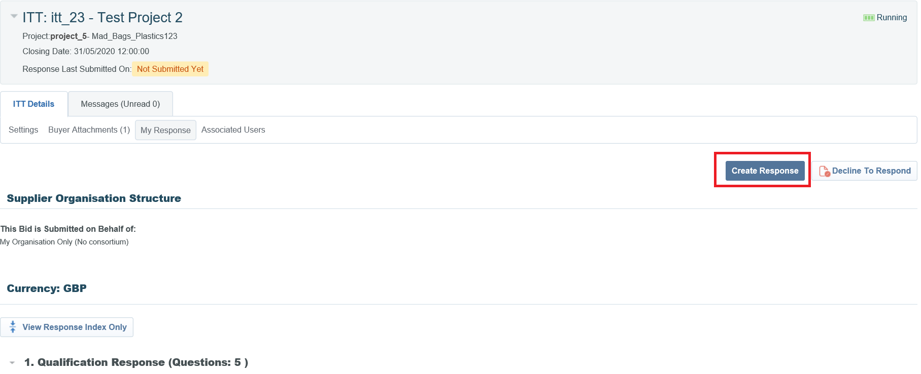
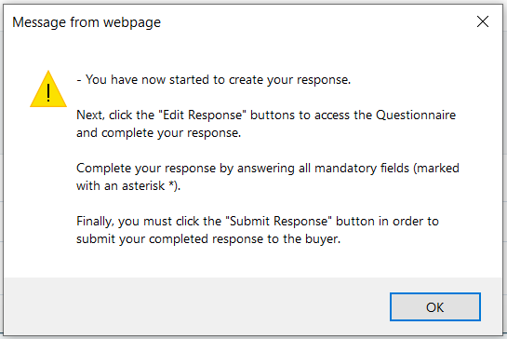
Creating a response to a tender
14. When you are ready to start your response to the SQ or ITT, click into the tender project title and click on ‘Create Response’
A pop up notification will appear. Click ‘OK’

Slide 16


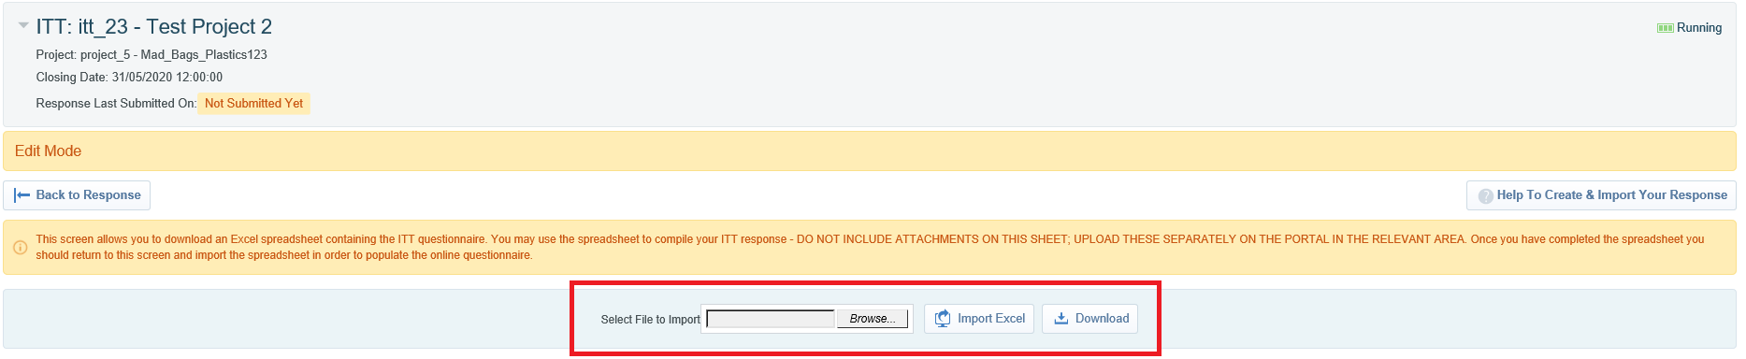
Creating a response to a tender
15. You will be able to see the relevant envelopes in the Questionnaire associated with the tender. This could include a Qualification, Technical and /or Commercial Envelope (or all three).
You can choose to respond to each question individually using the ‘Edit Response’ button
or you can click on the ‘Export / Import Response’ button to download a copy of the Questionnaire into Excel to complete offline.
Click on ‘Download’ to get a copy of the Questionnaire and save it to your computer. Use Browse to find your saved file and ‘Import Excel’ to upload your completed response to Bravo.

Slide 17
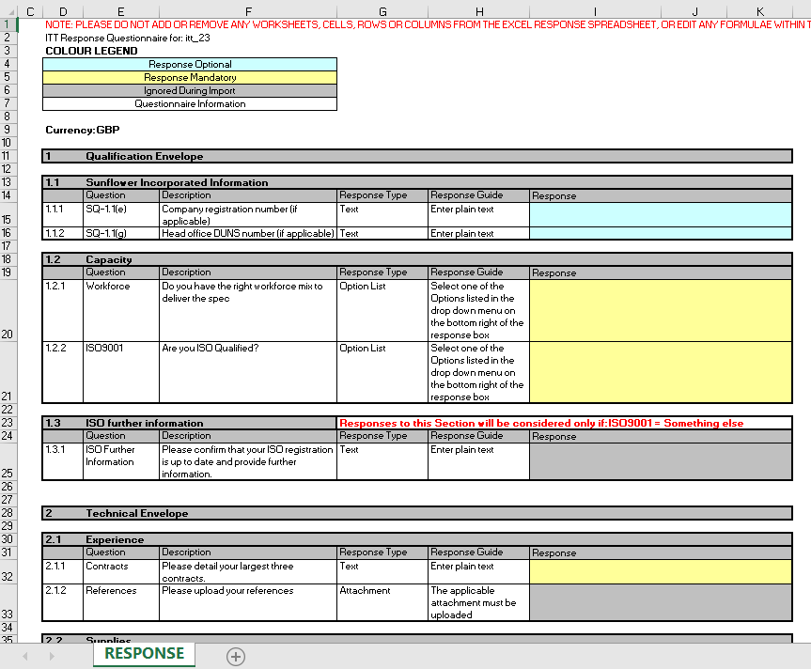
Creating an offline response to a tender
16. You can see in this illustration that you can respond to text based questions and multiple choice questions by clicking the drop down menu available for each ‘option’.
Please note that there are only 2000 characters available in a text based response. If a Buyer requires >2000 characters within a response, it should be an ‘attachment’ type question instead. Please raise this as a clarification, if you are concerned.
Where a question requires an attachment you will need to attach the file manually to the relevant question within Bravo. This is covered in the next few slides.

Slide 18
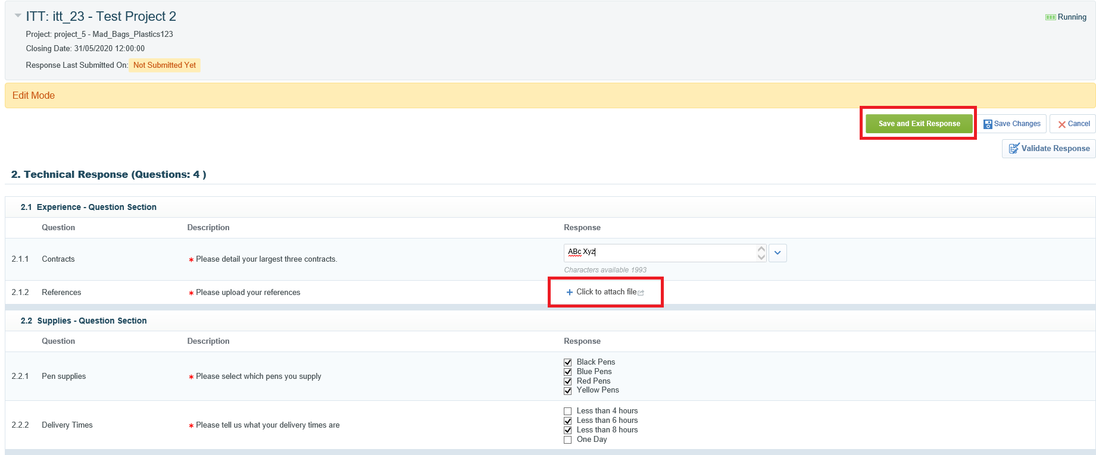
Attaching files to responses
17. If you have chosen to respond manually within Bravo, use the Edit Response button for each relevant envelope. This is how you can add attachments where necessary. Then Save and Exit Response when you are finished editing.

Slide 19
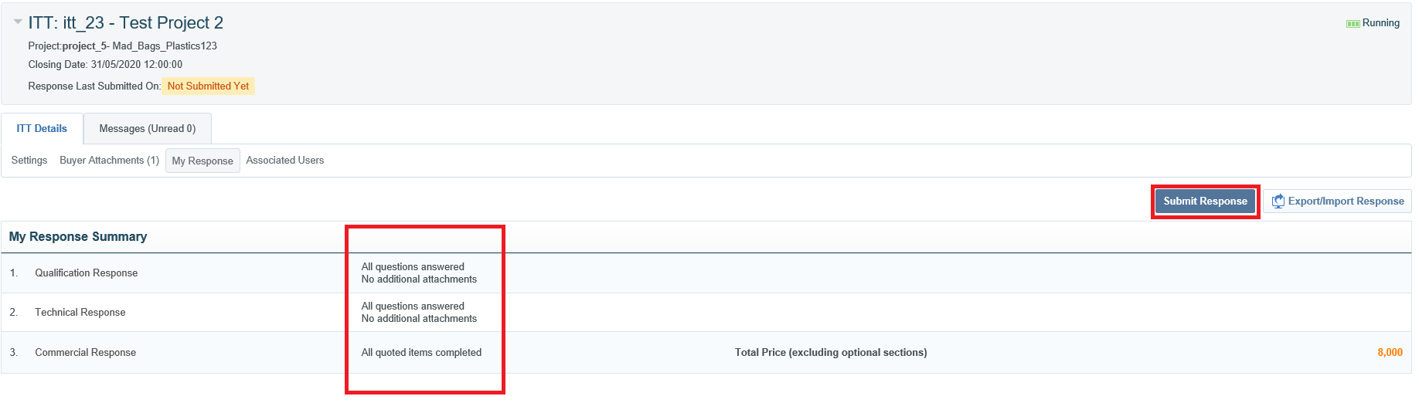
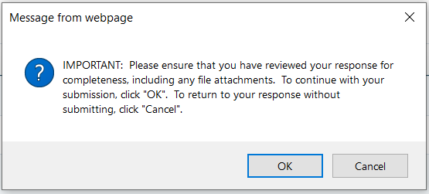
Submitting your response
18. When all questions have been responded to it will show in ‘My Response Summary’
Once you are happy with your final tender responses, click ‘Submit Response’ and click ‘OK’ to the pop up notification.
You can submit your response as many times as required for updates/amendments up until the published tender deadline. Thereafter no further edits are permissible.

Slide 20
Further Support
Bravo helpdesk
Phone:
0800 069 8630
+44 203 608 4013
E-mail:
help@bravosolution.co.uk

Slide 21
289 High Holborn, London
WC1V 7HZ, United Kingdom
0203 435 6590
contacts@attain.co.uk
www.attain.co.uk

