Slide 1
Supporting Cambridgeshire’s Voluntary & Community Sector
Provider Event - 10 March 2016

Slide 2
The County Council is seeking an innovative Provider(s) to deliver infrastructure services to the VCS and to facilitate representation
We want…to bring in fresh thinking
…the voice of the sector to be heard
…a collaborative approach
We are offering a grant agreement for up to three years – up to £120,000 p.a. (up to £360k by August 2019)

Slide 3
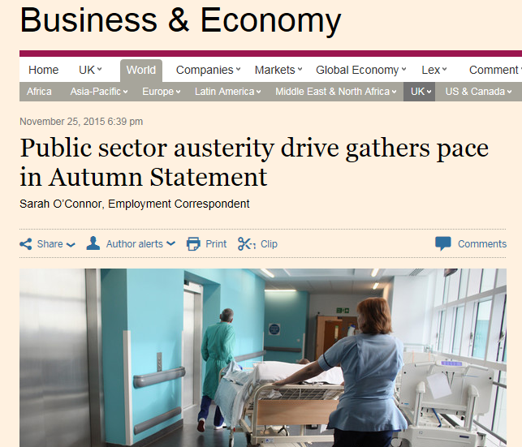
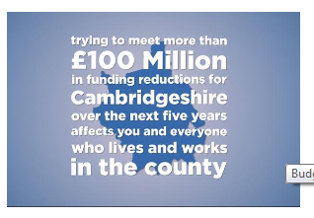
National and Local Context
Service provision as we know it will change radically, and the role of the VCS is critical to that.
Our challenge is understanding and responding to the impact of cuts in the fastest growing county in the country…
The only way to meet this challenge is to work together

Slide 4
Moving from our current position
One Agreement for up to three years
9 Service Level Agreements
A wide range of support services
1 Year Agreements

Slide 5
What we want to achieve…
Key
Outcomes
To develop and maintain a strong, innovative, well networked and sustainable VCS in Cambridgeshire. A sector which facilitates social action that contributes to vibrant and resilient communities
To enable the VCS to effectively support Cambridgeshire’s communities to remain well and to live independently, in line with the Council’s Transforming Lives model and the Think Family approach, and the Community Resilience strategy: Stronger Together
To enable Cambridgeshire’s VCS to make a positive contribution to the county’s economic prosperity, the environment and the overall health and wellbeing of its communities
To facilitate a representative ‘voice’ for the sector with demonstrable mechanisms to deliver this including effective two-way communication between CCC, the infrastructure organisation(s) and the wider sector

Slide 6
What we want to achieve…
Sustainable, well-managed and effective organisations
New organisations, projects or networks are set up
The voice of the sector is heard
Effective Local Councils, Village Hall Committees & community groups
Volunteering is supported and developed
Impact and value of the VCS is understood
A sector characterised by partnership, that is well networked
Importantly, we do not want to
prescribe how this should be achieved

Slide 7
Defining the sector
We define the VCS in its widest sense; including charities, residents, associations, community and self-help groups, social enterprises, village hall organisations and Local Councils (there are 232 Town and Parish Councils in Cambridgeshire).
It is estimated that:
3000 groups are loosely connected to infrastructure services, but many more are not;
More than half of these groups have turnover of less than £10,000 and are run entirely on volunteers with 80% of the remainder having fewer than 5 staff members;
15% manage a turnover of £100,000 or more.
(Source: http://www.cambridgeshireinsight.org.uk/VCS)

Slide 8
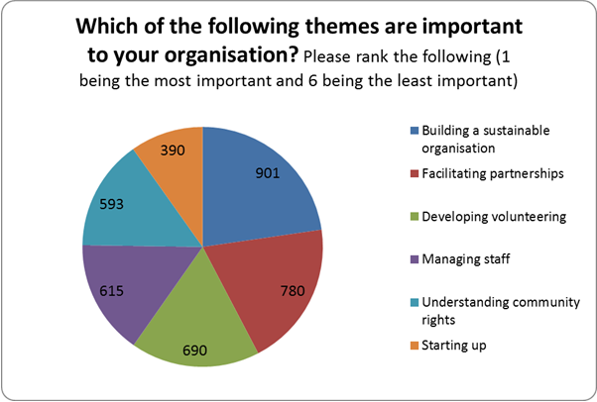
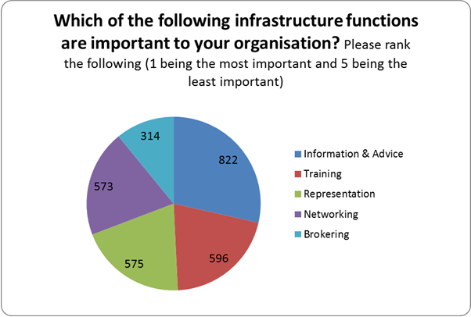
Service Delivery
An outcome-based approach (non-prescriptive) but important principles are:
Resources to be allocated at District level, taking account of deprivation and population
Further collaboration amongst VCS infrastructure organisations
Effective model for VCS representation and engagement
Providing information and advice
Good partnership working across sectors
Deliver efficient services across the county

Slide 9
We expect the successful provider to…
Be progressive and entrepreneurial in its vision and its practice
Demonstrate its own effectiveness, sustainability, breadth of income base, good practice as an employer of staff and volunteers
Demonstrate leading edge practice
Have an effective online presence
Empower and enable organisations to generate ideas, to harness resources
Be a learning organisation
Be well networked
Provide challenge to organisations they support
Broker relationships between different sectors
Weighted to bidders with knowledge and experience of working in the county

Slide 10
Performance and Monitoring
The determination of key performance indicators, baseline data, and the mechanisms and measurement against these indicators, will be worked through with the successful organisation(s) following the award of the grant.
Quarterly performance meetings will be held
Quarterly monitoring information will be provided
An annual report will be provided
An end-of-project lessons learned document will be produced prior to the end of the grant
District Councils and Health Partners have expressed an interest in joint monitoring arrangements, therefore these meetings will be open to key partners.

Slide 11
Procurement Process and
Electronic Tendering
Sarah Fuller
LGSS Procurement

Slide 12
Indicative Tender Timetable
Event | Date
Tender launch | 5th April 2016
Clarification submission deadline | 2nd May 2016
Tender submission deadline | 9th May 2016
Tender outcome notification | Early July 2016
Grant start | 1st September 2016

Slide 13


Jargon Busting
Contracts Finder
eSourcing Portal
OJEU

Slide 14
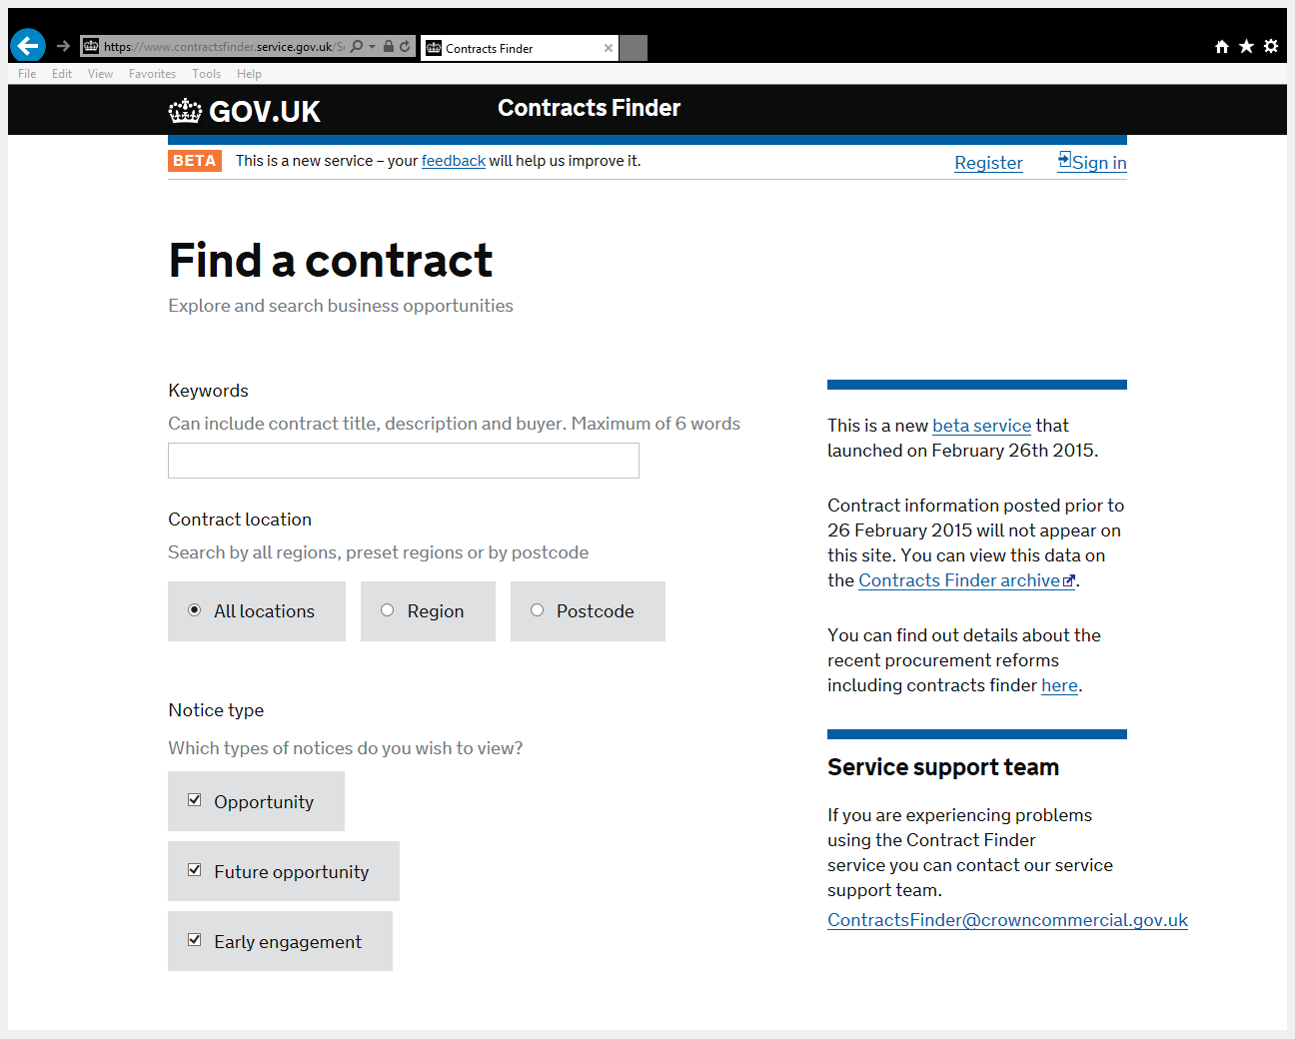
Contracts Finder
www.contractsfinder.service.gov.uk
Used to advertise all contracts over £10,000.
Mandatory for all public sector contract opportunities
Register to receive alerts
Notes:
Source Cambridgeshire – no longer using from January onwards
14

Slide 15
www.lgssprocurementportal.co.uk
Audit trail
Streamlined process
Reduced costs
Time saving
Market feedback – supplier responses saved

Slide 16
Support Available
User Guide explaining:
Registering an Account
Logging In and Accessing Contract Opportunities
Drafting and Submitting a Response
Contacting the Buyer and Due North

Slide 17
Technical Support Available
Due North Helpdesk
Tel: 01670 597 137
Email: support@due-north.com
Opening Times: 08:30 – 17:30 (Mon – Fri)

Slide 18
Last thing...
Additional accounts: You can register a primary account and additional sub-accounts. However, each one acts individually and only the person who registered their interest in a contract will receive notifications.
We recommend that if you want more than one person to work on a tender then you use a central email address that each person has access to.

Slide 19
What next...
Register on Contracts Finder
Set-up alerts
Register on the LGSS eSourcing Portal
Await emails for login details
Login to the Due North portal
Register interest in the contract opportunity
Draft response
Submit response

Slide 20
Do
Read all of the tender documents carefully
Answer the question!
Refer back to the specification
Look at any information in the “Description” and “Supplier Help”
Include relevant examples
Ask a clarification question if you’re not sure
Check your attachments

Slide 21
Don’t
Contact any council officers unless specifically asked to
Go over the word limit
Attach sales material
Cut and paste from other documents or from the internet
Repeat yourself – ask if you’re not sure
Be late!

Slide 22
Thanks for listening Any Questions?

