Slide 1
Registering and Applying for an PQQ/ITT/AQP process.

Slide 2
Getting Started
To receive the tender documents for any procurement run on the Attain e-tendering Bravo Portal, you must register your organisation.
You will be required to do this only once.
Please note that all information submitted via this portal is strictly secure and restricted to the Attain Procurement Team.

Slide 3

Registration
To register with the Attain E-Tendering portal:
  Click on link below for the portal
  https://attain.bravosolution.co.uk/
  2. From the portal Home Page, click the ‘Click Here to Register’ link

Slide 4
Registration
  3. Accept the terms & conditions for using the portal
  Complete your organisation & personal details
  Choose a memorable username and submit
  You will then be sent an email with your unique password, please treat this securely (if you lose it there is a ‘Forgot my Password’ link on the portal homepage
To Note: Once you have registered, there is an option ‘Help for suppliers for any stage of the process’
Important Note: Any AQP processes are always uploaded as an ITT (Invitation to Tender)

Slide 5
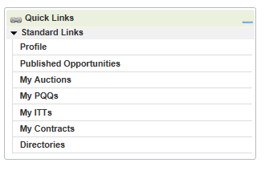
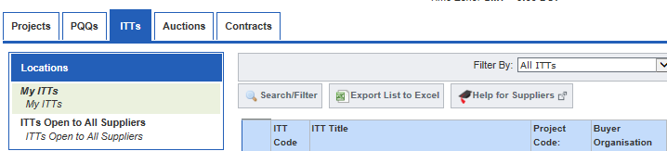
Finding your PQQ/ITT/AQP
Navigate to your ‘My ITTs/PQQs’ area of the portal & select the AQP (ITT)

Slide 6

Finding your PQQ/ITT/AQP
  To continue click the ‘Create Response’ action (or ‘Decline to Respond’ if you do not wish to respond)

Slide 7
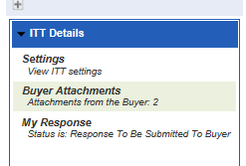
Downloading your PQQ/ITT/AQP Documents
An PQQ/ITT/AQP may be structured in different ways
an online questionnaire (this is known as Qualification or Technical Parameters)
an attached document questionnaire
a mixture of both
From here you can now access any attachments by clicking “Buyer Attachments” on the left-hand side of the page

Slide 8
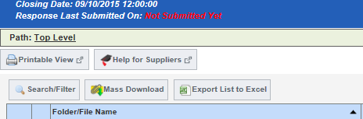
Downloading your PQQ/ITT/AQP
3. When downloading Documents you have the option to ‘Mass Download’
Note: mass download requires a Java plug-in, if you cannot use this download individually

Slide 9
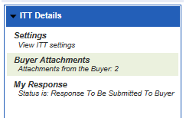
Uploading your PQQ/ITT/AQP documents
Click “ My Response” found on the left hand side of the screen
To Note:
When completing your documents, save them on your desktop

Slide 10
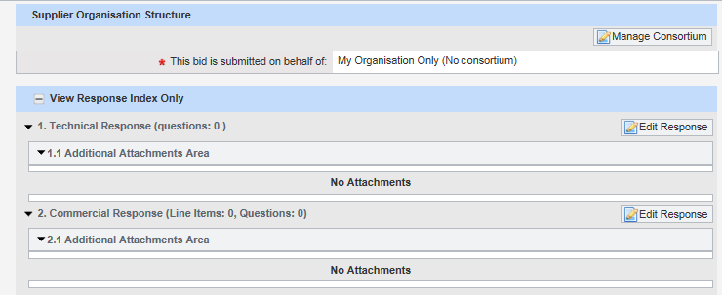
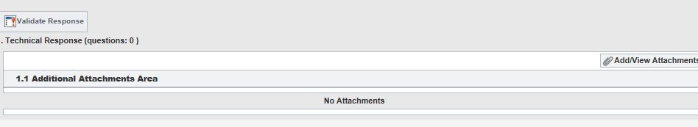
Uploading your PQQ/ITT/AQP Documents
2. To upload your response click on the ‘Edit Response’ and upload.
If you have multiple attachments then please click on Add/View Attachments and upload as many attachments as you need.

Slide 11
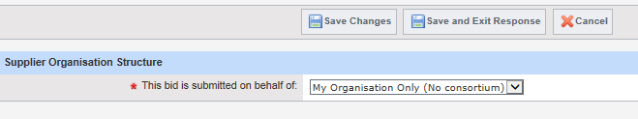

Completing your PQQ/ITT/AQP
Note: When you have finished each section of the question always click ‘Save and Exit Response’
1. When you have completed your response click the ‘Submit Response’ action (& confirm) to submit it to the Buyer.

Slide 12
Further Information
Within the suite of tender documentation there is a “Responding to a Tender” that provides further detailed instructions on how to use e-Tendering portal.
For further information or assistance please contact the Helpdesk on:
Tel: 0800 368 4850
E-Mail: help@bravosolution.co.uk
On behalf of the East Riding Of Yorkshire CCG, we thank you for your interest in this project.

