Slide 1
DHDO – IHS Challenge
15 Apr 19

Slide 2
The Status Quo
The UK Joint Medical Group (JMG) manages a largely traditional ‘face-to-face’, Doctor/Dentist led, primary healthcare (PHC) service
Delivering occupationally focussed PHC (including force preparation e.g. vaccinations ahead of deployments), GP Services, Dental, Community Rehab and Mental Health services
To a Population at Risk of 230k regular and reserve personnel (and in some cases, their families)
Within >150 Treatment Facilities across the UK
Via a uniformed and civilian contingent of >4000 clinicians, leaders and administrators
Supported by an online integrated healthcare record (DMICP) accessible by authorised clinicians
PHC services are overseen by Defence Primary Healthcare (DPHC) on behalf of the single Services (Royal Navy, Army & Royal Air Force).

Slide 3
The Ambition
MOD aims for DPHC to take advantage of its unique potential to create a standardised primary healthcare service to the UK armed forces. A recent independent study (the DHDO Study) identified considerable opportunity to optimise and modernise the way in which PHC is delivered by exploiting proven technology, maximising the workforce and grouping care facilities to create ‘Care Groups’, overseen by ‘Care Group Co-Ordination Centres’ (also known as ‘Group Hubs’) that undertake demand and capacity planning, analytics, scheduling, resource management, ensuring standardisation/reducing unwarranted variation and encouraging service improvement.
Current State
Pockets of Excellence
Excellent Patient Satisfaction
but:
Inefficient
In-flexible
Stressed/stretched
Manpower Reliant
Unwarranted Variation
Desired State
Efficient
Modern
Flexible
Resilient
Maximised
Standardised

Slide 4
The Care Group Concept
The ‘Care Group’ concept, not dissimilar to the NHS Network approach, will see the grouping of a number of closely located medical treatment facilities (‘care centres’). Where this model differs to the majority of NHS GP partnerships, is that each ‘Care Group’ will be overseen and enabled by ‘Care Group Co-Ordination Centres’ or ‘Group Hubs’, for short. Through the proactive use of data and building relationships with customers/demanders (the single Services), the ‘Hubs’ will take an evidence based approach to demand and capacity planning. The ‘Hubs’ will be responsible for coordinating and distributing specific healthcare services across the ‘Group’ in an agile fashion, with resources shared between ‘Care Centres’ (military and MOD civilian clinicians, supplemented by temporary healthcare workers), supported by technology such as remote consultation tools (where appropriate), in order to provide the right care in the right place at the right time.

Slide 5
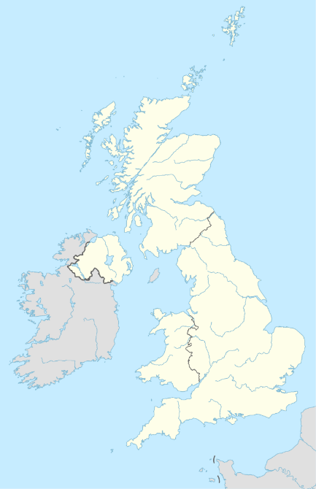
‘Hub’
Care Group Co-Ordination Centre
Standardisation
Demand & Capacity Modelling
Scheduling
Resource Management
Data Ownership
Service Improvement
Standard Operating Procedures
Data Architecture
Digital Solutions
Access to Resources
Care & Safety Policies
Flexible Workforce Policies
Patient Empowerment Policies
Care Group Co-Ordination Centre Concept
Care Centre
Care Centre
Care Centre
UK Footprint
Underpinned with
Supported by
Care Centre
Care Centre
‘Hub’
Delivering
Pilot area to test the new Hub concept between Apr 19 & Apr 20
For illustrative purposes only - Hub locations yet to be agreed
Care Centre
Care Centre
Sharing Resources
&
Flexing Services
Care Centre

Slide 6
Care Group Co-Ordination Centre/’Hub’ Responsibilities
The ‘Hub’ will act as the coordinating function, overseeing and enabling all of the care centres within a specific ‘Group’. It is proposed that the ‘Hub’ will be responsible for the following activities:
Triage: Managing a defined triage service to ensure that patients access healthcare at the most appropriate level (self care, remote consultation, face-to-face consultation, secondary healthcare etc). This service may be preceded by a digital triage capability.
Analytics: Collating and exploiting healthcare data across the group to drive improvement and report on performance.
Demand Planning: Further exploiting data and working with customers to predict healthcare demand across the group
Capacity Planning:
Scheduling: Scheduling primary healthcare services (including ‘remote/digital’ options) to deliver against the demand via the most effective and efficient method, considering resources available (people, technology, facilities)
Rostering: Defining the resource requirement for each service and assigning roles to deliver
Rota Mgmt: Managing resources across the Group to ensure the services are manned appropriately
Driving Improvement: Reporting issues and risks through the chain of command, working with other ‘Hubs’ to share best practice and lessons identified, as well as enabling the sharing of best practice and lessons identified across the ‘Care Centres’.
Budgetary: Managing the assigned budget, to include spend on temporary healthcare workers

Slide 7
The Challenge
To further develop the concept of the Care Group Co-Ordination Centre function (is it achievable? Practical? What are the challenges? What have we missed? What do we need to consider?)
To understand the capability and appetite of the independent healthcare sector to support its delivery (capability to deliver the whole requirement? Better to break the requirement into specific elements? Tools and training only?)

Slide 8
Key Considerations
Unwarranted Variation – Whilst PHC facilities come under the Command of a single organisation (DPHC) and work to SOPs and policies, there is a considerable amount of unwarranted variation across the facilities, partly due to the legacy of having been split under x3 different Commands prior to April 2013. This will need to be addressed.
Operational Requirements – The eventual operating model will need to take account of the clinical expertise and maintenance of skills required for Exercises and Operations. i.e. the model will need to ensure military staff receive the appropriate experiences to prepare them for delivering care on Ops. There is, however, opportunity through this programme to re-shape how that requirement will be met.
Digital Compatibility – Any new digital solutions will need to work through the MOD gateway and be serviceable through MOD IT equipment.
Culture Change – Currently, Med Centres are readily accessible and generally staffed 8am-5pm, patients can usually present for a same day appointment with a GP. The potential changes will require deliverers to undertake new ways of working, thinking and innovating whilst patients will need to think about different ways of accessing healthcare.
Cortisone – A new Integrated Healthcare Record (Cortisone) is already in development scheduled for delivery in 2021. DHDO needs to be cognisant of any changes this will present, and ensure DHDO concepts and tools are considered and compatible.
Clinical Resources– For the purposes of this exercise, MOD will resource all ‘care giver’ roles within the ‘Care Group’ concept.

