Slide 1


RBWM Domiciliary Care – stakeholder consultation
Discussion points– market engagement

Slide 2
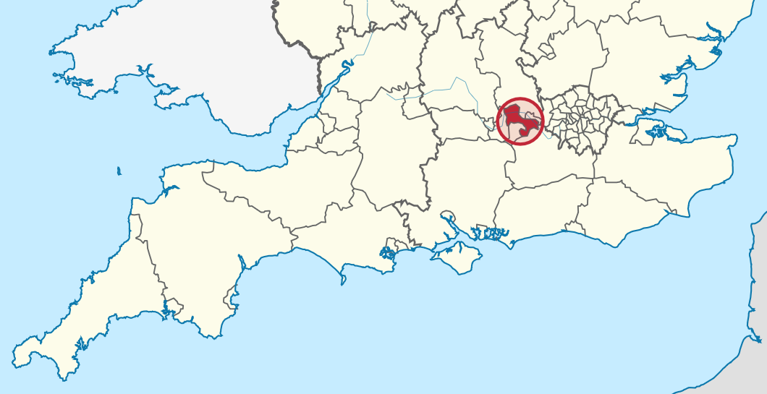
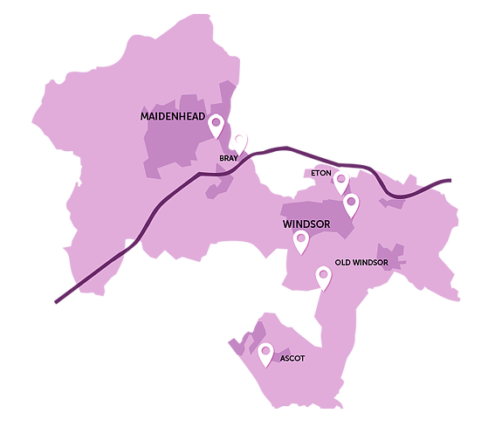

Royal Borough of Windsor and Maidenhead
The Royal Borough of Windsor and Maidenhead is one of six unitary authority areas within Berkshire. RBWM covers the two towns of Windsor and Maidenhead, as well as Ascot. The Royal Borough of Windsor & Maidenhead is located 15 minutes from Heathrow Airport and less than 30 miles from central London. It has rich historical connections blended with a unique royal patronage.
With its international reputation and permanent presence in the top ten list of ‘must visit’ places in the world, the Royal Borough of Windsor & Maidenhead blends rich cultural heritage with successful modern business development. Home to the iconic Windsor Castle, Ascot Racecourse and Legoland Windsor, the Borough is home to many top UK and International businesses and is a natural choice for meetings, conferences and events.
Geographical Context
The Borough covers approximately 79 square miles, located in Berkshire at the heart of the Thames Valley
Situated between Slough and Bracknell, the Borough boundary also adjoins the Counties of Surrey and Buckinghamshire.
Notes:
Add in for framework

Slide 3
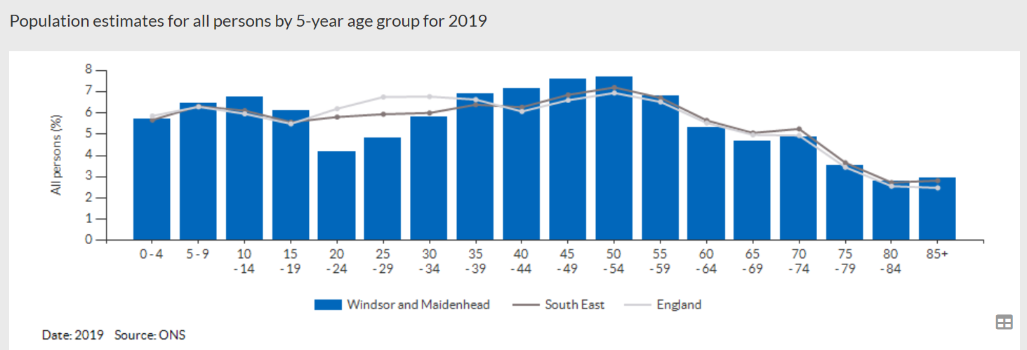
Needs and Provision within the Royal Borough
The ‘Office for National Statistics’ (ONS) produces estimates of the number of people living in the area based on factors such as births, deaths, and migration. According to the ONS the borough's population at 2019 was around 151k. England’s population continues to age disproportionately with the proportion of people aged 65+ now accounting for 20% of the population. This is broadly mirrored in the Royal Borough, where just under 19% of the population are in the 65+ cohort.
Trend data for the Royal Borough suggests that the 65+ cohort will continue to increase over the next 10 years, as shown below.
We need to continue to plan and prepare for this expected increase in the older population and will do this through:​
Ensuring we create conditions that enable people and communities to have the opportunities to help themselves. ​
Increasing capacity by refreshing our current contracting arrangements with Domiciliary care providers. ​
Enabling choice, supporting with Direct Payments so that residents can access and control the services they need.
Forging strong provider partnerships to ensure quality, sustainability and fit between needs & resources​ and to encourage partnership working.

Slide 4

The Royal Borough of Windsor & Maidenhead Local Profile
Demographics – Census 2011
The population:
77.5% white British
13.8% Black and Ethnic Minority (BME)
8.6% white non-British
Household composition
16.5% of people were living alone
11.9% of people over 65 were living alone
Language
4.4% of households had no adults speaking English as their main language
Employment
59,064 (56.6%) of people were employed
1243 (1.2%) were long term unemployed
1834 (1.8% of people were not in work because they were sick or disabled
Health
7952 (5.5%) of people reported that their daily activities are limited a lot by their health
3872 (2.7%) of people reported they were in bad health
1081 (0.7%) of people reported they were in very bad health

Slide 5

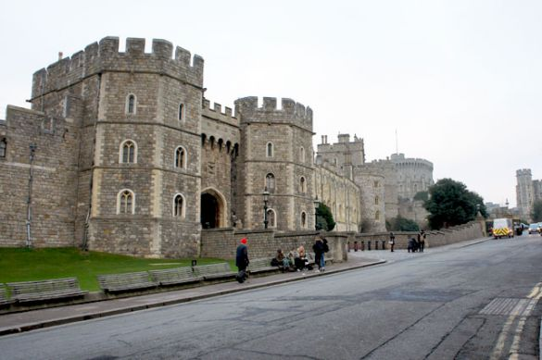
Current Market Provision
£4 Million p.a. is spent on brokered domiciliary care.
This accounts for around 4,000 hours per week, supporting around 350 older people.
Approx 93% of the care is delivered through 5 providers, with whom the Council hold existing contracts which expire in August 2022. The remainder is commissioned on spot contracts.
4 of the 5 providers are CQC rated as “Good”.
The average care package equates to around 10.5 hours per week.
Providers can respond to new care packages quickly.
No capacity issues.
Only a small cohort of providers deliver up to 90% of the care
“First past the post” – whoever responds first wins the care package.
Agencies are paid on commissioned hours not delivered hours.
There is no electronic call monitoring currently. The system is reliant on trust – there is a reputational risk to the Council.

Slide 6
Our vision for the new service
“Building a borough for everyone – where residents and businesses grow, with opportunities for all”
Our vision is underpinned by six priorities:
Healthy, skilled and independent residents
Growing economy, affordable housing
Safe and vibrant communities
Attractive and well-connected borough
An excellent customer experience
Well-managed resources delivering value for money

Slide 7
Issues that we will need to consider in the new contract
How do we provide a way for new providers to be able to be considered during the contract lifespan?
How do we build in review of the care package once it is set up? What time period works well?
How can we ensure that the new model focusses on supporting the individual to achieve their identified outcomes and increases self-reliance?
er choice for people over the life of the new contract.
How do we build in provision for the individual to use their Direct Payment as an alternative to Council commissioned service?
How can we ensure that providers are able to deliver care across the whole of the Borough? Do zones or areas work?
What are your views about electronic call monitoring? What system works well in your experience?
We will need to ensure a range of outcomes for differing needs (e.g. home from hospital; needing no further support after 8 -26 weeks of receiving service; assisted to remain in their own home etc
For existing providers – what is your experience of transitioning to new contracts? What has worked and what has not worked?
What is the role of reablement and how does this work best as an interface with Domiciliary care?
How can we ensure we are giving client preference and choice through this process? How would providers balance client preference against availability of resource?

Slide 8
Proposed agenda for the follow up meeting
Recap (10 mins) (discussing the answers to the initial questions sent out)
Service model ( approx. 40 mins )
Discussion on the issues highlighted in Slide 7
In your experience what works well in the Commissioning of Domiciliary Care?
What needs are you seeing in your delivery of services in RBWM / elsewhere?
What is your experience of working on a “gainshare” approach?
How do you measure outcomes of people receiving your service?
What experience do you have of using Assistive tech and call monitoring systems? What works well? What doesn’t?
What factors would encourage you to work with the Royal Borough and tender for this service?
Procurement model (approx. 10 mins)
What is your experience of using a Dynamic Purchasing System?
What works? What is challenging you?
Pricing model (s)

