Slide 1
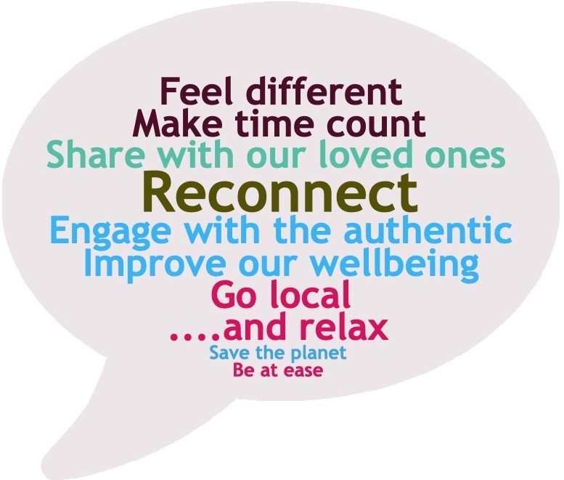
Mapping the experiential product in Kent
Context
Over the past 10 years, travellers have increasingly sought out ‘more’ from their leisure time, continually hunting for that truly local and authentic experience that separates them from the tourism hordes. Whether this is the secluded beach that no one else seems to have discovered or the best family run restaurant in the district, visitors gain an immense sense of personal achievement to have found ‘the best, authentic, most unique, secret, unusual and downright bizarre’; and when they take to social media this experience becomes an almost ‘badge of honour’, that all who follow will want to obtain.
This consumer-led desire has given birth to platforms like Airbnb experiences; events like ‘On Captain’s Orders’ at the National Maritime Museum and products like escape rooms, immersive theatre and trekking the South Downs with lamas.
Now, the desire for our leisure visits to be ‘experience’ rather than ‘observation’ led has become the norm. Couple this with our new-found need to reconnect to people and places driven by the current Covid-19 travel climate; experience-based travel is set to continue on its current growth curve.
Due to the size and breadth of Kent’s tourism offer, the Visitor First strategy was developed as part of the previous Interreg project; placing visitor at the heart of the brand positioning and reflecting the personalities of the E, W and N Kent areas. During this analysis, it is clear that the opportunities to develop and enhance new and current product align with this destination brand structure, as experience-led product places the customer’s needs at the centre of its proposition.
The customer wants to…

Slide 2
Putting the Visitor First
For an experience led product to be successful, it has to be customer led. Today’s visitors are looking for something that is authentic, unique and makes them feel like a local rather than a visitor. Due to the county’s size and breadth of offer, Visit Kent developed the Visitor First strategy in-order to spotlight the unique proposition of East, West and North Kent, giving them a clear brand voice. Championing the experience-based product, this enables a destination to amplify and even develop the brand message.
East Kent
Personality: Bright, vibrant, fun – an eclectic and diverse region that embraces the young and the old alike
West Kent
Personality: Lush, ripe and nostalgic – a warm and reassuring region with a long history
North Kent
Personality: Strong, proud and bold – an hidden gem going through a transformation
Imagery: Docks and ships, seagulls and sirens, factories and warehouses
Imagery: Riverbanks and beaches, battlements and berries, seafood and spires
Imagery: Green fields, stately homes, country pubs, castles, churches and cream teas, rich in heraldic association
IMAGINATION
FREEDOM
CURIOSITY
EXPERIENCE PRODUCT
Closer to the coast
Seafood
Photography
The Great Outdoors
Food & Drink
Wellbeing
Green fingers
The Farming Landscape
Culture
Multiculturalism
Heritage (Neolithic – Maritime/Industrial)
Nature
East Kent reflects an almost endless list of experience opportunities that align to the historic, nostalgic, creative and retro image of the coast. There is however an opportunity to strengthen this brand voice by capitalising on the countryside.
West Kent finds its brand strength in the established heritage offer, which although always popular with the visitor, can sometimes be a slight hindrance when trying to establish an immediacy to travel. Opportunities around the growth of the food & drink product via year-round accessibility to the vineyards along with wellbeing and self-improvement all offer opportunity
North Kent, is dominated by a coastal /industrial image with leading attractions such as the dockyards and naval heritage. However, the emerging strength of the cultural offer, reinforced by the opportunity to build on the region’s multiculturalism will bring hidden gems to the fore, for visitors to discover.

Slide 3
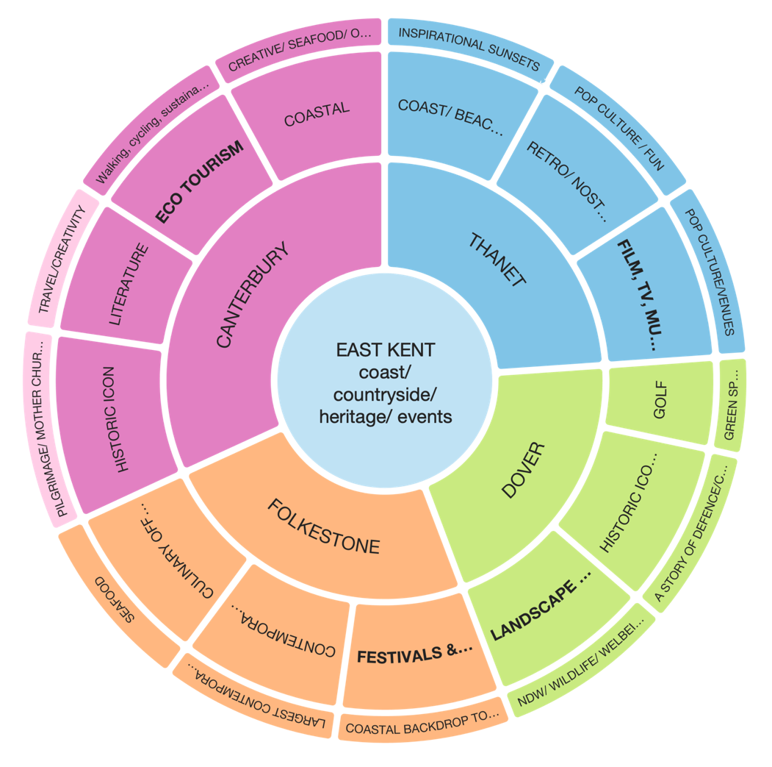
Options Analysis for East Kent – Core Strengths
East Kent has an established product offer built around the coastal, heritage and countryside appeal, but it’s dominated by icons. Because this recognition and recall of long-standing product such as Canterbury Cathedral & the White Cliffs is so strong, other key areas have often had to fight to be heard.
Folkestone is fast gaining national and international recognition as the UK’s largest outdoor art exhibition; which is reinforced by the growth over the last 10 years of the Creative Quarter, home to local artisans and creative SMEs. 2021 will see the 5th Folkestone Triennial, bring world class artists to the town, further cementing Folkestone’s positioning as a contemporary arts destination. Can this be utilised further to connect visitors with the town’s creative locals?
Dover has long held the iconic status of England’s ‘welcome home’ image thanks to the White Cliffs, insuring the area’s inclusion on multiple coach day trips from London. However, dwell time is short with lower than desired economic return.
The profile of the golf product and the now rescheduled Open, will also shine a spotlight on East Kent. All of these iconic attractions and events deliver a strong foundation to raise the profile of other great attractions such as the surrounding countryside of the Downs with the layers of heritage that are almost passed by unnoticed from the port.
Thanet is home to a multitude of truly stunning blue flag beaches, well deserving to be the backdrop to any fashion or film shoot. However, it struggles with a kiss-me-quick pre-conceived image of an English coastal resort with a domestic audience. Turner Contemporary has confirmed the area’s status as a creative centre that takes its inspiration from the natural setting; and the revival of Dreamland and love for ‘all things retro’ has fuelled the growth of SMEs that collectively celebrate nostalgic, retro, geek appeal – perfect to develop local led product development, aligning to pop culture.
Fig 1.4
Canterbury is one of England’s premier heritage cities, where the Cathedral has been attracting visitors for centuries to its medieval streets. However, in recent decades dwell time has receded, and as with many heritage-based destinations there is a perceived lack of urgency to visit. The city, countryside and surrounding coastal towns are brimming with potential, whether it’s learning how to prepare your favourite oyster dish or walking in the footsteps of Pilgrims on the North Downs Way – the key is turning these activities from ‘things to do’ into great ‘experiences to remember’.

Slide 4
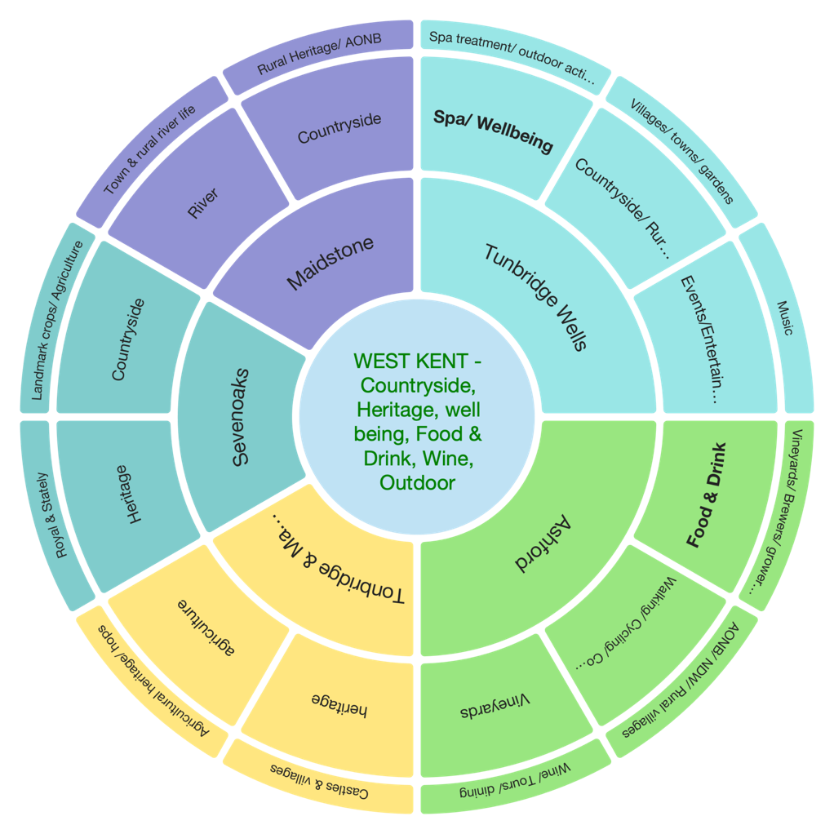
Options Analysis for West Kent – Core Strengths
West Kent is dominated by a strong rural countryside product, thanks to a considerable proportion falling into the North Downs and High Weald AONB. The area is rich in heritage attractions along with a rural towns/villages product. Over the past 10 to 15 years, this has formed the perfect backdrop for the development of an excellent food and drink offer; most notably being the rise in vineyards that are increasing year on year.
However, when the lead consumer offer is built on heritage and landscape, it can be a double-edged sword. These ‘firm roots’ reassure the visitor, but don’t establish an immediacy to travel, it is a case of, “if it’s always been there, then what’s the rush”. Focusing on experiencing rather than on just visiting, can create a sense of immediacy.
Ashford benefits from good rail and road connectivity, linking London and the continent in less than an hour. Home to some of Kent’s most well-known vineyards like Chapel Down and Gusbourne, it also has a considerable section of the North Downs Way with outstanding areas such as the Wye Downs, Westwell and Chilham. This is complemented by village gems such as Smarden, Biddenden and the market town of Tenterden.
Tunbridge Wells is known for its Georgian gentrification, royal spa status, abundance of stately homes and Wealden countryside. The borough offers a wide range of activities from sailing and mountain biking to rock climbing and curling. To complement the outdoor offer, there is also a range of spa and pampering treatments and opportunities for self-improvement from expanding your wine knowledge to perfecting your pianist skills.
Sevenoaks can be somewhat overlooked as a short break destination due to its proximity and rail connections to London, leading to a high number of day visits to its castles, gardens and stately homes. Focusing on generating experiences through activities such as behind the scenes and ‘how to’ courses, could be effective in increasing dwell time as well as off-season short breaks.
Fig 1.5
Maidstone/Tonbridge and Malling Boroughs are dominated by the Downs and the Medway River as well as being home to iconic heritage sites such as Leeds Castle. The river and high percentage of the area that falls within the AONB, offer a brilliant backdrop to explore farm diversification experiences, from hop growing to green florists, as well as excellent rail connectivity for the North Downs Way and river experiences.

Slide 5
Options Analysis for North Kent – Core Strengths
For many domestic and international visitors, North Kent is still undiscovered, even though it has the Dockyard and Dickens; hence the Visitor First destination branding leads on ‘curiosity’ for this area.
Because it is ‘known, yet not known’, developing experience led product creates an opportunity to challenge perceptions, creating the chance to support activity such as the City of Culture Bid for 2025. Although dominated by the Thames Estuary and the Medway towns, there is a substantial countryside product; layers of heritage and a range of diverse stories and notable historical characters both fiction and non-fiction that bring the area to life.
Gravesham is a somewhat forgotten slice of North Kent; the consumers perception is dominated by the riverside town of Gravesend, known as the English home of Pocahontas and for its links to maritime defence heritage. Yet this is very much a district of stories, from the breadth of cultures that have and still do call it home, to the pilgrims that have travelled through its stunning countryside. The multicultural experience offered by the Gurdwara and festivals celebrating calendar events such as Eid or Diwali, all offer a new and engaging opportunity to welcome visitors.
The Medway towns are steeped in history linked to renowned historical figures such as Dickens and Nelson, where visitors can visit their homes, experience themed events and explore the dockyards where ships like the Victory were built. However, because of North Kent’s entrenched alignment to such characters, it can be challenging for new products to break through. This is where a focus on experience rather than visit, offers new opportunities. A great example was earlier this year, when Rochester Cathedral housed ‘Museum of the Moon’ resulting in a record breaking 120,000 visitors during the off-peak season Feb / March. This event has shone the light on what’s possible when art and heritage combine.
Fig 1.6
Swale has a diverse offering from heritage market towns to marshland with industrial heritage and seaside fun; Its offer breaks down into 4 key product areas – Coastal, Heritage, Countryside & Nature and Family. Areas of strength that are gaining recognition are wildlife and countryside, thanks to the experience offered by Elmley Nature Reserve. There are additional opportunities around the North Downs Way, as well as capitalising on the fruit and hop growing heritage in the borough, telling the full story from hop garden to beer garden with Shepherd Neame. Although the smallest of the district councils, Dartford has some unique experiences that are known both nationally and internationally, Bluewater is the 5th Largest shopping Centre in England and Brands Hatch circuit which hosted the F1 Grand Prix until 1986 and still hosts the GT and British Superbikes, with public track day experiences.

