Slide 1
Service Connect Guide for Sub Contractors

Slide 2
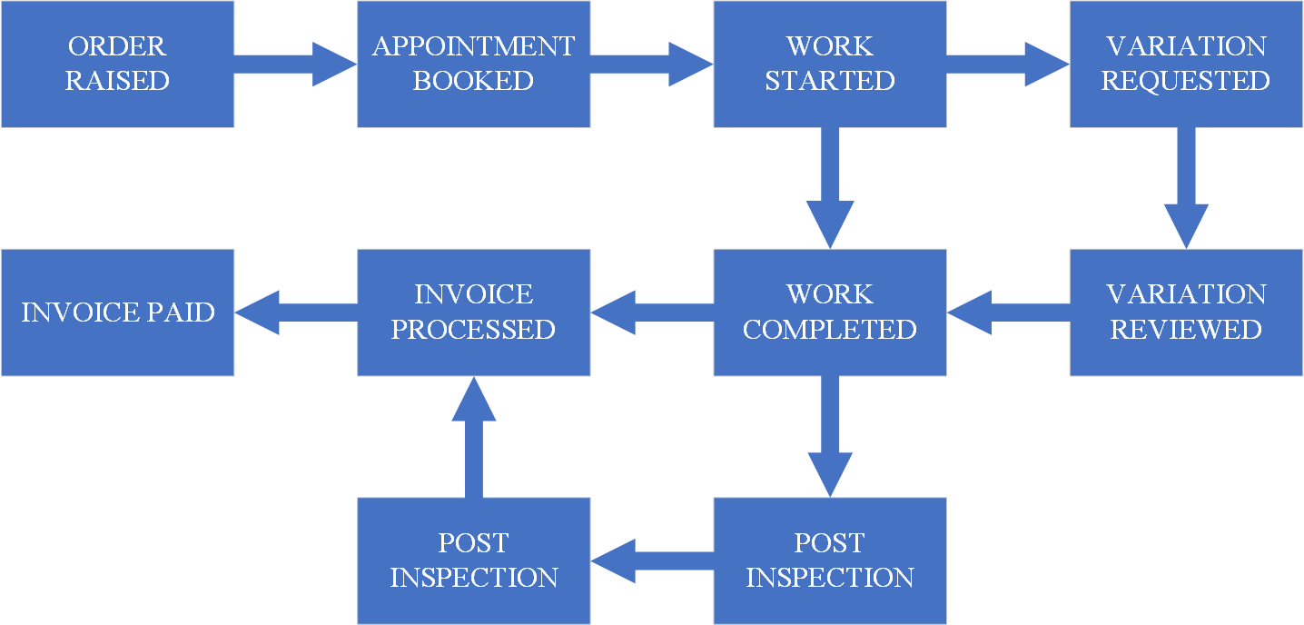
Order Lifecycle

Slide 3
Subcontractor Order Statuses
Status Name | Description
Released | Available to the supplier to start work
Work in progress | Works in progress and status until work is billable
Work complete | All SOR codes have been completed, completion documents – completion documents and pictures were uploaded
Ready to invoice | Order is ready for supplier invoice – to be saved into Documents' tab
Awaiting approval | Awaiting approval
Financially approved | Financially approved – invoice sent for payment
Invoice matched | Invoice matched

Slide 4
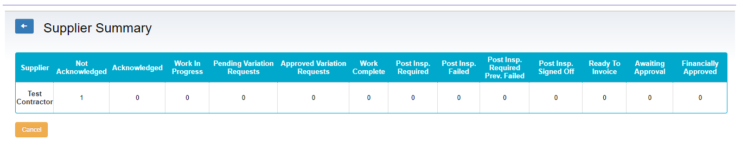




Receiving Work
New work appear in ‘Not Acknowledged’
Work progresses left to right
Each box summarises individual orders and if clicked filters orders to selected status
Return to full list of unfiltered orders

Slide 5
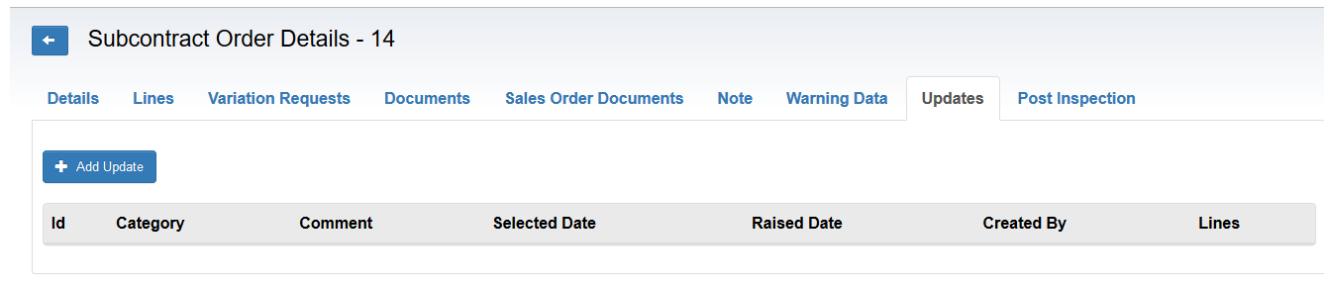
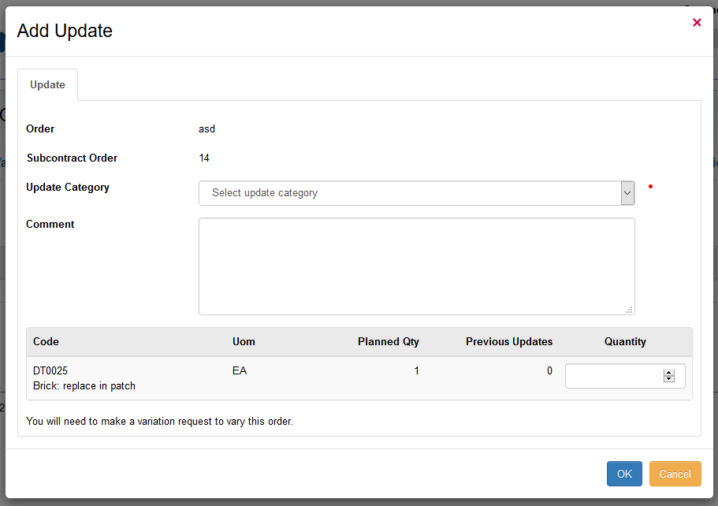
Acknowledge Order and add any future updates
Access Updates Tab
Add Update
Select Category of Update
Add any option comments
OK
Repeat for all future updates as required

Slide 6
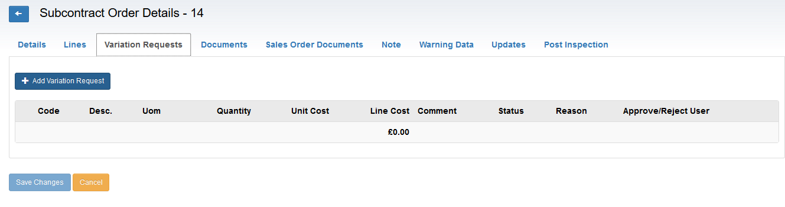
Lines Tab - Update/ change an SOR
Lines Tab shows all SORs allocated to an order *Should SORs need updating or changing the contractor needs to follow the Variation process.
Upon submitting a Variation it needs to be clarified if the Variation is for current works required or a retrospective request for works already carried out.

Slide 7
Documents
Within the Documents tab you will save all completion reports, quotations and invoices.
- You will be able to select the type of file upon uploading it
- Before and after pictures are saved in “Photos” tab and should be marked (Before or After) pictures *Image ?

Slide 8
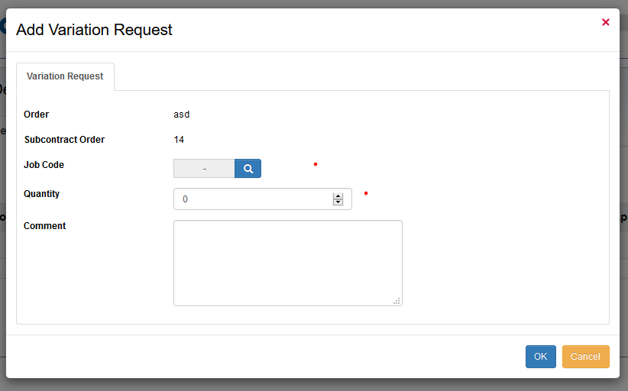


Variation Requests
Variation Requests Tab
‘Add Variation Request’ Tab
Add Job Code
Add the Quantity
Add any optional Comments
OK

Slide 9
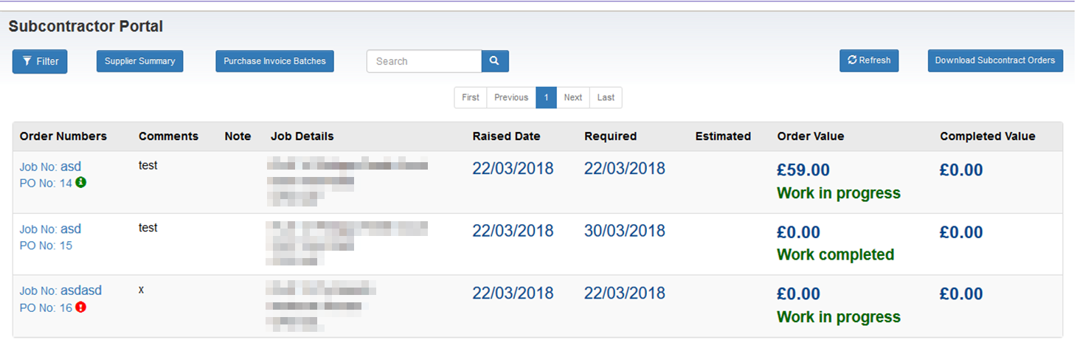
Variation Requests 2
Approved Variation Request
Pending Variation Request

Slide 10
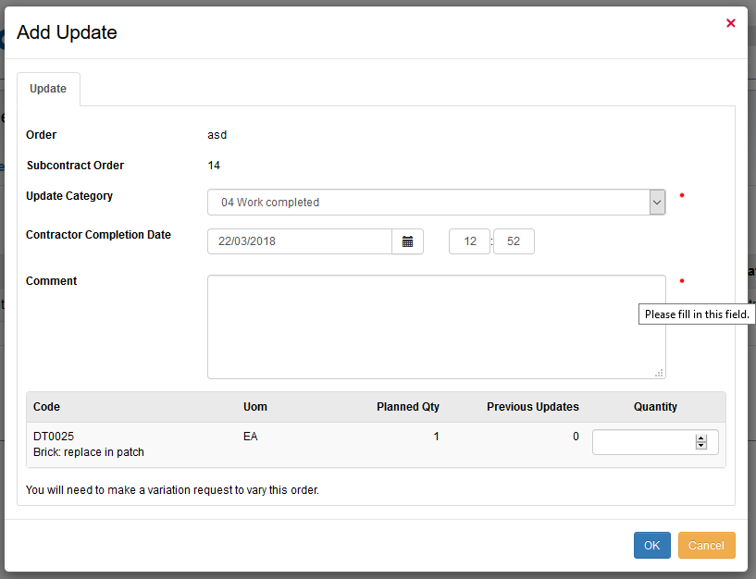

Completing Works and Job Codes for invoicing
Access Updates Tab
Add Update
Select Category of Update – Work Completed
Confirm Date of Work Completed
Comments
Select Quantity of Complete Job codes if assigned multiple
OK to confirm

Slide 11
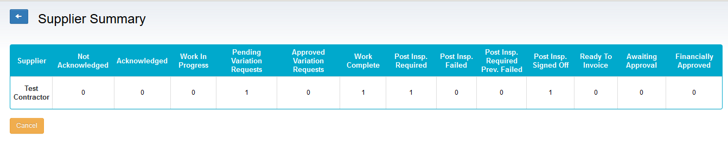
Post Inspections by RBKC
Order where all work has been completed
Order flagged for Post Inspection
Order where Post Inspection has been passed

Slide 12
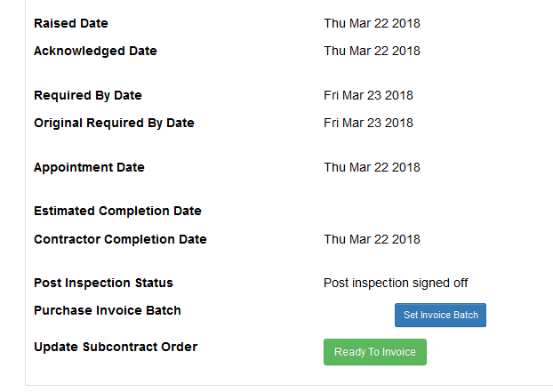
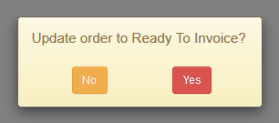
Work Complete Status
Details Tab
‘Ready to Invoice'
Yes

