Slide 1
Learning from Low Cost Low Carbon Housing
Suppliers Engagement Day
Nicola Lazenby

Slide 2
Introductions & Agenda
Time | Activity
10:00 - 10:30 | Arrival – tea/coffee available
10:30 – 11:00 | Project Overview (BEIS)
11:00 – 12:00 | Housing Development Presentations
12:00 – 12:30 | Questions & Answers
12:30 – 13:15 | Lunch (provided) + Networking
13:15 – 13:30 | Next steps
13:30 – 14:00 | Final Questions

Slide 3
Project Overview
Evaluate and evidence a series of low cost, low carbon housing developments
The overall objectives for this research are to:
Investigate the drivers, barriers, attitudes and challenges, and how they are overcome
Initial planning, financing, design and build, through to occupation.
Explore what affects the levels of quality and standards delivered
Explore how occupant’s understand their home
How that understanding affects the way they try to use it
Explore modelled energy performance and actual measured performance of occupied homes.
Identify the reasons for these differences (if any) between modelled and real performance
Explore how LoCoLoCO2 can impact the future of smart energy systems and future grid demand

Slide 4
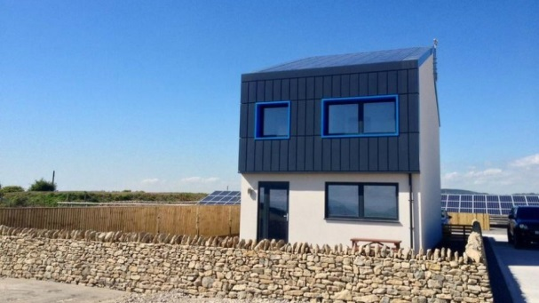
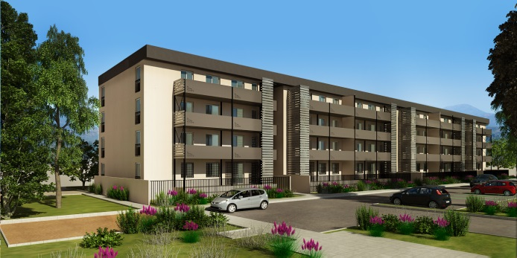
Case Studies Housing Developments
Pobl
South Wales
Buildings as power stations
WeLink
Liverpool
Low carbon
HAB Housing
Bristol
Passivhaus

Slide 5
Budget & Timelines
Project budget: up to £1.4 million + VAT
3 year project: ~March 2017 to March 2020
Invitation to tender due mid-February

Slide 6
Outline Project Stages
Stage 1
Establish research time lines
Stage 2
Understanding drivers, barriers, attitudes and challenges
Stage 3
Practical implications through the build process
Stage 4
Stage 5
Cost and energy performance of LoCoLoCO2
Dissemination

Slide 7
Establish research time lines
Stage 1
Overview:
Produce research project plan
Identify stakeholders to be involved in research, including those involved in:
Planning stage, e.g. local authorities, developers, housing associations
Design stage, e.g. architects, main contractors, surveyors
Build stage, e.g. builders, trade professionals
Occupancy
Key Skills:
Project management
Relationship management

Slide 8
Understanding drivers, barriers, attitudes and challenges
Stage 2
Overview:
Views of stakeholders on low-cost, low-carbon homes
How can we increase uptake?
What are the barriers?
What are the differences between traditional builds?
What are the skills & competencies required?
What are the cost drivers?
Key Skills:
Social research
Stakeholder engagement
Knowledge of building sector

Slide 9
Practical implications through the build process
Stage 3
Overview:
Are the homes being built as designed?
What is the impact of low-carbon technologies?
What is the fabric performance of these homes?
Key skills:
Knowledge of quality & build standards
Social research
Knowledge of building fabric testing
Understanding of low-carbon technologies

Slide 10
Cost and energy performance of LoCoLoCO2
Stage 4
Overview:
How do low-cost, low-carbon homes perform?
What are the reasons for this performance?
How do they compare to traditional homes?
How do occupants respond to low-cost, low-carbon homes?
What are the wider impacts of low-cost, low-carbon homes?
Key skills:
Social research
Home energy monitoring
Knowledge of low-carbon technologies

Slide 11
Dissemination
Stage 5
Overview:
Dissemination across relevant stakeholders
Traditional methods
Innovative methods
Key Skills:
Stakeholder engagement
Communication
Understanding of building sector

Slide 12
Summary
Summary
Project budget: up to £1.4 million + VAT
3 year project: ~March 2017 to March 2020
Invitation to tender due mid-February
Housing Developments
HAB
Pobl
Welink
Stage 1
Establish research time lines
Stage 2
Understanding drivers, barriers, attitudes and challenges
Stage 3
Practical implications through the build process
Stage 4
Stage 5
Cost and energy performance of LoCoLoCO2
Dissemination

