Slide 1
Delivery of the Teacher Sabbatical Pilot
Tuesday 9th October – 3.30pm
Please note that by undertaking this initial market engagement we are not committing to proceed to a formal procurement but all the information gathered will feed into an options appraisal to agree the preferred approach. Depending on the outcome of this initial market engagement, the DfE reserves the right not to continue to a formal tender process.

Slide 2
Agenda
Agenda Item | Lead person
Introduction | Rebecca Rylatt
The story so far | Chris Biggs
The Teacher Sabbatical Pilot | Chris Biggs
The key challenges | Alisha Hubert
Commercial headlines | Karen Barber
Process and timeline | Karen Barber
Next Steps and Questions | Chris Biggs

Slide 3

Who we are
The Department for Education (DfE) is responsible for education, children’s services, higher and further education policy, apprenticeships and wider skills in England.

Slide 4
Introduction to the team
Chris Biggs – Project Lead
Rebecca Rylatt – Team Leader
Alisha Hubert – Project Support
Karen Barber – Commercial Business Partner

Slide 5
Market engagement objectives
Awareness raising
Market intelligence
Feasibility
Informing the design of the pilot

Slide 6
The story so far
On 15 December 2017, we launched our consultation on ‘strengthening Qualified Teacher Status (QTS) and improving career progression for teachers’. The consultation closed on 9 March 2018 and a government response was published on 4 May 2018.
Part 1
Extended induction period of two years
Development of an early career framework
Strengthened mentoring provision
Part 2
Development of new specialist qualifications
Setting up a work-related sabbaticals pilot for experienced teachers

Slide 7
The Teacher Sabbatical Pilot
Our key principles
Focus on experienced, classroom teachers – who have been in the profession for at least 10 years
Mutual benefits – benefiting both the school and their teacher
Minimal burden on schools
Flexibility – exploring a range of different sabbatical durations
Do you think that a fund to pilot sabbaticals would be a positive step for the profession?

Slide 8
 | Week 1 | Week 2 | Week 3 | Week 4 | Week 5 | Week 6 | Week 7 | Week 8 | Week 9 | Week 10 | Week 11
Teacher
School
Sabbatical Providers
Contractor
DfE
Evaluator
Application Round One
Teacher submits registration
Teacher notified of outcome
Teacher submits application
Teacher & School notified
Teacher and LM agreement on developmental objectives
School approves application
No
Yes
Yes
Is teacher successful?
Yes
Does SP approve appointment?
Does SP approve appointment?
No
Further info requested
No
Advertise for initial registration by teachers
Contractor reviews registration
Guidance and application pack for teachers issued
Further info shared with SP
Matching process
Update
Update
Details of unsuccessful applicants shared
Details of successful and unsuccessful applicants shared

Slide 9
 | Week 11 | Week 12 | Week 13 | Week 14 | Week 15 | Week 16 | Week 17 | Week 18 | Week 19 | Weeks 20 - 24
Teacher
School
Sabbatical Providers
Contractor
DfE
Evaluator
MoUs signed
Pre-sabbatical activity
Teacher – SP pre-meet
Sabbatical starts
Check-in
SP - Teacher pre-meet
Sabbatical provider transfers funds to contractor
Check-in
Guidance circulated to stakeholders
Contractor receives MoUs
Funds paid to school
Check-in
Update from contractor
Update from contractor
DfE transfers funds to contractor

Slide 10
 | Week 25 | Week 26 | Week 27 | Week 28 | Week 29 | Week 30 | Week 31 | Week 32 | Week 33 | Week 34
Teacher
School
Sabbatical Providers
Contractor
DfE
Evaluator
End of sabbatical
Follow-up activity
Pre-return to school meeting
Report on sabbatical
Sabbatical provider transfers funds to contractor
Report on sabbatical
Follow-up activity
Funds paid to school
Reports reviewed
Update from contractor
DfE transfers funds to contractor
Update from contractor
Reports reviewed

Slide 11
The key challenges
Managing expectations
Securing release of teachers
Funding pressures
Securing sabbatical providers
Measuring success
Designing appropriate eligibility criteria

Slide 12
Commercial headlines
- Single stage ‘Open Procedure’ procurement​
- No opportunity for negotiation​
- Contract to be awarded in February / March 2019​
- Two (2) year contract with option to extend by a further two (2) years (subject to approval)
​
- Four (4) week mobilisation process​
- Service starts in April 2019

Slide 13
Stages of the bidding process – Open Procedure
Bidders submit ITT response/proposal including costings
Desktop evaluation of bidders’ written responses, including moderation & clarification
Final moderation
Notification of results and feedback
10 day standstill period
Contract award
Commencement of Contract
Competition Stages

Slide 14
Invitation to Tender (ITT)
Competitive tendering process in which suppliers are invited to submit sealed bids for the supply of specific and clearly defined services during a specified timeframe.
Bidders will prepare a bid and complete the standard supplier questionnaire (SSQ).
Pre-defined scoring criteria will determine the outcome.
Scoring criteria will be based on “most economically advantageous tender” (“MEAT”), an evaluation methodology based on a balance of Technical (Quality) and Price.

Slide 15
Contract Award
DfE will be carrying out a desktop evaluation of bids to determine whether or not bidders will be eligible for a contract award.
Notice of intent to award.
A mandatory standstill period of 10 days will take place.
Contract Award.
Successful supplier should be ready to deliver the service from April 2019.

Slide 16
Approximate timeframe
Date | Activity*
October 2018 | Market engagement event / RFI deadline
Late November 2018 | Invitation to Tender is published
Early January 2019 | Bids to be submitted
January / February 2019 | Assessment of bids
Late February / Early March 2019 | Contracts awarded
April 2019 | Delivery to commence
*All activity is also subject to approval and funding being available.

Slide 17
DfE e-Procurement system ‘Bravo’
Before you can access anything on the DfE e-tendering portal you will need to register on to Bravo
This registration takes a matter of minutes
You start by accessing https://education.bravosolution.co.uk
This takes you to the following screen

Slide 18
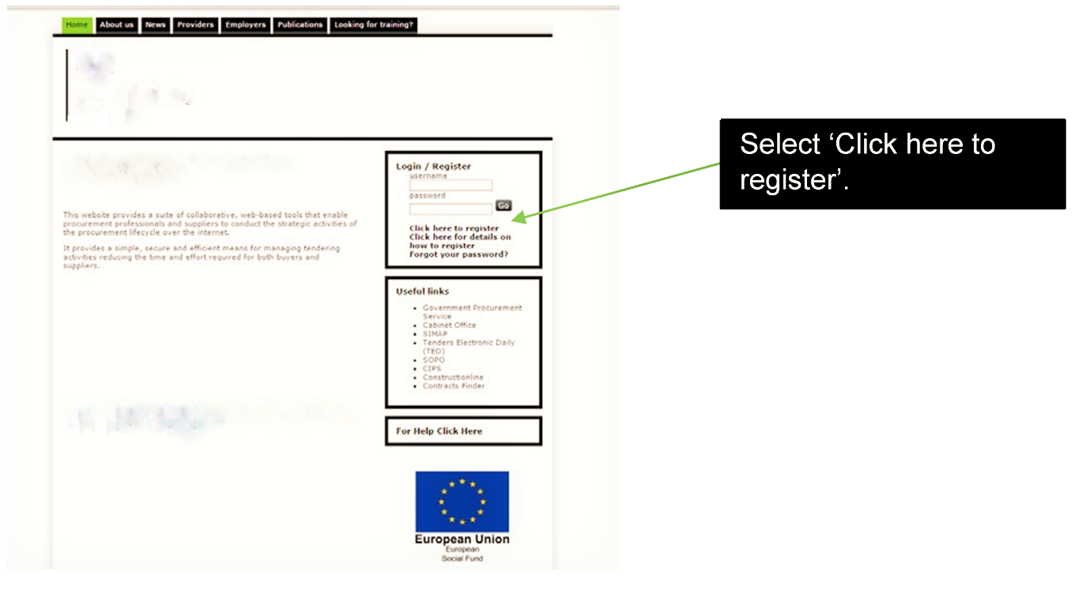
Bravo registration screen

Slide 19
What organisations must not do
Canvas help, assistance or opinion on the tender or the procurement process in general from any DfE employee or other Government Department, Agency or NDPB other than through the e-Tendering portal message board.
Submit a partially completed tender as this will not be evaluated.
Submit a tender after the closing date and time as this will not be considered.

Slide 20
Next steps - RFI
The DfE has made available a Teacher Sabbatical Pilot Request for Information (RFI) on Contracts Finder with the purpose and aim of:
Seeking opinion from potential providers to assist in finalising our procurement strategy.
Receiving responses from potential providers of the pilot on the impacts that the design of the pilot may have.
Gauging the level of interest in the tender to deliver the pilot.
The RFI can be accessed via the PIN notice: https://www.contractsfinder.service.gov.uk/Notice/0fd09a39-6bf0-4ebc-b80c-a70cda303ea8
Completed questionnaires should be returned via the sabbatical.pilot@education.gov.uk email address by 6:00pm on Tuesday 16th October 2018:
Please note: This is not an invitation to bid, this is solely a RFI and no direct business will be awarded as a result of completing this RFI. Responding to this document does not advantage or disadvantage any supplier in a future procurement process. No supplier selection or supplier preference is implied.

Slide 21
Next steps - General
Further information will be made available on contracts finder after this event, including:
The market engagement slides
Q&A response pack (by Friday 12th October)
Please register on Bravo Solution to be kept up to date on ITT developments. For any assistance with the portal, bidders should contact the Bravo helpdesk: help@bravosolution.co.uk
Contact us at: sabbatical.pilot@education.gov.uk if you have any questions. Please note, once the procurement is open for competition all communication is to be directed through the Bravo Solution portal.

Slide 22


