Slide 1
The National Institute for Health
Research
Dr. Kay Pattison

Slide 2
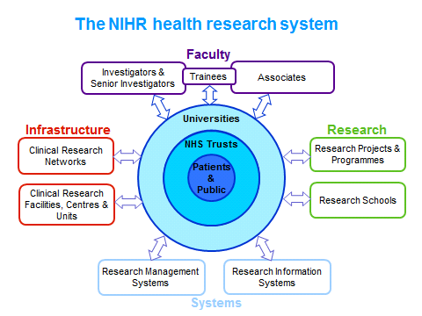

Slide 3
The Central Commissioning Facility
(CCF)
The CCF will manage a total portfolio spend of about £366M a year and is a critical component of the NIHR

Slide 4
The CCF will provide commissioning and management support services for the following:
  NIHR and DH Research Programmes
  NIHR and DH Research Infrastructure
  NIHR Research Schools
  NIHR Research Support Services and
  NIHR Hosted Services.

Slide 5
The CCF will manage the following research programmes :
NIHR Programme Grants for Applied Research
Research for Patient Benefit
NIHR Invention for Innovation
NIHR Health Protection Research Units

Slide 6
The CCF will manage the following research programmes (contd.) :
NIHR Blood & Transplant Research Units
Health Innovation Challenge Fund
NIHR Research Design Service
NIHR Horizon Scanning Research & Intelligence Centre (HSRIC)

Slide 7
The CCF will manage the following research infrastructure:
Biomedical Research Centres and Biomedical Research Units
Collaborations for Leadership in Applied Health Research and Care
Patient Safety Translational Research Centres
Clinical Research Facilities for Experimental Medicine

Slide 8
The CCF will manage the following research infrastructure (contd.):
Healthcare Technology Co-operatives
Diagnostic Evidence Co-operatives
NIHR Translational Research Collaborations
DH Designated Academic Health Science Centres

Slide 9
The CCF will manage NIHR research schools:
The NIHR School for Primary Care Research
The NIHR School for Social Care Research
School for Public Health Research

Slide 10
The CCF will provide the following research support services:
Patient and Public Involvement
NIHR Faculty
Intellectual Property Unit

Slide 11
The CCF will provide the following research support services (contd.):
Performance in Initiating and Delivering Clinical Research
High-level Management Support for DH Research Networks, Clinical Research Facilities, and Cancer Research working, and reporting to DH

Slide 12
The NIHR Evaluations, Trials and Studies Coordinating Centre (NETSCC)

Slide 13
NETSCC is a critical component of the NIHR and provides support for Programmes of research with a total spend of £137M a year.

Slide 14
NETSCC will provide identification, prioritisation, commissioning and management support services for the following:
Efficacy and Mechanisms Evaluation (EME) Programme
Health Services and Delivery Research (HS&DR) Programme
Health Technology Assessment (HTA) Programme

Slide 15
NETSCC will provide identification, prioritisation, commissioning and management support services for the following (contd.):
Public Health Research (PHR) Programme
Systematic Reviews (SR) Programme
NIHR Clinical Trials Unit (CTU) Support Funding

Slide 16
NETSCC will provide the following research support services:
Patient and Public Involvement
Evaluation of Impact
Journals Library Series
NIHR Meetings Organiser
Research on Research
James Lind Alliance

Slide 17
Challenges
identifying and prioritising research of relevance,
accessing skilled researchers,
obtaining sufficient numbers of peer reviewers to assess proposals,
speed versus quality of operation,
ensuring efficiency of administration,

Slide 18
Challenges (contd)
ensuring compliance with good research governance,
establishing appropriate reporting systems,
involving patients and the public in all aspects of the research process,
handling policy sensitive research,
managing potential conflict of interest

Slide 19
The NIHR Office for Clinical Research Infrastructure
(NOCRI)

Slide 20
NOCRI is an important element of the NIHR. It exists to:
champion, support and maximise the coordinated working of the Department of Health’s £0.5bn/year investment in research infrastructure in the NHS; and

Slide 21
NOCRI also helps: -
  other public,
  industry and
  charity research funders
navigate this infrastructure.

Slide 22
NOCRI will:
promote economic Growth by promoting and enhancing the nation’s reputation as a world-class centre for early translation (experimental medicine), clinical and applied clinical research

Slide 23
NOCRI will also:
be a unique resource for the global life sciences industry - sign posting to and improving the quality, efficiency and success of translational research

Slide 24
NOCRI will (Cont’d)
facilitate collaborations between NIHR-funded infrastructure and funders of research, maximising NIHR’s impact
manage and facilitate NIHR Translational Research Partnerships and Collaborations

Slide 25
NOCRI will (Cont’d)
provide seamless and rapid links to the NIHR's Clinical Research Network for appropriate research/collaborations
provide analyses, intelligence and information on NIHR research infrastructure

Slide 26
Challenges:
understanding the NIHR-funded research infrastructure and identifying expertise, capacities and capabilities in order to facilitate and catalyse research collaborations
developing and managing productive relationships with industry, charity and public health research funders to support NOCRI’s objectives

Slide 27
Challenges cont’d:
ensuring coordination of and delivery of NIHR Translational Research Partnerships’ and Collaborations’ research
ensuring seamless working with other components of the NIHR to ensure that contract and collaborations research opportunities identified to NOCRI are progressed efficiently and effectively for patient benefit and health and wealth of the nation.

