Slide 1
Eat Well Market Engagement Workshop
13th December 2018

Slide 2
The Core Service
Development of a food offer in each cluster
Delivered Meal Service
365 days per year
welfare checks
failsafe for people
SCC Extra Care/Sheltered Housing schemes
365 days per year
provided in designated settings (Erskine Court, Potters Court, Weston Court)
Some aims of the Eat Well Service
increase number of people eating together (reduce loneliness)
reduce malnutrition (as per number of people diagnoses by UHS)

Slide 3
Understanding the Issues of good nutrition and hydration
Historical influence
Retirement/bereavement
Age related conditions
Food environment
Access to food
Psychological/Personal
Social engagement

Slide 4
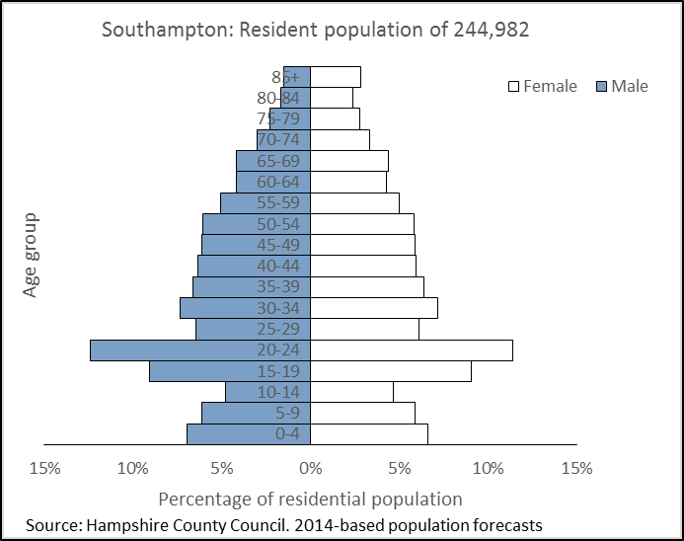
Southampton
Over 65 population is set to increase by over 15%,
between 2015 and 2021 (to 39,800 people)
Over 85 population set to increase by over 20%,
Proportion of the total Southampton population over 65 will also increase over this time.

Slide 5
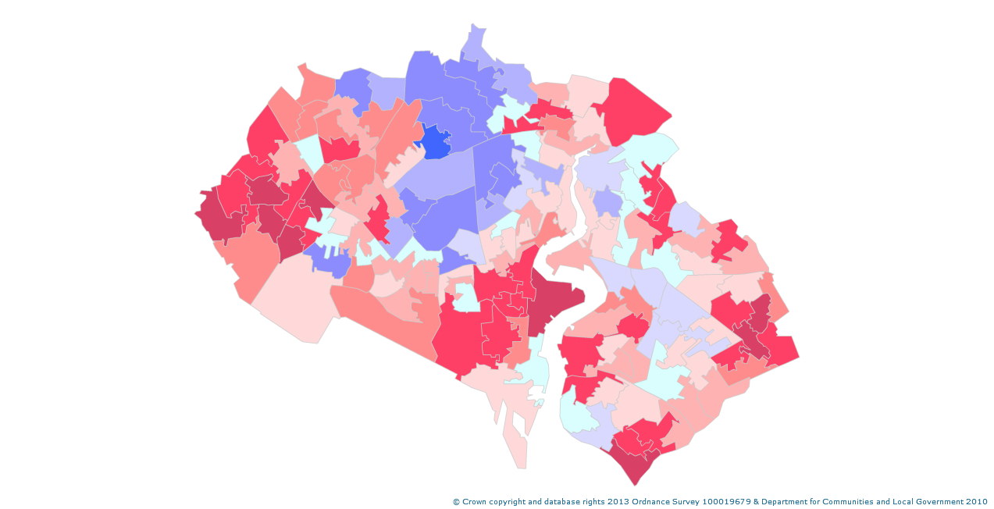
Deprivation
Dark Red = Higher levels
Characteristics of a northern city
Loneliness
Dark Green = Higher levels of risk

Slide 6
The Need
Malnutrition is common in the UK, affecting more than three million people at any one time.
Around 1 in 3 patients admitted to acute care will be malnourished or at risk of becoming so, and 35 percent of individuals admitted to care homes will also be affected.
In addition 93 percent of those at risk of, or suffering from malnutrition will be living in the community.
The scale of dehydration in the UK is unknown but is associated with a number of known causes of harm to people.
There is very limited data available on the specific needs of people in Southampton, many focuses on Obesity.
The cost for disease-related malnutrition for health and social care expenditure is more than £13 billion. (Elia and Russell for BAPEN, 2009).

Slide 7
What's on offer to people now?
Meals on Wheels
Home Delivered Meals
Shops & Online Shopping
Luncheon Clubs
Extra Care Restaurants
& Sheltered Housing
Southampton Living Well Service
(day services)
Domiciliary Care
Initiatives to help families (free school meals during holidays)
Food Banks
Homeless schemes
Dietetic Team
In the hospital and community

Slide 8
Considerations for a Service Model
Lead provider for the City
Concession type contract approach
Financial benefits & risks with operator
Meals for eligible customers and provide at a discounted rate without VAT being applied.
Provider to access to kitchens across the council (extra care & sheltered housing schemes & civic centre) at a fixed cost
Working alongside existing commissioned services
Southampton Living Well (Affiliate Scheme)
Healthy Southampton (Behaviour change)

Slide 9
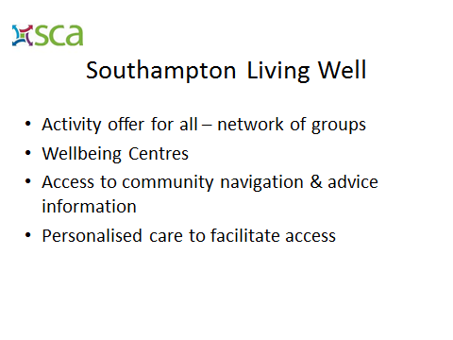
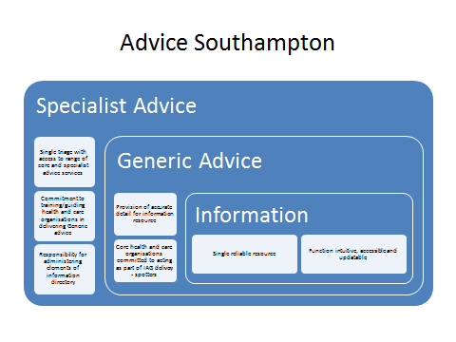
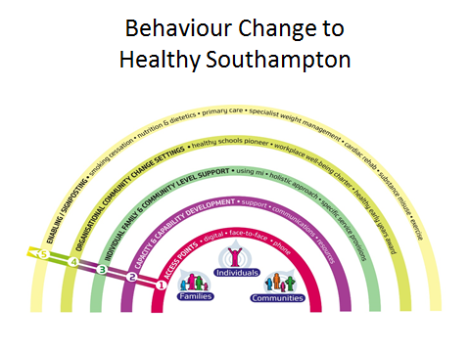
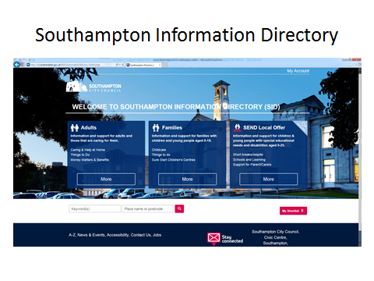
Developing an Eat Well Service
Community Development
&
Community Navigation
Local Solutions Groups

Slide 10
What are the positive aspects of the Eat Well service specification? What improvements/concerns to you have with the service specification?
In Groups

Slide 11
In Groups
Economic Model?

Slide 12
Indicative Timescales
Stage | 2019 Dates
Evaluation of feedback from the ‘Request for Information’ and todays event | Week 1 and 2 January
Advertise the tender opportunity (subject to approvals) on Contracts Finder and the Curtis Fitch Tender Portal | Week 4 January
Submission of Offers | Week 4 February
Evaluation of Offers | Week 4 February/ Week 1 March
Notification of result of evaluation | Mid-March
Mobilisation | Late March/April

Slide 13
Next Steps
Closing Date on Contracts Finder 20th December 2018 Completion and submission of Requests for Information Todays presentation will be attached to the Contracts Finder notice Some feedback will be attached to the Contracts Finder notice

