Slide 1
Supplier information session
Support for development of a rail industry cyber security strategy
Presented by Maria Grazia Vigliotti

Slide 2
Introduction to RSSB
RSSB is a membership organisation in the railway
RSSB brings different organisations together to make collective decisions about:
  Safety and
  Technical standards.
On the behalf of the railway industry RSSB manages
  Innovation and
  R&D projects

Slide 3
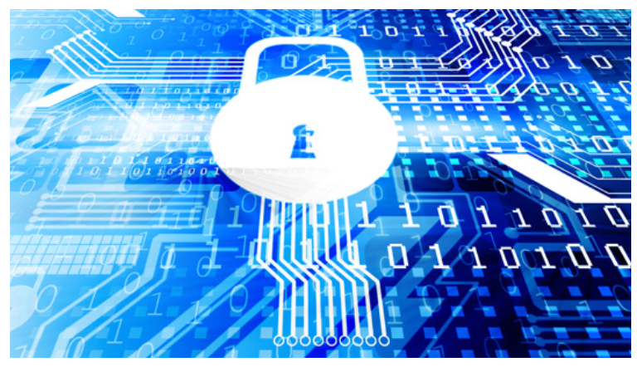
Cyber security in the railway
The Centre for Protection of National Infrastructure (CPNI) has asked RSSB to facilitate the production of an industry cyber security plan – this is supported by the DfT
Key requirements:
Industry involvement including TOCs, FOCs, ROSCOs, NR, BTP, DfT, ORR, CPNI
Completed in a short period of time (six months)
Notes:
DfT wrote to RSSB in March 2014 asking RSSB to work “with the industry to assess the need for rail-specific standards and guidance, covering both resilience measures and the processes and methods needed to manage cyber security”. Being a new function for RSSB, the RSSB Board considered and supported this in May 2014. Through the cross-industry High Integrity Systems Group RSSB has so far fulfilled this request through the provision of guidance on the RSSB website, taken from the DfT’s rail cyber security guidance.
Further discussions have taken place, including CPNI, and an industry cyber security plan has been requested.
For this to have impact and benefit it needs cross-industry support, including BTP, ORR, DfT, suppliers and CPNI
Operational railway systems includes control systems such as signalling, SCADA, CCTV, etc.
Railway management systems includes shared ticketing systems, TOPS, TRUST
Business systems includes company (owning group) back-office systems
Scope could allow for opt-in or opt-out of parts.
Cyber security is a complex subject that exposes companies to risk. The cost of mitigating this risk could be significant for some players. Therefore an approach that shares cost and more effectively mitigates the risk is worthwhile. RSSB can bring the industry together to help determine the most suitable approach in an efficient and effective manner

Slide 4
Outline content of the strategy
Strategy will contain:
A set of goals that the strategy will implement
A set of prioritised activities required to be undertaken in [Rail Industry] Control Period 5 (CP5, 2014-2019) and CP6 (2019-2024)
Roles and responsibilities for stakeholders
The cost of the activities and sources of funding to implement the cyber security strategy
Governance principles for the cyber security strategy

Slide 5
Development of the strategy
The work will start in February
Governance for development of the strategy:
Cross-industry Advisory Group (AG): steers the themes of the strategy
  It meets every two weeks
  It takes informed decisions on the content of the strategy
Drafting Group: writes the strategy following the decisions and the steers from the AG (meet roughly every two weeks)
Notes:
Strategy (from Greek στρατηγία stratēgia, "art of troop leader; office of general, command, generalship"^{[1]}) is a high level plan to achieve one or more goals under conditions of uncertainty. In the sense of the "art of the general", which included several subsets of skills including "tactics", siege craft, logistics etc., the term came into use in the 6th century C.E. in East Roman terminology, and was translated into Western vernacular languages only in the 18th century. From then until the 20th century, the word "strategy" came to denote "a comprehensive way to try to pursue political ends, including the threat or actual use of force, in a dialectic of wills" in a military conflict, in which both adversaries interact.^{[2]}
Strategy is important because the resources available to achieve these goals are usually limited. Strategy generally involves setting goals, determining actions to achieve the goals, and mobilizing resources to execute the actions. A strategy describes how the ends (goals) will be achieved by the means (resources). The senior leadership of an organization is generally tasked with determining strategy. Strategy can be intended or can emerge as a pattern of activity as the organization adapts to its environment or competes. It involves activities such as strategic planning and strategic thinking.^{[3]}

Slide 6
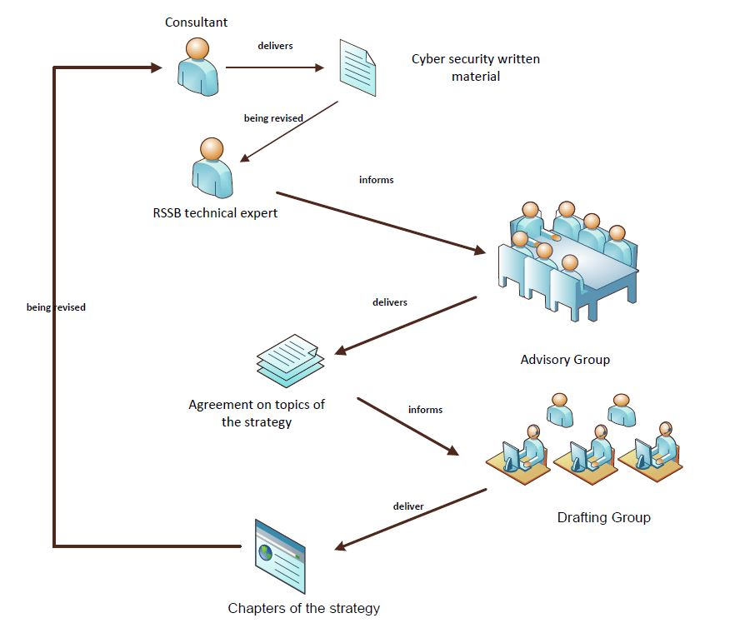
Workflow diagram

Slide 7
Deliverables
Each meeting will have a different topic to be considered by the AG:
Structure and scope of the strategy
Goals of the strategy
Risk based approach
Developing high level architectures for
Rolling Stock
CCS
Energy
Stations and infrastructure

Slide 8
Deliverables (cont.)
Security processes for human behaviour and training
Resilience (detect/report/respond and recover)
Funding and costs of the activities
Governance of the strategy
Revision of the work

Slide 9
Whom we are looking for?
Somebody who has:
Detailed knowledge in cyber security principles (and standards)
Knowledge/experience of writing industry strategies
Somebody who can:
Assess in an abstract way very large heterogeneously connected systems
Deliver high level architecture of the current digital systems in use in GB railway
Perform research/assessment to related areas of security such as the interplay between safety and security
Deliver clear and concise written documents containing sound and principled cyber security recommendations
Manage senior stakeholders

Slide 10
Procurement Process
Draft procurement timeline:
Request for proposal documentation will be advertised on contracts finder.
All clarification questions will be uploaded onto contracts finder for other suppliers
to view.
 | Start Date
Market Engagement Event | 10th December 2015
RFP issued | W/C 21st December 2015
Supplier clarification questions deadline | 11th January 2016 @ 12.00 Noon
Deadline for Submitting Tenders | 15th January 2016 @ 15.00 hours
Tender Evaluation | W/C 18th January 2016
Supplier Interviews | W/C 1st February 2016
Estimated notification of award decision | 5th February 2016
Target contract commencement date | W/C 15th February 2016

Slide 11
QUESTIONS?

Slide 12
What a good bid looks like?
A good bid shows that:
The supplier has understood the requirements
There is a clear plan on how to deliver the outputs
The skills and experience of the consultant are clearly linked to the deliverable
The supplier has understood the risks, and identified new ones, in the project, and there is a clear mitigation plan in place
Daily rates are clearly justified

