Slide 1
Services to maximise take-up of DfE's 2-year-old entitlement and deliver business support to early years providers Market warming brief Tuesday 6 October 2020 The Session will start at 3pm. Please ensure your camera is switched off and your microphone is muted.

Slide 2
Ground rules
Information in these slides is for the purpose of the upcoming tendering exercise. Full details will be set out in the Request for Quotation (RFQ).
The specification and timeline may be subject to change prior to the launch of the tendering exercise.
Not for wider use or dissemination without the express permission of the Department for Education.
Please enter your questions in the side bar and we will answer as many as we can in the Q&A session. Any questions we are unable to answer will be followed up within 48 hours via a Q&A document.
Notes:
To be aware, we’re pursuing this procurement at the moment but things may change subject to ministerial priorities. The entitlements are a significant part of the Department’s agenda and a significant offer to parents. We don’t anticipate that changing over the course of the procurement but we do just need to caveat the possibility.

Slide 3
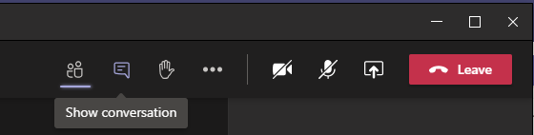
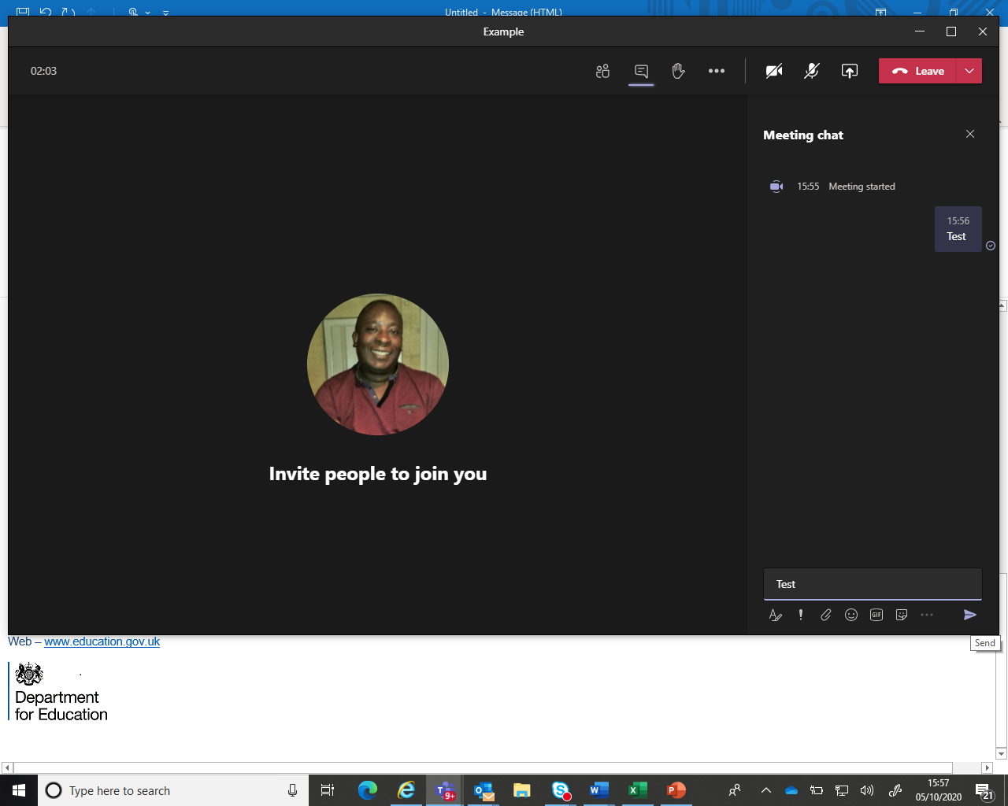
Ground rules
You can access the sidebar by clicking on the following icon at the top of the screen:
Once in the side bar please type your question in the box at the bottom of the page on the right-hand side. Please either click on the 'send' icon or press enter. Please type and send the message ‘Test’ to ensure the facility is working for you:
Notes:
To be aware, we’re pursuing this procurement at the moment but things may change subject to ministerial priorities. The entitlements are a significant part of the Department’s agenda and a significant offer to parents. We don’t anticipate that changing over the course of the procurement but we do just need to caveat the possibility.

Slide 4
Session outline
15:30 – Introduction of DfE staff
15:35 – Presentation
16:05 – Commercial Process & Timetable
16:15 – Q&A
16.30 – Close
Notes:
Housekeeping: refreshments, toilets and fire drills

Slide 5
Session purpose
DfE is seeking to procure a supplier(s) to:
(Lot 1) support delivery of the Early Education for 2-year-olds entitlement by local authorities (LAs); and
(Lot 2) promote provider sustainability and childcare sufficiency by offering business advice to childcare providers and developing the business support skills of LA officials.
4/5-month contract duration – November 2020 – March 2021.
Contract value of up to £250,000 inc VAT– split into two separate lots.
Notes:
Extension: ideally we would look to a 1+1+1 or a 1+2 model, however we can’t make any commitment about that at the moment as it will be contingent on the next spending review. Any extension would, of course, also be based on performance.

Slide 6
Session purpose
This market warming session will:
Provide context around delivery of the 2-year-old entitlement.
Provide an initial overview of the aims and requirements of the services we are seeking to procure.
Explain the bidding process.
Give you the opportunity to ask questions about the procurement.
Notes:
Extension: ideally we would look to a 1+1+1 or a 1+2 model, however we can’t make any commitment about that at the moment as it will be contingent on the next spending review. Any extension would, of course, also be based on performance.

Slide 7
1. Background to the entitlements

Slide 8
Delivering the entitlements
The DfE offers 3 Early Years Entitlements for parents:
15 hours entitlement for disadvantaged 2-year-olds (‘2-year-old entitlement’)
Universal 15 hours for all 3- and 4-year olds (‘Universal entitlement’)
Additional 15 hours for some 3- and 4-year olds (‘30 hours’)
To enable the DfE and LAs to meet the different policy objectives of each of the entitlements, statutory requirements are set out in the following legislation:
The Childcare Act (2006)
The Childcare Act (2016)
The DfE also provides statutory and operational guidance to LAs.
Notes:
There is a wide range of early years entitlements, some of which are owned by other departments (e.g. Tax-Free Childcare under HMRC, UC childcare allowances under DWP). This contract is predominantly concerned with those entitlements owned by the DfE but there will inevitably be some crossover and our contractor would need to be aware of how these interact with the bigger early years picture. For the purposes of this presentation we will focus on these three.
Each of the entitlements has specific policy objectives and we will look at these in more detail during the presentation.
Early education and care has been shown to have a range of developmental and social benefits for participating children. This is particularly true for children from disadvantaged backgrounds, who stand to benefit the most but whose families are often the hardest to engage.
If the entitlements are not delivered effectively, there is a risk that eligible children will miss out on the best possible start in life.
Not only is effective delivery the ‘right thing to do’ (because failing to deliver could lead to children missing out on the best possible start in life), we also have a legal obligation to deliver.
Childcare offer
Age of eligible child
Family circumstances
DfE: 15 hours for disadvantaged 2 year olds
2
Parents must be in receipt of state support and earning below £15,400 (UC) and £16,190 (TC)
Low income
DfE: Universal 15 hours for 3 and 4 year olds
3-4
All parents of 3 and 4 year olds are eligible
DfE: 30 hours for working parents for 3 and 4 year olds
3-4
Parents must work equivalent of at least 16 hours at NMW per week
Mid – high income
Earnings below £100k per year
DWP: Universal Credit: Childcare element
0-16
Parents must be in work
Low – mid income
No minimum limit on earnings or hours worked.
Max per month of £646/child or £1,108 for two children
HMRC: Tax-Free Childcare
0-12
Parents must work equivalent of at least 16 hours at NMW per week
Mid – high income
Earnings below £100k per year
Max support: £2,000 per year per child

Slide 9
Legislation & statutory duties
Childcare Act (2006) | Childcare Act (2016)
Duty on English local authorities to secure sufficient childcare for working parents. Duty on English local authorities to secure early years provision free of charge. Type and amount of free provision and the children who benefit from free provision. Provision about how local authorities should discharge their duty. Limits on the requirements local authorities can impose when they make arrangements to deliver early education places for 2-, 3- and 4-year-olds. Duty on English local authorities to provide information, advice and assistance to parents and prospective parents. Secretary of State able to make regulations placing a duty on English local authorities to publish certain information at prescribed intervals. Duty on English local authorities to provide information, advice and training to childcare providers. | Duty on the Secretary of State to secure the equivalent of 30 hours of free childcare over 38 weeks of the year for qualifying children. Children in England will qualify if they are under compulsory school age and meet the description set out in regulations. Regulations set out the conditions to be met by parents in order for their children to qualify. Allows the Secretary of State to discharge their duty by placing a duty on English local authorities to secure free childcare for qualifying children.
Notes:
Here you can see the statutory duties set out in the Childcare Act 2006 and 2016. We have pulled out the key points in bold. Our contractor’s work will support all aspects of delivery against these duties.
Childcare Act (2006):
Section 6, which places a duty on English local authorities to secure sufficient childcare for working parents.
Section 7 (as substituted by section 1 of the Education Act 2011), which places a duty on English local authorities to secure early years provision free of charge. Regulations made under s7 set out the type and amount of free provision and the children who benefit from free provision.
Section 7A (as inserted by the Children and Families Act 2014). Regulations made under section 7A make provision about how local authorities should discharge their duty under section 7.
Section 9A (as inserted by the Children and Families Act 2014). Regulations made under section 9A limit the requirements local authorities can impose when they make arrangements to deliver early education places for two-, three- and four-year-olds.
Section 12, which places a duty on English local authorities to provide information, advice and assistance to parents and prospective parents. Section 12 is amended by section 5 of the Childcare Act 2016 to enable the Secretary of State to make regulations placing a duty on English local authorities to publish certain information at prescribed intervals.
Section 13, which places a duty on English local authorities to provide information, advice and training to childcare providers.
Childcare Act (2016):
Section 1, which places a duty on the Secretary of State to secure the equivalent of 30 hours of free childcare over 38 weeks of the year for qualifying children. Children in England will qualify if they are under compulsory school age and meet the description set out in regulations made under Section 2. These regulations also set out the conditions to be met by parents in order for their children to qualify.
Section 2, which allows the Secretary of State to discharge their duty under section 1 of the Act by placing a duty on English local authorities to secure free childcare for qualifying children. This duty is set out at regulation 33 of the Childcare (Early Years Provision Free of Charge) (Extended Entitlement) Regulations 2016

Slide 10
2-year-old entitlement
Policy intent: to prepare disadvantaged children for school and improve their life chances; to narrow the development gap between disadvantaged and advantaged children.
The 2-year-old entitlement has been available nationally to disadvantaged 2-year-olds since September 2013:
Provision equates to 15 hours for 38 weeks per year but can be ‘stretched’.
2-year-olds are eligible for 570 hours of free early years provision:
If the parents are in low income employment or in receipt of specific benefits including out of work benefits and low income support.
where the child has a statement of Special Educational Needs or is in receipt of Disability Living Allowance.
where the child is Looked After by the local authority or is no longer Looked After as a result of an adoption order, special guardianship or a child arrangement order.
if they have certain immigration statuses.
This entitlement supports school readiness and bridging the learning gap between this group and their more advantaged peers.

Slide 11
Universal entitlement
Policy intent: to prepare children for school and improve their life chances, support parents to move into work and support families with the cost of living.
The universal entitlement for 15 hours of early learning, has been available since 2010:
All 3- and 4-year-old children in England are entitled to a universal offer of 570 hours a year.
Provision equates to 15 hours for 38 weeks per year but can be ‘stretched’ over more weeks.

Slide 12
30 hours
Policy intent: to support more parents to move into work, or to work more hours should they wish to do so, and to support families with the cost of living.
Since September 2017, 30 free hours of childcare has been available to 3- and 4-year-olds of eligible working parents:
This is an additional 15 hours per week on top of the universal entitlement of 15 hours of free childcare for parents of all 3- and 4-year-olds;
The entitlement is delivered 30 hours per week up to a maximum of 38 weeks a year, or 570 hours stretched across more weeks of the year, totalling 1,140 hours.
Eligibility is based upon both parents working in a couple household, or a single parent working in a lone parent household, with minimum and maximum income thresholds applied (including those on zero hours contracts and self-employed workers, and parents on sickness or caring benefits).
Notes:
If needed can explain how parents apply - Parents apply to HMRC via the Childcare Service found at <www.childcarechoices.gov.uk> and if eligible, were given a code which their chosen childcare provider validates with the local authority before a place is taken up.
Families where both parents are working (or the sole parent is working in a lone parent family), and each parent earns, on average, a weekly minimum equivalent to 16 hours at national minimum wage (NMW) or national living wage (NLW), and less than £100,000 per year.
Working will include employed and self-employed persons.
Parents do not necessarily need to actually work 16 hours a week, but rather their earnings must reflect at least 16 hours of work at NMW or NLW, which is £107 a week at the current NMW rate.
This includes those parents on zero contract hours who meet the criteria.

Slide 13
LA delivery: what we know about take-up
We want to build and improve on the successful delivery of these existing free entitlements. At the January 2020 census point, it was reported that:
1,271,544 3- and 4-year-olds (94%) including those in reception places benefited from the universal 15 hours of funded early education
143,400 two-year-olds (69%) from the most disadvantaged families have benefitted from funded early education
345,704 children benefited from the extended entitlement for some 3-and 4-year-olds (30 hours).

Slide 14
LA delivery: COVID-19
COVID–19 has severely disrupted take up of the 2-year-old entitlement and presented childcare providers with a number of challenges.
March 2020 - only children of critical workers and vulnerable children were able to access childcare, leading to some children missing out on their entitlement.
June 2020 - childcare was opened up to all children, however safe practice guidance was introduced to prevent the spread of the virus.
July 2020 - space limitations were eased, however attendance was lower than normal for the time of year.
As a result of this, childcare providers have faced a drop in their income
A large number of disadvantaged 2-year-olds were unable to access their entitlement during the pandemic. Gaps in education at this age can have a detrimental effect of future life chances.
Notes:
We have started to see demand for childcare places increasing but they it is not yet back to pre-COVID-19 levels for a number of reasons:
Parental confidence to use childcare due to fear of infection
Less need for childcare as parents are working from home or are working fewer hours
LA resource redirected to other LA functions (e.g. brokerage) rather than 2-year-old entitlement outreach
Childcare staff on furlough has meant less capacity to cater for parental demand (sufficiency and flexibility).

Slide 15
2. Services to maximise take-up of DfE's 2-year-old entitlement and deliver business support to early years providers

Slide 16
Contract aims
Our contract will have two central aims:
Improving take-up of the 2-year-old entitlement (Lot 1)
Maximising take-up of the 2-year-old entitlement, so that as many eligible children as possible benefit from the advantages of early education and care.
Promoting provider business sustainability (Lot 2)
Delivering advice on sustainability to childcare providers and building the confidence of LA officials to have business support conversations with their local markets.
Our contractor(s) will be expected to work with a range of partners to support delivery of the Early Years Entitlements including:
The Department for Education (Early Years Entitlements Team; regional leads)
Local authority early years teams
Childcare providers
Family-facing professionals
Notes:
2YO take-up is expressed as a percentage of eligible children, as identified using lists of eligible children we receive from the Department for Work and Pensions.

Slide 17
Improving take-up of the 2-year-old entitlement (Lot 1)
Maximising take-up of the 2-year-old entitlement, so that as many eligible children as possible benefit from the advantages of early education and care
Our contractor will:
Work with LAs to support increased take-up of the 2-year-old entitlement.
Provide targeted intervention to 20 LAs with the lowest 2-year-old take-up rates, leading to improvement in confidence levels to maximise take-up of the entitlement.
Assist LAs in developing strategies to reach the least engaged families, and in mitigating the barriers preventing these families from accessing their entitlement to a free place.
Share best practice about ‘what works’ to improve 2-year-old take-up with the wider national community of 151 LAs, through 8 digital regional events and the Foundation Years website.
Notes:
Encouraging a greater number of providers to offer the 2YO entitlement.
Don’t want promotion of 2YOs to be at detriment of other DfE and OGD offers. Helping LAs, providers and family facing professionals to understand the best options for parents from the holistic package of offers. (Example of TFC in addition to free hours).

Slide 18
Provider business sustainability (Lot 2)
Delivering advice on sustainability to childcare providers and building the confidence of LA officials to have business support conversations with their local markets.
Our contractor will:
Promote good business practice to EY providers in light of COVID-19 and beyond.
Support LAs to engage with the childcare market and offer advice about financial sustainability.
Develop the content and host two webinars: one for childcare providers (business advice on sustainability) both through the COVID-19 pandemic and beyond; and another to build the confidence of LA officials to have business support conversations with their providers.
Provide mechanisms by which childcare providers can access training materials outside core business hours.
Provide free, digitally available accompanying products for the above events to support providers post-contract, which may include but are not limited to content on planning for financial sustainability, future-proofing businesses, and promoting resilience.
Notes:
Best practice: E.g. how to get the most from staffing ratios;
Flexibility: e.g. stretching the offer; how to work with other providers to ensure flexibility while maintaining a sustainable business model. Flexibility is key to working parents being able to access the entitlements- most complaints about sufficiency relate to flexibility rather than location.
SEND: The Government is committed to ensuring that all families have access to high quality, flexible and affordable childcare. We understand parents of disabled children too often experience problems accessing childcare.

Slide 19
General principles
The contract will be advertised as two separate lots:
Lot 1: Supporting LAs to maximising take up of the 2-year-old entitlement through good-practice webinars, targeted support and helping family-facing professionals to communicate the benefits of the entitlement to parents.
Lot 2: Providing business advice and resources to support childcare providers in creating sustainable business models during the COVID-19 pandemic and beyond, and building the confidence of LA officials to have business support conversations with their providers.
The contractor will deliver targeted intervention for to the 20 LAs with the greatest take-up challenges and generic support for all 151 LAs by sharing best practice of what works to LAs via digital regional webinars and the Foundation Years website.
As well as working with the DfE, LAs, providers and family-facing professionals, the contractor may be expected to engage with other organisations to maximise impact and avoid duplication e.g. PACEY - Together for Twos programme.
The Department is looking to receive bids that will provide value for money whilst providing innovative and flexible approaches to meet the aims of the contract.
The Department will consider bids from organisations for each lot and the contract will include a payment by results element linked to Key Performance Indicators.
Notes:
VFM and innovation: While we have a key list of functions we require from the contract, which I will go on to explain on the next slide, we are open to innovation in terms of how those functions can be delivered.
Other organisations: Example of childminding- engage with PACEY. NCB for SEND

Slide 20
Functions of the contract
Reporting: monthly contract reporting to DfE (completion of key deliverables and performance against KPIs).
Capability-building: Group events, one-to-one interventions and resource sharing for:
Lot 1
LAs: to address identified risks and issues and build confidence in monitoring and improving take-up.
Family-facing professionals: to encourage the effective sharing of messaging about the benefits of taking up the 2-year-old entitlement.
Project management: Dedicated resource to plan and manage the above activity.
Lot 2
Childcare Providers: to promote effective business planning in order to improve and provide sustainable business models.
LAs: to provide LA officials with confidence to offer their providers business support
Project management: Dedicated resource to plan and manage the above activity
Notes:
Intelligence gathering: A key point to stress here is that we are looking for sector expertise, which should be evidenced in bids. This is because we want to be able to support formal data collection with understanding of how LA early years teams and the childcare market work.
Currently a website in place that does this.

Slide 21
Key Performance Indicators
The contract(s) resulting from this forthcoming procurement will include key performance indicators (KPIs) which will be monitored throughout the term. These KPIs will be based on:
Attendance numbers at web events
Improved confidence levels of attendees
Improved confidence levels of intervention targets.
In order to incentivise performance, we intend to introduce a requirement that bidding organisations will need to put 7.5% of the total contract value “at risk” as a service credit of the contract.
We anticipate that this will be utilised at the end of the term with any potential deduction being taken from the final monthly payment.

Slide 22
3. Commercial process and timeline

Slide 23
Procurement process
This tendering exercise will be carried out as a Request for Quotation (RFQ) exercise via the “Education and Children’s Social Care” (ECSC) Dynamic Purchasing System.
The ECSC DPS is used to buy professional, educational and children’s social care services to support government policy in schools and local authorities. It is open for new registrants throughout its term, however it is a requirement that potential suppliers must be registered prior to the publication of the opportunity in order to access it.
This RFQ mini-competition exercise is a single stage process that will be published on the Redimo2 e-Procurement System and the bidding window will be approximately 10 working days from the day of publication.
The evaluation criteria for this opportunity with be a mixture of Technical and Price elements, with each making up 80% and 20% of the total marks respectively.

Slide 24
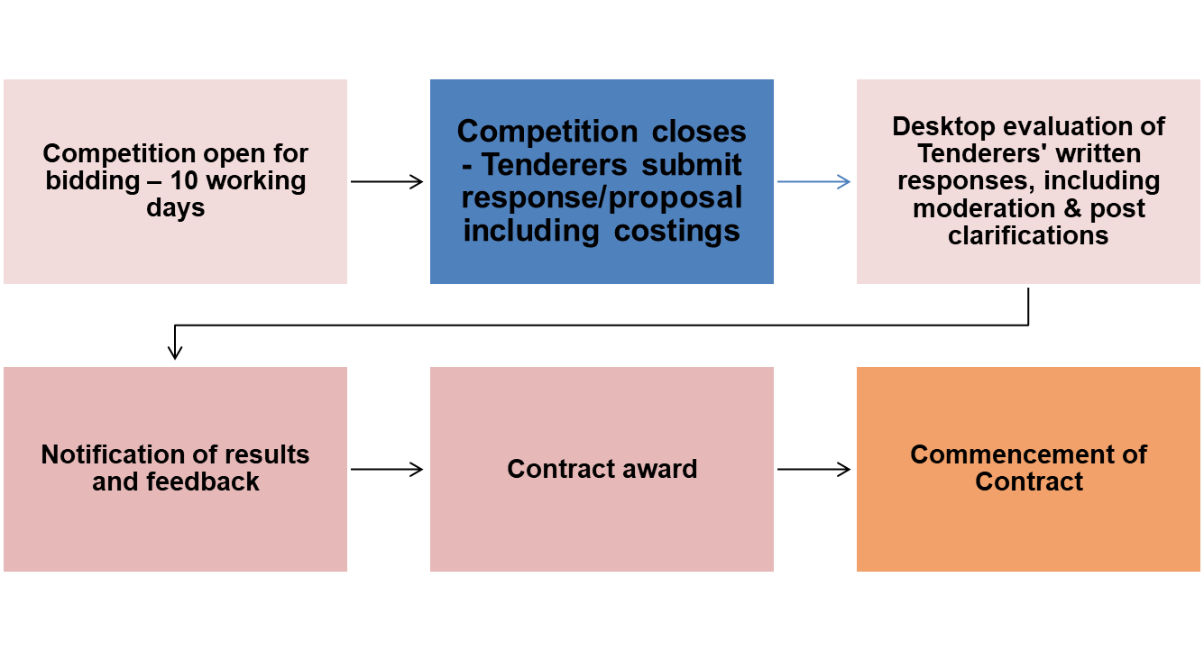
Evaluation & Award
Upon the tender deadline, each tender response will be assessed for compliance with the mandatory criteria – the DfE reserves the right not to consider any non-compliant responses – prior to the commencement of the “desktop” evaluation of technical and price elements.
Evaluation and Moderation of all responses will be undertaken by a dedicated evaluation panel from across the DfE.
The Notification of result is expected in mid November 2020.

Slide 25
Timeframe
Date* | Activity
6 Oct 2020 | Market engagement event
12 Oct 2020 | Publication of RFQ via e-tendering portal
26 Oct 2020 at 14:00 | Deadline for tender responses
11 Nov 2020 | Notification of Result
16 Nov 2020 | Contract agreed and commencement of work
*Indicative dates. DfE reserves the right to change at own discretion.

Slide 26
E-procurement System Advice
Before you can access the RFQ you will need to register on the DfE e-tendering portal on Redimo 2.
Please see the guidance on gov.uk for more information:
https://www.gov.uk/government/organisations/department-for-education/about/procurement#educational-and-childrens-social-care-professionals-dynamic-purchasing-system-ecsc-dps

Slide 27
What organisations must not do
Canvass help, assistance or opinion on the tender or the procurement process in general from any DfE employee or other Government Department, Agency or Non Department Public Body other than through the e-Tendering portal message board.
Submit a partially completed tender as this will not be evaluated.
Submit a tender after the closing date and time.

Slide 28
4.Q&A

Slide 29
End of Presentation
Earlyyears.entitlements@education.gov.uk
Notes:
If you have any questions please send them to the following email address.

