Slide 1

John Sykes Project Manager National Overview
February 2016

Slide 2
Vision
…to create a Social Innovation Model for the Development of Total Place Integrated Transport Provision in Northamptonshire and participating Authorities…

Slide 3
Regional Projects
Overview
37 projects funded across country –although some are some joint initiatives
Top 6 Local Authority awarded over £350k each are:
Gloucestershire
Cheshire East
Lincolnshire
Surrey
Northamptonshire
Cambridgeshire

Slide 4
Regional Projects
Key outcomes from across projects are:
Economy of scale/reinvest/efficiencies
Accessibility/inclusion
Better understanding of needs/demands
Engaging NHS/Trusts/non-emergency transport
Single point of access/one-stop shop
Integrating specialist transport ie social care/SEN
Improving viability of the commercial networks/community transport
Links to regeneration /LEP
Creating a Social enterprise model

Slide 5
Total Transport is About Pooling Benefits
Keeping people independent
Access to jobs
Access to education and training
Access to health care
Also, in theory, providing better services with less money

Slide 6
Lots of people have tried this…
Joint budgets and transport needs assessments
Joint procurement
Joint vehicle fleets/booking systems
Public buses replacing bespoke services
Transport provision linked with service provision e.g. health appointments
Demand responsive rural transport pilots (often disappearing when budgets finish)

Slide 7
Supporting Total Transport Programme
ATCO Total Transport Executive
Networking and sharing
Good practice and barriers
Dissemination
Monitoring and Evaluation Framework
On-going throughout 2 years
Maintaining profile of initiative
Issues, problems, costs and benefits
Outputs/outcomes – qualitative and quantitative
Success factors

Slide 8
Total Transport Executive
National group
DfT and other government departments
Other interested partners (CTA, CBT, PTEG, ...)
Representatives of ‘large’ pilots (>£350k)
Representatives of ATCO regional groups
Regional groups
Three or more (North, Midlands, South)

Slide 9
National Conclusions
Total Transport is part of wider cross-government interest in smarter spending (e.g. cycling and health)
Huge opportunities but also difficulties
If these pilots work they can lead to further funding and cross government support i.e. Connectivity fund/Developer funding etc.
Linkages between transport and other sectors are critical

Slide 10

Network Northamptonshire background and deliverables
John Sykes
February 2016

Slide 11
Key Elements
The Overall Project has three Key Elements:
Element 1: Undertake all necessary survey work, analysis and evaluation of existing provision within Northamptonshire, leading to early implementation of key initiatives from 2016/17 onwards
Element 2: Extension of the project to embrace NHS and medical facilities
Element 3: Cover the proposed Combined Authority area of Northamptonshire, Buckinghamshire and Oxfordshire

Slide 12
Element One
Initial data collection work concentrated on four key areas of:
Health Sector - Trust hospitals/ Northants NHS
Education- Schools/Further/Higher Education
Business
Social Enterprise model

Slide 13
Data driven approach to “solutioneering innovation”
8,198 School pupils (Transported by NCC)
107,901 School pupils in Northants
3,537 Special needs (SEN)
Total 119,636 (239,272 movements per day)
1,683 NCC employees (Project Angel)
4,369 NHS (NHFT)
17,626 FE/HE students
1,623 HE staff
6,600 NGH (NHS) & St Andrews
Total 31,901 (63,802 movements per day)
Data circa 22% of
Northants population
based on 2014 (714k)
(25% when we include biz)
The opportunity (current data) is circa
303,074 per day
1,515,370 per week
78,799,240 per year
Will include non Emergency health care transportation Q1 2016

Slide 14
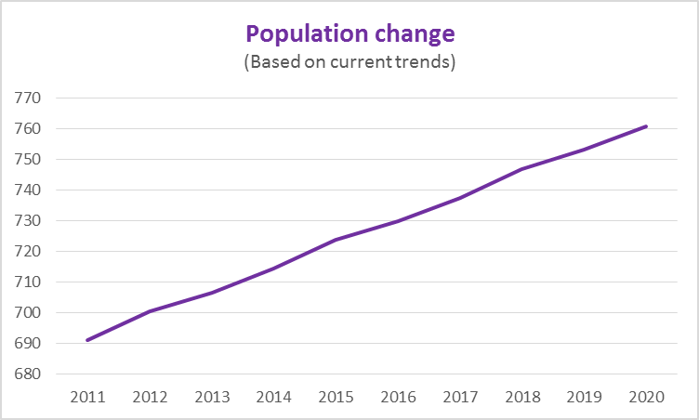
Innovation in a changing environment
12% of NN population
have a disability
30% of new home ownership
comes from outside County

Slide 15
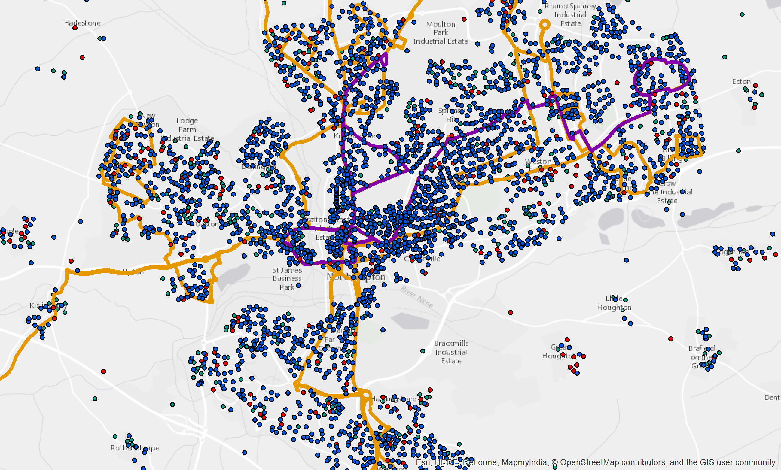
Data against public transportation routes

Slide 16
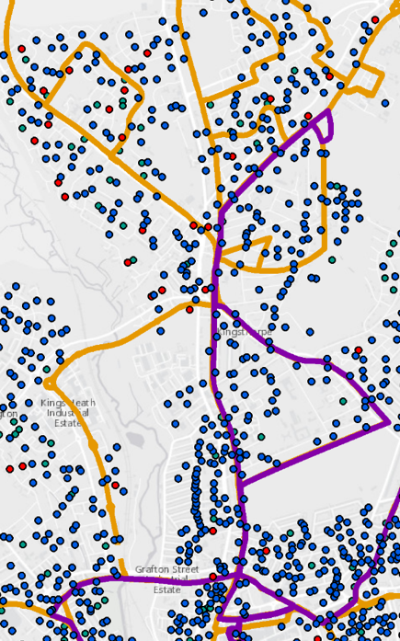



Kingsthorpe corridor – the data driven trial
Potential revised solutions
Bike hire x 2
E-car x 3
University
Asda
Racecourse
Bus passes – link to real
time app
Lift share
Connection to bluetooth data feeding a journey app
(ITS solutions)
Existing solutions
Bike hire x 3
E-car x 1
University
Albion Street
Train station

Slide 17
Proposed Outcomes for Demonstration Projects
NHS
Explore the walk-on/walk-off patients currently using non emergency transport, especially renal capacity
Explore the possibility of merging spare NCC contracted/SEN transport capacity with non-emergency demands
Explore the synergies between NHS and NCC staff mobility demands

Slide 18
University
Explore current student/staff travel patterns and extend the UNO services accordingly. Also possible merging with FE College student demands e.g. Moulton and Northampton
Look to increase availability of sustainable/active modes within University campus e.g. electric cars/bikes clubs, mobile phone bus tickets, real time, car sharing etc.
Schools
Look to identify two academy/secondary schools within reasonable travel distance of each other and develop a potential travel cost saving programme for September 2016, by adjusting start times and amalgamating transport need.
And/or develop travel plan options for new school at Barrack Road

Slide 19
Business
Create a desktop exercise to develop more effective links into the proposed new business park at DIRFT by end of project.
Work with actual businesses on the Brackmills and Pineham business parks in order to develop more effective transport links to the sites.

Slide 20
Other Project Areas
Strategic Alliance
Work with Bucks CC as a strategic partners to share good practice and develop an alternative ‘rural’ demonstration projects.
EU links
A number of potential EU research strands have already been identified from the Horizon 2020 & Innovate UK Transport options. These need to be developed further over next few months.
Social Enterprise Model
Look to develop a partnership model across NCC and the Universities of Northampton and Hertfordshire. This could be further supported by Social Enterprise bodies outside of the proposed group e.g. HCT

Slide 21
Structures of a social enterprise
Community interest company (CIC) A CIC is a legal form created specifically for social enterprises. It has a social objective that is "regulated" ensuring that the organisation cannot deviate from its social mission and that its assets are protected.
Industrial and provident society (IPS) This is the usual form for co-operatives and community benefit societies. Democratically controlled by their members in order to ensure their involvement in the decisions of the business.
Companies limited by guarantee or shares the most common legal structure for businesses, often considered to be the most flexible, particularly companies limited by shares. While they can ensure they have a social mission written into their Memorandum and Articles of Association, this is not regulated.
Group structures and charitable status Tax is an important consideration for some organisations where the retention of surpluses is essential, particularly if they can't take on equity. In these cases the tax breaks associated with charitable status can be an important factor.
After detailed research it was chosen to embrace the Community Interest Company (CIC) Model

Slide 22
Thank you Questions?
February 2016

