Slide 1
King George V Sports Field, Raydon car park
Proposal for surfacing and minor works
Works package #1

Slide 2
Location
Existing: stone layer on top of clay sub soil.

Slide 3
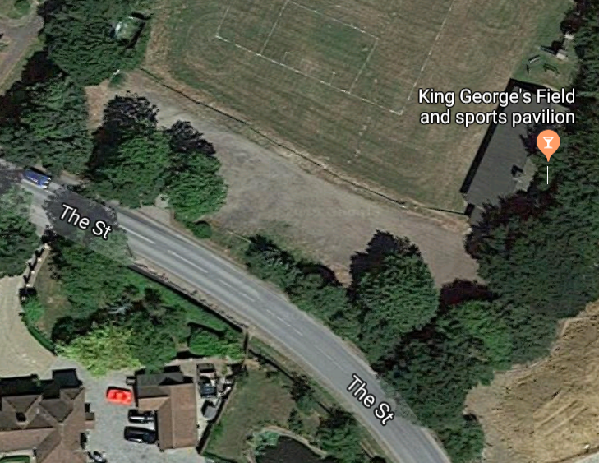
Scope of works
Remove surplus spoil at north end. Weedkill.
Supply and lay new SMA surfacing. Make good and extend MoT Type1 stone base.
Match new surface into existing crossover.
Take up and set aside for reuse existing telegraph poles.
Reinstate telegraph poles to perimeter to form boundary.
Allow for all safety and welfare provisions.
5m
N
16.7m
80.4m
12m
3.5m
12.6m
17.3m
5m
42.5m
16.9m
10.2m
9.4m

Slide 4
Notes
Client
King George V Playing Field Committee
The Street
Raydon
Suffolk
Funding
Raydon Parish Council
Technical contact Keith Lovering RPC Councillor
The Green The Street Raydon IP7 5LW 07939 075143

