Slide 1

Market Engagement Event
Domestic Abuse Refuge Accommodation Services
21 April 2021

Slide 2
Housekeeping
Please stay on mute during the presentation
Event is being recorded
Cameras On or Off – your preference.
Questions relating to presentation to be entered in the Comments Box
All questions to be answered at the end of the presentation
Slides will be circulated to attendees

Slide 3
Welcome & Introductions

Slide 4
Agenda
- Our Vision for our Residents
- Conversations with Partners
- Vision and Values for the service
- Service outline
- Tender Timeline
- Procurement

Slide 5


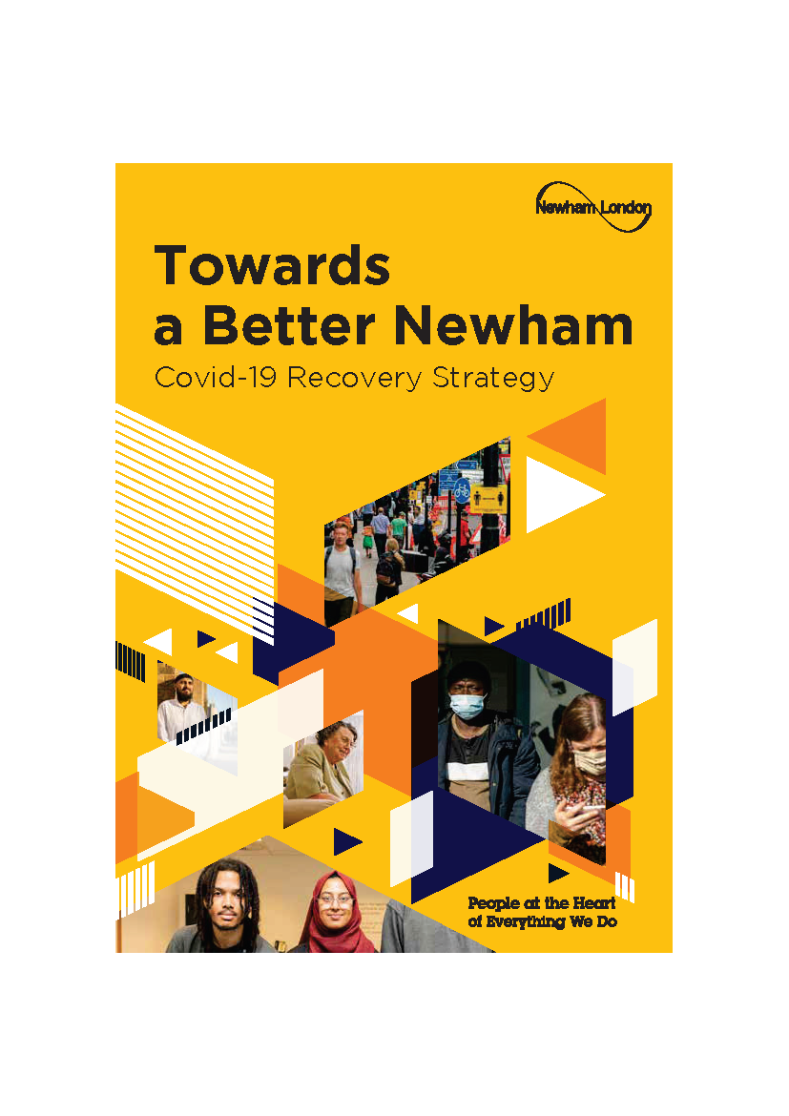
Our Vision for our Residents

Slide 6
Our Vision for our Residents
The Mayor of Newham - (Towards a Better Newham, foreword):
‘.. a fundamental shift to embed an economy which places the health and wellbeing of our residents' and race equality central to our aspirations of inclusive growth, quality jobs and fairness in Newham.'

Slide 7
Our Vision for our Residents
  Delivering this service supports the Council’s ‘Towards a Better Newham’ Covid-19 Recovery Strategy. Specifically:
Pillar 1: Our measures of success will be the health, happiness and wellbeing of our residents.
Pillar 2: The Council is committed to enabling every resident under 25 to be safe, happy and cared for, with positive activities to secure their long-term wellbeing
Pillar 3: The Council will take action to ensure all residents are supported and enabled to access work and other opportunities in the new economy.
Pillar 4: The Council will assist our residents to be healthy, happy and safe so they are supported during times of recession and are able to thrive in the new economy.
Link to strategy:
https://www.newham.gov.uk/downloads/file/3035/towards-a-better-newham-strategy

Slide 8
Our Vision for our Residents
  Newham’s 50 Steps to a Healthier Borough: Health and Wellbeing Strategy 2020-2023. ln particular the following priorities and their respective steps:
Priority 1: Enabling the best start through pregnancy and early years
  Step 4: Give every child in Newham the best start in life
Priority 2: Supporting our young people to be healthy and ready for adult life:
  Step 12: Enable most at risk children and young people to achieve their full potential and have access to specialist care and support services.
Priority 4: Developing high quality inclusive services, ensuring equity and reducing variation
  Step 19: Improve equity in health and care service provision for all
  Step 20: Service provision reaches high standards of access and inclusivity to ensure health and wellbeing for all with a particular emphasis on BAME communities.
Priority 5 Meeting the needs of those most vulnerable to the worst health outcomes:
  Step 21: Support our most vulnerable residents to achieve and maintain relative good health, including mental health and overall wellbeing.
  Step 22: Support the mental health of our most vulnerable residents
  Step 23: Reduce the impact of domestic and sexual violence on families and residents.
Priority 12: Building an inclusive economy and tackling poverty
  Step 49: Maximise the reach of the London Living Wage in the borough
  Link to strategy:
  https://www.newham.gov.uk/downloads/file/2595/50-steps-strategy-document

Slide 9

Conversations with Partners
Over the last 18 months the Council has carried out two stakeholder engagement opportunities. These were centred around women with lived-experience and included engaging with over 20 different provider organisations, as well as a range internal and external support services. This work has been pivotal in designing the service and capturing what is important to women using refuges.
In summary, Stakeholders told us they wanted:
Service delivery which
  Provides trauma-informed, needs-led, holistic wrap-around support, which moves with survivors to help prevent further repeat victimisation.
  Has a workforce which is suitably trained, competent and confident in working with survivors and children from diverse backgrounds and reflects the community they serve.
  Seeks to encourage independence and emotional wellbeing for women by keeping their views at the heart of what they do.
Service user describing what a refuge should be –
‘should not just be a place to live but should be working for us’

Slide 10
Conversations with Partners
Practical support which includes
  Advocacy services and legal advice covering matters relating to immigration status, housing, protection orders, family court orders, and welfare benefits
  Support to gain education, training and employment
  Access to key statutory services – health (GP registration), school placement for children etc.
  Resettlement packages, which include counselling support and peer support. Support should be extended beyond 3 months for survivors and their children where necessary.
  Subsidised costs for food, living expenditure(utility bills) and travel
Accommodation which is
  Safe and secure
  Has household equipment and furnishings which are of good quality
Non-institutional in presentation and reflects a safe and welcoming environment.

Slide 11
Conversations with Partners
Quotes from women with lived-experience:
‘I have no understanding of the legal system – where do I go for help?’
‘I am not used to living here (UK) it is good to speak with someone from the same country as me who knows the personal boundaries because of cultural and religious expectations’
‘Women arrive feeling scared and disorientated not knowing what to expect’
‘Women should feel at peace’
‘Sometimes women are afraid to go out and may not always want to communicate with women from other cultures, support should be offered to give women confidence to go outside’
‘It is important I am able to speak to someone about how I feel and wat I need who speaks my language and understands my language’
‘Activities outside of the refuge are important, it helps us’
‘Activities should be provided for both women and children. These should not just be arts and crafts’
‘It would be good to have a buddy to help me get to know the local area and what I can do outside of the refuge. It should not always be about going outside for appointments’

Slide 12

Vision and Values
Vision and Values for Women’s Refuge Accommodation
Following on from the extensive stakeholder engagement, four key priorities where developed. These set out the Council’s vision and values that the procurement and future service will adhere to.
Reflects our Values
That everyone has the right to live a life free from abuse and violence
The recognition of the impact of trauma and our commitment to support the individual and families to attain post traumatic recovery
Our commitment to understanding and addressing gender-based violence
To maximise support and increase opportunities for children and families residing in Newham
To commission services which recognise and reflect the history and cultural diversity of the borough

Slide 13
Vision and Values
Vision and Values for Women’s Refuge Accommodation (cont.)
2. Demonstrate our understanding of the needs of minoritised and marginalised groups
Recognising that minoritised communities continue to face barriers, racism and exclusion and cultural discrimination in society, which the Covid-19 pandemic as highlighted further in the context of health outcomes
The Council remain committed to addressing inequality by recognising the need for specialist services and continue to fund them
Maximising access to services including enabling women with physical disability, learning disability, mental health needs and those who require additional support with communication to access services
Our continued commitment to working in partnership with specialist, community, faith and grass roots organisations
Ensure the tender process fully evidences the requirement to provide high quality specialist services with clear measurable outcomes, which have been coproduced with service users and are meaningful
Enabling access to specialist legal advice for immigration and civil protection remedies

Slide 14
Vision and Values
Vision and Values for Women’s Refuge Accommodation (cont.)
3. Work in accordance with child and adult safeguarding practise
Placing the safety of women and children at the heart of refuge services
Ensuring that our services are aligned with anti-oppressive values and practise
Providing specialist trauma-informed, child centred services for children residing in the refuge
Ensuring that families are provided with specialist housing support to access appropriate secure move on accommodation
Actively addressing the risk of child homelessness due to domestic abuse
4. Offers choice and autonomy to service users
Ensure that the voice of service users are at the heart of delivering and monitoring services
Enabling service users to contribute to contract monitoring feedback ensuring issues raised are explored and addressed
Maximising learning opportunities for service users via education and employment support
Providing advocacy support to both children and adults residing in the refuge
Providing a trauma-informed approach to addressing gender based violence

Slide 15
Service Outline
Core Service Outline
25 beds for women from Black and South East Asian heritage (care and support only)
Women 16 aged years and over
Currently providing 10 bed spaces for children up to age of 15 (boys up to 12 years old with 12-15 year olds accepted following an individual risk assessment and appropriate)
Trauma-informed approach to support with an embedded approach to addressing gender-based violence and intersectionality
Enhanced services for children and family
Enhanced move-on support of at least 3 months post exit
Stays over 9 months will require discussion with commissioner
London Living Wage will apply
Contract Specifics
- Starting on 1 April 2022
Five years with the option to extend for a further two years (5+2)
Fixed price tender (i.e. 100% Quality), £198k p.a. / £1.386m over seven years

Slide 16
Service Outline
Service Outcome Themes
Provide good quality safe accommodation that is responsive to the needs of women and their families
Addressing the experience of violence and trauma through support which promotes recovery and personal growth
Supporting women to achieve confidence and achieve independence in their lives
Demonstrable practise and a commitment to embedding a trauma informed approach through service delivery
Strong service user engagement that contributes to service development and outcomes
Providing excellent support that enables women to move on from refuge accommodation in a structured, enabling way

Slide 17
Introducing L&Q and L&Q Living
L&Q is a regulated charitable housing association. The L&Q Group houses around 250,000 people in more than 105,000 homes, primarily across London and the South East.
L&Q Living is a subsidiary of L&Q Group and provides support, care and housing services to over 6000 vulnerable people.
L&Q Living directly manages services for older persons, younger persons with complex needs, mental health services as well as learning disability services.
L&Q Living, though it’s Agency Contracts & Quality Team, manage the contractual relationship with around 80 specialist housing support providers who deliver services in L&Q properties to a range of different client groups, for example refuge services.

Slide 18
The Housing Management Contract
L&Q works with a range of organisations to provide accommodation for use as supported housing or registered care homes. We strongly believe that some services are best delivered to the customer by one provider and have developed the Housing Management Contract to enable that.
Entering into contract with L&Q for the delivery of supported housing or registered care homes can be achieved either by the provider electing to submit their request to be vetted directly to L&Q or through tendering for commissioning authorities care/support contracts and vetted subject to that process.
The Housing Management Contract delegates responsibility for the delivery of housing management services to the support service provider, who acts as L&Q’s agent.
The Housing Management Contract clarifies roles and responsibilities of both L&Q and agent’s in terms of housing and tenancy management, property maintenance, out of hours emergencies and contract monitoring arrangements.
Agency Contracts & Quality Team - Housing Management Contract

Slide 19
Housing Management Allowances
In return for providing housing management services on behalf of L&Q, Agents receive an allowance.
Agents collect rent and service charge from residents. L&Q issues quarterly invoices to Agents, in arrears. The invoices collect the core rent and landlord service charges due to L&Q, less the allowance retained by the Agent.
Schedule 4 of the Housing Management Contract specifies the arrangements for allowances.

Slide 20
Contract Monitoring
Each Managing Agent is allocated a dedicated Agency Contracts & Quality Officer, in turn each Agent nominates a dedicated contact to represent them.
An annual monitoring programme is issued which details all of the monitoring data, documents and activities which is required of an Agent.
A minimum of three contract liaison meetings are carried out each year.
Inspections of properties is carried out once every 12 to 24 months.
Audits of Agent’s corporate policies, procedures and operational practice are carried out once every three years.
Agency Contracts & Quality Team - Housing Management Contract

Slide 21
Vetting
Vetting is carried out by L&Q to ensure that providers who wish to enter into the Housing Management Contract are,
are able to meet with the values and ethics of L&Q,
are robustly governed and financially viable,
are skilled to deliver housing and property related management/services to a standard that is as good or better than L&Q could deliver itself.
The vetting process is an in-depth review of an organisation’s financial viability, governance and capacity. Housing and tenancy management procedures are reviewed and references are obtained. References would, ideally come from another Registered Provider that the support provider has a contractual relationship with. Arrangements to visit a suitable service or meet with operational staff are made, subject to Coronavirus measures.

Slide 22
Please direct questions or queries regarding L&Q’s Housing Management Contract or Vetting process by email to
Jo Summers, Senior Agency Contracts & Quality Officer.
JSummers@lqgroup.org.uk

Slide 23

Tender Timeline
Tender Timeline
Governance Process to commence the procurement | Mid April – Early June 2021
Advert on Find a Tender + Contracts Finder | Mid June 2021
Deadline for Clarifications | Mid July 2021
Tender period | 35 days including weekends
Evaluation and Moderation Period | Approximately 3 weeks
Governance Process for Contract Award | October – November 2021
Mobilisation | Approximately 12 weeks
Anticipated Contract Start | 01 April 2022

Slide 24
Procurement
Registration to e-tendering portal.
New e-tendering system is Oracle Fusion – register now, do not delay your registration
7 step registration process:
Step 1 Company details
Step 2 Contacts
Step 3 Create supplier address
Step 4 Business Classification – Select Business Type e.g. SME
Step 5 Products and Services – Select ‘Social Community Care Supplies & Services – Children’ and select all relevant services within this that you provide
Step 6 Supplier Questionnaire
Step 7 Review
- Guides & Videos https://elyq.fa.em3.oraclecloud.com/fscmUI/faces/PrcPosRegisterSupplier?prcBuId=300000002089195 (Guidance documents will be sent alongside this presentation).
For system technical queries, please contact fusion.sourcing@onesource.co.uk

Slide 25
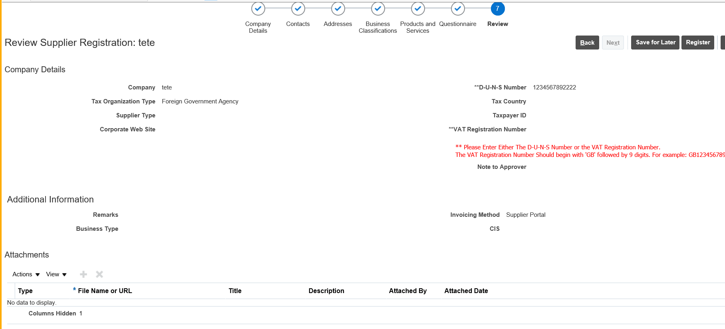
Procurement
Registration to e-tendering portal.
Supplier Registration Home Screen

Slide 26
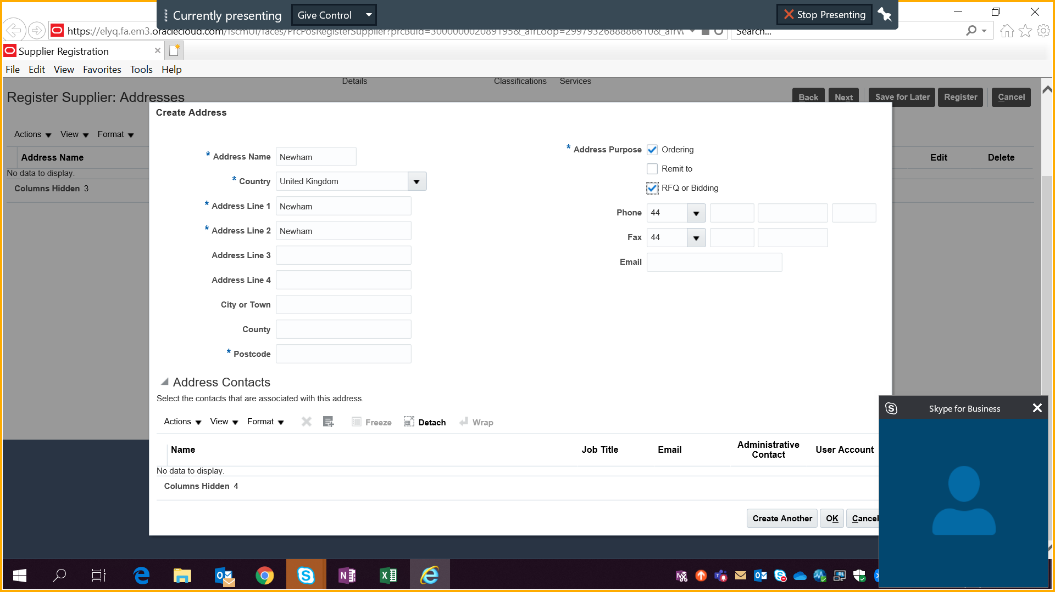
Procurement
Registration to e-tendering portal.
Create supplier address – need to select ordering and RFQ/bidding options

Slide 27
Procurement
Selection Questionnaire
Organisational information required even though it is provided in earlier sections
Grounds for mandatory exclusion – required as per the Public Contract Regulations 2015 (PCR). Will include questions for example, corruption, fraud, money laundering etc.
Ground for discretionary exclusions – required as per PCR. Will include questions for example, breach of environmental obligations, professional misconduct etc.
These are yes/no questions. If answer is yes to any, you will need to provide further details

Slide 28
Procurement
Procurement Process
The procurement is subject to the light-touch regime under Section 7 Social and Other Specific Services.
Under Regulation 76 the Council is free to establish a procedure, provided that procedure is sufficient to ensure compliance with the principles of transparency and equal treatment of economic operators (service providers)
Advert in ‘Find a Tender’ and Contracts Finder
Providers to complete selection questions and the tender documents, pricing schedule etc.
Providers who pass the selection questions will have their tender evaluated. There will be minimum requirements stated in the tender documents.
Tenders will then be evaluated against the set criteria detailed in the tender documents. This will be followed by a moderation meeting.

Slide 29
Procurement
Tips for Completing Bid
Read the instructions to tender, specifications, terms and conditions (T&C’s), scoring rationale and award questions
If anything unclear then ask clarification questions through e-tendering portal (Fusion). These will be shared with everyone
Specification – sets out the service requirements and expectations. You should ask yourself if you can provide the required services and consider if the contract is worth you bidding for, particularly for unregulated services
Selection Questions – will set out minimum requirements, you must answer these. Some of them may be pass or fail questions.
Award/Method Statement questions - respond with detailed examples demonstrating how you will deliver the service for the Council, linking your proposal to the specification. Consider award criteria for each question
Bid submissions must be in English

Slide 30
Procurement
Tips for Completing Bid
Do not assume we have prior knowledge of your experience
Responses will be evaluated on their own merit, ensure to include details for the question asked, even if included previously
Respond within stated word count
Do not miss out any questions, answer all the questions
Newham is a London Living Wage employer and encourages all suppliers to work towards this
Consistently SAVE your work – security protocols will automatically “time-out”
Please remember you MUST “Submit” your response to the Buyer
Submit your bid in advance, ideally 24 hours before the tender submission deadline. Let us know if there are any technical or systems issues in advance. Late submissions will not be accepted

Slide 31

Q & A
Q&A
Questions from Comments Box

