Slide 1
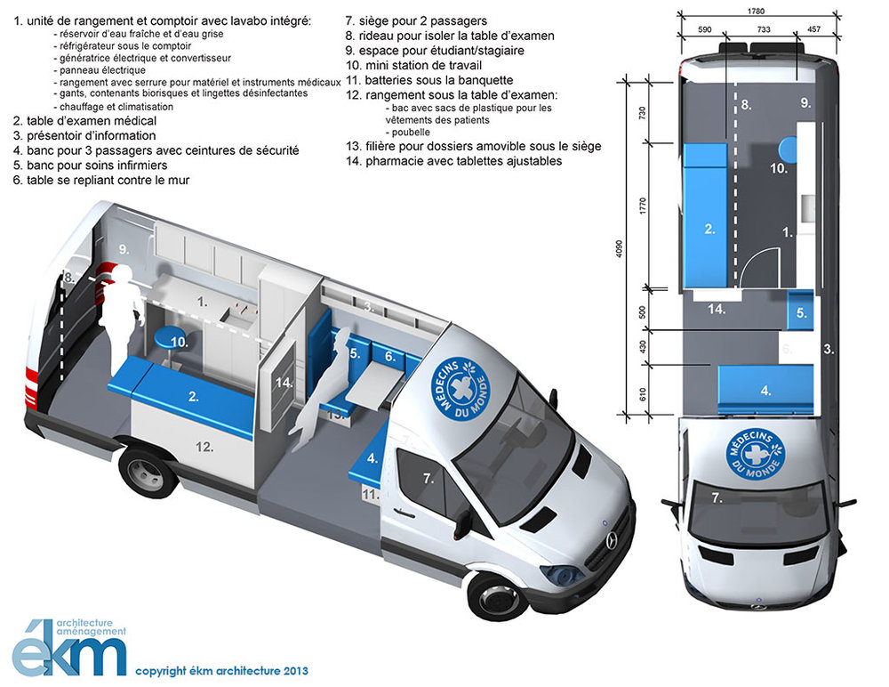

Slide 2
Mobile Clinic - Content List
1. storage unit and counter with integrated sink:
- fresh and grey water tank- under-counter refrigerator
electric generator and converter
electrical panel
storage with lock for medical equipment and instruments
gloves, biohazard containers and disinfectant wipes
heating and air conditioning
2. medical examination table
3. information display
4. bench for 3 passengers with safety belts
5. nursing bench
6. folding table against the wall
7. seat for 2 passengers
8. curtain to isolate the examination table
9. space for students/trainees
10. minimum workstation
11. batteries under the bench seat
12. storage under the examination table:
- plastic bag bin for patients' clothing - waste bin
13. removable file die under the seat
14. pharmacy with adjustable shelves

