Slide 1
The Teaching and Leadership Innovation Fund (TLIF) supplier information events
London (27 February), Birmingham (28 February), Sheffield (1 March), Manchester (2 March) and Webex (3 March)

Slide 2
Agenda
Today’s session will include:
13:30 – 13:50 Introduction and overview of the Teaching and Leadership Innovation Fund – Richard Jones
13:50 – 14:00 Round One: Commercial process and timeline – Richard Jones
14:00 – 14:30 Q&A session

Slide 3
Introduction and Overview of the Teaching and Leadership Innovation Fund (TLIF)

Slide 4
The Teaching and Leadership Innovation Fund: Introduction
In October 2016, the Secretary of State announced a three-year investment in a Teaching and Leadership Innovation Fund worth up to £75 million, which will support the delivery of high quality professional development to teachers and school leaders in areas of the country that need it most: https://www.gov.uk/government/news/social-mobility-package-unveiled-by-education-secretary.
The Secretary of State announced the first bidding round into the Fund on 16 February in her keynote speech at the inaugural national conference of the Chartered College of Teaching: https://www.gov.uk/government/speeches/justine-greening-teachers-the-experts-driving-social-mobility.

Slide 5
The Teaching and Leadership Innovation Fund: Introduction
A need for better professional development of teachers and leaders (particularly in schools and areas that are facing challenges) is not a new issue.
Evidence shows that the most successful education systems in the world are characterised by strong systems of professional development.
This fund will enable providers to bid for funding to improve the quality of teaching and leadership in challenging areas and schools with the aim of improving the outcomes of children and young people through professional development for teachers and leaders.

Slide 6
The Teaching and Leadership Innovation Fund: The evidence
The proportion of secondary schools rated as good or outstanding by Ofsted for quality of teaching is 23 percentage points lower in the most deprived areas compared to the most affluent ones; and schools serving deprived communities are less likely to be judged by Ofsted to be ‘Good’ or ‘Outstanding’ for their leadership and management than those with least deprivation.
Recent research suggests that time is a barrier to take up of professional development. For example, a recent EPI report based on TALIS 2013¹ data said:
¹ http://epi.org.uk/wp-content/uploads/2016/10/TeacherWorkload_EPI.pdf
Of the 36 jurisdictions in the dataset, England ranked 30th in terms of the average number of days spent in a year on certain types of professional development.
Teachers in England spent only an average of 4 days on these CPD opportunities (including courses, observational visits, seminars and in-service training), compared with an average of 10.5 days.
Workload represents a significant barrier to accessing professional development according to 60 per cent of teachers in England. Only six other jurisdictions reported higher levels of agreement to this statement.

Slide 7
The Teaching and Leadership Innovation Fund: Insight from schools
We talked to many teachers including those in underperforming schools and Opportunity Areas.
They told us about the barriers:
Teachers in schools in challenging circumstances have many demands on their time
Cover for off-site CPD may not be available or not available at a quality which would enable the teacher to be released
CPD may not be regarded as a priority
External CPD is often limited or rationed and often only used for ‘technical’ updates – i.e. curriculum training
They said good CPD is:
Bespoke - teachers need to choose things that suit their personal style and/or targets their own personal weaknesses.
Flexible - it has to be adaptable for a variety of different contexts (location, equipment, ability level, Special Educational Needs and Disability).
Incremental - so that teachers can change gradually and consistently, rather than having to constantly reinvent everything they do.
Proven - to work in their particular context.
Incentivised - as teachers have so many other pressures on their time.
Good CPD should meet the CPD standard: https://www.gov.uk/government/publications/standard-for-teachers-professional-development

Slide 8
The Teaching and Leadership Innovation Fund: Aims
The key aims of the Fund are to:
Improve the provision of teachers’ continuing professional development (CPD) and leadership development in areas and schools that are facing challenges
Stimulate the demand for provision of teachers’ CPD and leadership development in areas and schools that are facing challenges
Support the development of a sustainable market in CPD and leadership development that will be capable of becoming self-funding in the future

Slide 9
The Teaching and Leadership Innovation Fund: Bid focus
Geographical targeting: bids must have a strong focus on delivering the majority of their provision in priority areas. We will expect at least 70% of provision to be delivered in these areas, and will look more favourably on those bids with a high proportion of delivery in these areas.
Schools targeting: bids will need to clearly demonstrate how they will focus on the most challenging schools (i.e. rated by Ofsted as 3 or 4), whether within priority areas or elsewhere.
Sustainability: all programmes should demonstrate value for money and how they will seek to be sustainable after the funding ends.
Contextual awareness: the design of teacher CPD and leadership development has to recognise the twin challenges of time and workload pressures on staff in schools, and the particular challenges of the types of schools and areas which TLIF is seeking to prioritise.
Diversity: The bids should demonstrate how they will support diversity so we would expect participants to be at least representative of the diversity in the locality

Slide 10
The Teaching and Leadership Innovation Fund: Priority areas – Opportunity Areas
There are 12 Opportunity Areas across the country that will receive additional support to remove barriers to social mobility:
Blackpool
Bradford
Derby
Doncaster
Fenland & East Cambridgeshire
Hastings
Ipswich
Norwich
Oldham
Scarborough
Stoke-on-Trent
West Somerset
In these areas, DfE is working with local organisations, including early years providers, schools, colleges, universities, the voluntary sector and businesses to help local children and young people get the best start in life, no matter what their background.

Slide 11
The Teaching and Leadership Innovation Fund: Priority areas – category 5 and 6 local authority areas
Category 5 and 6 local authority areas are those areas with the weakest standards/capacity to improve, based on an assessment used to create cold spot maps in analysis used for the 2016 schools’ white paper.
These areas are listed by name on Contract Finder alongside the Prior Information Notice:
https://www.contractsfinder.service.gov.uk/Notice/2c427176-4c7f-43b7-ab75-0f328e3c5d2c
Detail on the methodology is available at:
https://www.gov.uk/government/publications/defining-achieving-excellence-areas-methodology

Slide 12
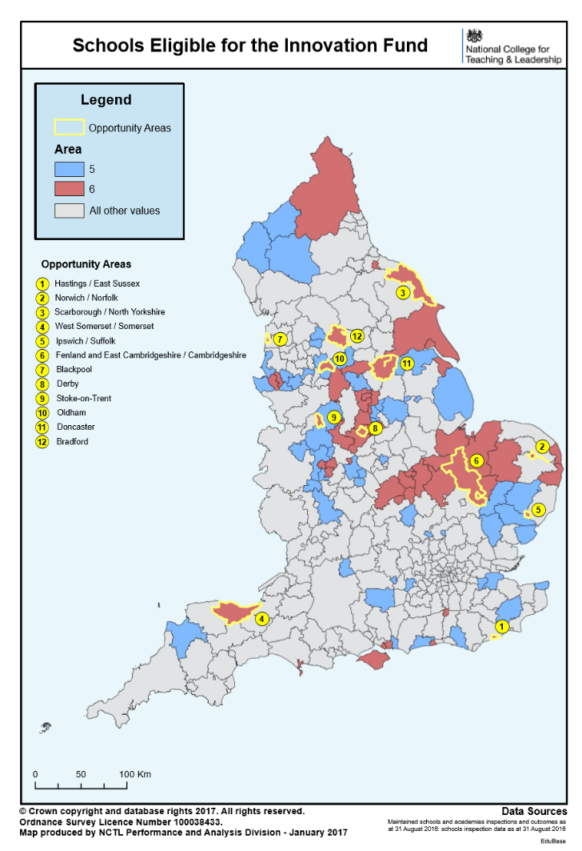
Map of the Opportunity Areas and category 5 and 6 areas

Slide 13
The Teaching and Leadership Innovation Fund: Conclusion
We need great teachers and leaders right across the country, particularly in challenging schools and areas, to raise standards and intervene quickly to tackle underperformance in schools.
We want to ensure that this fund is used effectively to have a real impact, implementing proven evidence-based projects where appropriate, and supporting the development of innovative new ideas where needed.
We want to build our evidence-base of ‘what works’ in order to focus our future activity and will be putting in place an independent evaluation of the Fund.
We are therefore looking for providers to bid for funding to improve the quality of teaching and leadership in schools and areas that are facing challenges, with the overall aim of improving the outcomes of children and young people through professional development for teachers and leaders.

Slide 14
Commercial Process and Timeline

Slide 15
The Teaching and Leadership Innovation Fund: Application Round One
We anticipate that the bidding for Application Round One will open mid-March and close mid-April 2017.
We will be seeking evidence-based proposals for teachers’ CPD and/or leadership development, which would be ready to deliver to participants between September 2017 and January 2018 at the latest.

Slide 16
The Teaching and Leadership Innovation Fund: Indicative stages of the bidding process
Issue Invitation to Bid
Bidders submit response/proposal including costings
Desktop evaluation of bidders’ written responses, including moderation
Bidder interviews/ clarification
Final moderation
Notification of results and feedback
10 day standstill period
Contract award

Slide 17
The Teaching and Leadership Innovation Fund: Redimo2
This procurement will be managed through Redimo2.
Using Redimo2 provides:
An easily accessible system for bidders and evaluators
A fair, open and transparent process for submitting and evaluating responses
A fully auditable process
A method that enables communication across all bidders
System availability 24/7
Suppliers interested in participating in this procurement will need to ensure that they are fully registered on Redimo: https://supplierlive.proactisp2p.com/Account/Login/?cid=DFE
Guidance and/or training will be provided to new suppliers around the time of the launch of the opportunity. 1:1 support is available by email Commercial.CONTACTPOINT@education.gov.uk

Slide 18
The Teaching and Leadership Innovation Fund: Specific requirements for Application Round One
Specific requirements for Application Round One include:
Capacity to deliver in the required timeframe, either in the autumn term 2017, or at the latest starting in January 2018.
Evidence of impact - which can be validated and can demonstrate how this will improve the quality of teaching and/or leadership.
Bidders must be able to deliver at scale, and bids must set out the reach and how the programmes will be delivered and targeted towards priority areas
Proposals that are distinct from existing programmes which are contracted by Government for teachers and school leaders.

Slide 19
The Teaching and Leadership Innovation Fund: Approximate timeframe
An extended notice with further information for application round one will be available in Contracts Finder in due course.
All dates are indicative.
All activity is also subject to funding being available and proposals meeting the required standards.
Date | Activity
Mid-March 2017 | Open bidding round for 30 days, further webex sessions to be held once it is open (taking account of school holidays)
End April-mid-May 2017 | Assessment of bids
Mid to end-May 2017 | Standstill period/contract development
Beginning of June 2017 | Contracts awarded
September 2017 – January 2018 | Delivery to commence

Slide 20
The Teaching and Leadership Innovation Fund: Future Application Rounds
The Department for Education expects to run a limited number of TLIF bidding rounds during the current spending review period (ending March 2020).
We expect that future application rounds will address broadly similar aims to those for Application Round One. However, there may be additional areas of focus, and further requirements, which will be developed as the Department for Education continues to develop its evidence base of what works and identifies the needs of the system.

Slide 21
The Teaching and Leadership Innovation Fund: Further information and contact details
Further information is available on our website (including a link to Contracts Finder and a section where you can register your interest to be kept up to date on developments and application round dates) : https://www.gov.uk/guidance/teaching-and-leadership-innovation-fund
We will publish all materials made available at these information events on Contracts Finder w/c 6 March https://www.contractsfinder.service.gov.uk/Notice/2c427176-4c7f-43b7-ab75-0f328e3c5d2c
A ‘Frequently Asked Questions’ document will be released with the formal bidding documentation on Redimo2 (https://supplierlive.proactisp2p.com/Account/Login/?cid=DFE) and published on Contracts Finder.
We have set up a space on Slack (https://slack.com/) called TLIF Providers which you are welcome to use to continue to network after today. If you would like to join this group please send your email address and a request to join to Mailbox.TLIF@education.gov.uk
If you have any questions or queries please contact us at Mailbox.TLIF@education.gov.uk

Slide 22
?
Any questions?

