Slide 1

Medway CCG Mental Health Update
Sharon Dosanjh
Head of Mental Health Commissioning
Notes:
Fern

Slide 2



National Guidance
The mental health delivery plan
The Five Year Forward View for Mental Health
Kent and Medway STP
Notes:
STP – Sustainability and Transformation Plan

Slide 3

Ring-fenced Funding
Young Peoples Wellbeing
Eating Disorders
Psychiatry Liaison
Perinatal
Early Intervention into Psychosis

Slide 4

Young People Wellbeing Service
New service started Sept 2017
New provider NELFT
SPOA
Up to age 25
No Tiers

Slide 5

Eating disorder Service
Kent and Medway wide service
New provider NELFT
New community based service 1st Sept 17

Slide 6
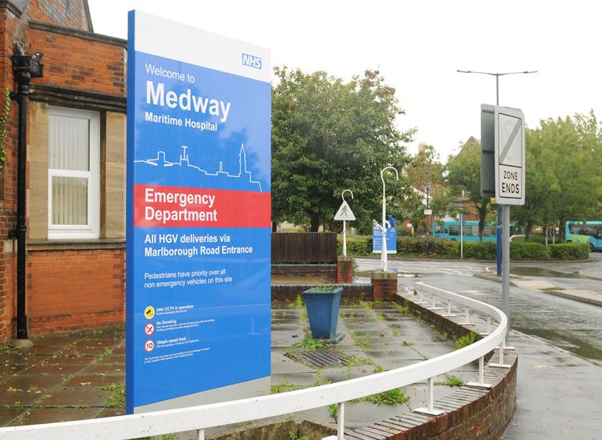
Liaison Psychiatry
24/7
“Core 24”
Improved pathway
Pathway through UTC
1 hour target

Slide 7

Perinatal Mental Health
KMPT provide service
Expansion of workforce
Additional Training funding
Local MBU in Dartford

Slide 8

IAPT – Medway Talking Therapies
Provider led service from 1st Feb 17
Lead Provider – Insight
Partners
  Think Action
  North Kent Mind
  IESO Digital (online service)
Self referrals accepted
  0300 029 3000
  medway@insighthealthcare.org
Notes:
Tom

Slide 9
Services in the Community
Primary care mental health service
Rainham GP mental health nurse pilot
Wellbeing café at the Sunlight café
Megan
IPS service – Aspirations
Medway Healthwatch
Care Navigators

Slide 10
Peer Support Service
Experience led service
Peer support groups
Work closely with current service
Recovery focussed
Support clients in other services

Slide 11
Contact Details
Lead | Contact Details
Sharon Dosanjh - Medway CCG Head of Mental Health Commissioning | sharondosanjh@nhs.net Phone: 01634 335165
Notes:
Tom

Slide 12


