Slide 1
Cornwall UKSPF Youth Engagement Project
UKSPF Youth Engagement Specialist Partners Opportunity
EOI Briefing Event 8 June 2023

Slide 2
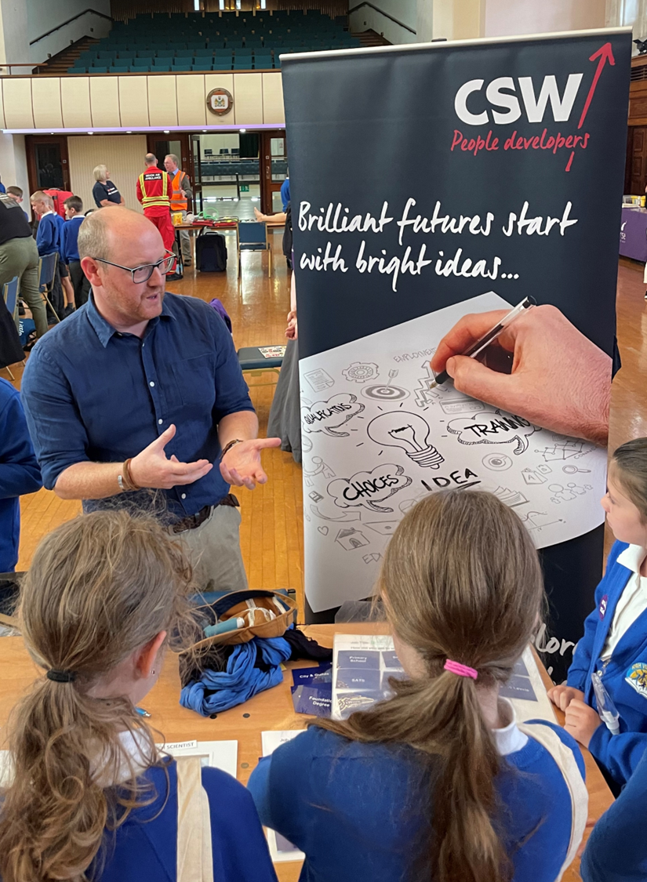
About CSW
We are a not-for-profit Social Enterprise delivering brighter futures for Young People (YP), communities, and organisations across the Southwest for over 25 years
Owned by the LA’s of Cornwall, Devon, Plymouth and Torbay
Examples of Current Contracts:
Transitions – Cornwall, Devon, Plymouth, Torbay and Somerset
Services to Education – Personal Guidance, WEX (Devon), IiC – South West
COMPASS ESF – Cornwall
SENDIASS - Cornwall
STEM – Devon & Cornwall
#Focus5 TNLF/ESF – Devon and Somerset
#Progress Somerset UKSPF
SMART Skills ESF - Devon

Slide 3
Opportunity Summary
UKSPF People and Skills - Youth Engagement
Open Competition: Cornwall Good Growth published
Contract: 1 Jan 24 to 31 Mar 25
Value: circa £900k
EoI Looking for specialist delivery partners
Accessed via Contracts Finder
CSW Lead in partnership with Cornwall Education Business Partnership (Cornwall Council)

Slide 4
Overall Youth Engagement Project Specification
Support young people to access and navigate a simplified, yet comprehensive, employment and skills support offer
Collaboration and integration of YPs’ services with effective and compliant data sharing, helping young people to easily navigate support and avoid being ‘bounced’ around
Identify and refer to mainstream, commissioned or bespoke support to fulfil their personal YP person pre-engagement and triage services, working with the People Hub
Specialist delivery partners in key areas like mental health, employability, life skills including financial wellbeing, and support to access housing support (accessing existing support where available)
Initial assessments to develop personal action plans
Assess and remove other needs and barriers which may prevent young people from accessing training, education or employment
A specialist framework to support needs not deliverable by project delivery partners
Intensive key worker support for young people with the most complex needs goals

Slide 5
Key Themes for EoI
Improving Social Mobility for Disadvantaged Young People (16-24)
NEETS and SEND
Cornwall EBP linkages
Collaboration
Integrated Approach – CSW Transitions, People Hub, EBP, Careers Hub, Specialist Partners
Support – One To One/Removal Of Barriers
Build Confidence, Resilience and Competence
Improve Basic and Life Skills
Address Key Issue – Mental Health

Slide 6
What are we looking for? (1)
Within the components of our integrated approach, we are looking for effective support in key areas like mental health, employability, life skills including financial wellbeing, and support to access housing support (using existing provision where appropriate). We will help people aged 16 to 24 derive improved outcomes.
Targeted specialist support for young people aged 16-24, including care leavers, special educational needs (SEN), and social emotional and mental health (SEMH) young people, and those who are not in employment, education, or training (NEET) or at risk of being NEET.
Support – Mental Health, financial well-being, housing
Engage and Assess YP
Work Experience / Work tasters working with EBP where appropriate
Support YP further their opportunities for employment

Slide 7
What are we looking for? (2)
Support re-engagement for target groups - carers, lone parents, etc
Young Person centered support as may have multiple issues
Employability Skills – English/Maths/digital skills
Remove structural barriers e.g. Childcare and Travel
Learning and experiencing through employment
Providing YP with a voice
Include appropriate CEIAG in any support provided.
Ensure alignment with current and emerging careers advice.
Consider offering digital alternatives to help meet future challenges including the design and delivery of work experience/work taster opportunities both physically and virtually.

Slide 8
Key Outcomes
Key target areas
E33 – Employment support for economically inactive people: Intensive and wrap-around one-to-one support to move people closer towards mainstream provision and employment, supplemented by additional and/or specialist life and basic skills (digital, English, Maths and ESOL) support where there are local provision gaps.
E34 – Courses including basic skills (digital, English, Maths (via Multiply) and ESOL) and life skills and career skills provision for people who are unable to access training through the adult education budget or wrap around support detailed within E33.
Supplemented by financial support for learners to enroll onto courses and complete qualifications.
E35 - Activities such as enrichment and volunteering to improve opportunities and promote wellbeing

Slide 9
Good Growth Principles
The aim that by 2030 the CIoS creative and carbon-neutral economy will be realising opportunities for its people, communities, and businesses to thrive, benefiting the environment and providing an outstanding quality of life for all.
Deliver inclusive growth, clean and circular economic development, drive innovation, improve productivity, diversify our economy, and deliver environmental growth to all communities.
Progress towards Net Zero, create jobs that pay at least the Real Living Wage (RLW), avoid the use of zero hour/minimum hour contracts, and provide equality of outcome and ensure nature recovery.
Reducing the gap in healthy life expectancy, a healthy start in life and maximising opportunities for people with disabilities and health conditions.
Look to measure growth in partner collaboration through life of the project.

Slide 10
Next Steps
Indicative Dates | EoI Stage
2 June 23 | Expression of Interest Call published on Contracts Finder
5 June 23 | Full Youth Engagement Specification published on the Good Growth website.
2-3pm 8 June 23 | Briefing Event (via Teams)
8 – 15 June 23 | Queries and Clarifications to procurement@cswgroup.co.uk
16 June 23 | Submission of supporting policies / specified documents to procurement@cswgroup.co.uk
21 June 23 | Expression of Interest submission deadline
22 June – 30 June 23 | EoI scoring / Dialogue
3 – 4 July 23 | Applicants informed of decision
31 July 23 | Good Growth Application submission deadline
November 23 tbc | Partners Commissioned (subject to funding)

Slide 11
Questions?

