Slide 1
Repairs and Maintenance Bidders Day
26 September 2019

Slide 2
Overview of Day
An introduction to LBHF, a future procurement process and the Council’s requirements
Tight timeline – so refreshments in the room
Housekeeping
Questions will be asked and answered if possible at the end of each section. Other questions will be taken away as clarifications.
All responses provided, along with all slides and notes, on Capital E Sourcing in the next two weeks
Formal process, notes being taken, can’t respond too freely, but hope the session will be of use

Slide 3
Overview of Day
11.00 Welcome and outline of the session
11.15 Overview of Hammersmith and Fulham
11.35 Overview of Procurement Process
11.50 Customer Service Centre
12.05 ITC Requirements
12.20 Lots 1-3 Responsive Repairs and Voids
12.35 Lot 4 – Responsive Capital
12.40 Lot 5 – Gas
13.00 Lot 6 – Electrical
13.20 Asbestos surveying and analytical
13.30 Lots 7 & 8 – Asbestos removal
13.40 Final request for questions
13.55 Closing remarks

Slide 4
Introductions
The Economy Department of the London Borough of Hammersmith and Fulham
David McNulty – Assistant Director, Operations
Fiona Darby – Assistant Director, Place Services
Des Vincent – Assistant Director, Repairs
Richard Buckley – Assistant Director, Property and Compliance
Will Shanks – Client Governance and Commercial Manager

Slide 5
Overview of the borough
Location: Hammersmith and Fulham is located in the west of London between the City and Heathrow airport. It borders Brent to the north, Kensington & Chelsea to the east, Wandsworth and Richmond-upon-Thames to the south, and Ealing and Hounslow to the west. The borough has three thriving town centres – Hammersmith, Fulham and Shepherd’s Bush. unique in London in having three professional football clubs, Chelsea, Fulham and QPR
Size: It is one of the smallest local authorities in England (and 3rd smallest London borough), covering only 1,640 hectares (Census 2011). It is made up of 16 electoral wards from College Park & Old Oak in the north to Sands End in the south. It is a long and narrow in shape running north to south, with the Thames forming its southern border and curving around its south-west side.
Population: the borough’s is estimated to be 186,075 people in 2019, and the population is expected to grow to 264,737 over the next 20 years. Hammersmith and Fulham is also England’s eighth most densely populated area with 113 people per hectare.
Notes:
Each of the Responsive Repairs Lots is broadly geographically located around one of the key town centres of Shephard’s Bush, Hammersmith and Fulham.
The Borough is geographically long but relatively easy to walk across.

Slide 6
Overview of the borough
Key demographics: The age profile of Hammersmith and Fulham is typical of a young, diverse and mobile urban population. There are fewer people near retirement age, and a lower level of younger children than in London and England.
The borough’s population is diverse with 61% of residents from an ethnic group other than White British. Foreign-born residents made up 4 in 10 of the borough population in 2011 - the 10th highest in England & Wales.
Deprivation: 17 areas of the borough were in the 10%-20% of most deprived in the country in 2015. These areas are mostly in the north of the borough but also in parts of Hammersmith and north Fulham.
Those areas with the highest deprivation in relation to barriers to housing and services and living environment tend to closely correlate with large social housing estates (e.g. White City (north western part); Edward woods; Charecroft; Clem Atlee and Wormholt North).

Slide 7
Key housing issues concerning R&M
High demand for social housing: 1,893 households on the housing waiting list (March 2019); 1369 homeless households living in temporary accommodation; 12 people sleeping rough on a typical night – repairing and reletting voids quickly is crucial to tackling housing need
The safety and quality of council homes: the Council is working with residents to improve fire safety in high-rise council homes; it set up a council run Repairs Customer Service Centre and Estate repairs service to improve quality and resident experience in April 2019; and, has allocated £121m to its capital programme - improving the quality of the repairs service is a top priority for members
Improving resident satisfaction: the council’s approach to service delivery is to involve residents - ‘doing things with residents and not to them’. Residents are very actively involved in service design and monitoring – Working Groups, Resident Forums, surveys, local events, Tenant and Resident Associations. Repairs are very important to residents – improving satisfaction and resident experience is also a key priority
Notes:
The performance on turning around voids is critical because of the pressure on housing in Hammersmith & Fulham.
At present Hammersmith & Fulham is prioritising a compliance-based approach to its capital programme to ensure safe, quality housing.
It is vital to have a responsive repairs service which is sensitive to the needs of residents. There is active resident involvement in the repairs service with established forums and working groups in place. Contractors will need to prioritise how to work effectively with these groups.

Slide 8
Repairs and maintenance - history
2013-2019: repairs and maintenance delivered by a single multi-trade contractor working across the whole borough (delivering gas, electrical and asbestos services too)
April 2019-July 2020: an interim model in place: 3 repairs and voids contractors geographically split
M&E delivered by range of separate, specialist contractors
New DLO
New Call Centre
Period of learning and bedding in systems

Slide 9
Repairs model August 2020 - 2025
Direct Labour
Organisation
Single call centre
Repairs contractors
Responsive capital
Specialist contractors
Customer
Service
Centre
Gas repairs and serving
Lot 5 – borough wide
Communal works, estate inspections,
handyperson, minor Fire Risk jobs
Responsive repairs
+ minor voids
Lot 1 - North
Responsive (unplanned) capital, structural voids
Lot 4 – borough wide
Asbestos
Lot 7 & 8
Electrical
Lot 6
Responsive repairs + minor voids
Lot 2 - Central
Responsive repairs + minor voids
Lot 3 - South
Other
specialists
Notes:
The diagram is a representation of the model to be procured. All contact will come in to the council Customer Service Centre – this is where contact will be focused and jobs will be raised and appointed.
The in-house DLO will continue to deliver communal works, estate inspections, a handyperson service and minor FRA works.
The exact definition of what is included in Lot 4 is in the process of being refined.

Slide 10
Overview of Procurement Process
Everything is subject to change until the OJEU Notice is published
Today represents the Council’s thinking at present
We are currently reviewing Lot 4
What it will consist of
How it fits within the procurement plan

Slide 11
Overview of Procurement Process
The process will be a competitive procedure with negotiation
All works-related contracts will be procured under one OJEU notice
There will be a second OJEU notice for Asbestos surveys (service)
There will be a lot structure, based on service and geographical division of the works
Companies can bid for all lots, but only a maximum of two will be awarded to the same company
Awards will be based on MEAT and the Council’s requirements of separation of some service provision

Slide 12
What we are procuring - now
Lot 1
Responsive Repairs
Lot 2
Responsive Repairs
Central
Lot 3
Responsive Repairs
South
North
Lot 4
Major Works
Whole Borough
Lot 5
Gas and Mechanical
Whole Borough
Lot 6
Electrical Works
Whole Borough
Lot 7
Asbestos Removal
Central
Lot 8
Asbestos Removal
North and South
c. £3m p.a.
c. £3m p.a.
c. £3m p.a.
c. £5m p.a.
c. £5m p.a.
c. £2m p.a.
c. £250 k p.a.
c. £250 k p.a.

Slide 13
Indicative Timetable
Publication of OJEU Notice – end of October – early November 2019
Deadline for submission of Selection Questionnaire – end of November 2019
Deadline for submission of Tenders – end of January 2020
Negotiation phase – February and early March 2020
Award – end of March 2020
Mobilisation – April to July 2020
Contract commencement – 1 August 2020
Notes:
One of the critical aspects of mobilisation will be the mobilisation of the IT solution and integration with Northgate. Time and resources will need to be dedicated to this development and testing.

Slide 14
Overview of Procurement Process
The procurement process will result in the new contracts being in place for 1st August 2020.
They will be for 5 years + 1 + 1
Social value: want to hear what you can offer but Council priority is employment, training and apprenticeships
Planned works are not included in this process
Communal repairs are currently being undertaken by our in-house repairs team (DLO)

Slide 15
Questions?

Slide 16
Customer Service Centre
The Council manages the Repairs Customer Service Centre in house
We raise, prioritise and appoint the initial job and act as the first point of contact for residents
Under the new model, contractors will manage their own follow on and no access appointments as long as all appointments are visible to the Customer Service Centre and carefully managed
The focus is on excellent customer care and doing as much as possible at the first point of contact
Call Centre Advisers focus on describing the problem and not diagnosing the remedy
Contractors’ planners/schedulers have a crucial role
Hours of operation are 8am-6pm Monday to Friday with an outsourced out of hours call centre for evening and weekend emergencies only.
Contractors must co-locate with the Customer Service Centre and have a presence during core hours of 8am to 6pm to support joint working
All letters, drop cards, messages must use the main customer services number and H&F branding
Notes:
The Customer Service Centre will be the first point of contact for residents and will be where works are raised and appointed. Customer Service Advisors will gather as much information about the problem as they can to describe this, but are not responsible for diagnosing the remedy.

Slide 17
Customer Services – Complaints & Insight
The Complaints Resolution Team is also centralised within the Council
The team’s role is to investigate and respond to all complaints/enquiries about the repairs and M&E services
Reducing complaints and providing quick positive resolutions is a key area of focus for the Council
We have a dedicated Customer Insight Team to drive learning and service improvement across the service
We send text-message based satisfaction surveys after the repair is complete
We have a dedicated in house trainer for the Call Centre

Slide 18
Customer Services – Resident Priorities
Service is easy to contact
Residents have an estimate of how long the work is going to take
For operatives to turn up within a specified time slot and let residents know if they’re going to be late
Residents are kept updated, especially if any appointments have to be changed
Everyone they deal with is polite, helpful and empathetic
Everyone understands and is able to flex the service in response to vulnerability
Getting jobs right first time
We offer them a service at a time they want, including evening and weekend appointments
We respect them and their home throughout the process

Slide 19
Questions?

Slide 20
ICT
Overview of ICT requirements:
Systems – Northgate i-world (core repairs system), Geometra (compliance incl. Asbestos), Tech Forge (Asset Management), NetCall (telephony).
Integration – full suite of BARIS API’s to be used for real/near real-time integration to Northgate. Other means (flat file FTP) also available for specialists. Telephony integration to track calls passed to you.
Appointments (1st and follow-on) – appointment making and tracking is the key priority.
Reporting: Primarily from Northgate so we require a comprehensive and detailed exchange of data to inform KPI’s.
Mobilisation: three months of day by day testing of all functions and scenarios before go live. Who, how, when, contingency & DR.
On going resource: who, how, when?
New IHMS: in late 2021/early 2022 new IHMS system will be mobilised.
Notes:
It is important that appointment information flows between the council and contractor system using a full suite of APIs.
It is critical that within mobilisation there is significant testing of the IT systems to ensure all requirements are working. An ongoing resource will be needed for progression.
When this contract starts the council will be using Northgate as its system to raise and manage works orders and it is this system the contractors will need to integrate with. In a couple of years the council will be moving to a new Integrated Housing Management System and it will be a requirement to integrate with this new system when it is mobilised.

Slide 21
Questions?

Slide 22
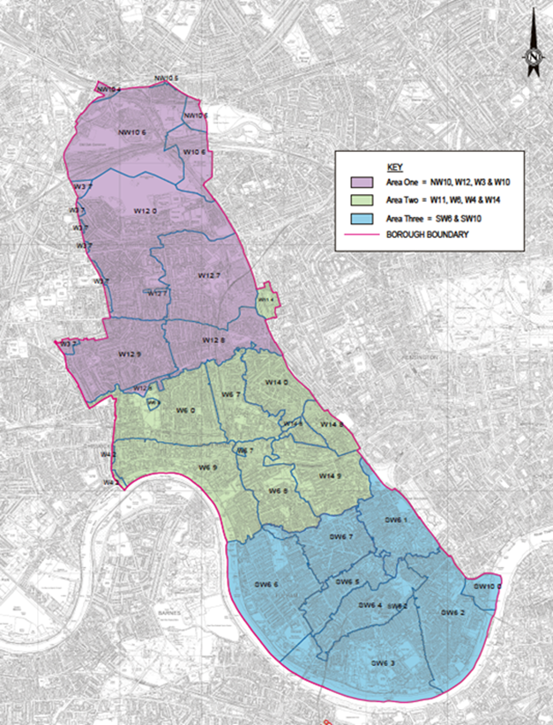
Lots 1-3: Responsive Repairs and Voids
Responsive repairs split into 3 lots (can only win 1 lot)
c12,000 properties. Lots 1 (North) and 3 (South) are similar sized but lot 2 (Central) has 50% more properties than lot 1
+ anticipated 350-450 minor voids a year
No structural voids (provided by lot 4)
We are asking for two prices:
Three years of minor voids (then done by DLO)
Five years of minor voids
Notes:
Please note when looking at the volume of works orders per lot that there may be multiple jobs linked to one work order.
We tend to define minor voids as voids which do not require capital works.

Slide 23
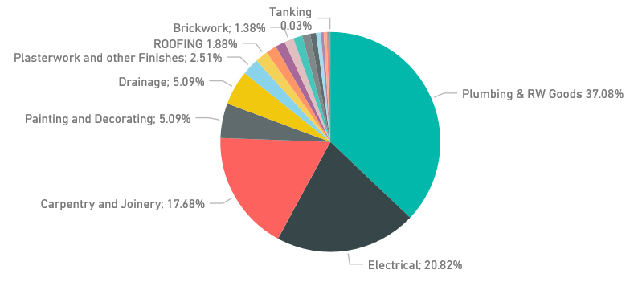
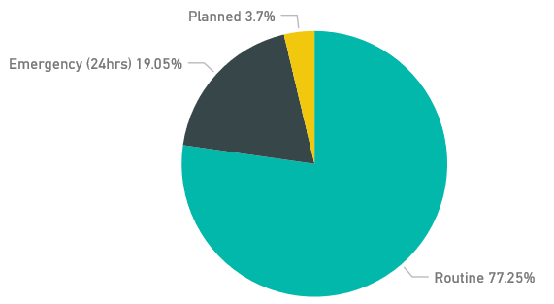
Repairs demand – priorities and trades
3 priorities for interim model
Emergency (24 hour)
Routine (30 days)
Planned (90 days)
High % of emergency jobs (new Call Centre, lots of legacy jobs on 4th or 5th visit)
New contracts will feature a 7 day priority time – expected to reduce emergency jobs
High proportion of repairs since April have been linked to water and drainage issues
Will provide demand data with OJEU notice

Slide 24
Repairs KPIs and quality
Fewer visits and missed appointments are key priorities for residents
97% appointments made and kept
92% Same day fix (24 hour window)
97% completed within timeframe + average completion time targets
+ resident satisfaction and complaints targets
New priority timeframes
24 hour
7 working days
20 working days
60 working days
A dedicated Client Manager for each contract plus a team of surveyors and technical officers
Client approach based on working together to find joint solutions
10% post-inspections
Notes:
The ‘first time fix’ is something which is very important to residents and which they emphasise as a requirement from the service.
Post-inspections will be conducted to ensure quality of workmanship and service.

Slide 25
Repairs commercial model
PPP and PPV based on prices for flats, houses and bungalows
Individual repair limit (IRL) of £2,000 for repairs and £6,000 for voids
Out of scope and >IRL will be priced using SOR
We will provide expected average replacement of component items for pricing
Expect clarity on overhead models and assumptions behind them
Expect clarity on profit and efficiency sharing
We have received positive feedback during interim period regarding the speed of paying PPP
Notes:
The individual repair limits in place were chosen as they are considered to enable contractors to use their expertise to get on with most work.

Slide 26
Lot 4 – Responsive Capital
Responsible for structural voids
Responsible for unplanned/responsive capital works, with a focus on fire safety and compliance
Different clienting and KPI approach (project not volume based)
Possible to be awarded lot 4 alongside any one other lot.

Slide 27
Questions?

Slide 28
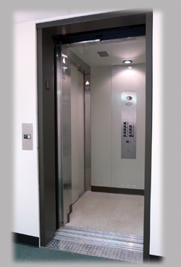



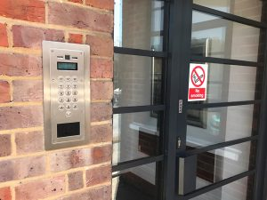
Mechanical and Electrical
Lot 5 - Gas
Lot 6 – Electrical

Slide 29
Services included within the lots
Gas
Domestic
Commercial
Electrical
Door Entry
EICR.s
Pat Testing
Lighting Protection
Lot 5
Lot 6

Slide 30
Gas: LBHF approach 2020
We maintain and inspect 11,153 domestic gas properties
1
We maintain and inspect 43 communal sites
2
Three gas safety inspectors
3
Gas Safety Manager Gas compliance officer
4
Our Existing Gas Contractor covers 24/7 365days
5
Meetings held monthly to ensure levels of safety and increase standards
6
Compliancy must always stand at 100%
7

Slide 31
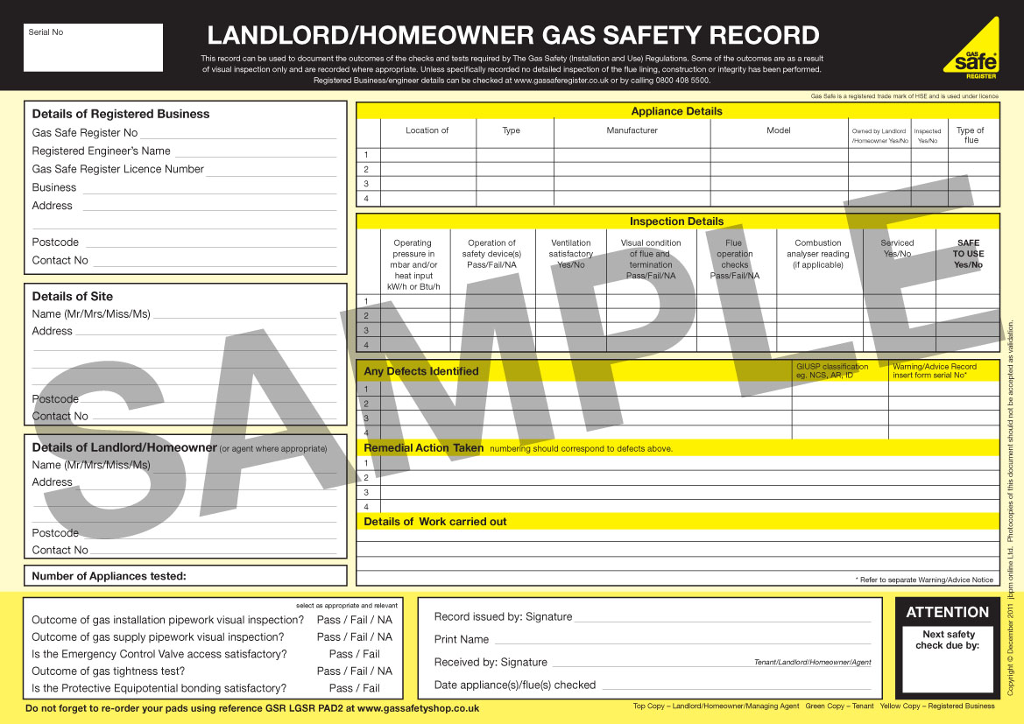
Gas: LGSR
LBHF is 100% GAS compliant 26th of September 2019
Live system and document checks carried out every day
No LGSR will be considered compliant by LBHF unless it has passed the 39 checks set out in the Corgi Document Management System

Slide 32
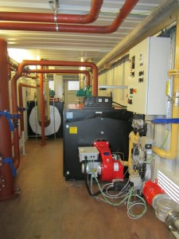
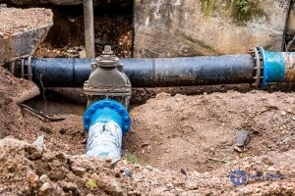
Boilers and plant rooms
Boiler replacements
LBHF install Ideal Logic boiler with some 7,000 high efficiency boilers already fitted across the borough (assisting with lowering fuel bills and reducing the need for multiple repairs).
All non-Ideal Logic boilers can be replaced if the contractors deem it ‘beyond economical repair’. The total of these replacements and planned works will not exceed 1,000 installs in any given year.
LBHF will ask that the contractor undertake the 5 year warranty works on behalf of Ideal, within our KPI timeframes.
Plant rooms
£2.9m of plantroom upgrades planned in 2019 – investment that should impact on future repairs.
6 recent plant room replacements demonstrates LBHF commitment to reduce fuel consumption with new high efficiency boilers.
Underground supply pipes (Seagrave 5 months).

Slide 33
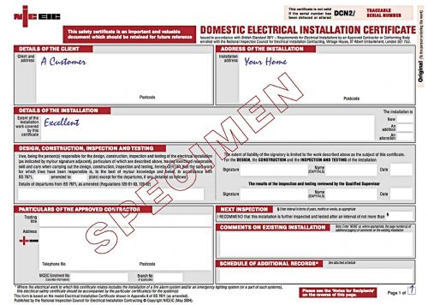
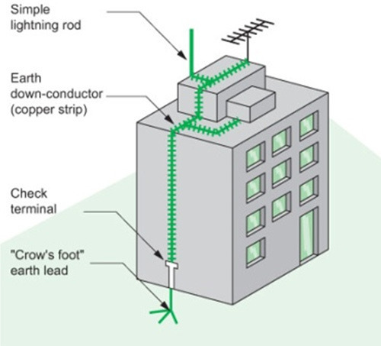
Electrical
Electrical Installation Condition Report (EICR): All EICR’s will be deemed satisfactory by LBHF after it meets the 78 checks of the CORGI document management system.
Electrical works: The contractor will undertake all C1 & C2 uncovered from the EICR reports.
Thermal testing: LBHF annually undertake thermal testing to all our (70 x 18m+) buildings.
Pat Testing: We examine, test and tag annually all fixed and portal appliances in sheltered property & TRA Halls.
Lightening protection: We examine and test 596 LBHF properties annually, producing a satisfactory certificate.
Door entry: LBHF undertake PPM to 252 systems compliant to SFG20.
Gates and Barriers: 9 sites where we undertake PPM to SFG20 Level.

Slide 34
Questions?

Slide 35
Asbestos
A single UKAS accredited Surveying and Analytical supplier to be appointed to cover the whole Borough (under a separate OJEU notice)
2 Licensed Asbestos Removal Contractors Lot 7 and Lot 8 - successful bidder in each lot will act as reserve in other half of Borough
Asbestos suppliers will not be required to interface with Northgate over Baris – all work orders will be raised in Northgate and issued by email
Asbestos contracts will support all repairs, voids and project work
Asbestos contracts require 24/7 emergency response 365 days per year

Slide 36
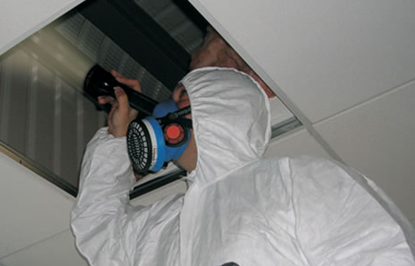

Asbestos Surveying and Analytical
Will play a key role in supporting all works
Will also undertake programme of reinspections to all non-domestic areas – currently on an annual basis
All analytical services to support 2 Licensed Asbestos Removal Contractors and any emergency air testing
Communication with residents to book appointments will be via the Council’s Customer Service Centre – 3 way call system
Notes:
Surveying is not part of this OJEU notice and will be procured on a slightly different timeframe.
Asbestos removals will need to work in symbiosis with the surveys, being informed by these.
Asbestos contractors will not be required to interface with Northgate through BARIS – rather an e-mail or spreadsheet upload solution will be found to sharing works orders.
Asbestos contractors will be required to deliver a 24/7 emergency service.
There is a 3-way call process with the Customer Service Centre to book appointments.
Asbestos surveys need to be uploaded into Geometra (LBHFs document management system) in the correct format, and the 3-day KPI turnaround includes this upload.

Slide 37




Asbestos Surveying and Analytical
Survey information will be required to be uploaded to the Council’s Asbestos Register ‘Geometra’ on a daily basis via FTP
Full surveys will be required in PDF format in addition to a data (CSV) file and photographs

Slide 38
Asbestos Surveying and Analytical
KPIs will focus on response times against SLAs;
4 hours for emergency attendance
24 hours for urgent surveys (instruction to report issue)
3 days for voids surveys (instruction to report issue)
5 days for standard surveys (instruction to report issue)
KPIs will also measure customer satisfaction and quality of surveys and data

Slide 39


Lots 7 & 8 – Asbestos Removal
All asbestos removal whether licensed or not will be undertaken under these contracts by a Licensed Asbestos Removal Contractor
Communication with residents to book appointments will be via the Council’s Customer Service Centre
Post works completion documentation will be submitted by email to allow the Council’s asbestos register to be updated
Notes:
Lot 7/8 (asbestos removals) will each cover half of the borough (split into north and south) – the contractor in either area can support the other as needed with works orders.

Slide 40
Asbestos Removal
Removal contractors will be required to have strong experience in the social housing sector and excellent communication both on site and with office and managerial staff
KPIs will focus on response times against SLAs;
4 hours for emergency attendance
Repairs - 5 days for attendance for non-licensed works/site inspection of licensed works
Voids - 3 days for attendance for non-licensed /site inspection of licensed works
KPIs will also measure customer satisfaction and submission of completion paperwork

Slide 41
Questions?

Slide 42
Any final questions – please see note takers after the session

Slide 43
Closing Remarks
Please watch out for the OJEU notice
Please let us know anything that occurs to you through Capital E Sourcing
Thank you for attending

Slide 44
End of Session

