Slide 1
Solar Framework Bidder Morning
10th February 2020

Slide 2
Welcome

Slide 3
Our Mission
In January 2019 Cornwall Council declared a climate emergency, recognising the need for urgent action to address the climate crisis. While the whole world needs to adapt, in Cornwall we have an opportunity to lead the way in demonstrating what is possible. The sooner we change, the sooner we can create a Cornwall that provides a clean, prosperous and fair future for all.
As a council we have a leading role to play in the climate emergency, but we cannot deliver these ambitious outcomes alone, we will need support from all of our residents, from our communities, businesses, schools, public sector partners, the voluntary sector and many more. We all have an important role to play in making change happen.

Slide 4
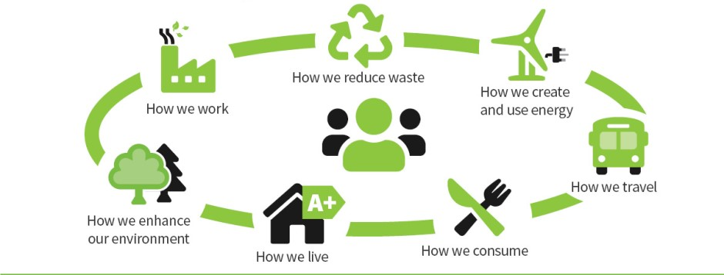
How we are going to do it!
This is where the Framework comes in!

Slide 5
Aims of the Day
Aims of today are:
Generate interest in the market for the Framework
Share the aims and objectives of the Framework
Share how we are planning to structure the Framework and procurement process to achieve those aims and objectives
Seek feedback on these plans – both today and after

Slide 6
Welcome
09:00 – Welcome
09:15 – Project Pipeline
09:30 – Framework Objectives and Scope
09:50 – Framework Operation
10:15 – Any Questions
10:30 – 10:45 - Break
10:45 – 12:00 – An Introduction to Public Procurement

Slide 7
Project Pipeline

Slide 8
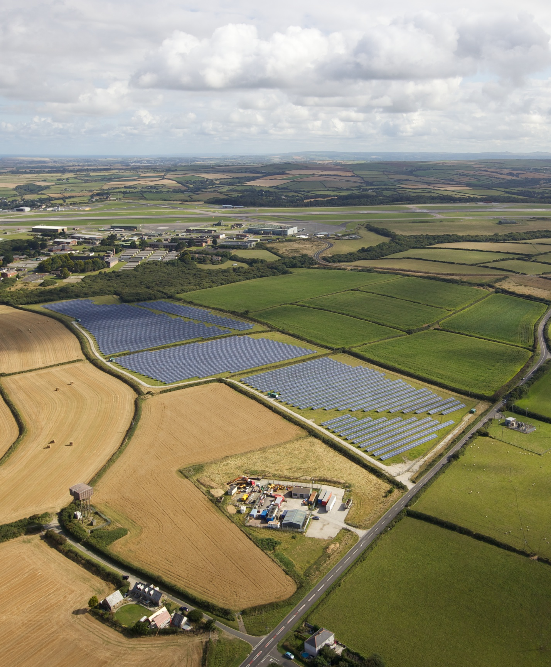
Opportunity
Increasing our installed capacity of renewable energy
Carbon neutral Council by 2030
£multi-million pipeline of solar PV projects under development
Notes:
CC already have experience installs from previous PV rounds inc Kernow solar farm

Slide 9
Project Pipeline
Phase 1 - for Summer 2020 install:
160kW + 50kW commercial rooftop
400kW ground mount
Further projects:
500kW x1 school rooftop
600-700kW commercial rooftop spread across 10 sites
1-3MW ground mount
Future pipeline:
Council offices, workspaces, leisure centres, schools and academies, domestic.
Notes:
Future pipeline - Will cover roof, ground and solar canopies

Slide 10
Framework Scope and Objectives

Slide 11
Framework Objectives
Meet the Council’s pipeline requirements
High quality design and install
Support local companies
Easy to use both for suppliers and 3rd parties who access the framework (schools, town and parish Councils)

Slide 12
Framework Scope
Lot | Type | Size | Number of companies
1 | Domestic (10 properties) | Any | 1-3
2 | Commercial rooftop | < 50kW | 1-3
3 | Commercial rooftop | > 50kW | 1-3
4 | Commercial ground mounted | Any | 1-3
5 | Post installation inspections | Any | 1
Notes:
Specifications available for each lot
Do we mention solar canopies

Slide 13
What Success Looks Like
Demonstration of delivery of high quality, safe and maintainable installations to minimise risk
Demonstration of value for money
Reasoning behind specification for products specified
Provision of no-cost survey and design work as required
Demonstrates H&S competencies/ training assessments:
e.g. Management of the work and responsibilities, arrangements for controlling site risks, risk assessment and method statements, Safe working procedures, site set up and welfare arrangements, site induction and project briefs, arrangements for sub-contractors and evaluation of their safety documentation, project COSHH data and formulation of COSHH risk.
Training of key Council stakeholders on solar PV, particularly monitoring
Provision of a key contact person (and vice versa) to ensure effective communication and delivery.
Complaints procedure
Timescales for delivery

Slide 14
Value Added
South West based or using local subcontractors where appropriate
Experienced providers
Low carbon in operations
Shares industry updates
Can signpost to relevant funding opportunities
Active in bringing potential RE opportunities to the Council
Can support joint marketing opportunities
Demonstrates O&M capabilities
Can work on both low-voltage and high-voltage projects
Notes:
Positive working relationship or future build out
Providing work, helping to grow local economy

Slide 15

1. Domestic Rooftop
• A 3kW on-roof array on a south-facing slate roof with 30° tilt, no shading, in Cornwall. Portrait orientation with suitable access equipment for a 2-storey building.
• Tier-1 crystalline solar PV modules that are MCS-accredited and appropriately salt-mist tested for saline environments.
• Single-phase inverter with remote module performance and arc-fault detection capability enabled, minimum 10-year warranty.
• A suitable non-penetrative fixing system.
• All DC and AC cabling containment and switchgear (including TGM metering).
• Full installation, testing and commissioning to most up-to-date regulations and guidance.
• Structural assessment and Building Control approval.
• Grid connection application and liaison with WPD and Support client to arrange metering.
• System and monitoring handover, including PV electrical and mechanical system schematics and post-installation site visit with a representative from, or appointed by the Council.
• Provide a comprehensive 1-year warranty and a system health-check prior to handover to the designated O&M provider.
For the purposes of this bid please assume an import and export rate of 16p/kWh and 5p/ kWh respectively, and site utilisation of 30%. A 20% VAT rate applies.

Slide 16

2. Commercial Rooftop <50kW
• A 30kW on-roof array on a south-facing concrete tile roof with 20° tilt, no shading, in Cornwall. Portrait orientation with suitable access equipment for a 2-storey building
• Tier-1 crystalline solar PV modules that are MCS-accredited and appropriately salt-mist tested for saline environments.
• 3-phase inverter(s) with remote module performance and arc-fault detection capability enabled, minimum 10-year warranty. Assume inverter installation on ground floor next to other electrical distribution equipment.
• A suitable fixing system.
• Online monitoring of solar PV performance and import/export energy flows.
• All DC and AC cabling containment and switchgear.
• Full installation, testing and commissioning to most up-to-date regulations and guidance.
• Structural assessment and required Building Control approval.
•Grid connection application and liaison with WPD and Support client to arrange metering.
• System and monitoring handover, including PV electrical and mechanical system schematics and post-installation site visit with a representative from, or appointed by, the Council.
• Provide a comprehensive 1-year warranty and a system health-check prior to handover to the designated O&M provider.
For the purposes of this bid please assume an import and export rate of 14p/kWh and 5p/ kWh respectively, and site utilisation of 80%. A 20% VAT rate applies.

Slide 17

3. Commercial Rooftop >50kW
• A 150kW on-roof array on a south-facing steel trapezoidal roof with 15° tilt, no shading, in Cornwall. Portrait orientation with suitable access equipment for a 3-storey building.
• Tier-1 crystalline solar PV modules that are MCS-accredited and appropriately salt-mist tested for saline environments.
• 3-phase inverter(s) with remote module performance and arc-fault detection capability enabled, minimum 10-year warranty. Assume inverter installation on ground floor next to other electrical distribution equipment.
• A suitable fixing system.
• Online monitoring of solar PV performance and import/export energy flow.
• All DC and AC cabling containment and switchgear
• Structural assessment and Building Control approval.
• Arrange formal grid connection offer from WPD prior to installation
• Full installation, testing and commissioning to most up-to-date regulations and.
• Grid connection application and liaison with WPD and Support client to arrange metering.
• System and monitoring handover, including PV electrical and mechanical system schematics and post-installation site visit with a representative from, or appointed by, the Council.
• Provide a comprehensive 1-year warranty and a system health-check prior to handover to the designated O&M provider.
For the purposes of this bid please assume an import and export rate of 12p/kWh and 5p/ kWh respectively, and site utilisation of 80%. A 20% VAT rate applies

Slide 18

4. Commercial Ground-Mounted
• A 500KW ground-mounted system, south facing with 30° tilt, no shading, in Cornwall. Portrait orientation.
• Assume that planning has been granted, the site is level, good access is provided and the array is set out as a square.
• Tier-1 crystalline solar PV modules that are MCS-accredited and appropriately salt-mist tested for saline environments.
• 3-phase string inverter(s), minimum 10-year warranty. Assume inverter installation on the array frame.
• Online monitoring of solar PV performance and import/export energy flows.
• A suitable monopole pile-driven fixing system.
• All DC and AC cabling containment and switchgear.
• Structural assessment
• Arrange formal grid connection offer from WPD prior to installation
• Full installation, testing and commissioning to most up-to-date regulations and guidance (e.g. IET Code of Practise).
• Grid connection application and liaison with WPD and support client to arrange metering (where applicable).
• System and monitoring handover, including PV electrical and mechanical system schematics and post-installation site visit with a representative from, or appointed by, the Council.
•
Provide a comprehensive 1-year warranty and a system health-check prior to handover to the designated O&M provider.
In addition to the above please provide an indicative unit cost (£/ meter) to trench a single cable through a field to a depth of 1m, including labour, plant hire and appropriate sanding and taping.
For the purposes of this bid please assume an import and export rate of 12p/kWh and 5p/ kWh respectively, and site utilisation of 0%. A 20% VAT rate applies.

Slide 19

5. Post-Installation Quality Assessment
3rd-party post-installation quality assessment to provide reassurance that the PV system has been installed according to the agreed specification and to current standards and industry best practice.
The onsite assessments of installation quality cover the physical implementation of the design and workmanship. The following tasks will be carried out as part of a site inspection:
Adequate rectification of any issues identified is vital to ensure that a good quality system is installed, and therefore that the system is safe and the technical and financial performance is likely to be achieved. It is understood that the client would undertake rectification measures via their appointed installation contractor.
If significant remedial measures are required a second visit may be required to ensure the works have been completed correctly. However, for minor issues photographic evidence of improvements will normally suffice.
Safe access to each solar array and system equipment will be provided by the Council or their appointed installation contractor and needs to be available for the site visit. We therefore recommend that the installation quality assessment is completed as soon as practically possible after the systems have been commissioned.
Verification of system components to design | Checking that the installed system reflects the design and any subsequent variations are compliant and have been considered.
Installation compliance checks | Including electrical and mechanical installations, safety signs and labelling.
Assessment of workmanship | Assessing the installation and its components are fit for purpose and are capable of providing the required function through observation of good installation practices.
Validation of contractors QC procedures | The initial installation compliance checks will allow us to assess whether the installer's QC procedures are effective and to feed information back in order to strengthen any weak areas.

Slide 20
How The Framework Operates

Slide 21
Introduction to Capital Projects
The Framework and any call-off contracts will be managed by the Council’s Capital Projects Team.
The team exists to manage the elements of the Council’s Capital Programme which is delivered internally (as opposed to by Treveth).
Staffed largely by Project Managers with Commercial and Site Support teams.
The Capital Projects team has existing Frameworks in place alongside which this contract will sit:
Built Environment Professional Services (BEPS) – Consultant Requirements
Major Works – Large construction, M&E and Housing Schemes
Minor Works – Smaller construction projects
Demolition
Health and Safety Inspections
In order to maintain easy of use the structure of contracts and call off processes is kept as uniform as possible.

Slide 22
Lot Structure
Mixture of single supplier and competitive lots:
Lot | Type | Size | Number of companies
1 | Domestic | Any | 1-3
2 | Commercial rooftop | < 50kW | 1-3
3 | Commercial rooftop | > 50kW | 1-3
4 | Commercial ground mounted | Any | 1-3
5 | Post Installation Inspections | Any | 1
For competitive lots the number of suppliers will depend on scores achieved during the tender

Slide 23
The Framework
Modelled on Councils other Frameworks – contract consists of the Framework contract containing all standard legal elements and Schedules providing Framework specific information.
While the Schedules are Framework specific numbers is kept uniform across Frameworks so while there are 31 included 20 are marked as not use.
Schedules included are:
Framework Pro-Forma (Call Off Documents etc., Access Agreements etc.)
KPIs
Insurance Requirements
Turn Over Rebate
Method of Operation
Health and Safety
Key Personnel (Framework Manager)
Organisations (who else can use the Framework)
Projects (reverse the right to use for installation of complimentary technologies)
Framework Management
Safeguarding

Slide 24
Procurement Process
OJEU Open Procedure. Starting March, aim to conclude by June
Run through our etendering Portal SupplyingtheSouthWest.org.uk (Pro Contract/Due North)
Tender will consist of:
Standard SSQ Questions (Pass/Fail)
Who you are
Exclusionary Criteria
Health and Safety
Equality and Diversity
Insurance
Data Protection
Financial Standing
Modern Slavery
Tender Specific Quality Questions (70%)
Tender Specific Price Questions (30%)
Based upon standard scenarios with list of standard variations.
Weighting applied to each to produce a “Tender Price”

Slide 25
Procurement Process
Quality Questions will be on:
Quality of the Installation – What processes will be used to ensure low maintenance costs
Quality of Equipment
Quality of Handover
O&M – Responses to incidents
Resources – Key People at Framework and Site Level
Health and Safety

Slide 26
Call Off Process
Issue Project Notification Form to all suppliers on a Lot
Supplies respond stating whether or not they would bid on a Project
Issue Form of Enquiry to all suppliers indicating their interest in a project
Receive bids and evaluated
Award contract (MOA)
If used by an Organisation other that the Council an Access Agreement must be signed by that Organisation.
Planning already achieved. Design may or may not be included.
In certain circumstances the Council may wish to award a contract without competition as set out in the Method of Operation.
There may be occasions where we instruct other Framework holders (e.g. Kier, Gilbert and Goode or Mispace) to use Framework contractors to install panels as part of their projects. In these circumstances appointments will be made outside of the Framework but installations should be based upon the same high quality specification.

Slide 27
Call Off Process
Call Off contracts are based upon NEC4 Engineering and Construction Short Form. There will be some z clauses included in the Framework.
Site and Works Information are provided as part of the call-off process

Slide 28
Call Off Process
Call Off Assessment Criteria:
Quality (60%)
Price (40%)
Price – Fixed cost for the installation. Maximum price chargeable is Framework rate plus site specific add-ons.
Quality:
Method Statement – Site Specific to include Liaising with site occupants, equipment selected, project specific risks, sub contractors and low carbon installation
Programme
Key People

Slide 29
Comments
Copies of the draft documents are (or will be) available on Contracts Finder or at http://bit.ly/CCSolar
Any comments on them or any thing else in this presentation in the next two weeks would be welcome.

Slide 30
Any Questions?

Slide 31
Public Procurement

Slide 32
What The Law Is
Public Procurement is governed at EU level by the Public Procurement Directive (2014/24/EU) transposed into UK law by the Public Contract Regulations 2015.
Alongside these regulations sit by Procurement Policy Notes issued by the UK Government, advice from the Public Procurement Review Service and UK and EU case law.
The law lays out:
The processes that can be used (Open, Restricted etc.)
Time limits for those processes
Rules for contract management (limiting variations etc.)
Questions that can be asked during the tender – they can only relate to the future not the past
Appeals processes and consequences (cancelled contract or damages)
The law largely relates to contracts over a threshold, but there are fundamental requirements for Contracting Authorities to be:
Non-discrimination
Equal Treatment
Transparency
Proportionality

Slide 33
Requirements on the Council
The fundamental requirements impact all parts of a procurement.
For example if a bidder forgets to upload a document as part of their return:
Need to be proportionate – not allowed just to disqualify the bidder
But need to be fair to other bidders – does extra time give the bidder an advantage?

Slide 34
Requirements on the Council
Before and during the tender treat all bidders fairly, ensuring everyone has the same opportunities and access to the same information.
We can talk to bidders but during this process must ensure the requirements aren’t shaped around a particular solution.
Disclose all tender documents at the start of the process making them available free of charge to all interested parties.
Disclose all assessment criteria including any sub criteria and weightings.
Publish notices advertising the requirement (and it’s award)

Slide 35
General Tips For Tendering
If anything is unclear or contradictory – ask!
The contract cannot be changed after tenders are submitted but can be changed during the tender – make requests then. Do not submitted caveated bids – they are not valid.
Don’t mark questions as confidential unless they relate to the specifics of your bid. This delays answers.
Don’t wait too late to ask for an extension.
Read scoring criteria for quality questions and address them in your answers.
If you have any concerns act quickly – only have 30 days to challenge from when you SHOULD have known about the issue. Use the Public Procurement Review Service if you want to remain anonymous.

Slide 36
Tips For Tendering
Complete online questions early – Due North is not user friendly and is slow.
Check you pass minimum criteria before doing rest of tender – and if you don’t remember requirements for Council to be proportionate!
Check page limits, especially if saving as pdf.
Where CVs are requested tailor to contract.
Check details – if reusing work check names have been changed correctly, we are not a County Council!

Slide 37
Any Questions?

Slide 38
Thank you / Meur ras
If you have any questions or comments
Stuart.Hinde@cornwall.gov.uk

