Slide 1
Understanding key drivers that impact travel choice
Presented by Andrew Gleeson

Slide 2
Introduction
Who are RSSB
What is Research and Development
How are we funded
Who are we

Slide 3
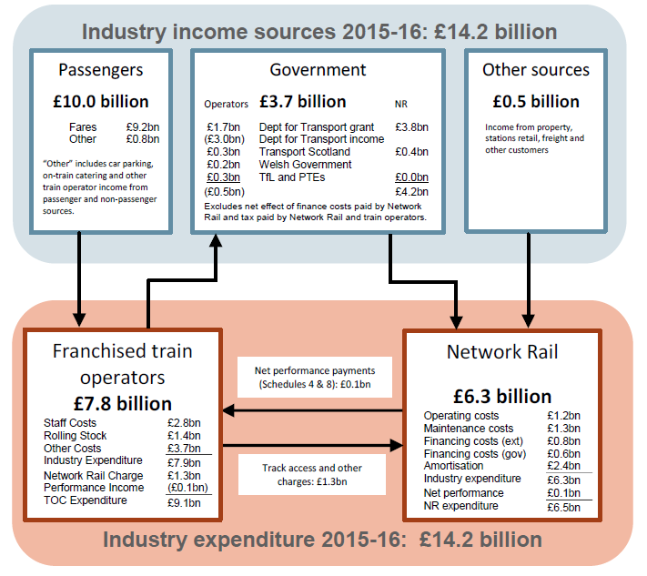
Introduction – Why is predictability important

Slide 4
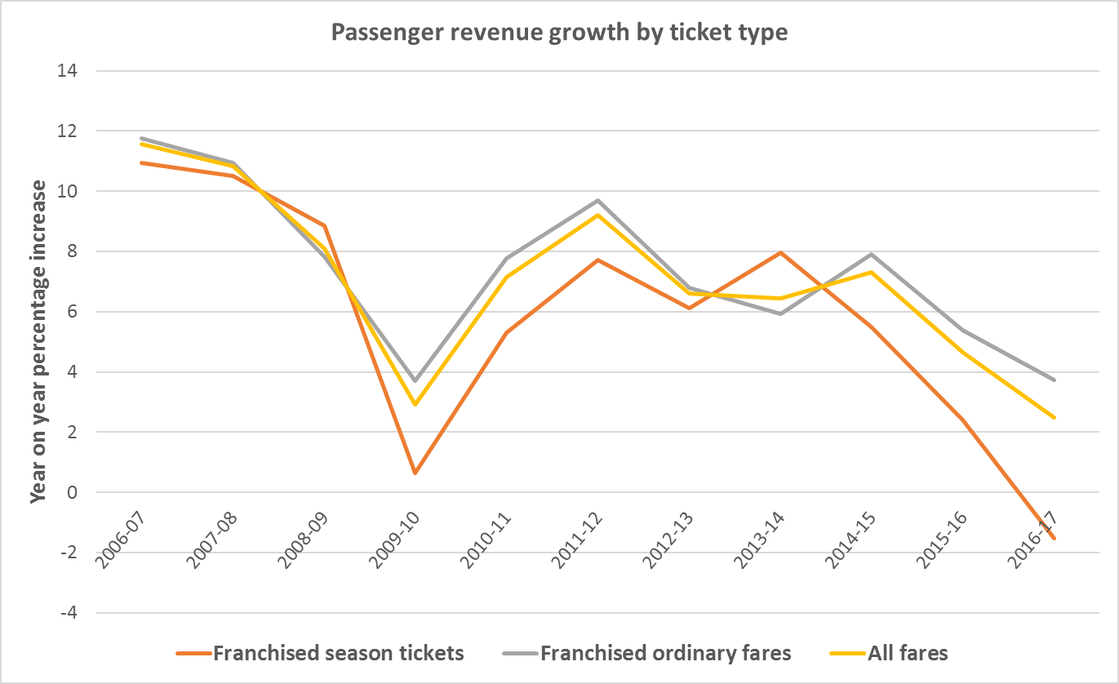
Background
A unexpected decline in growth in the rail industry (https://dataportal.orr.gov.uk/)
Then
Now

Slide 5
Work so far – Hypothesis
An accelerated pace of change in society could lead to dramatic changes currently outside of our understanding.
A recent desk based research funded by RSSB and carried out by KPMG has identified key trends that could have an impact. Scoping study on future trends that could influence passenger rail demand (2017), KPMG
Identified the need to have a better understanding of:
Potential impacts of the key trends identified
The decisions made by customers

Slide 6
Work so far – Trends
Transport needs
Transport choices
Structure if the economy
Price, quality and availability of transport
Policy and regulation
Robotics
Connected vehicles
Regulation
Gig economy
Automation
Autonomous vehicles
Hyperloop
Demand management
Licensing
Socio- demographic structures
Alternatives to travel
Integration between modes
Online commerce
Charging
Income distribution
Flexible working
Digital Railways
Dispersion of personal networks
Remote working
Sharing economy
Growing population
Urbanisation
3D printing
Account based ticketing
Ageing population
Mobility as a service
Car ownership
Drones
Personalised information

Slide 7
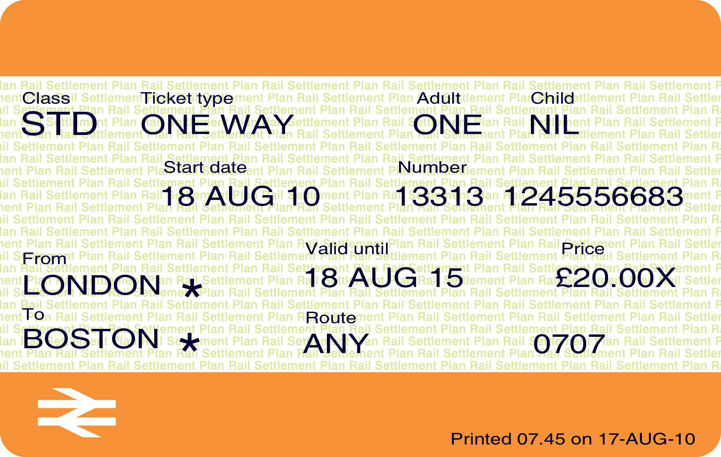



Work so far - Customers
What does a customer look like?
Advance
Business
Off peak
Commuter
Anytime
Leisure
Season

Slide 8
Objectives of our study
Ability to predict how key trends impact rail demand in the future
Have the capability to monitor the development of these trends
Understanding different customer’s needs and what drives their behaviour
Identifying ways industry can meet these changing needs
Promoting ways to encourage growth in existing and potential customers

Slide 9
Discussion

Slide 10
What we need from you
Technical:
Are their barriers to achieving the objectives?
Is this the right approach, and can the objective be achieved?
What are the challenges?
What does good look like?
What should the deliverables be?

Slide 11
What we need from you
Time: Completed by March 2018
Are timescales achievable?
What more could be achieved within a longer time period?
Budget: £150k upper limit
Is the budget appropriate?
How might the outputs change with a variation to the budget?
Anything else: Is this the right approach, Have we missed something?

Slide 12
Thank you

