Slide 1
General practice services for the Dulwich population
21 June 2018

Slide 2
Welcome
Team
Caroline Gilmartin – Director of Integrated Commissioning
Jean Young – Head of Primary Care Commissioning
Rachel Doherty - Primary Care Commissioning Manager
Emily Gibbs – Clinical Lead
David Mansfield – Procurement lead
SEL PCT TBC

Slide 3
Welcome
Agenda
Introductions and housekeeping
Background
Proposed Model
Questions and Answers
Discussion
Procurement Process and Draft Timeframe
Next Steps

Slide 4
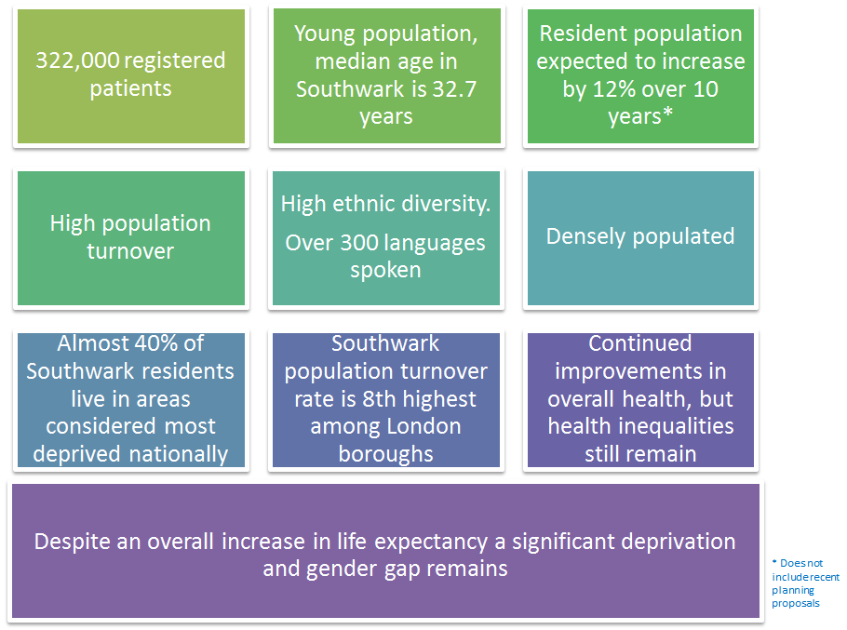
Introduction to Southwark CCG

Slide 5
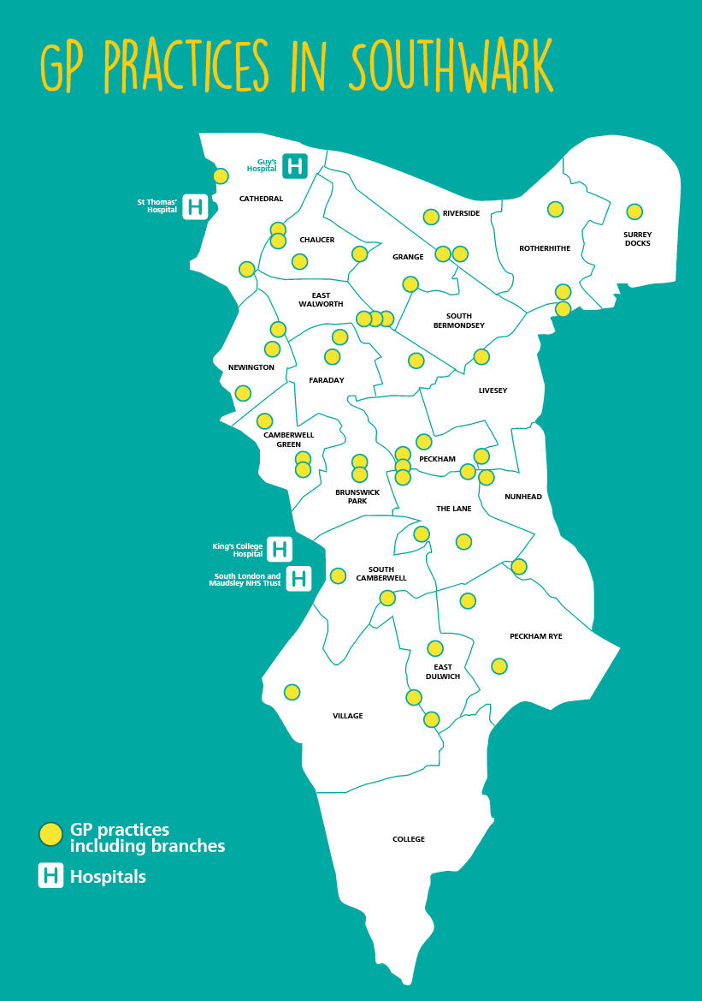
Introduction to Southwark CCG
Southwark GP services profile:
38 GP practice contracts over 41 sites
2 APMS contracts expiring in March 2019 in Dulwich
Extended Primary Care Service in Peckham for south Southwark patients
1 new Dulwich Health Centre with General Practice service space from spring 2020
Consideration of other populations needs e.g. Barry House residents

Slide 6
Southwark Five Year Forward View
The CCG and Southwark Council want to enable the best possible health and care outcomes for the people of Southwark as set out in our joint Southwark Five Year Forward View.
Our shared vision is for people to stay healthier at home for longer by:
supporting people to manage their own health and well-being,
doing more to prevent ill health and by providing more services in people’s homes and in the community, with less reliance on care homes and hospital based care,
supporting people to feel in control of their lives and their care, with the services they receive co-ordinated and planned with them around their individual needs
enabling stronger, more resilient and resourceful communities.
Southwark health and care providers have come together in two Local Care Networks (covering the north and south of the borough) to work collaboratively to try and address common challenges. GP Federations in Southwark represent general practice on the LCN Boards.
.

Slide 7
Primary Care Strategy
All Southwark practices are members of our GP federations – extended primary care service providers working with local practices; population health management; neighbourhood clusters to improve service quality
Southwark Clinical Effectiveness Approach
Our commissioning intentions for general practice focus on the three specific areas – Access/ Prevention/ Care Coordination. These are included within the new premium specification
Combination of individual and collective incentives to reduce unwarranted variation.
A focus on continuous quality improvement to support the sustainability of general practice in Southwark and quality improvement for our patients

Slide 8
Background to Requirement
NHS Southwark CCG currently have 2 separate General Practice Alternative Provider Service (APMS) contracts in Dulwich which will be procured as 1 APMS contract with a merged registration list
Also considering the future of the Extended Primary Care Services (GP hub 7 day a week, 8am – 8pm)
currently located at Lister Primary Care Centre APMS contract
Access for Dulwich patients in new site

Slide 9
Current Model
2 GP practice APMS contracts
Melbourne Grove Medical Practice
Hambleden clinic
1 APMS contract for GP hub 7 days a week, 8am – 8pm GP services – Extended Primary Care Service
Services for residents of Barry House - under review

Slide 10
Current Model
Hambleden Clinic | Melbourne Grove Medical Centre | Extended Primary Care Service
Current site: Denmark Hill, SE5 8HL It is proposed the practice will move to the Dulwich Health Centre in 2020 A member of the GP federation in south Southwark – Improving Health Limited 5388 registered patients (Q4 17/18) Current provider = AT Medics | Current site: 7 Melbourne Grove, East Dulwich, SE22 8QN It is proposed the practice will move to the Dulwich Health Centre in 2020 A member of the GP federation in south Southwark – Improving Health Limited 7181 registered patients (Q4 17/18) Current provider = Concordia | Located at the Lister Primary Care Centre in Peckham. It is proposed the practice will move to the Dulwich Health Centre in 2020 Service provides appts 8am – 8pm, 7 days per week for all patients registered with south Southwark practices (145,000 patients) Current provider = Improving Health Limited
Services to Barry House residents are current under review.
The CCG has historically commissioned 4 GP sessions were provided at Barry House.
NHS England commissions the Health Inclusion Team to provide health screening.

Slide 11
Proposal
Consideration of model to be procured dependent on engagement from providers and patients to be completed by early July
CCG Governance process July/August
Procurement start September
Award contract January 2019
New contract starts 1 April 2019 in current premises
Move to new premises spring 2020

Slide 12
Proposal
Questions and Answers on proposal
Market response to the proposal discussion
1 registered list – impact of move from current sites
Benefits of co-location of contracts
Impact of changes to the GP hub for patients and providers
1 contract or difference approach to service provision

Slide 13
Procurement Preparation
Register now on ProContract: https://procontract.due-north.com/register;
Access the ProContract Help centre for “how to” guides and video tutorials; and
Contact the ProContract Help desk if you are unable to resolve a technical problem (t: 01670 597136).

Slide 14
Procurement Imperatives
Post-publication, read all of the procurement documentation, specifically the Invitation to Tender (ITT) Guidance, Memorandum of Information (MoI) and Draft Contract;
Submit Clarification Questions as early as possible in the procurement phase (via ProContract) and note the deadline for receipt; and
Submit your ITT response by the stated deadline and in alignment with the ITT Guidance.

Slide 15
Indicative Timetable (subject to operational change)
A provisional timeline for the procurement, including key milestones (eg. ITT publication/submission date) will be communicated in due course;
The key dates are as follows:
Contract Award (January 2019)
Service Commencement (April 2019)
Service Move (Spring 2020)
To reiterate the key message from the preceding slide, you should use the available time prior to ITT publication to register on ProContract and access the guidance available from the Help centre.

Slide 16
Next Steps
A copy of this presentation will be posted on Contracts Finder and circulated by email to all attendees;
ITT publication date will be communicated in advance; and
Details of a subsequent Bidder Information event will be publicised.

Slide 17
Close
Q &A….

