Slide 1


A Place Brand for
April 2021

Slide 2
Places don’t need brands - places are brands.
It's important that places behave like brands because they're in competition - to attract businesses, investment, visitors and great people.
A place brand isn’t a logo or a font, it’s a set of shared values and common goals that give focus to a place and its people.
These shared values and common goals achieve vital things for two audiences:
LOCALLY - Crewe's placebrand can help to strengthen communities and unite locals through a shared vision of the town’s future.
PUBLICLY - The place brand can shape and enhance the image of Crewe that people hold in their minds - whether consciously or not - on a regional, national and international level.
This document lays out the Crewe narrative and shows how the Crewe values can translate into a visual language.
The visual brand isn't a logo, but a new visual way of communicating about Crewe using typography, pattern, shape and colour to create something that looks great and feels ‘Crewe’.

Slide 3
The research
1352 responses to a digital survey 150+ engaged face to face through a
place brand masterclass and workshops
5 sector-specific place narrative workshops
40 reports and data sets analysed
Media and social media monitoring
3 community outreach sessions
1-to-1 stakeholder consultations

Slide 4
Brand Narrative

Slide 5
1.1 Our values
We are people-powered
The people of Crewe built our town from the ground up. We made this place what it is – and we continue to play a part in its future. We are proud of our industrial heritage and continue that legacy, using our skills to forge quality in Crewe, with strengths in manufacturing, industry, digital and creativity. Through hard work, we are creating a place of celebrated businesses, skilled people and a self-starting attitude.

Slide 6
1.2 Our values
We get things done together
In Crewe, we are an active and engaged community. We participate, we are resilient and we’re always ready to roll up our sleeves; unafraid of a challenge and ready to embrace change. We welcome everyone to get involved and work to better ourselves and our place. We care about our
green space, prioritise the wellbeing of our people, and nurture talent in sports, culture and creativity.

Slide 7
1.3 Our values
We build connections
Crewe is a place of potential – where we work to better ourselves and our place through partnerships, connections and communities. We build pathways for skills, careers and living. We join the dots between our surrounding towns, ideally positioned to benefit our residents, businesses, visitors and the wider economy. As a beautifully connected place, Crewe plays a vital role in the region physically, socially and economically.

Slide 8
The Brand Filter
The brand filter is a tool which turns the values from a set of ideas into a decision-making framework.
To use the brand filter, you simply 'filter' any proposed idea or activity through the values. If all of the values are expressed in some way then the proposal will support and promote the Crewe narrative, and therefore the town as a whole. If the proposal falls short of any (or all) of the values, then you can identify actions that will help you to reach them.
This brings clarity to decision making, fosters innovation, encourages creative thinking and ensures that actions taken at every level of the town - from large scale development to community support; from procurement to PR - will positively contribute to Crewe's future.

Slide 9
CORE VALUE 1
We are people- powered
CORE VALUE 2
CORE VALUES
We get things done
together
CORE VALUE 3
We build connections
Brand Filter

Slide 10
Language: tone of voice
What is tone of voice?
Our tone of voice is how we communicate our personality to our audiences. It’s the kind of language we use and the words we choose – whether we’re writing or speaking
Why does it matter?
The way we speak influences how people think and feel about our place, so it’s essential to get it right. If we want all of our audiences - from residents to visitors to investors - to really understand who we are and what we stand for, then we need to communicate with them in the right way.
When do we need to think about it?
Always! Tone of voice (or personality) matters for every single communication opportunity that we have with our audiences – from websites and press releases to social media messaging, emails, and face-to-face interactions. Because it’s such a big part of how our place is perceived, paying attention to personality and tone of voice should be an important part of the narrative adoption process for Crewe.
Language tips
The Plain English Campaign’s language rules help brands avoid unnecessary jargon and clunky phrasing that can confuse or alienate people. Referring to these rules will encourage consistency and an accessible voice across all communications – no matter who you’re talking to.
Use friendly pronouns
Use ‘we’ and ‘you’ to help build an emotional relationship with your audience.
Be clever with the turn of phrase rather than relying on multisyllabic words. If you can’t say what you want in simple terms, try rearranging the sentence.
Use everyday English whenever possible
Use active verbs as much as possible - eg ‘Crewe has launched a new initative to improve local access to STEM career pathways’ rather than ‘a new initiative was launched in Crewe’.
What's the best tone of voice for talking about Crewe?
The way we communicate should align with our narrative, and be designed around the emotions that we want to evoke in our audiences. Based on the core values, we need to show that we are:
Down to earth - straightforward and trustworthy
Eager to make things happen - ready for change and not afraid of the work needed to make it happen
Focused on our future, and how it has been informed by our heritage
Always looking outward to our network of surrounding towns and villages
Always keen to tell stories of the achievements of our city and proud of our achievements
Always taking our natural environment into consideration
A can-do place with a can-do, positive attitude

Slide 11
Language: tone of voice
These are some words and phrases that could inform key messaging for marketing and promotional campaigns.
Can-do Crewe
Nurturing skills; celebrating industry A people-powered town
Industrial heritage to industrious people
Skilled people, brilliant businesses and a self-starting attitude We made this place
Forged by hand
A self made town
Hard working | straightforward | loyal | resilient We built our town from the ground up
Crewe joins the dots
Getting you where you want to be A home of skills and creativity
New skills, new industries, new people

Slide 12
Visual Identity

Slide 13
Crewe’s visual identity is inspired by graphic wayfinding systems, raw industrial materials and the constant energy and movement of a hard-working town.
Bold directional pattern form the primary visual language throughout our identity, demonstrating skill in making as well as Crewe's physical connectivity with surrounding towns & cities.

Slide 14
02.00 Visual Identity
A Place Brand for Crewe
CREWE BLUE
PANTONE
CMYK: 25 - 12 - 15 - 0
RGB: 36 - 90 - 168
#245AA8
02.3 Colour palette
Inspiration for our colour palette has been drawn from various Crewe characteristics.
Crewe blue, our primary colour, comes from Crewe's crest. Oil slick, industrial grey and charcoal are all hard wearing industry colours, whilst energy and racing red are tied to Crewe's automotive heritage. These individual tones have been carefully selected to help form strong associations with Crewe and our values as well as being suitable to create contemporary visual communications for now and many years to come.
OIL SLICK
PANTONE
CMYK: 25 - 12 - 15 - 0
RGB: 28 - 46 - 64
#1C2E40
ENERGY
PANTONE
CMYK: 25 - 12 - 15 - 0
RGB: 239 - 85 - 136
#EF5588
RACING RED
PANTONE
CMYK: 25 - 12 - 15 - 0
RGB: 178 - 41 - 41
#B22929
INDUSTRIAL GREY
PANTONE
CMYK: 25 - 12 - 15 - 0
RGB: 211 - 209 - 203
#D3D1CB
21
CHARCOAL
PANTONE
CMYK: 25 - 12 - 15 - 0
RGB: 34 - 36 - 36
#222424

Slide 15
02.00 Visual Identity
A Place Brand for Crewe
Guidelines 2020
02.4 Bold pattern
Our patterns are inspired by industrious machinery, cogs and bolts, all of which are commonly used to connect and construct.
Elements of a hexagon play the primary role in the creation of our patterns, whether that be a perfectly formed hexagon or some part of the hexagon, warped and tesselated to create a new pattern. These angles help to create a directional effect, tying in the pace and energy of industry and the people that power Crewe. Chevron arrows reference transport and connectivity -and form part of a universal graphic system we associate with journeying and wayfinding.
23

Slide 16
02.00 Visual Identity
A Place Brand for Crewe
Guidelines 2020
Light
Medium
Heavy
02.4 Detailed pattern
A. The angle of tracks / standard chevrons are based on the angled side of a hexagon, which is roughly 30° from the vertical line. These patterns are used as detail touches and are secondary to the bold pattern.
A. Tracks
B. Chevron arrows are a great way of creating texture and depth as well as drawing the eye to a particular piece of information.
C. The 30° rule can be broken only when tiling the chevron pattern to fit into a particular space, by stretching or compressing the grouped shapes.
B. Chevron
Measuring guide:
30°
30°
C. Warp & tile

Slide 17
02.00 Visual Identity
A Place Brand for Crewe
Guidelines 2020
02.4 Pattern & typography
A PLACEBRAND FOR CREWE
This page shows a combination of pattern and typographic compositions using our primary typeface, Chivo, in a variety of weights and styles.
It is important that there is always a relationship between typography (in both meaning and placement) with the bold and directional patterns. The pattern itself is inspired by our values - they are dynamic, energetic, connective and directional.
Skilled people, brilliant businesses and a self-starting attitude
WE WORK
A PLACEBRAND FOR CREWE
A PLACEBRAND FOR CREWE
A PLACEBRAND FOR CREWE
We create
A PLACEBRAND FOR CREWE
Forged by
Con
hand
nect

Slide 18
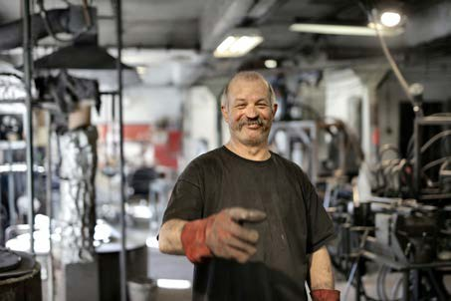
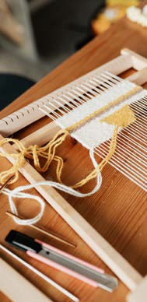
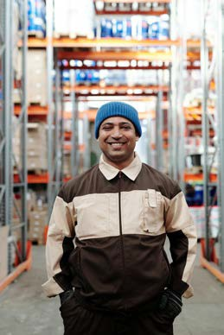


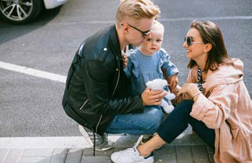

02.00 Visual Identity
A Place Brand for Crewe
Guidelines 2020
02.6 Photography
Images should cover a variety of different times of day and types of light. Honesty
is key so photos don’t all need to be in beautiful blue skies – neither Crewe's industrious spirit nor the beauty of its heritage places and natural environment are weather-dependent.
Avoid obvious filters – it’s important to communicate with honesty and demonstrate the value of being straightforward and down to earth.

Slide 19
Brand filter
It is all about actions and communication – big and small, and with and endless variety of themes and topics. What you do is much more important than what you say, but by knowing and using the Crewe Place Brand filter you are sure to stay on message!

