Slide 1
Open Market Engagement – Early Years Foundation Stage (EYFS) reforms
Early Years Quality and Outcomes Division
20 February 2019

Slide 2
Agenda
Welcome and introduction
Anna Mercy, Team Leader, Early Years Quality and Outcomes, DfE
Overview of Early Years Foundation Stage reforms
Anna Mercy, Team Leader, Early Years Quality and Outcomes, DfE
Overview of exemplification materials support requirements
Cath Gilligan, Early Years Quality and Outcomes, DfE
Overview of local authority events requirements
Anna Jones, Early Years Quality and Outcomes, DfE
Commercial and e-tendering process
Callum Bullimore, Commercial Team, DfE
Questions and Answers

Slide 3
Objectives of today
To provide you with:
Context of EYFS reforms
Importance of supporting the Early Years workforce in implementing the reforms:
  Awareness and understanding of key changes to the Early Learning Goals and Early Years Foundation Stage Profile and new curriculum guidance
An understanding of what we aim to achieve through the proposed activity and expected timelines.
An opportunity to ask questions about the support requirements and commercial process.

Slide 4
EYFS reforms - context
2017 manifesto commitment
Strengthening literacy and numeracy in the early years.
Social mobility agenda
Secretary of State ambition to reduce the proportion of children who do not achieve at least expected levels across all Early Learning Goals in the ‘communication & language’ and ‘literacy’ areas of learning at the end of Reception year by half by 2028.
Primary assessment consultation 2017
Strong demand from the sector to make improvements to the EYFS amidst widespread support for what is seen as a valued assessment in the EYFS Profile.
Calls for clearer Early Learning Goals and better alignment with Key Stage 1.

Slide 5
EYFS Profile reforms – in summary
Our reforms were announced in June 2018 and they underpin two key objectives: reducing teacher workload and improving outcomes- particularly in language, literacy and maths
Revising the Early Learning Goals so that they:
  Focus on strengthening language and vocabulary development to help close the ‘word gap’
  Strengthen literacy and numeracy outcomes at the end of reception year
  Better prepare children for Key Stage 1 – by better aligning with Year 1
  Are based on the latest evidence in childhood development – and the strongest predictors of future attainment
  Are clearer for teachers to interpret – making the EYFSP assessment more straightforward and reliable.
Streamlining assessment guidance and reviewing the moderation process to:
  Reduce teacher workload

Slide 6
EYFS reforms – curriculum guidance
Development Matters - main source of (non-statutory) guidance used by the early years sector as a framework for curriculum and tracking development
Opportunity to update this document to focus on ‘curriculum guidance’ rather than the ELGs – which are end point statements, not a curriculum.
Three objectives:
  Improving early years outcomes - sector and early years experts have told us that it is a rich curriculum which will drive good outcomes for children rather than burdensome tracking processes that detract from teaching.
  Reducing workload burdens – by supporting teachers and practitioners to focus on teaching and curriculum rather than evidence gathering and recording progress.
  Opportunity to develop specific guidance for reception year that sits clearly within the EYFS but links fluidly with the national curriculum.
      We are taking this work forward with sector experts, alongside our work to reform the Early Learning Goals.

Slide 7
EYFS reforms – timelines
We piloted the revised ELGs and new approaches to the moderation process with 24 schools from September 2018 – in partnership with the Education Endowment Foundation and NatCen.
NatCen published an independent evaluation of the pilot in autumn 2019.
We launched a public consultation on 24 October 2019, the consultation closed on 31 January 2020.
Expect to have published government’s response to the consultation by spring 2020 and to have laid regulations by summer 2020.
National roll-out will be from September 2021- giving the sector a year to prepare to implement the revised EYFS.
We wrote to headteachers of all primary and infant schools (maintained and academies) to offer them the opportunity to voluntarily participate as an Early Adopter in 2020.

Slide 8
Exemplification materials - overview
The current exemplification materials (based on the ELGs in the 2017 EYFS framework) will become obsolete when the final revised ELGs come into force
We need to continue to provide exemplification materials to ensure that teachers have a clear understanding of the expected level of development by for each of the new ELGs
New exemplification materials should:
  meet our overall objective of improving outcomes by age 5, particularly early language, and reducing teacher workload
  encourage teachers to use professional judgement when making EYFSP assessment on each child, being clear about not collecting/recording unnecessary evidence
  be clear and succinct – only include what is necessary
  provide consistent clarity about what each ELG descriptor means in practice (using relevant examples, whether illustrations, piece of writing or drawings, which a child might have done in class or home)
  support teachers’ understanding of what ‘best-fit’ looks like across the ELGs.

Slide 9

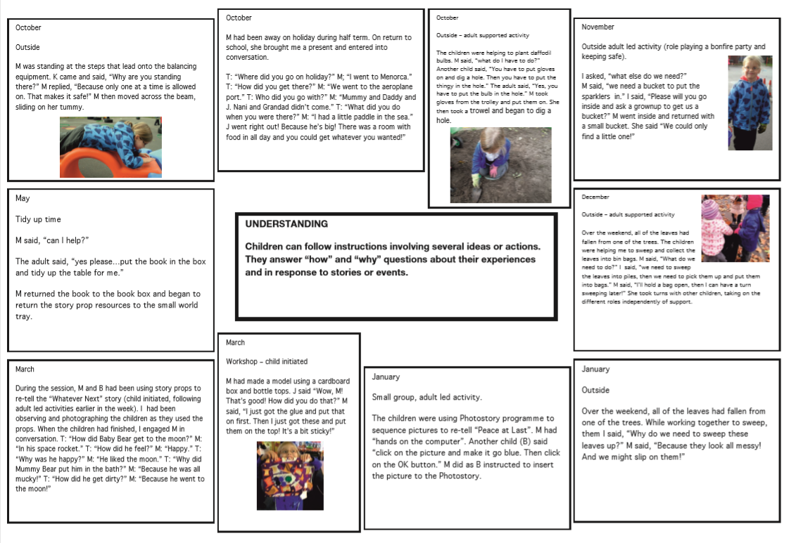
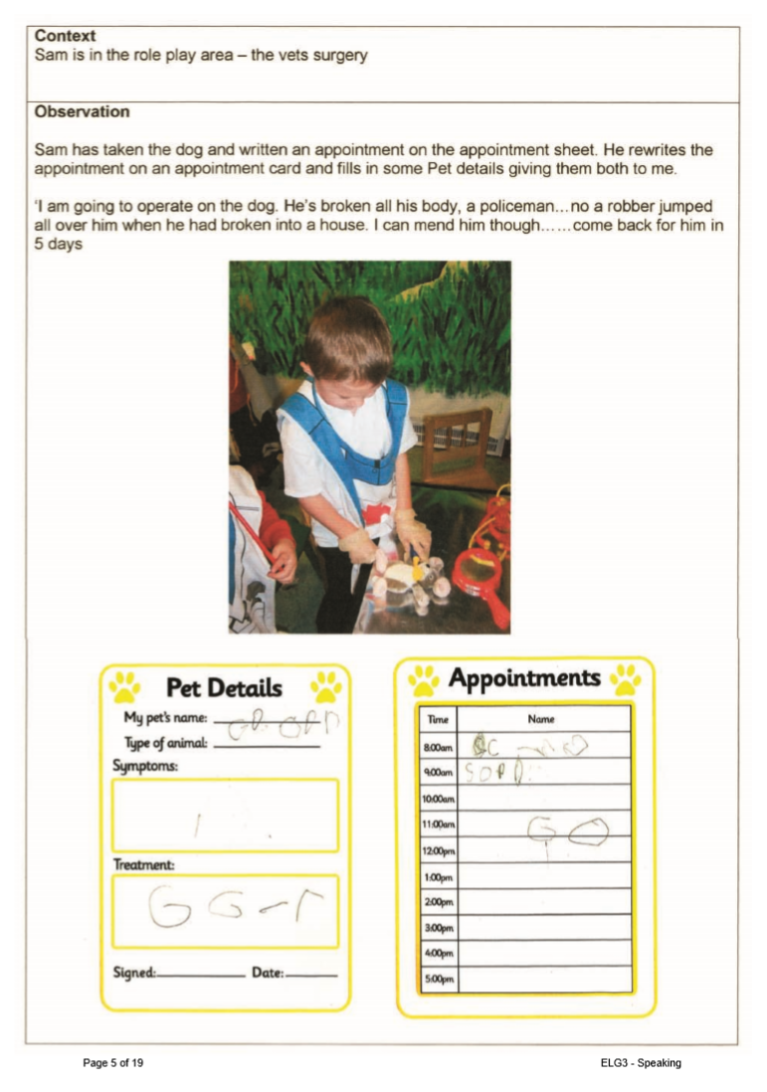
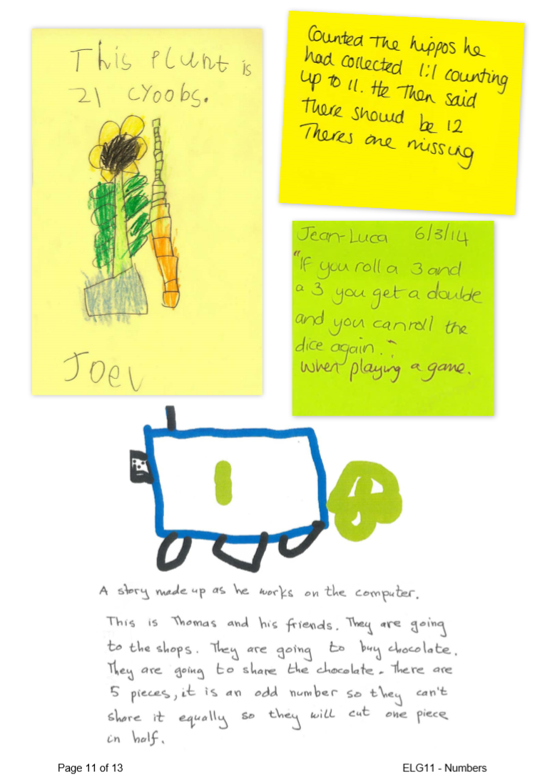

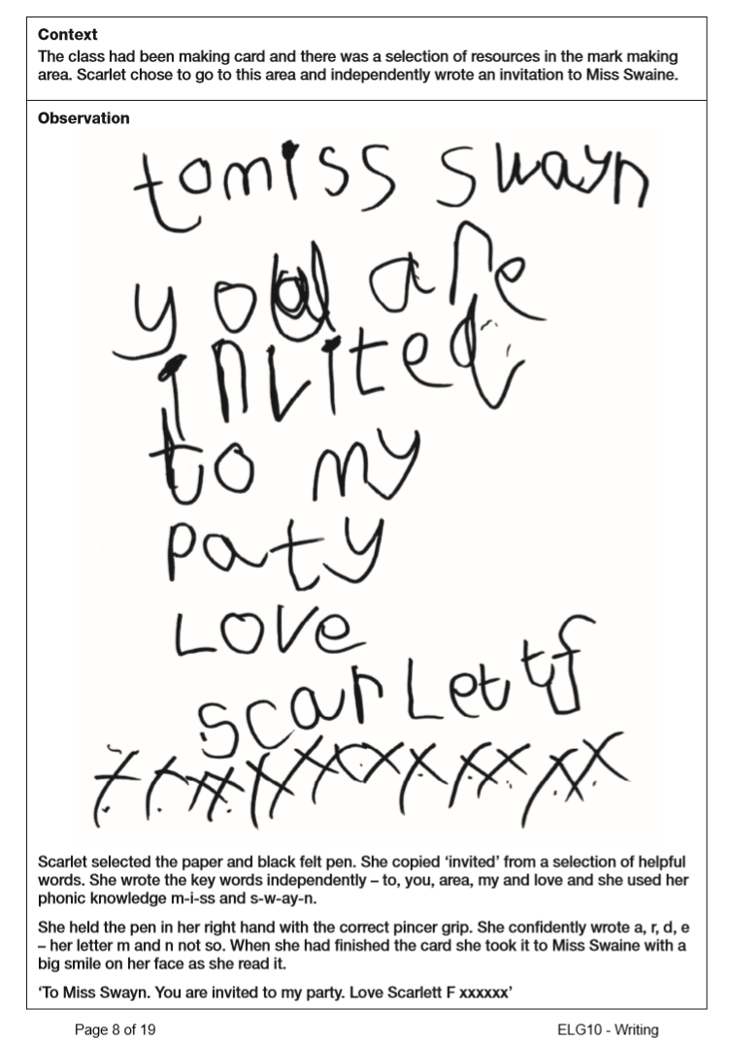
Current exemplification materials
Written exemplification materials are provided on gov.uk for all 17 ELGs
Exemplification materials:
  are provided as a non-statutory guide for practitioners to support the EYFSP assessment process
  demonstrate the expected level of development for each of the ELGs
  illustrate how information can be gathered to support EYFS profile judgements using a variety of evidence and forms of presentation but set out that there is no prescribed method of gathering evidence, nor any expectation that it should be recorded as shown in the documents.
Learning journeys (for the communication and language and literacy ELGs) are provided as a non-statutory template to illustrate how a child might progress through an ELG and how their attainment can be recorded

Slide 10
Issues with current exemplification materials
Volume – the current materials total over 200 pages of guidance
Instruction – the current materials do not provide any detailed narrative of how the example demonstrates the expected level of development
Interpretation –
  We have heard that there is some misinterpretation around how much evidence teachers should collect
  There is also misinterpretation around what the example is supposed to exemplify
  Unnecessary evidence gathering – we have heard that both the exemplification materials and learning journey templates can drive unnecessary and excessive evidence-gathering practice

Slide 11
Proposals for new exemplification materials
There is a strong appetite for high quality exemplification materials (EYFSP Pilot evaluation and stakeholder engagement)
Replace written exemplification materials with video exemplification to provide clearer, more succinct and user-friendly digital materials
Do not replace learning journey templates
  New exemplification materials need to be in place for early adopter schools in 2020/21
  We also plan to deliver a series of webinars to early adopter schools to support them in the assessment process, including in how to use the new exemplification materials effectively.
  PLEASE NOTE: All proposals and timings in the following slides are indicative and subject to final policy decisions

Slide 12
Draft specification
Suite of 18 digital videos comprising:
  1 x summary video
  17 x exemplification videos for each of the ELGs
    Around 2-3 minutes long
    2-3 examples of the expected level of development per ELG
    1-2 examples of just below the expected level of development per ELG
    Narrator/voiceover
    Should feature a range of contexts e.g. indoor/outdoor, 1:1/whole class scenario, child-initiated/adult-led
    teacher narrative around assessment
    Videos to be filmed on location at 8-9 exemplar schools (to be identified by DfE) across England
    Development and delivery of a series of webinars for early adopter schools to complement the exemplification materials.
Notes:
the narrator/voiceover must be a practitioner/teacher, or someone who recently held such a role.

Slide 13
Proposed method of delivery
Lot 1 – Assessment expert
Lot 2 – Practitioner expert
Filming
Lead on development of video exemplification content
Work with ELG experts
Develop storyboard proposals for 17 videos plus introductory video
Prepare exemplar school staff for filming
Develop and deliver a series of webinars
Support in preparing exemplar school staff for filming
Support in identifying suitable examples to feature in videos
Support in logistical planning
Support in development and delivery of webinars
To be delivered in-house
Will deliver all technical aspects of the project (filming, post-production, graphics, voiceover, subtitles, transcript)
All parties to work together to deliver the project

Slide 14
Timeline
Exemplification materials need to be in place for early adopters in 2020/21
The optimum time to film will be at the end of this academic year, 2019/20
Our proposed timeline is therefore as follows:
Date | Activity
March 2020 | Launch procurement
May 2020 | Award contract/s Meeting with DfE and filming company Develop storyboards
June/July 2020 | Prepare exemplar schools Filming to take place
Summer 2020 | Post-production
October 2020 | Draft video package for review by DfE Any additional filming if required after review Webinars for early adopters
December 2020 | Publish videos
January 2021 | Webinars for early adopters

Slide 15
Events for Local Authorities - overview
Local Authorities (LAs) are currently a key source of EYFSP assessment training and support for reception teachers, as stipulated in the EYFSP Handbook.
Currently, LAs also have the statutory responsibility to externally moderate EYFSP judgements in 25% of primary schools by the end of each academic year. Government is consulting on the proposal to remove this requirement and a Ministerial decision has not yet been taken.
We anticipate that, regardless of the future moderation policy, many reception teachers and head teachers will approach their LA for advice when implementing the new EYFSP for the first time.
It is therefore important that LAs are fully briefed to ensure support and messaging to schools is consistent across the country throughout the implementation period.

Slide 16
Proposal for LA events
We propose to hold a series of events for Early Years representatives from all LAs during the summer term 2020 to:
  Set out the key messages, context and rationale behind the final policy changes and ensure consistent messaging across central and local government.
  Go through the key policy changes and how they should be interpreted and offer LAs the opportunity to ask procedural and policy questions about implementation.
  Encourage knowledge-sharing and dissemination of best practice across Local Authorities, including on moderation of EYFSP judgements if the statutory duty is retained.
This will ensure that LAs are prepared to start offering advice and implementation support to early adopter schools from September 2020 and to all other schools as they prepare for national implementation in the lead up to September 2021.

Slide 17
Draft specification
Plan and deliver ten events for Local Authority representatives in summer 2020, including:
  Managing communications with LAs and organising sign-up to events;
  Acting as facilitator for all ten events;
  Liaising with external speakers stipulated by the DfE;
  Arranging venue hire, refreshments and administrating reimbursement for travel costs.
We anticipate the events will:
  Be held across the eight regions in England;
  Offer free places to a maximum of two representatives per Local Authority;
  Offer approximately 30 places per event;
    Take place in June and July 2020.
We require sector experts with experience and who have good knowledge of the issues and challenges within Early Years. A DfE representative will attend each event to deliver a DfE-led agenda item and to respond to Q&A from attendees.

Slide 18
Timeline
Early Adopter schools will begin implementing the new EYFS framework from September 2020.
LAs will need to be prepared to offer support and deliver consistent messaging from this point.
Our proposed timeline is therefore as follows:
Date | Activity
Early March 2020 | Launch procurement
Early May 2020 | Award contract/s
Mid June to early July 2020 | Deliver events

Slide 19
Commercial process
Callum Bullimore

Slide 20
Stages of the bidding process – Expression of Interest (EOI)
Bidders submit ITT response/
proposal including costings
Desktop evaluation of bidders’ written responses
Final moderation
Notification of results, intention to award and feedback
10 day grace period
Contract award
Commencement of Contract
Invitation to tender (ITT) published on DfE e-tendering portal ‘Jaggaer’
Competition Stages

Slide 21
Standard Supplier Questionnaire (SSQ)
A Standard Supplier Questionnaire asks potential suppliers to initially self-declare their status against the exclusion grounds and selection questions.
The SSQ is structured in 3 separate parts:
Part 1 - of the SSQ covers the basic information about the supplier: e.g. contact details, trade memberships, details of parent companies, group bidding etc.
Part 2 - covers a self-declaration whether or not any exclusion grounds apply e.g. insurance cover must be the minimum level required as stated in the SSQ etc.
Part 3 - covers a self-declaration regarding whether or not the company meets the selection criteria in respect of their financial standing and technical capacity.

Slide 22
Supplier Registration Service (SRS)
It is a mandatory requirement for all bidders to register with the Supplier Registration Service for Government. This is a Crown Commercial Service/Cabinet Office portal, which contains details of over 225,000 suppliers, of which 4,300 are registered as delivering goods and services to the Authority and its agencies.
The Authority will use data provided through the Supplier Registration Service to conduct financial assessment and due diligence checks to ensure that potential bidders do not expose the DfE to unacceptable levels of financial risk.
The portal provides both suppliers and buyers with a single place to create and share commercial information and if not already registered, bidders should do so via the following link: https://supplierregistration.cabinetoffice.gov.uk/

Slide 23
Jaggaer – DfE e-Tendering Portal

Slide 24
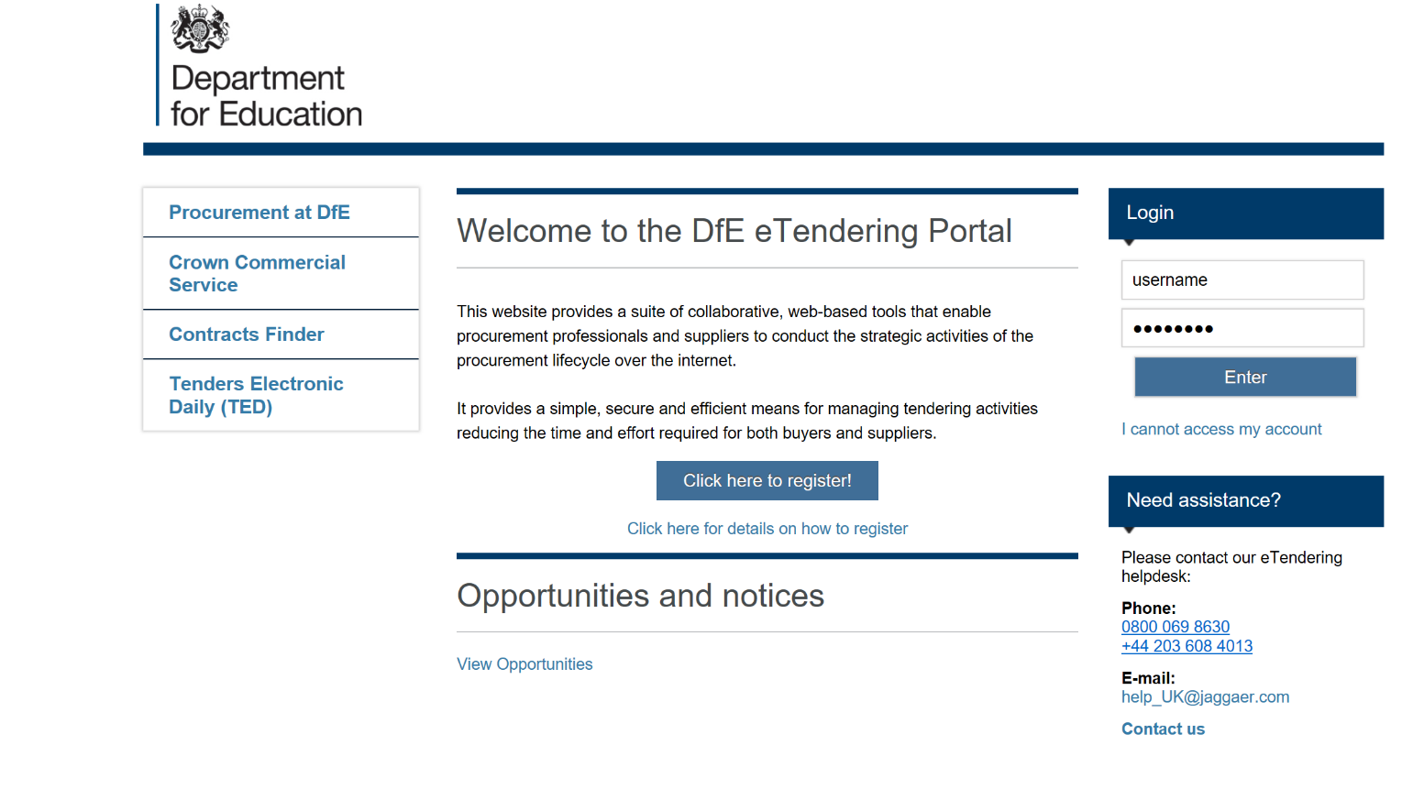
Jaggaer registration: https://education.app.jaggaer.com/web/login.html

Slide 25
What organisations must not do
Canvass help, assistance or opinion on the tender or the procurement process in general from any DfE employee or other Government Department, Agency or NDPB other than through the e-Tendering portal message board.
Submit a partially completed tender as this will not be evaluated.
Submit a tender after the closing date and time - any tenders published after the deadline will not be considered.

Slide 26
Further information
Further information will be made available on contracts finder after this event, including the market engagement slides and Q&A response pack.
Please register on Jaggaer to be kept up to date on all ITT developments.
Contact us at: EYFS.CONSULTATION@education.gov.uk if you have any questions.
Please note, once the procurement is open for competition all communication is to be directed through the Jaggaer portal. We will not respond to questions outside of Jaggaer.

Slide 27


