Slide 1

Intermediate Care Beds Procurement Overview
January 2021

Slide 2
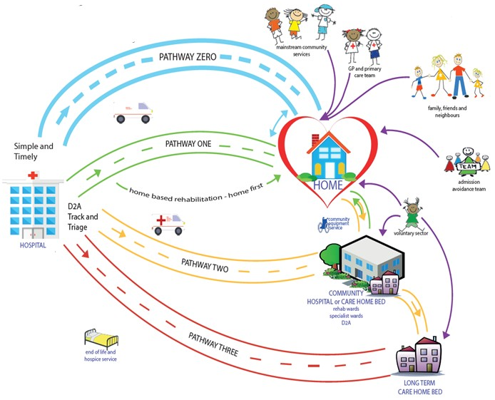
Context
Patients leaving hospital after a period of ill-health, sometimes need some time to build up their strength and rehabilitate with the help of therapists and special equipment to get back to their abilities before hospital or to reach a new baseline. Care homes are uniquely placed and experienced to provide nursing and care to support patients to continue their rehabilitation journey.
Sutton recognises the important input of the care home staff in delivering patient rehabilitation and working as part of a multi-disciplinary team with therapists from Sutton Health and Care Community Services and our local GP practices.
Sutton implemented the integrated discharge to assess pathway (Home First+) in 2020 and National Guidance - Bed Based Rehab is Pathway 2 which asks for beds to be available locally to support discharge from hospital.

Slide 3
Contract Core Needs
The service will receive referrals from Sutton Health and Care Home First+ team to prevent hospital admission and support discharge from hospital with timely access to a care home bed between the hours 08:00 – 20:00, 7 days a week.
The care home may be expected to receive up to three patients per day.
The care home will be part of a Multi-Disciplinary Team (MDT) providing comprehensive support to patients with dedicated input from therapists, carers, registered nurses and GPs and care home staff will be encouraged to learn skills from the therapists to support ongoing rehabilitation.
The value of the contract will be £2.67m over five years.
Maximising independence to support patients to return to their own homes, wherever possible.
11 beds in one location is the preferred model as therapy resources can be shared in the location and the staff will benefit from the opportunity to work as an MDT.
Utilisation (in bed nights) is expected to be at 80% or above.
Length of stay is a maximum of six weeks but the majority of patients stay two to three weeks.
Demand is likely to increase over Winter months, i.e. October to March.
Service Specification, KPI Reporting Requirements and Quality Dashboard embedded below.

Slide 4
Facilities Core Needs from Provider: Personal Accommodation
The Provider will provide:
Single rooms with en-suite.
Each room to have enough space to manoeuvre a sara steady, walker (therapies equipment).
Access to a hoist
Disabled accessible rooms with en-suite disabled facilities for bathing and showering would be considered ‘gold standard’
Call alarm system to enable Service Users to get help
Have furniture and fittings appropriate for Service Users including those with physical disabilities
Lockable cabinet for self-medication
Allow the Service Users to have access to their room at any time and as often as they wish

Slide 5
Facilities Core Needs from Provider: Therapy Spaces
Physiotherapy area ideally 5m x 5m in size to be on same floor as service users’ rooms
Equipment; parallel bars, small staircase, plinth, pedals, lower limb equipment, wall bars for upper limb exercises. This equipment is provided by Sutton Health and Care. Rails on corridor walls may be used as an alternative to parallel bars and this will be provided by the Provider.
Dining room on the same floor as the service users’ rooms that service users are encouraged to walk to and have meals in.
Therapy workstation for administrative work including updating records and telephone calls. Must include a chair and a desk.
Private space for weekly multi-disciplinary team meetings
Occupational Therapy space with kitchen dedicated for patients to complete OT assessments (i.e. not a staff room) including the following equipment supplied by the Provider:
Worktop for food preparation
Microwave
Kettle
Cutlery/crockery
Tray
Kitchen trolley
Table and chairs (for a minimum of 4 people)
Fridge

Slide 6
Current Indicative Timeline
Activity / Milestone | When
Invitation for providers to express potential interest | January 2022
CCG considers interest received from providers – with possible follow-up engagement discussions with interested providers | January 2022
CCG finalises its commissioning intentions and readiness for a procurement process | February 2022
Procurement process to award a new contract for Intermediate Care Beds in Sutton | Mid-March through April 2022
CCG awards new contract | Mid-May 2022
Contract established | Early June 2022
Mobilisation / Service commences | June / July/ August 2022

Slide 7
Embedded Documents

