Slide 1


Magnox Contract – FM Supply Chain
The exceptional, every day

Slide 2

Magnox Contract – FM Supply Chain
Agenda
About Mitie
About Magnox & the Ask

Slide 3
About Mitie
The exceptional, every day
Notes:
Introduce the video – (2 mins, 20 seconds) We can’t talk about Mitie without acknowledging our acquisition of Interserve in December 2020. We are now the UK’s leading Facilities Management and Professional Services company. Here’s a video that best tells the story.

Slide 4
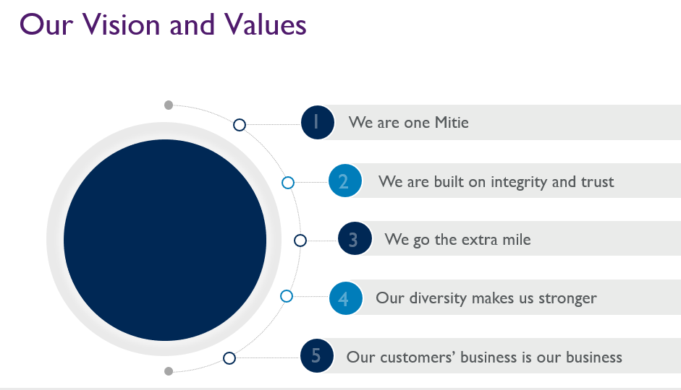
Magnox Contract – FM Supply Chain
At Mitie our Vision and Values are really important to us, this is divided into 5 key themes.
We are one Mitie – we all work together across the organisation which means we can deliver all service seamlessly.
We are built on integrity and trust – this is really important particularly on a public sector contract like SG – everything we do is under scrutiny and we should never not do the right thing for our customer.
We go the extra mile – this is the reason our retention rate is so high as we all go above and beyond every day.
Our diversity makes us stronger – we pride ourselves on being a truly inclusive place to work.
Our customers business is our business – this is the mindset of everyone in the organisation and what our clients love about the service.

Slide 5
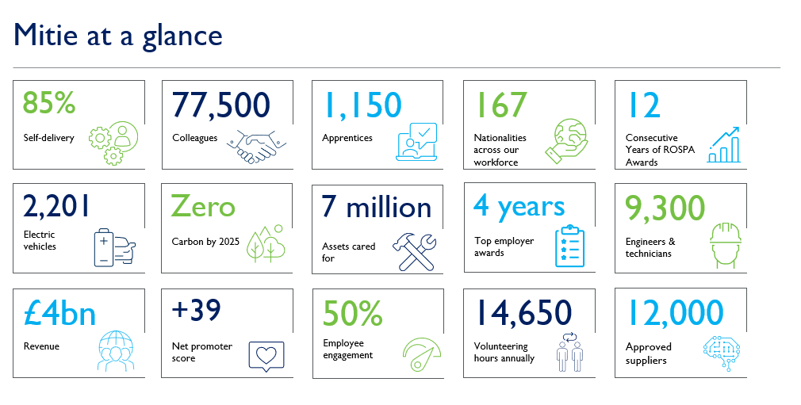
Magnox Contract – FM Supply Chain
We are the UK largest FM company, by some significant margins, nearly 2.5 times bigger than closest rival size wise Sodexo

Slide 6


































Magnox Contract – FM Supply Chain
Mitie at a Glance
Group Performance
Our Team with Interserve
Our Customers
Our Awards and Accreditations
£2.6bn
REVENUE
77,500 Team members
£3.5bn in sales
4,200 customers
£63.4m OPERATING PROFIT
2025 zero carbon emissions
BEST BALANCE SHEET IN THE INDUSTRY
With underlying improvement of £98m
+55 NPS
20K suppliers
7.5 million people use our services daily
19.1% HEADLINE REVENUE GROWTH
£1.5bn spend with supply chain

Slide 7
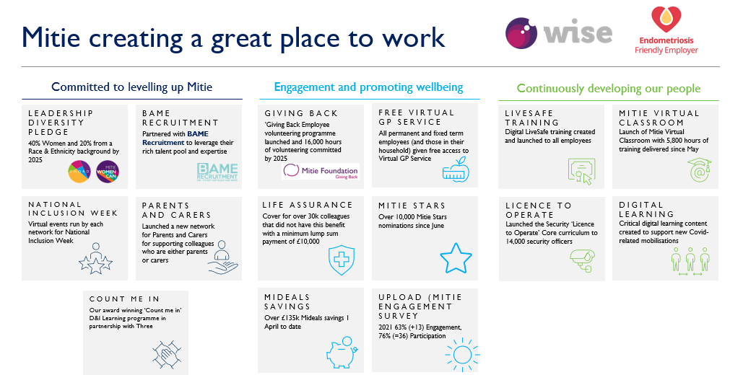
Magnox Contract – FM Supply Chain

Slide 8




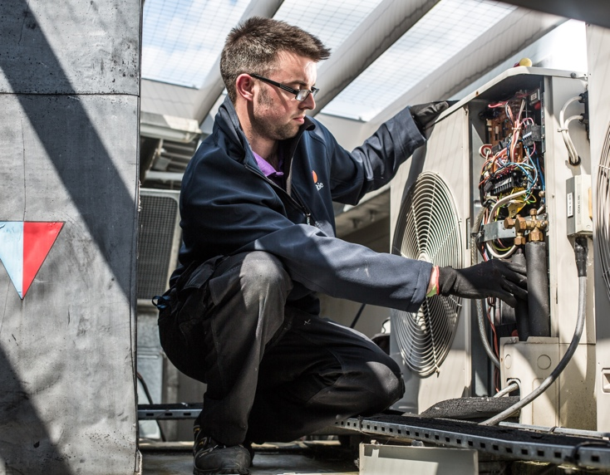

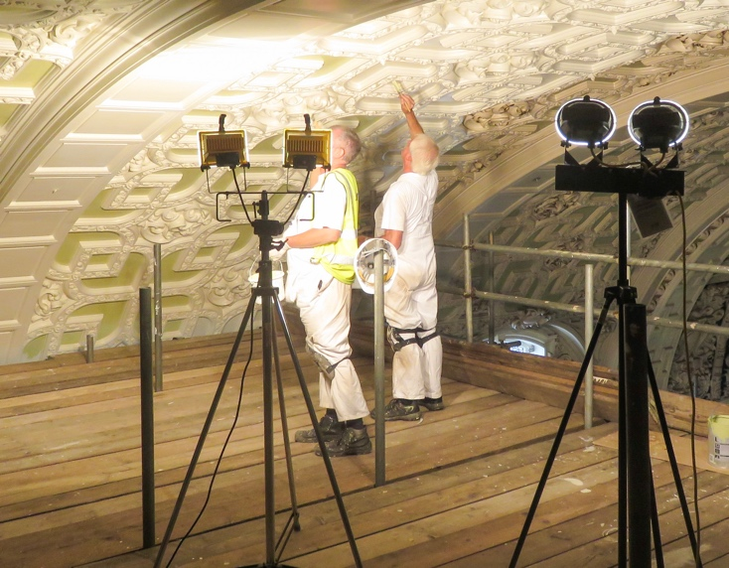

Magnox Contract – FM Supply Chain
Technical Services
Maintenance
Energy
Projects
Connected Workspace
6,142 technical experts
186 sustainability experts
1,081 projects professionals
46 data scientists
5m assets and 2.2m tasks complete
300,000 tonnes of carbon saved
1300+​ projects delivered
46,600​ assets​ monitored​
£640m turnover​
£17.5m turnover​
£140m​
380 sites connected to SOC​
IN ADDITION, WE MANAGE OUR INTEGRATED FACILITIES MANAGEMENT (IFM) ACCOUNTS

Slide 9
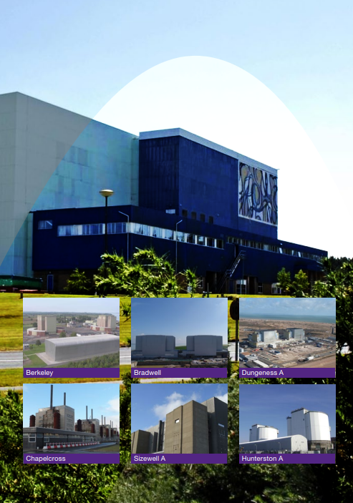

Slide 10
Magnox Contract – FM Supply Chain
Proposed Solution – Scope of Supply
Tier 3 & 4 Projects covering facilities Civils and M&E to include:
Building Alterations Excavation and Earthworks Concrete, Brickwork, Blockwork and Stonework Roofing Works Joinery Plumbing Installation | Electrical Installations Floor, Wall and Ceiling Finishes Glazing Painting and Decorating Drainage Works External Works.
The sites that cover the Magnox contract are as follows:
Berkeley
Bradwell
Chapelcross
Dungeness A
Harwell
Hinkley Point A
Hunterston A
Maentwrog
Oldbury
Sizewell A
Trawsfynydd
Winfrith
Wylfa

Slide 11
Magnox Contract – FM Supply Chain
Tender Process
Schedule of rates for key roles to be produced for tenderers to complete
Quality submission also required detailing contractor capability/experience
The RFQ will be completed on Mitie’s eSourcing platform (Coupa).

Slide 12
Magnox Contract – FM Supply Chain
SITE STANDARDS
SAFETY RESPONSIBILITIES OF CONTRACTORS AT MAGNOX LTD Sites
The Contractor is responsible for all aspects of safe management of their work and their sub-contractor’s work; this includes:
planning and managing the work; SSoW, RAMS, Construction phase plans, PTW, etc
ensuring that all personnel have the suitable skills, knowledge, experience and individual capability; - CSCS and Proof of competency is required for all roles
effective supervision; - SMSTS required
co-operating with the site; and
co-ordination of their work.
All contractors are required to adhere to the requirements of Magnox Ltd Contractor Site Instructions and relevant H&S Legislation including CDM 2015 when working on sites.
Security
All contractor staff required to be vetted to Baseline Personnel Security Standard (BPSS) level as a minimum. This requires provision of identify documentation, last 3 years employment history, proof of residence and DBS certificate. Higher levels of security may be required as requested for specific work areas.
Schedule of rates
All works require to be priced on an agreed schedule of rates. Contractors are to insert hourly rates against each discipline detailed on the attached schedule of rates and confirm % material mark up offered.

