Slide 1
Planting on Vacant & Derelict Land
14th December 2021

Slide 2
Context
The Nature for Climate Fund (NCF) of more than £750m was set up to support increased tree planting and peat restoration in England over this parliament.
Achieving the required level of woodland creation in England as outlined in the government’s election manifesto represents at least trebling woodland creation by the end of this parliament.
So government must explore every avenue to get trees planted and trial innovative solutions.

Slide 3
The case for change
We know there is a large amount of VDL in England, estimated 280k hectares of landfill sites and mineral works alone. We estimate there is enough of this land – VDL that is economically and ecologically degraded - to create at least 6,000 hectares of new woodland.
But there are various barriers to creation of woodland on these sites.
Existing grant schemes haven’t unlocked a significant amount of this land for planting.
So there is space for an innovative, bespoke offer specifically targeted at tackling these barriers and unlocking this land.
Woodland creation on VDL provides additional benefits from bringing unproductive land into productive use, alongside all the other benefits of woodland creation.

Slide 4
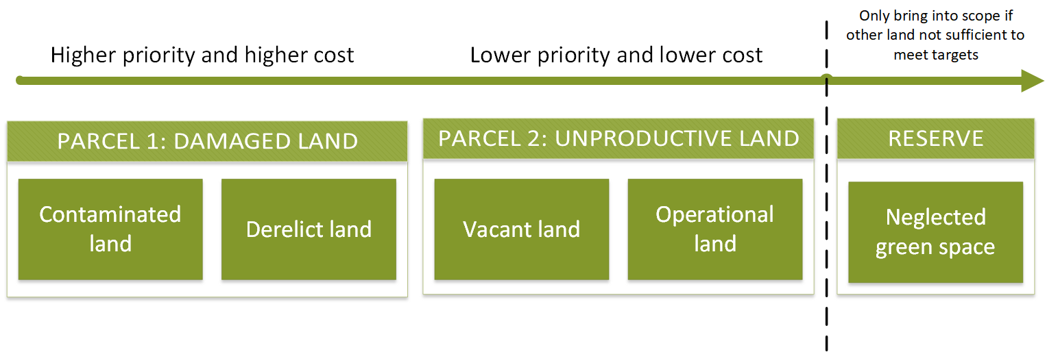
Scope
VDL is defined as either damaged land or unproductive land with barriers to productive use.
Damaged land is the highest priority to tackle as the benefits are greatest, but is also the most costly land to enable.
So the scheme will need to target both damaged and unproductive land, and will need to bring in co-financing.

Slide 5
Benefits
We want the scheme to deliver:
At least 6000 hectares of new woodland
Increased biodiversity and new habitats for wildlife
Greater access to woodland and green space, particularly for deprived communities
Carbon sequestration from trees and soils
Bringing forward damaged/unproductive land into beneficial use.

Slide 6
Tipping the balance
The “method” of the scheme is to use targeted public funding to tip the balance in favour of woodland creation.
1) Tip the balance of landowners’ decision-making towards woodland creation over leaving land derelict or converting to other land uses
2) Tip the balance for investors towards viewing woodland creation on VDL as a viable investment opportunity
The VDL offer will do this by:
Supporting the costs of enabling the land alongside planting costs
Providing a turnkey solution that takes the burden of bringing forward land off the landowner

Slide 7
Contract requirements

Slide 8
Proposed delivery model

