Slide 1
Traffic Officer Vehicle Loadout Project
Equipment bags

Slide 2
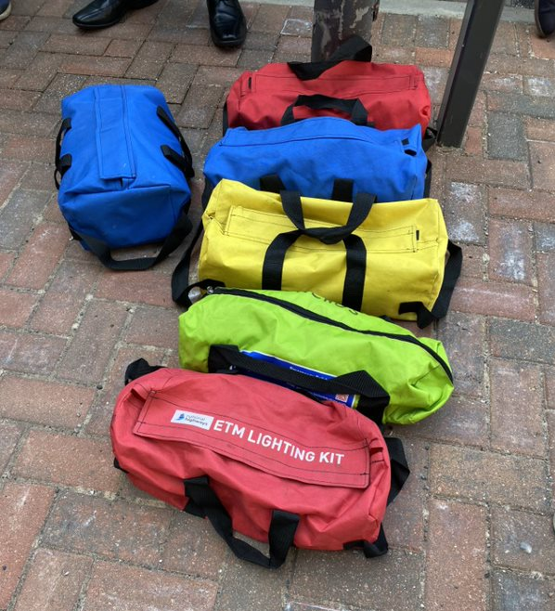
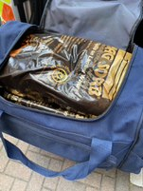
Equipment Bag List
Blue canvas bag (Velcro closing) - Animals on the Network.
Red canvas bag, (Velcro closing) - Load cell, tow strap & Round Sling with Shackle
Blue canvas bag, (Velcro closing) - Brother Straps, shackles & round slings. Small pouch – 2 x ABS’s.
Yellow canvas bag (Velcro closing) - Skates & lump hammer.
Red canvas bag (Velcro closing) - ETM Lighting
Fluorescent green, zip closing - Waterproof ponchos and thermal blankets.
Dark blue holdall – zip closing – absorbent material, cable ties, dust masks, safety cutter.

Slide 3
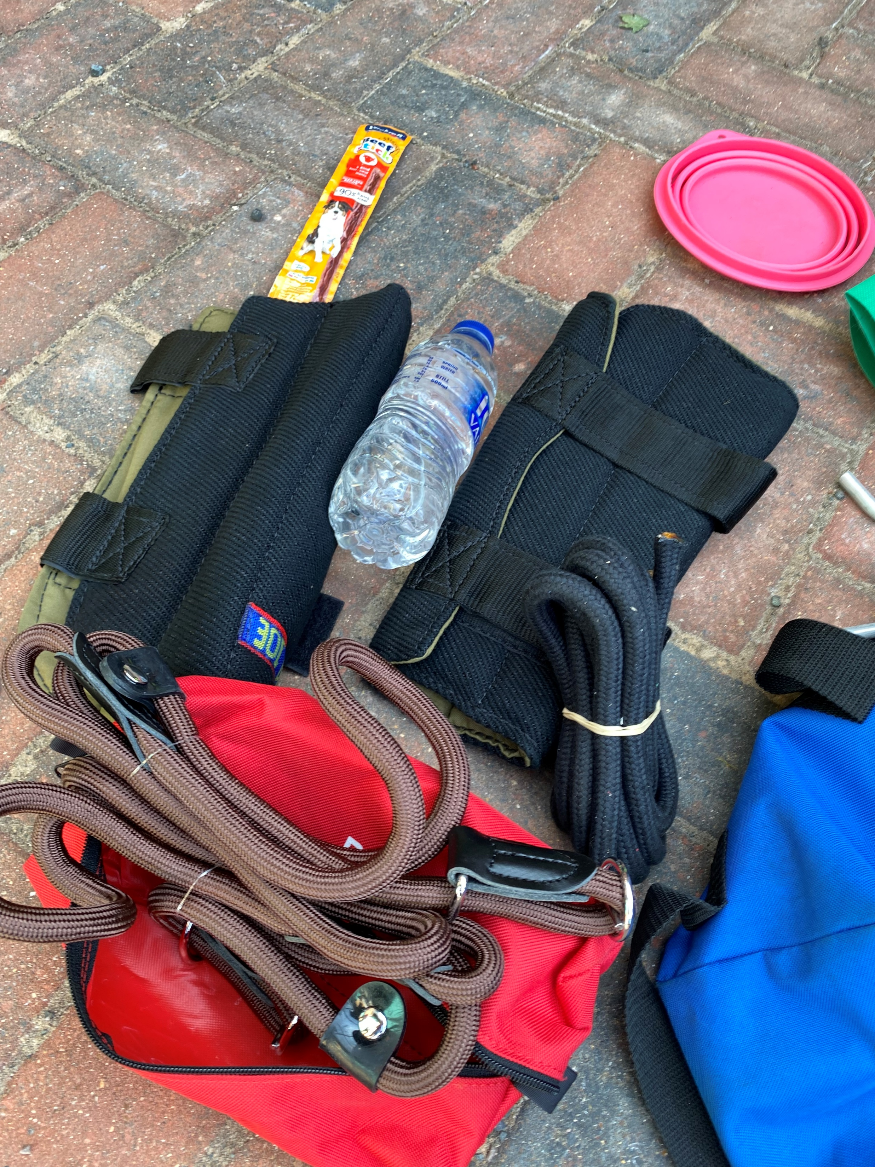
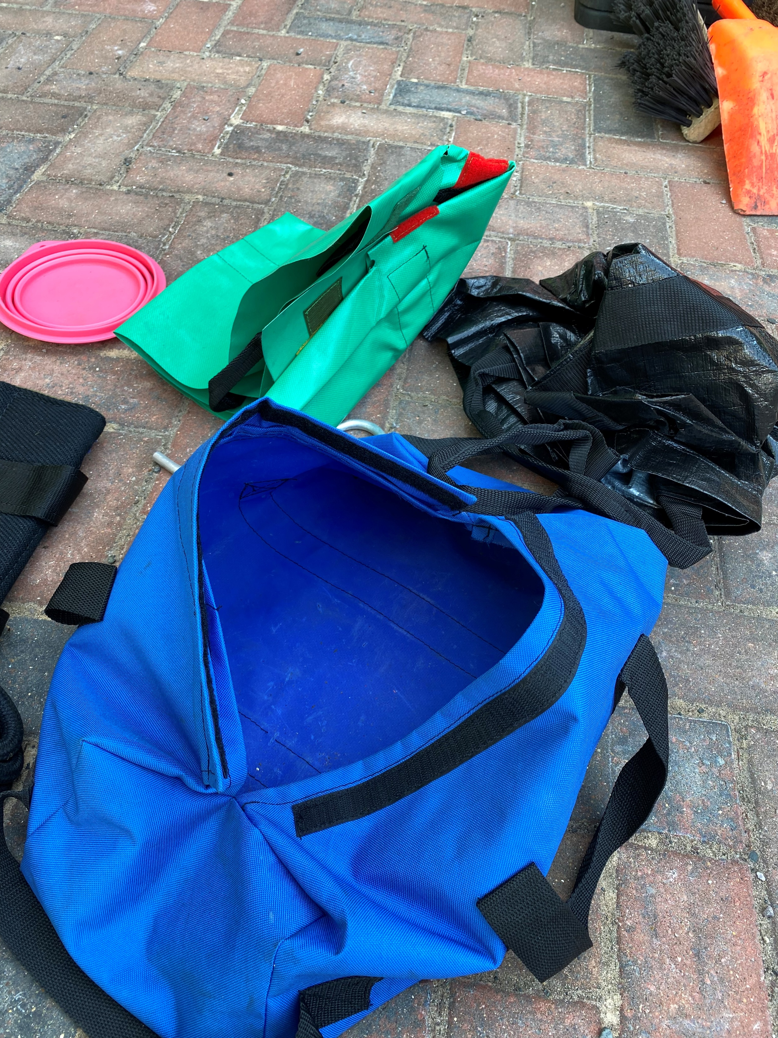
Animals on the Network – blue canvas bag, Velcro closing
Bottle of water
Dog Chew
Arm guards x2
Swan rescue bag
Swan vest
Collapsible bowl
Horse bridal
Dog lead (contained within small red bag)
repellent spray (Must not be left in the vehicle when not in use)
Notes:
Bag needs to be a different colour – Black.
K917 Dog Spray when in use must be stored in a cool place away from direct sunlight or sources of heat. The spray should not be permanently stored in a vehicle and should be removed and returned to the outstation COSHH cabinet when the vehicle is not in use.

Slide 4
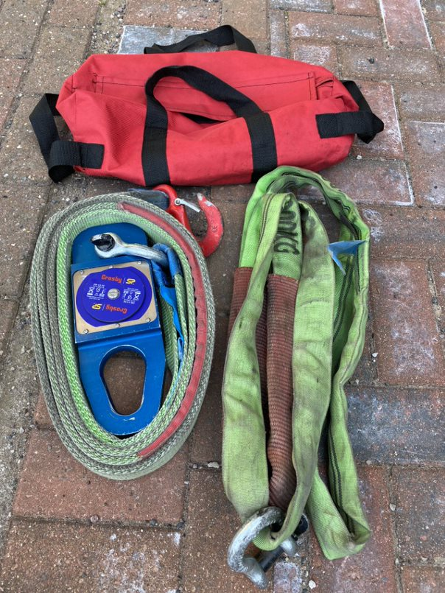
Load cell & Round Sling with Shackle - Red canvas bag, (Velcro closing)
Contents of bag –
Loadcell including tow strap
Round sling & shackle

Slide 5
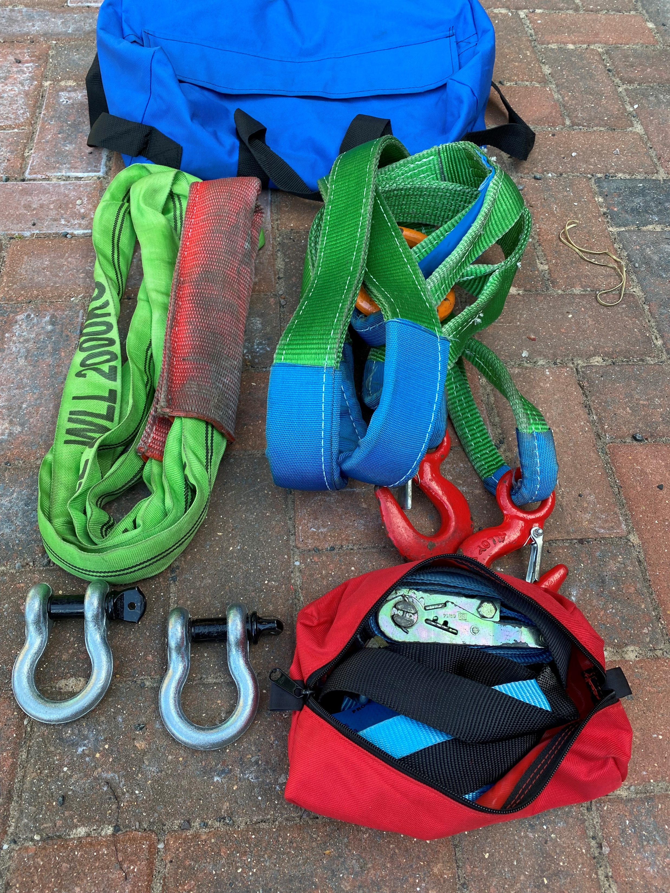
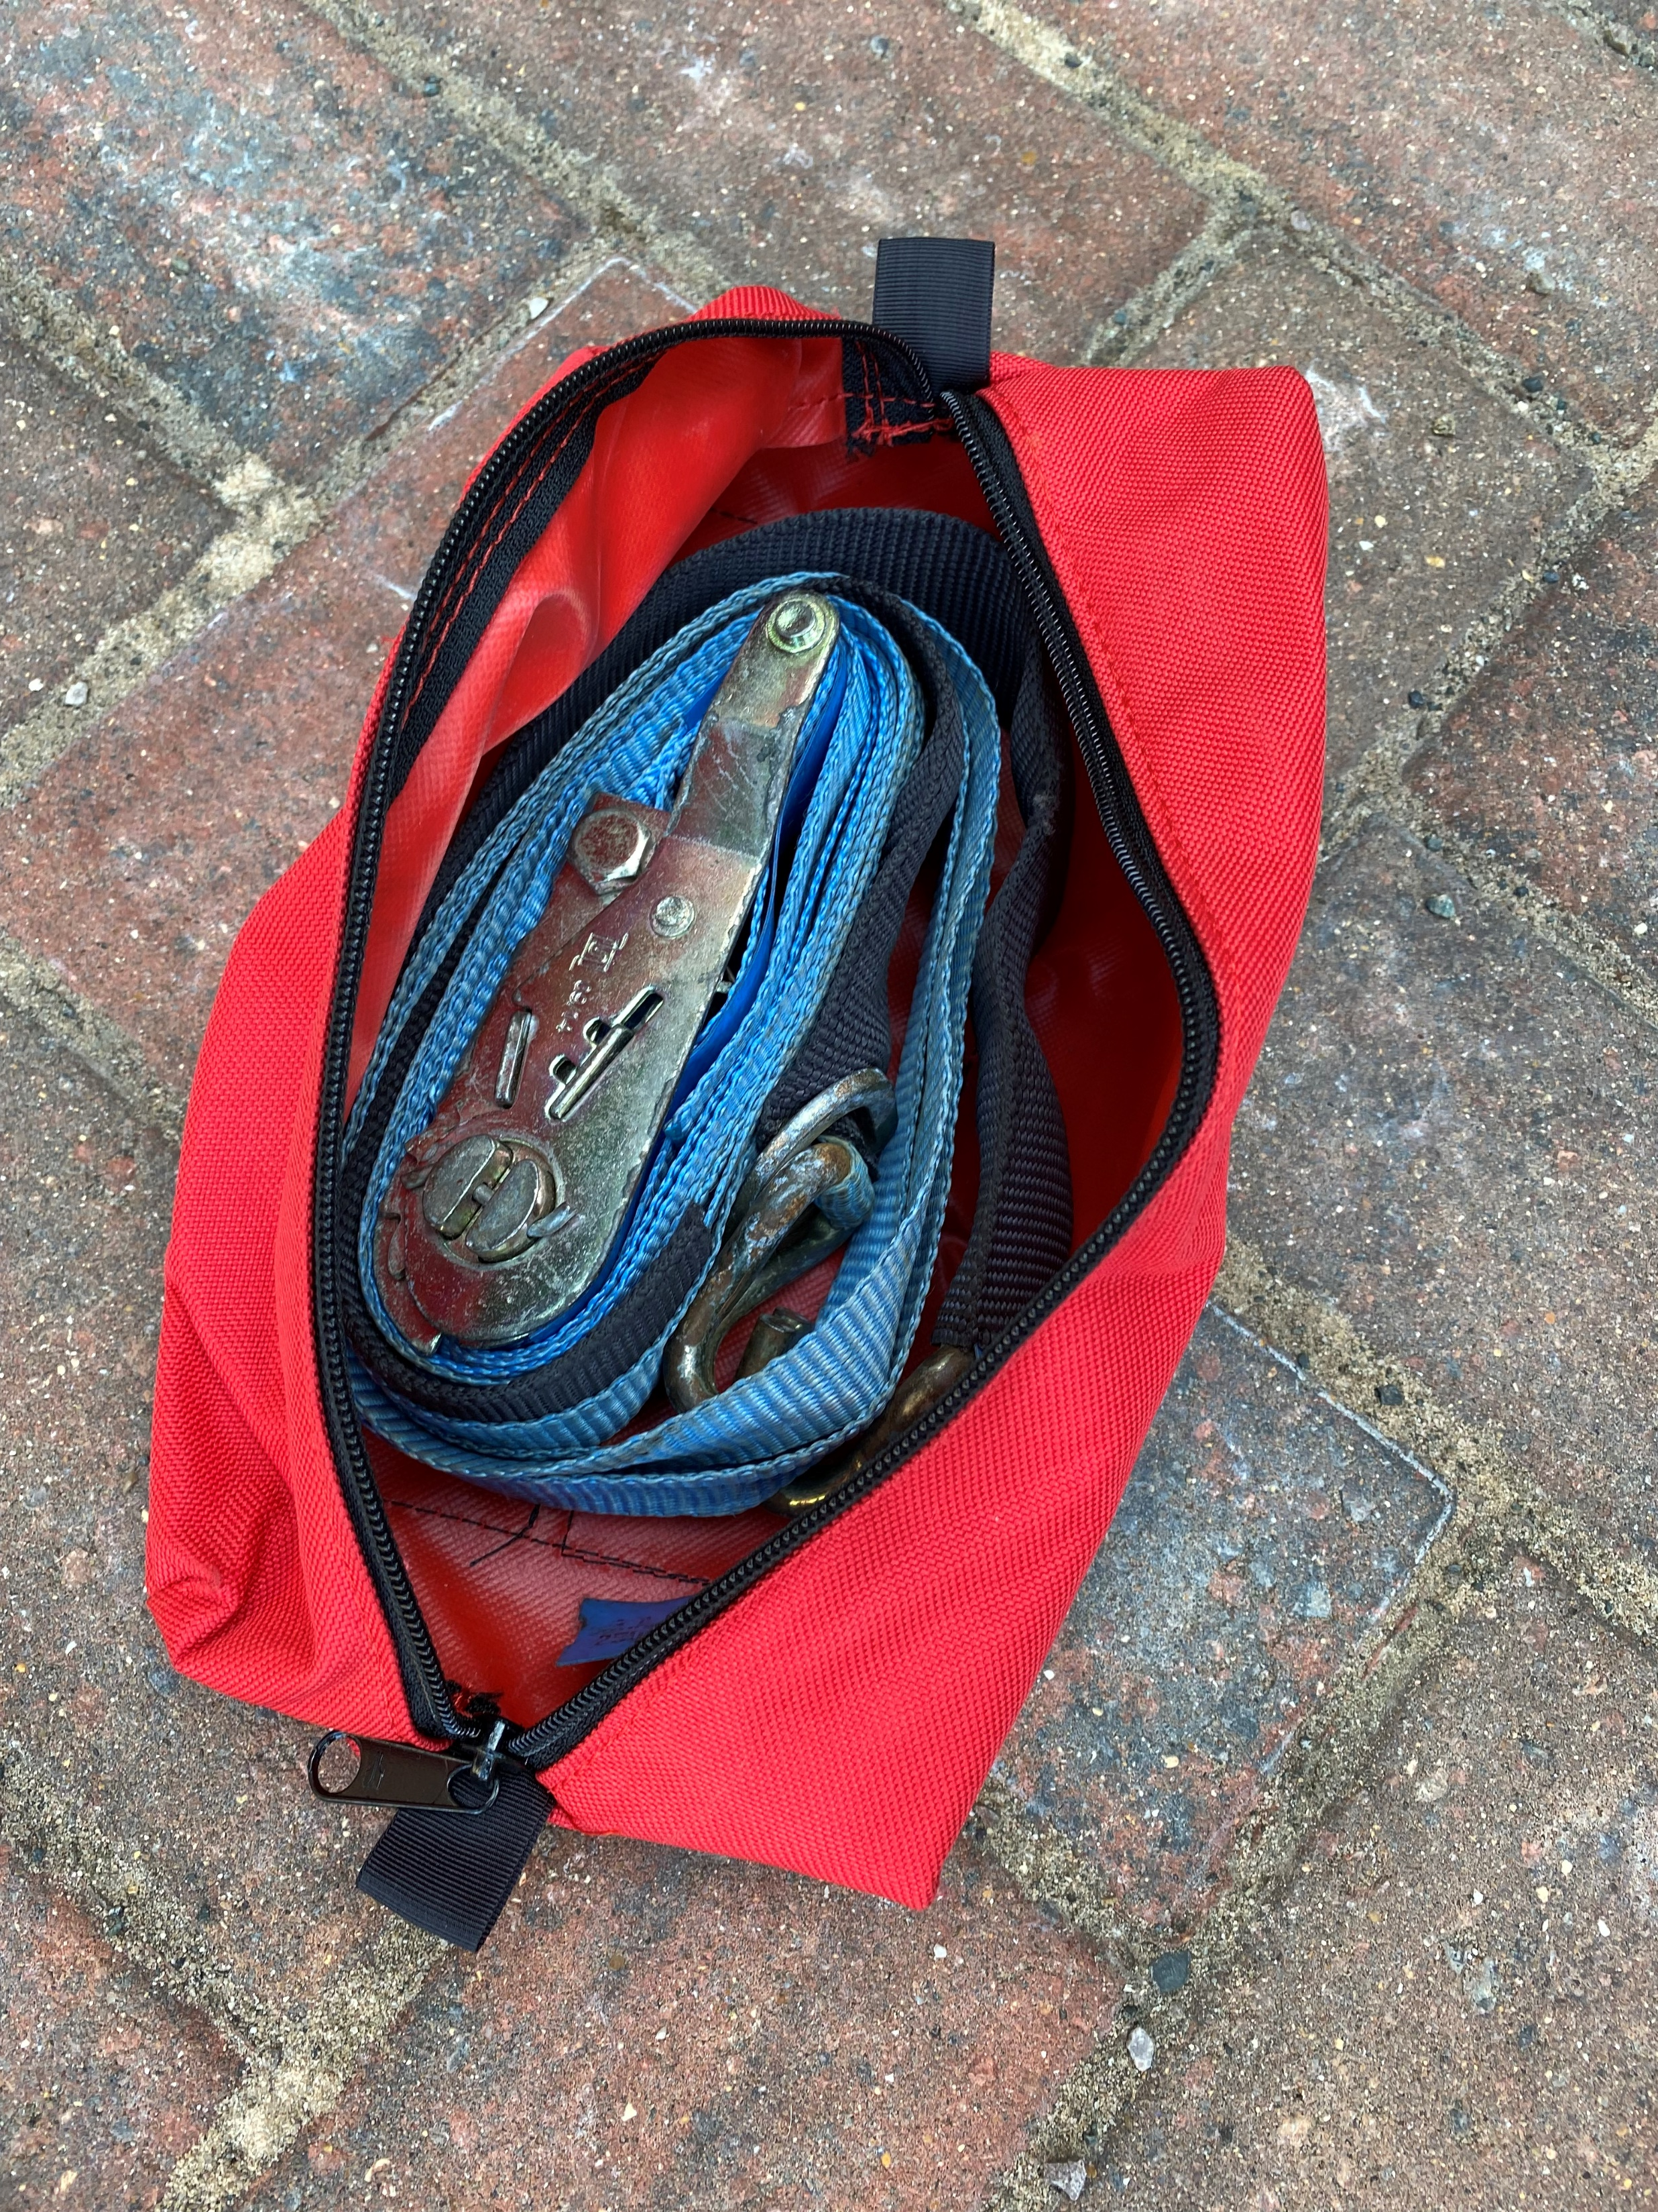
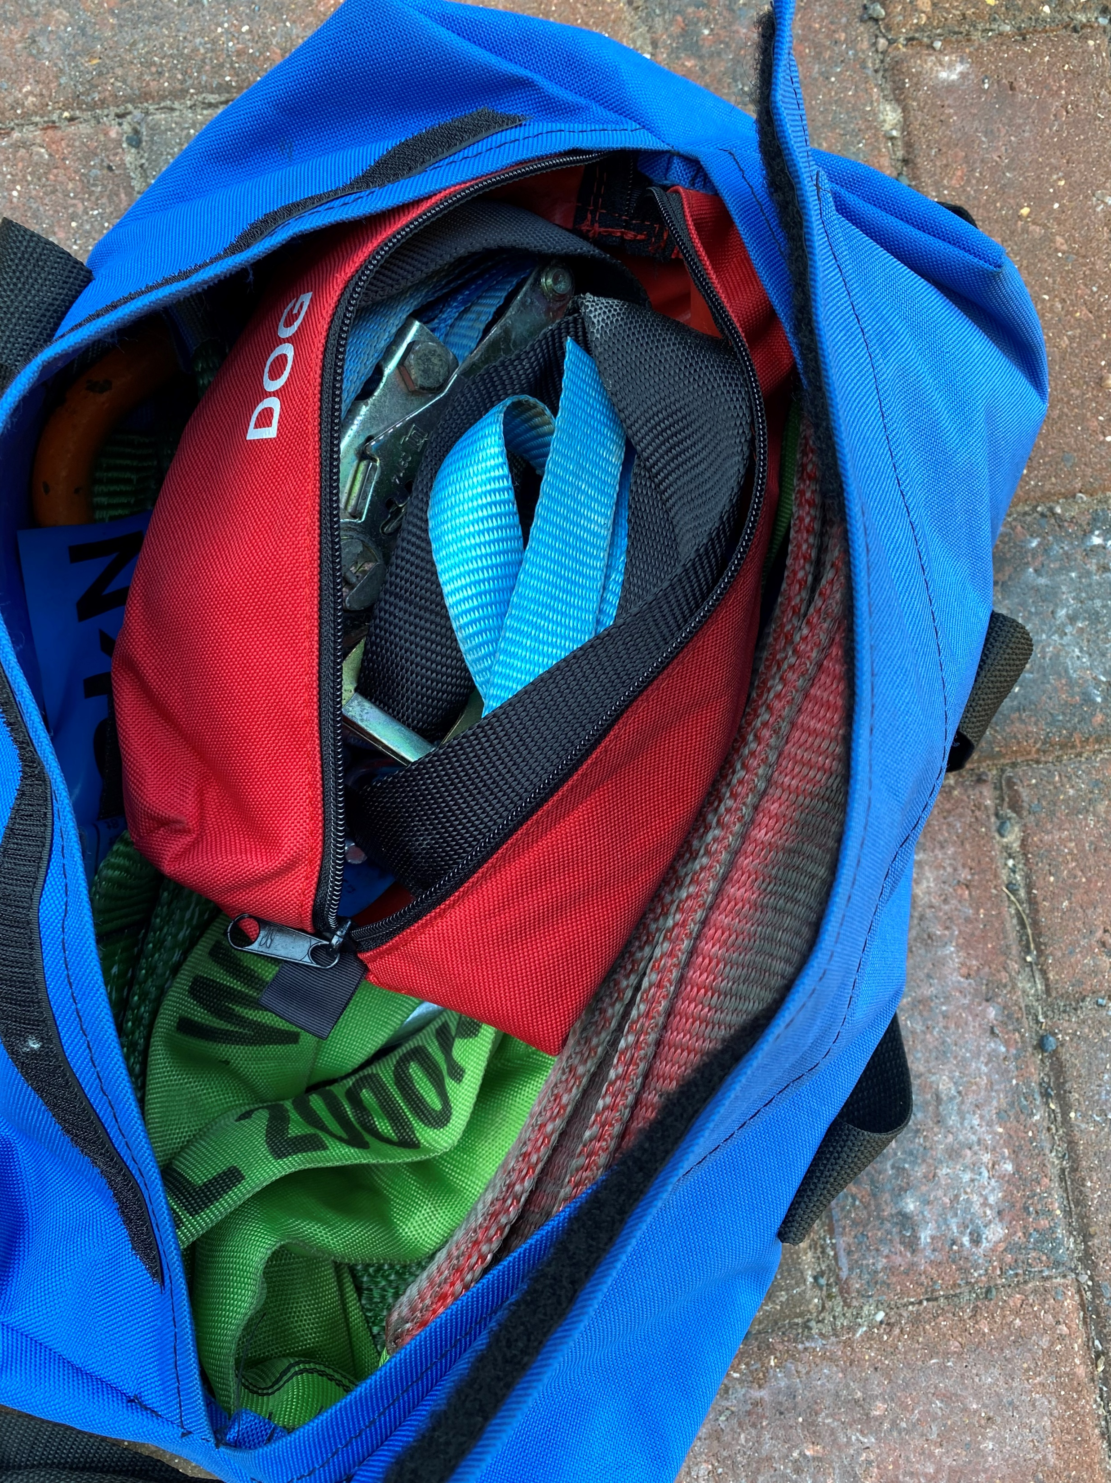
Brother straps, shackles and round sling – blue canvas bag, Velcro closing
Contents of bag –
Brother straps
Shackles x2
Round Sling
ABS strap x2 (contained in small bag, please note that the small bag is part of an on-going project to be rolled) out.)
Link back to slide 1
Notes:
Small red canvas bag is a new purchase for all ToV’s. Current showing the dog lead pouch, need to ask the contracts team whether they can supply without the wording ‘DOG’ written on it.

Slide 6
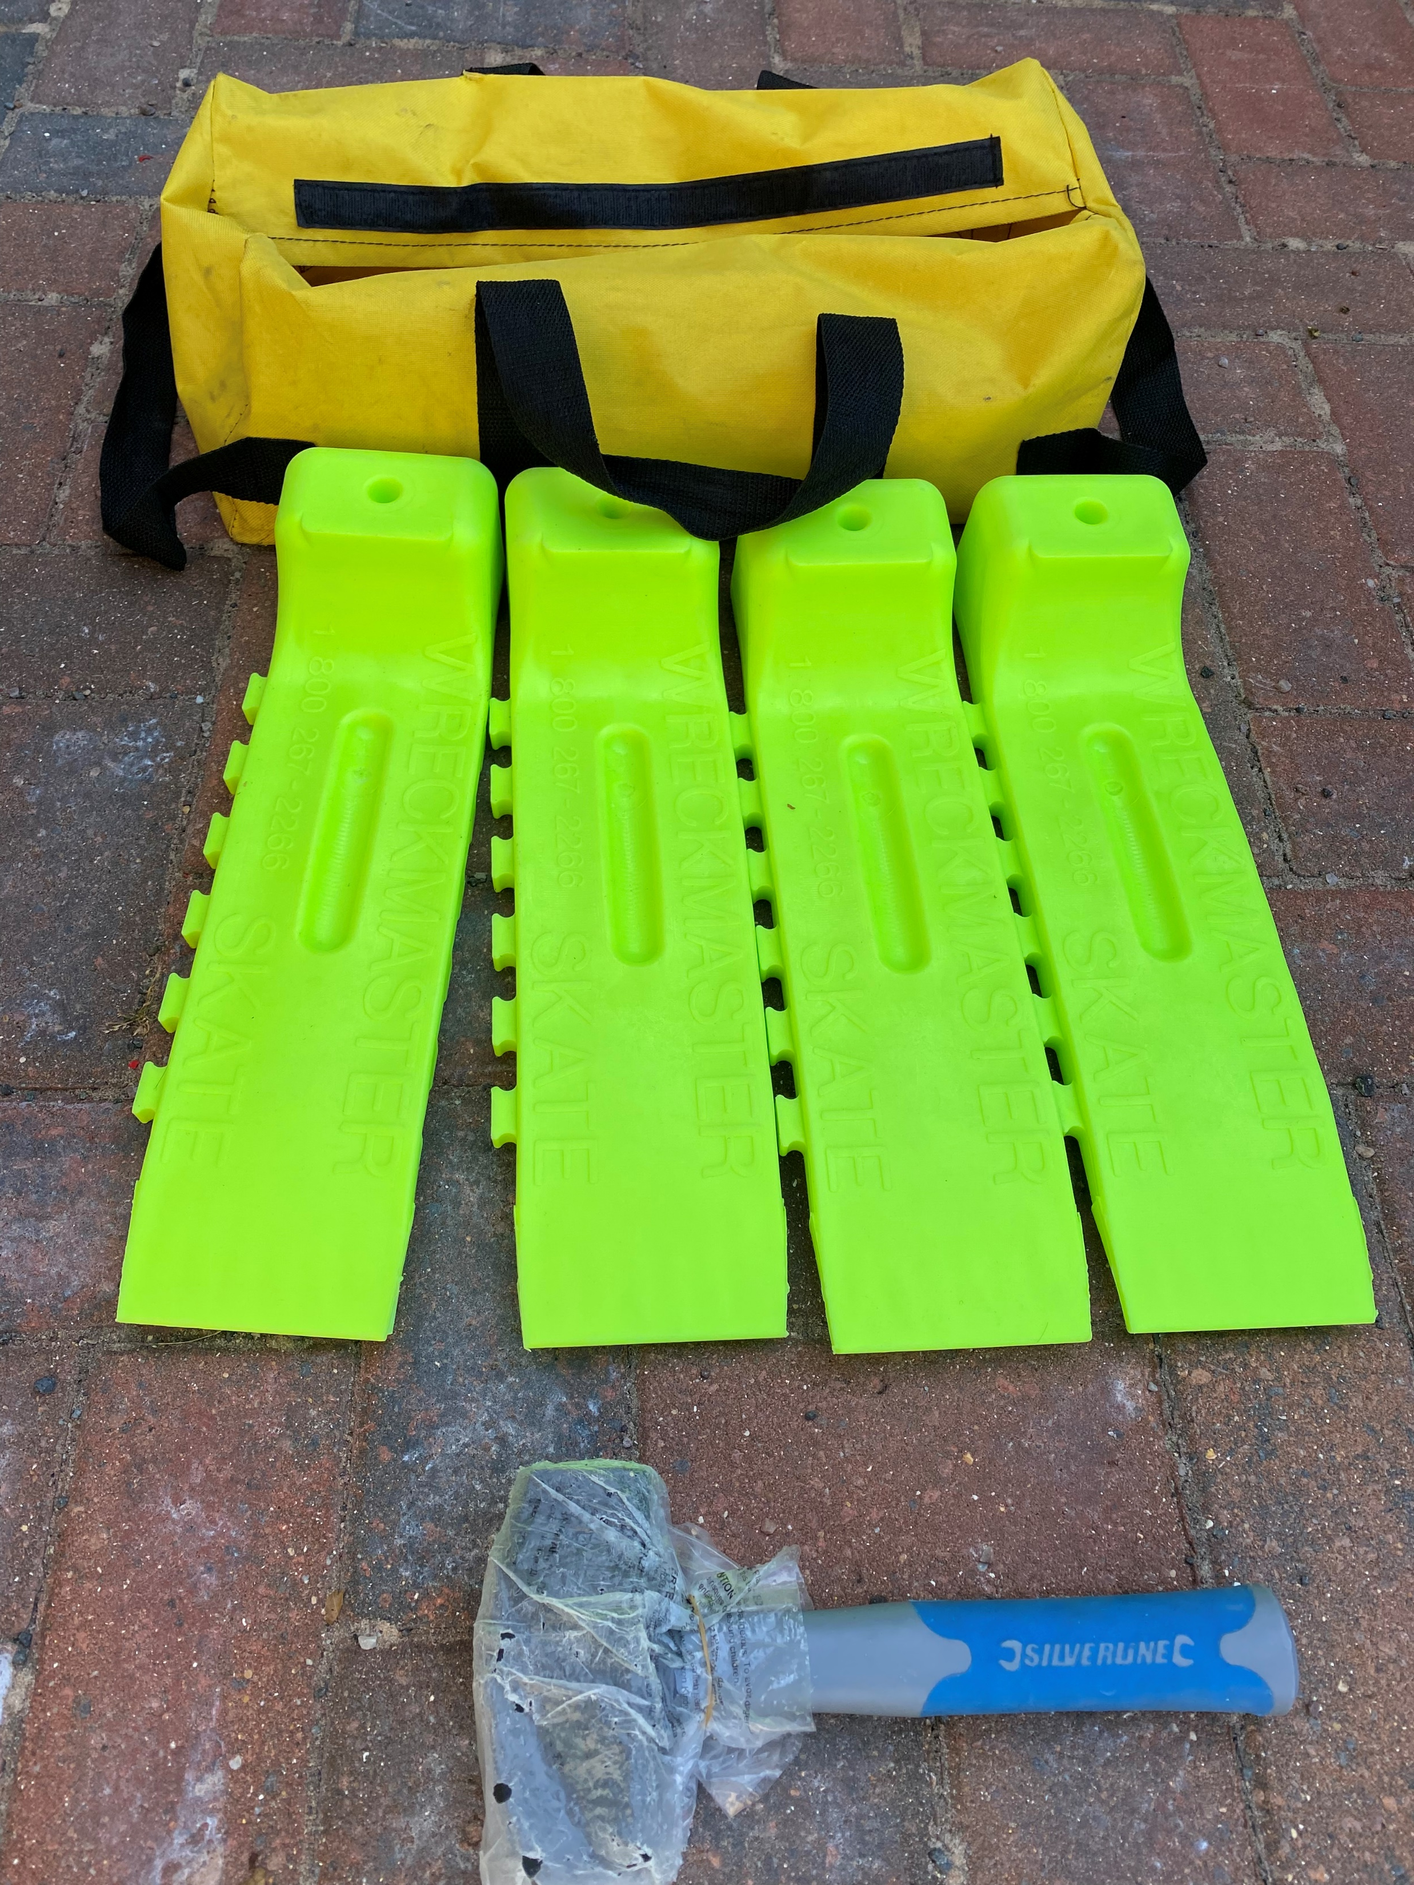
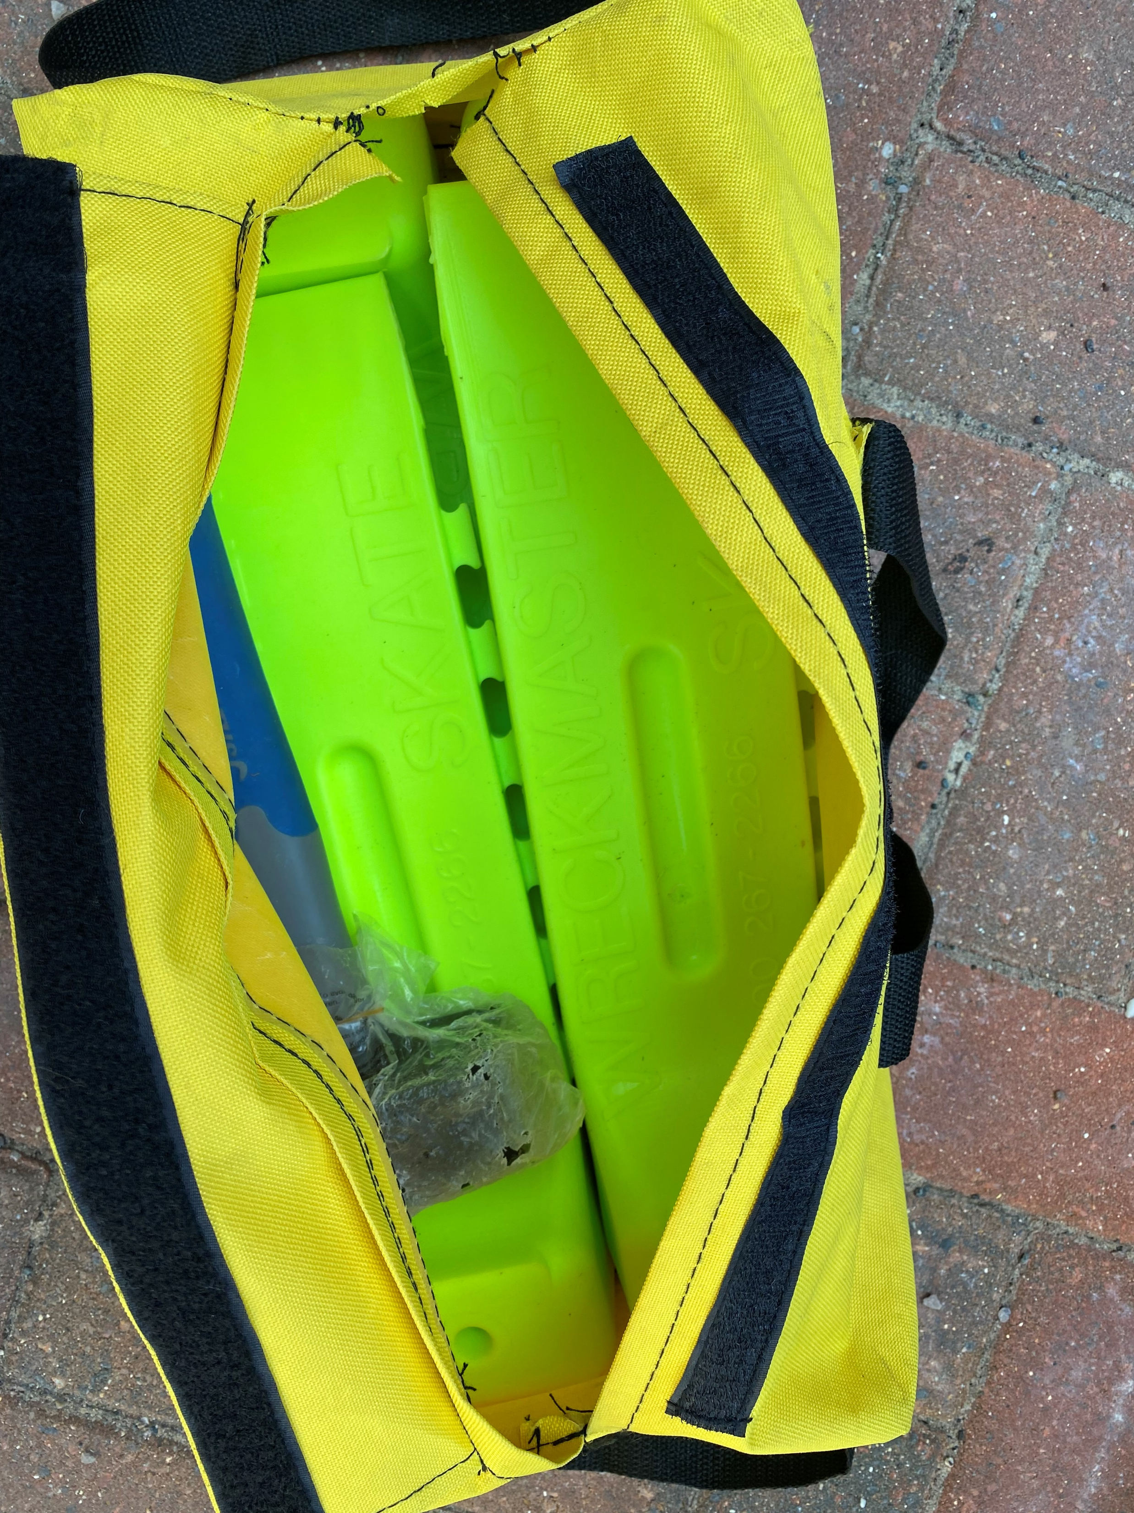
Skates & Lump Hammer – yellow canvas bag, Velcro closing
Contents of bag –
Vehicle skates x4
Lump hammer

Slide 7
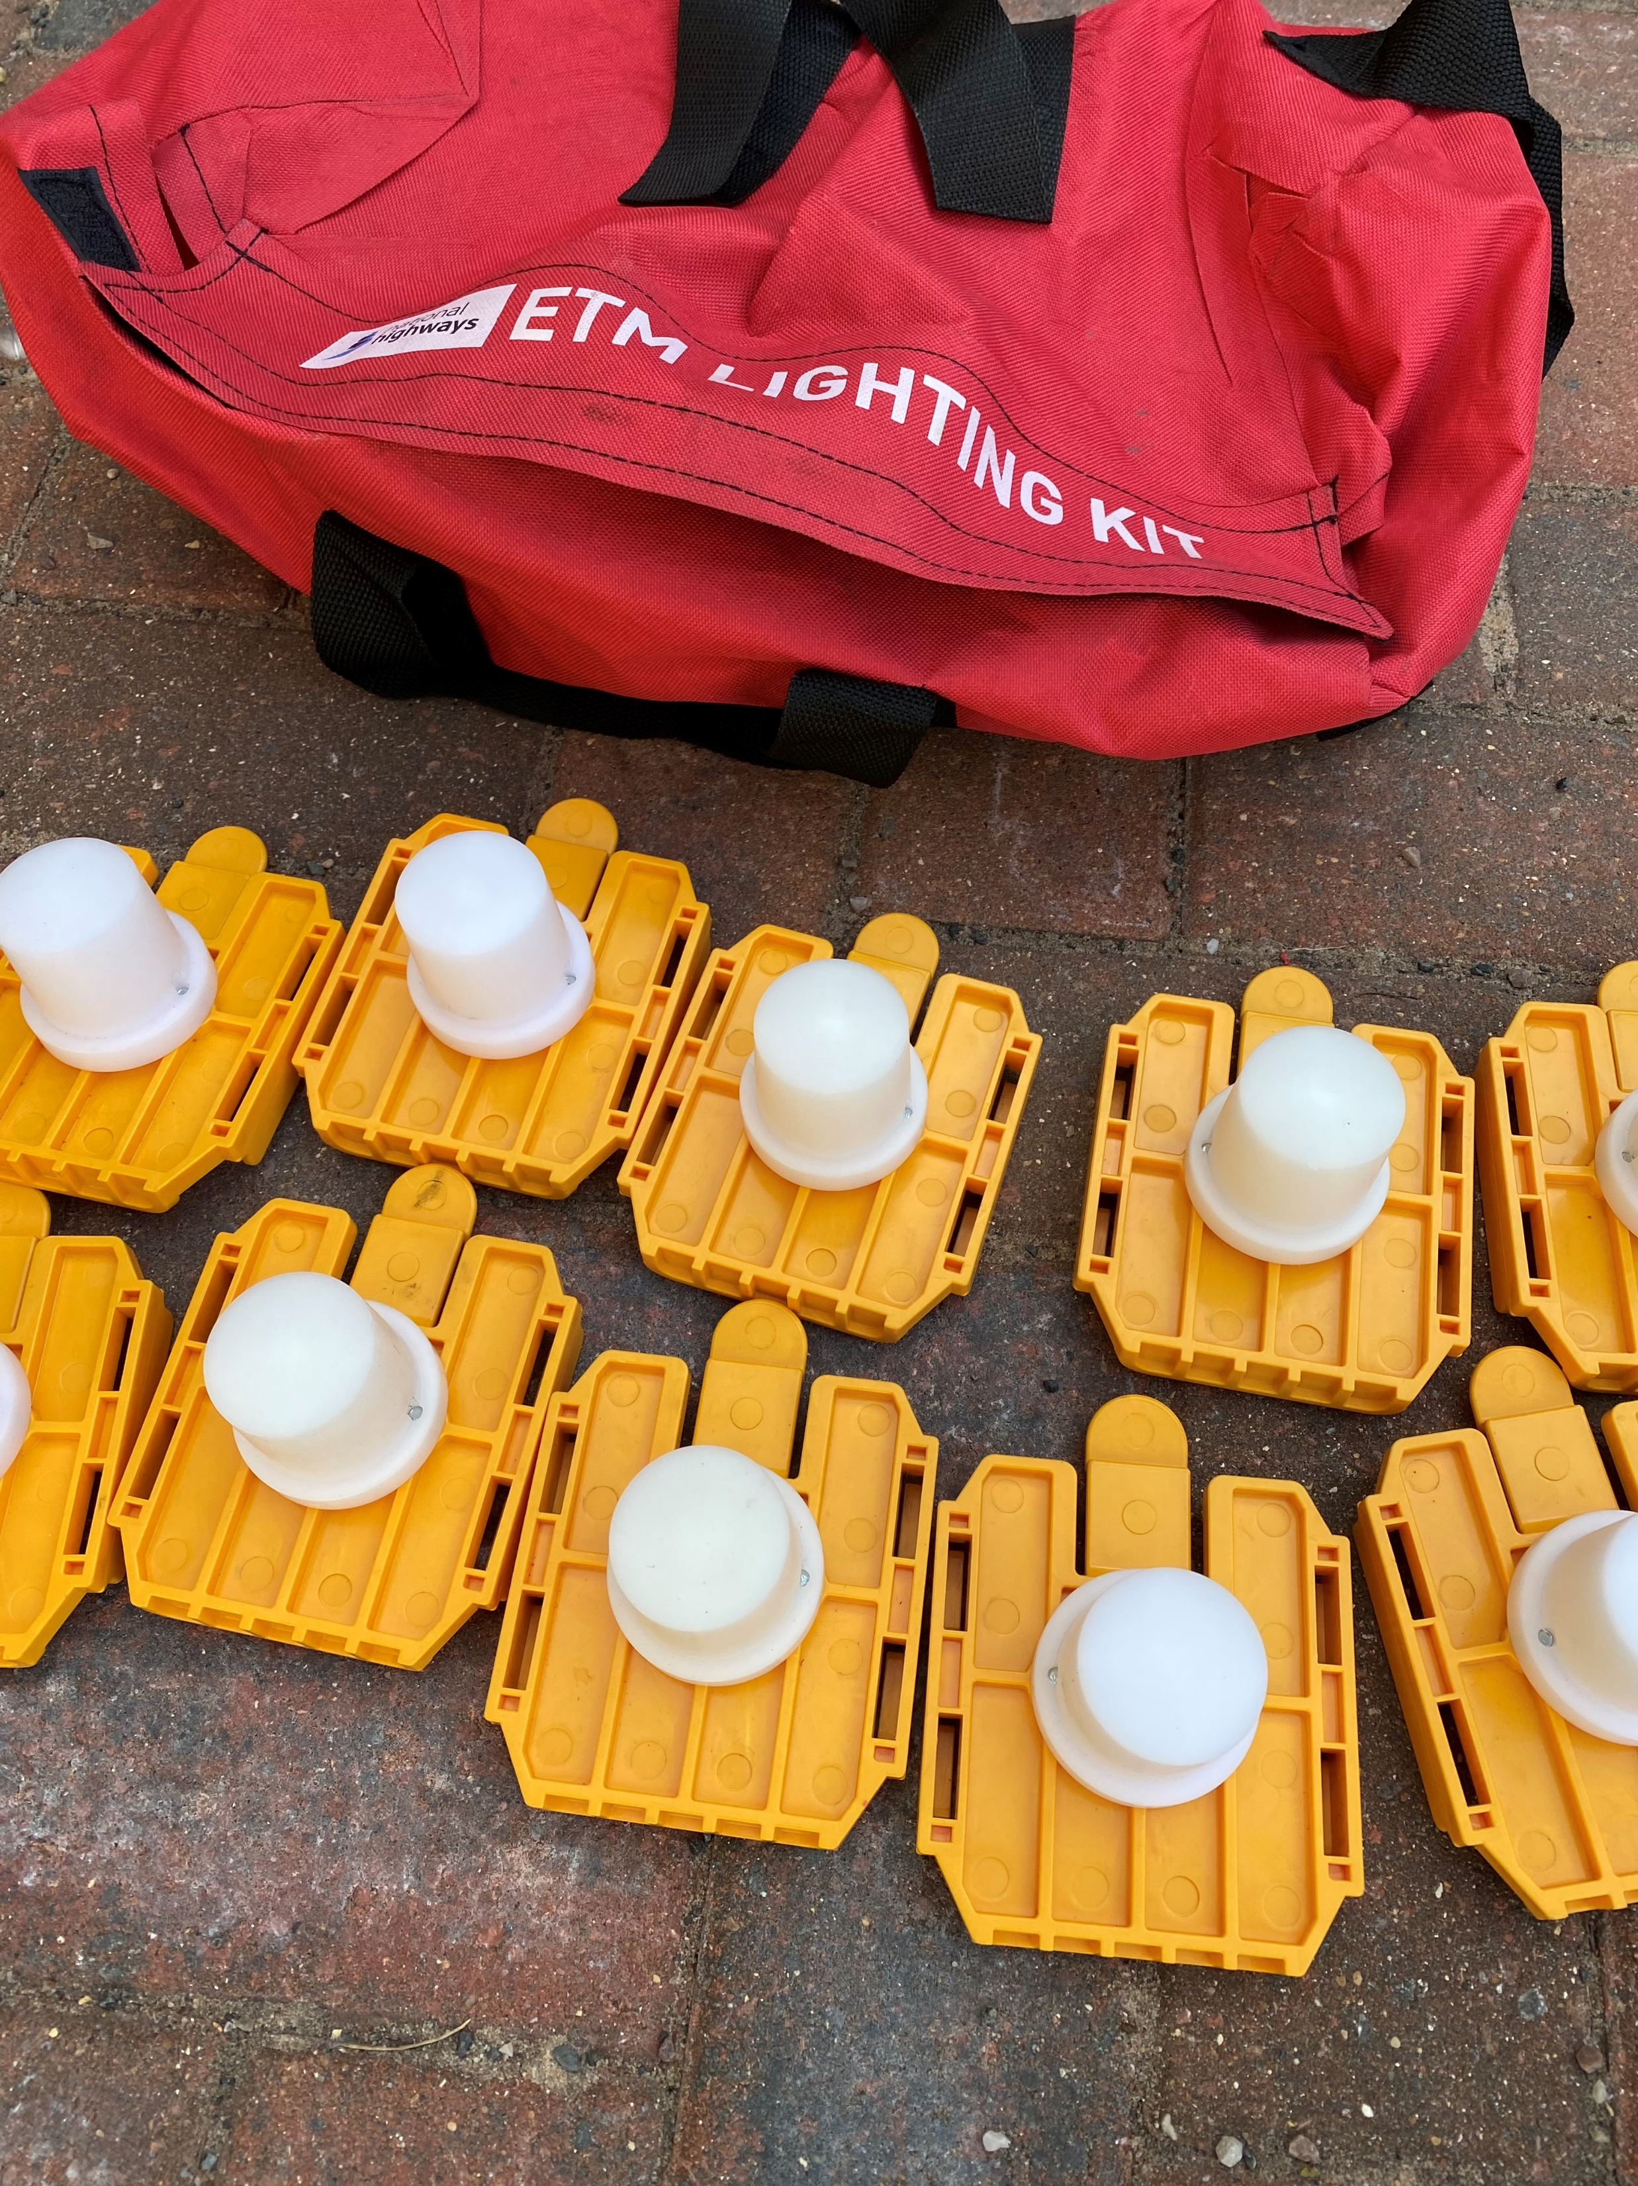
ETM Lighting – red canvas bag, Velcro closing
ETM – Redacted under FOIA Section 43(2) Commercial Interests sequential light equipment
Link back to slide 1

Slide 8
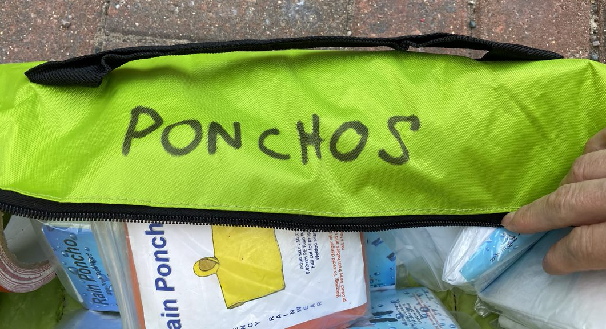
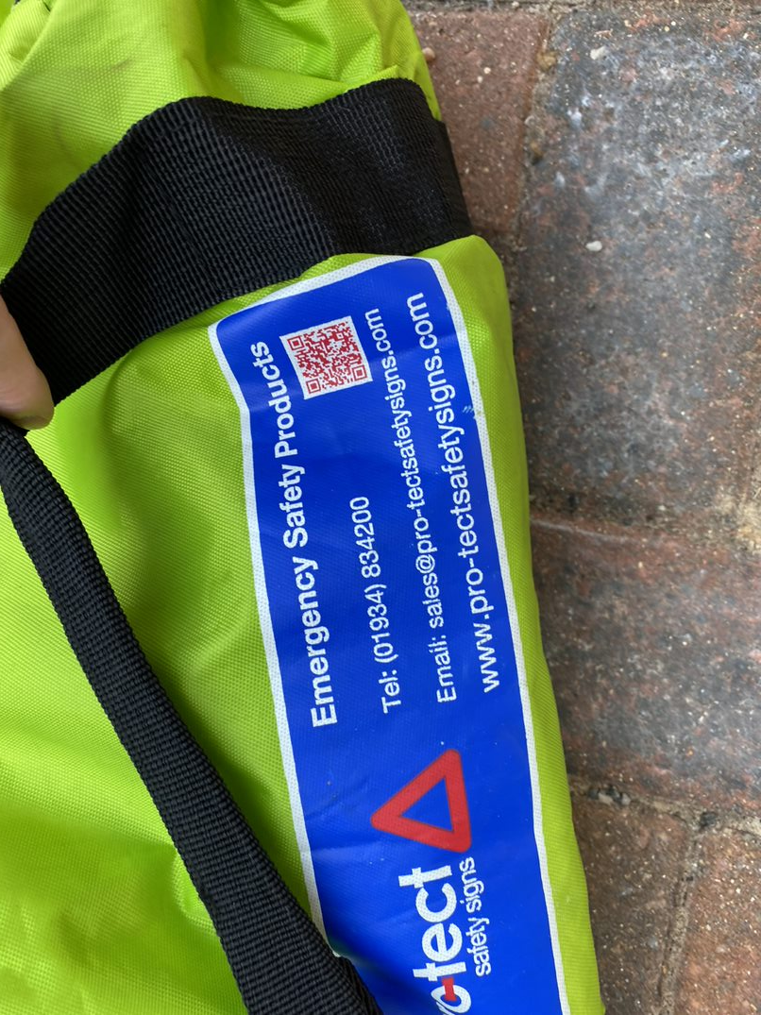
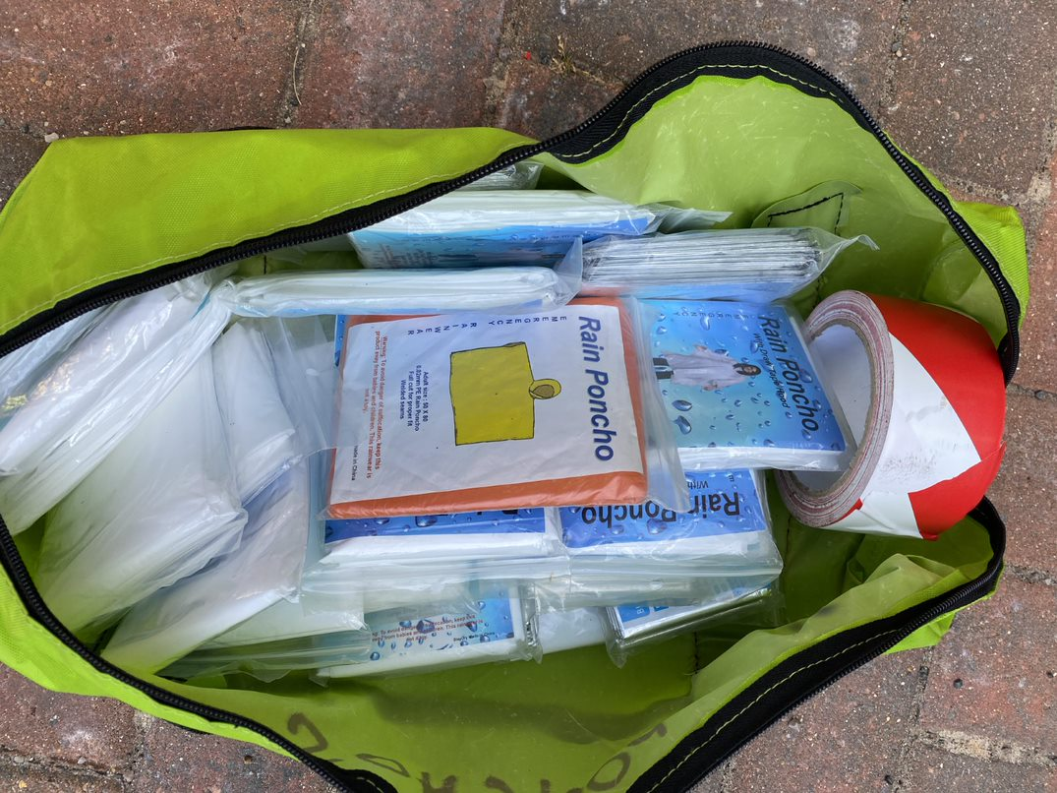
Waterproof ponchos and thermal blankets - Fluorescent yellow/green, zip closing
Contents of bag –
Rain ponchos
Adult thermal blankets
Incident tape x2
Notes:
Why was the incident tape in here again?

Slide 9
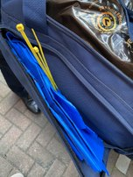
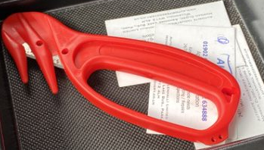
Absorbent Material – Dark blue holdall
3 bags of absorbent material
Cable ties
Dust masks (in side pocket)
Safety Cutter
Redacted under FOIA Section 43(2) Commercial Interests

Slide 10
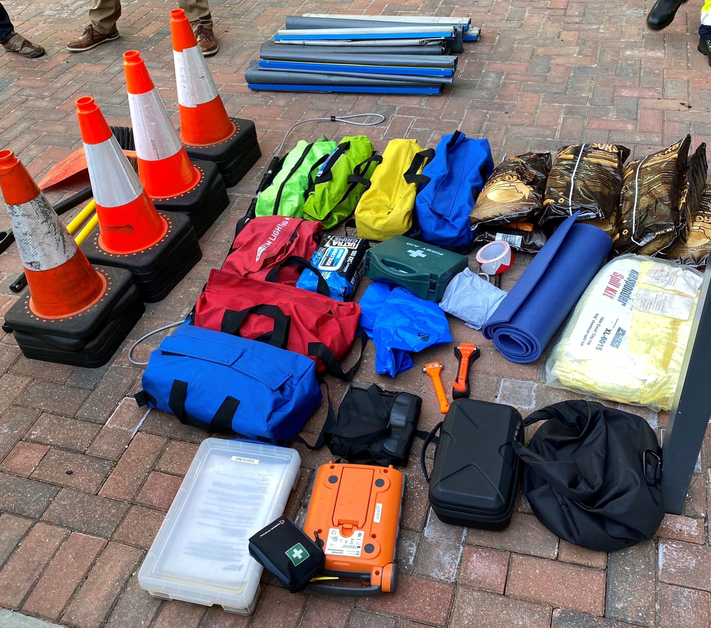
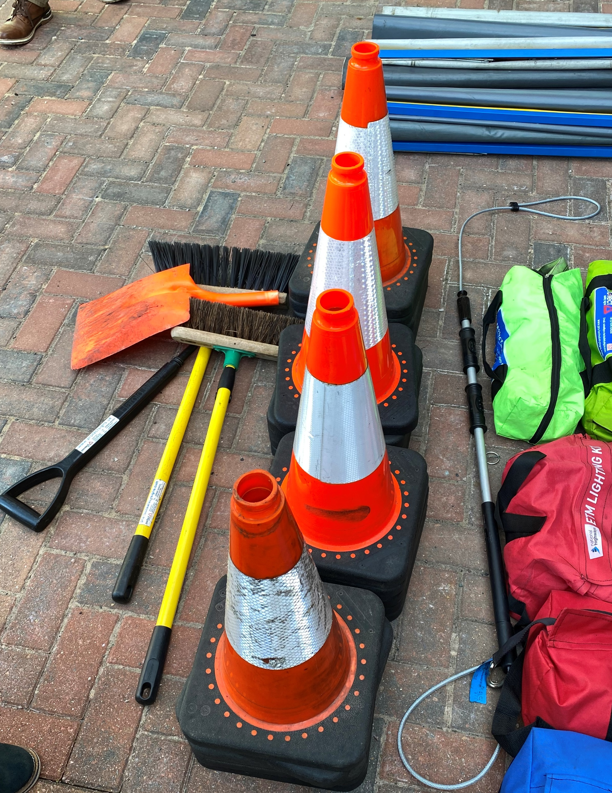
All equipment

Slide 11
Seasonal Items
Request Items
Sunscreen - Mainly stored in the Outstation but during hot weather would usually be put into the glove box or center console.
Bottle of water
Can of de-icer spray
Large animal response kit
Link back to slide 1

