Slide 1



Mental Health and Wellbeing Provision for C&YP in Cambridgeshire and Peterborough
Supplier Day 31st January 2017

Slide 2
Agenda
11.00-11.15 | Welcome & Introduction (JM)
11.15-11.30 | Mental Health Needs of Children and Young People in Cambridgeshire & Peterborough (HH)
11.30-12.00 | Specification/Consultation (Group Discussion)
12.00-12.15 | Tea & Biscuits
12.15-12.40 | Resume Group Discussion
12.40-12.55 | Hints & Tips on Bid Submission to Local Authority (HA)
12.55-13.00 | Close (JM)
13.00-13.30 | Break for Networking
13.30-16.00 | One to One Slots

Slide 3
Context
Joint procurement led on by Peterborough
Part of wider CAMHs transformation project
Main provision within Getting Help grouping of Ithrive
C.£700,000 pa 3+>2 year contract
Scope for different bidding structures:
Single provider
Lead/Sub contractor(s)
Partnership arrangement
Consortium arrangement

Slide 4
Proposed key dates
13 April 2017
4-6 July 2017
1st January 2018
21 May 2017
11 -22 Aug 2017
ITT issued
Provider presentations
Service commencement
April | May | Jun | Jul | Aug | Sept | Oct | Nov | Dec | Jan | Feb | Mar
ITT submission deadline
Alcatel period followed by contract award

Slide 5
Key Drivers
Significant level of unmet need
Gaps in provision
Additional investment
NHS target to increase access
Alignment of provision across two LAs

Slide 6

Our requirement
Innovative delivery model
Brief evidence based talking therapies (and promotion of mental health literacy)
Ithrive principles
Responsive to local needs
Increase reach
Deliver outcomes

Slide 7
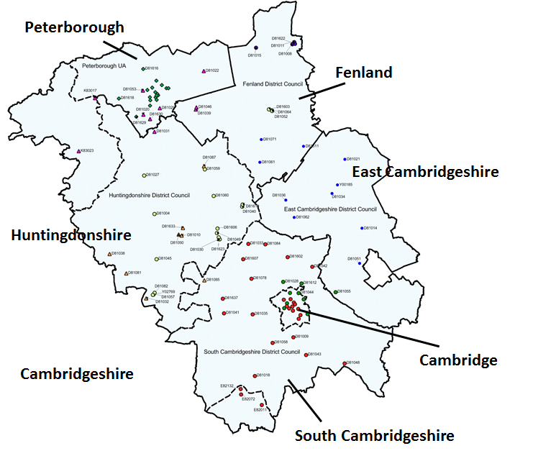
Summary of Needs: Cambridgeshire & Peterborough

Slide 8
Key Features
Geography - Rural/urban mix
Approx. 130,318 5-17 year olds and 86,567 aged 18-25 years old (2017)
Areas of new development e.g. Northstowe
Almost 80% of children in poverty in Cambridgeshire live in the less deprived areas
Peterborough has a higher percentage of residents within the most deprived economic quintile (37.5%) than England (20.2%)
In Peterborough 45% of school children were from minority ethnic groups in 2015

Slide 9
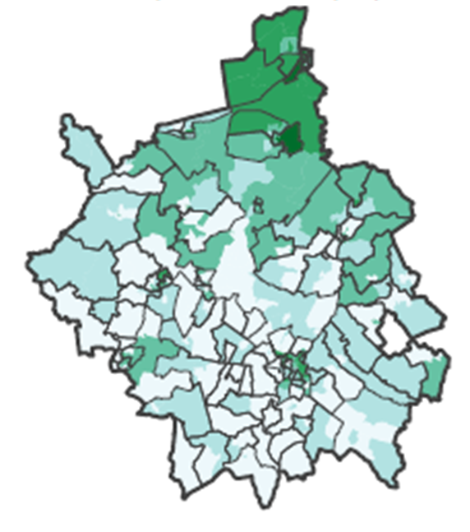
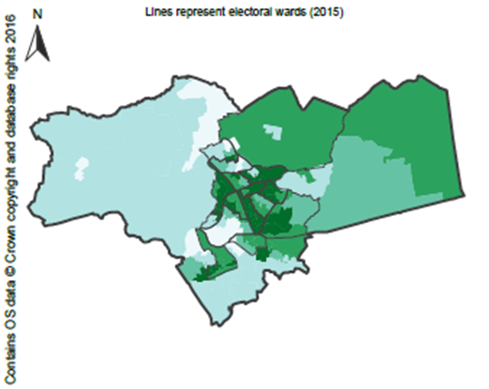
Deprivation
Cambridgeshire
Peterborough
IMD 2015 Quintiles – Darkest colour represents some of the most deprived neighbourhoods in England.
Source: Health Profiles, Public Health England

Slide 10
Mental Health
Estimated Number of Children and Young People with a Diagnosable Mental Health Problem in Cambridgeshire and Peterborough (2017):
 | 5-10 year olds | 11-17 year olds | 18-25 year olds
Cambridge City | 640 | 942 | 5,361
East Cambridgeshire | 558 | 822 | 1,192
Fenland | 514 | 850 | 2,003
Huntingdonshire | 995 | 1,621 | 2,641
South Cambridgeshire | 969 | 1,540 | 2,108
Cambridgeshire | 3,676 | 5,777 | 12,890
Peterborough | 1,331 | 1,864 | 3,471
Cambridgeshire & Peterborough | 5,006 | 7,640 | 16,361
Data for 2017, based on mid-2014 population estimates (ONS).

Slide 11
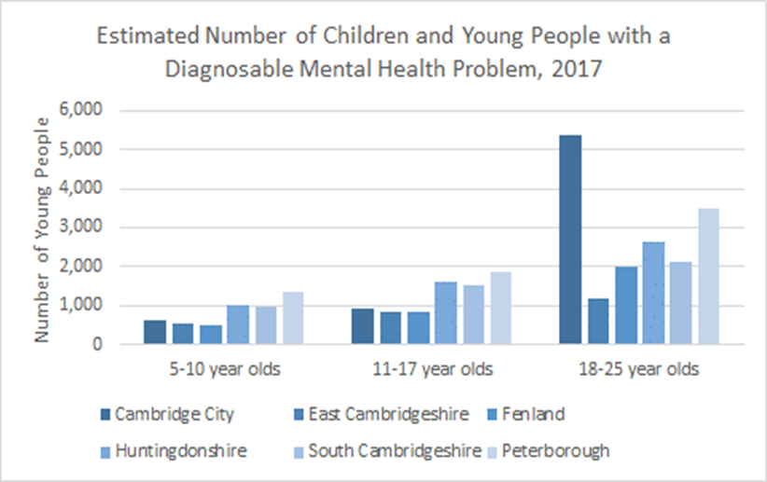
Need by Area

Slide 12
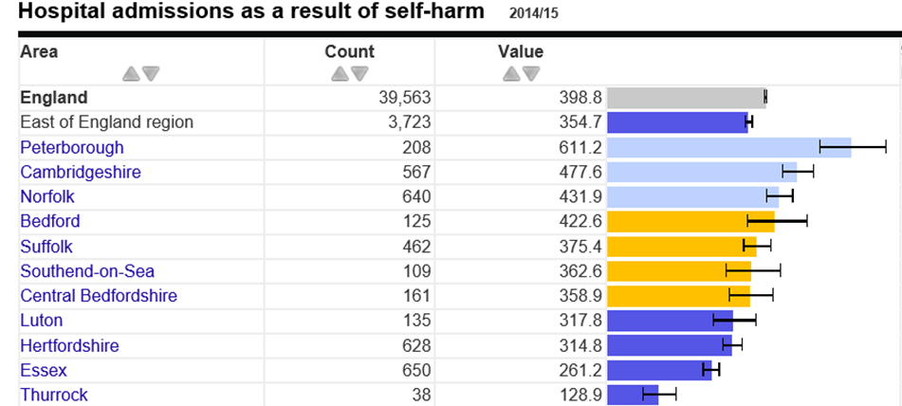
Self-Harm

Slide 13
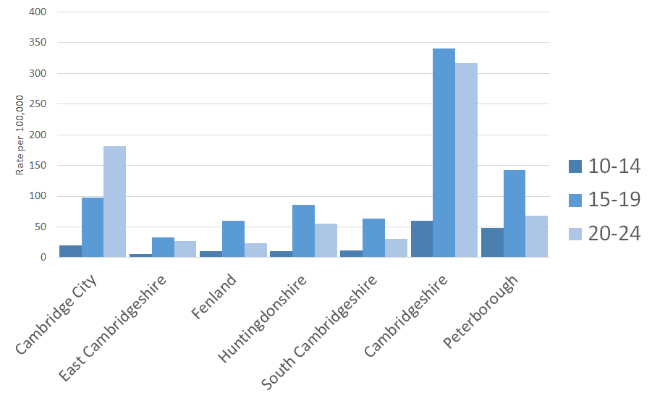
Self-Harm Admissions by District & Age

Slide 14
Current Service Activity–Cambs (15/16)
•Counselling services (13-25 years): 882 initial assessments, 671 ongoing counselling.
•66% female, 32% male.
•Most common presenting issues: Anxiety/stress, depression, anger, and relationship problems.
•Additional support for LGBTQ YP: 147 initial assessments and 103 ongoing support. 48% identify gender as ‘other’.
•Specialist Bereavement Support: Additional 92 young people (0-19 years) had an assessment (56% 5-10 years old).

Slide 15
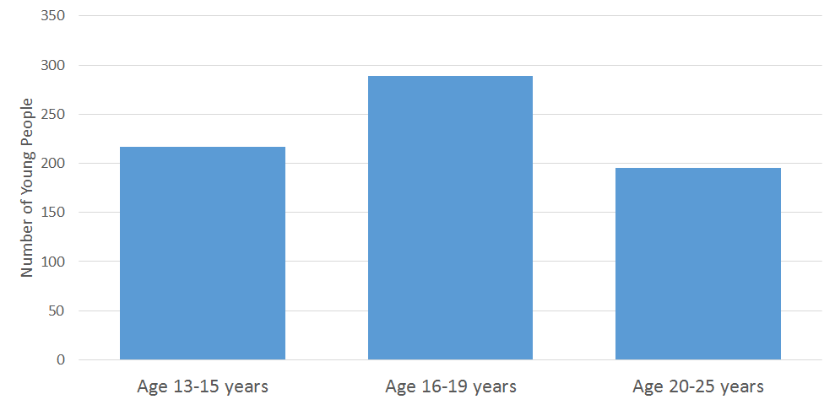
Age Profile (Counselling Services, Cambs 2015/16)

Slide 16
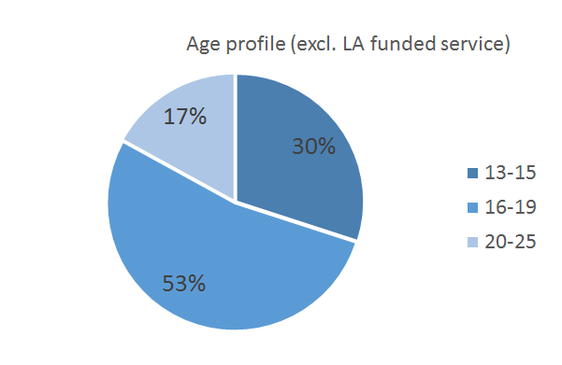
Current Service Activity - Peterborough
Peterborough
 | 5-11 years | 12-25 years | 11-17 years
Local Authority Funded Talking Therapies |  |  | 165
Non-Local Authority Funded Counselling |  | 169
•Mixture of self-referrals and a large number of referrals from schools.

Slide 17
Presenting issues - Peterborough
Anxiety / stress PTSD (UAS and refugees)
Depression and low mood Challenging behaviour
Relationship difficulties (family and peers) Impact of parental D/A misuse
Loss (divorce/bereavement) Sexual identity/orientation
Anger
Self harm
Attachment issues

Slide 18
Additional Services
Operating within a wider system, other services offering support include:
•Independently commissioned services in schools/colleges/universities e.g. counselling
•Psychological Wellbeing Service (IAPT) [17y+]
•CAMHS Getting More Help Services (Cambridgeshire and Peterborough Foundation Trust)
•Other voluntary sector provision that individuals can access
•Parenting programmes across Cambridgeshire and Peterborough

Slide 19
Scope
Main activity will be assessment and delivery of therapeutic interventions
Additional activity will include:
Provision of information and advice regarding emotional wellbeing for children, young people and parents/carers
Delivery of mental health literacy training to wider professionals including school staff

Slide 20
Eligibility criteria
Local (residence, school or GP)
Aged 4-5 up to 18th birthday for those in Peterborough and up to 25 in Cambridgeshire
Mild-moderate mental health issues (diagnosed or undiagnosed) and/or significant emotional wellbeing difficulties which are significantly affecting behaviour, functioning or relationships

Slide 21
Children and young people report improved mental health and emotional wellbeing and greater ability to self manage difficult emotions and cope with adversity
More children and young people access evidence based therapies to improve their mental health
More children and young people with mental health/emotional wellbeing issues receive the right level of intervention at the right time
More children, young people, families and professionals know how to promote and sustain good mental health and emotional wellbeing
Key Service Outcomes

Slide 22
Core Elements
Range of age appropriate, evidence-based talking therapies (CYP IAPT compliant ??????)
Pre and post bereavement support
Holistic assessment & early help assessment including specialist screening tools
Individualised care planning and review (including goal and outcome setting and review)
Case management
Evaluation framework to collate hard and soft data in which to measure effectiveness and improvements in outcomes at both individual and service level
Interface with Getting More Help (Specialist CAMHs) (onward referral/step down/co-manage)
Safeguarding
Parenting information, advice and support and signposting for parents/carers of those engaged in the service
Provision of general information and advice regarding emotional wellbeing for CYP, parents/carers or professionals
Signposting to other services
Mental Health literacy training for wider professionals and school staff
Creative approaches to engaging those with significant need but reluctant to engage (e.g. refugees, NEETs, LGBTQ young people)
Core Elements of Service

Slide 23
Additional Elements
Website and online presence which includes relevant information, advice and links to other sources of support
Advice for schools following significant traumatic event (in conjunction with specialist CAMHs) e.g. suicide
Participation in Early Help Hubs
Contribution to packages of risk support of individuals led by specialist CAMHs
Participation in Multi-Agency Safeguarding Hubs (MASH)
Service publicity and promotion
Participation in local and national public health campaigns
Healthy lifestyles information and advice as appropriate (oral health, sexual health, physical activity, nutrition, smoking cessation)
C-Card scheme and Chlamydia Screening 16-25s
Drug and Alcohol screening where appropriate
Contribution to strategy development and needs analysis
Additional Elements of service

Slide 24
Supplier Views
Inclusion of 4 FTE CYP Psychological Wellbeing Workers?
Requirement to have minimum Level 2 (Satisfactory) NHS Information Governance Toolkit?
IT/Data requirements to upload data to relevant NHS dataset?
Risk support?
Supporting information?

Slide 25
How could we measure quality?

Slide 26
How could we measure activity?

Slide 27

THE TRUTH ABOUT TENDERS…..

Slide 28

Evaluators LIKE giving marks to organisations

Slide 29


GETTING STARTED
STYLE OF QUESTION
EVALUATION CRITERIA

Slide 30

WHAT ARE EVALUATORS LOOKING FOR?

Slide 31
Comprehensive understanding of how the requirement will be met.
Comprehensive evidence that the response given will deliver all stated requirements.
Demonstrates how added value will be provided.

Slide 32
We have found that our approach is an effective one, not only in terms of achieving outcomes but also through the changes and feedback we see from individuals. For example, our feedback forms (13 completed) from Autumn 2015 show that, when service users were asked to rate the service, they gave an average response of 8.7 out of 10, indicating a high level of satisfaction. We are also regularly called on by partners to give advice and have received excellent feedback (exampled below).
There have been times when I have been working with the most desperate service users….I have been able to call upon X to get support and advice…. The difference this has made to the lives of service users I have worked with has been unquantifiable. X YZ December 2015

Slide 33
“I don’t always have the same opportunities to take part in activities as everyone else or have friends over as my dad is unwell . I have to stay home to care for him” X, aged 15
In a survey, 20% of young people said that they have been bullied away from school in the last 12 months (HRBS 2014).
Many tell us that access to free time, friendships and new experiences and learning is affected by caring. Children can feel stigmatised and avoid inviting friends over or can be short of time or money to do activities.
When we evaluated our group work we found:
• Reliance on groups for friendships ………….

Slide 34
The successful delivery of the X contract will be dependent on actively managing and mitigating the risks and challenges of operating an XX service. The main challenges to this are:
Effective partnership set up management
Staffing risks and challenges
Quality assurance across the partnership
Data and IT
Access to the X service, ensuring ‘no wrong doors’
Effective partnership set up and management
X will have shared operational procedures and policies in place to ensure services are maintained and contingencies are in place for any possible risk. The management of these will be a key feature of the Partnership Management Board (PMB) with the risk log reviewed and updated at each meeting.

Slide 35
GOOD LUCK

Slide 36
Questions

Slide 37
Contacts
Jo Melvin, Public Health Commissioner
joanne.melvin@peterborough.gov.uk
For any issues regarding access to tender documentation please contact
Wayne Stott
wayne.stott@peterborough.gov.uk

