Slide 1

HGV Levy: Foreign Operator Payment Service
May 2019

Slide 2
Market Engagement Purpose
Understand technical solutions available to support all service requirements
Evaluate commercial options and costs to maximise Return On Investment
Gauge solution build and implementation timescales

Slide 3
Policy Overview
The Government introduced the HGV Road User Levy in 2014.
Paid by all UK & Foreign HGVs (over 12 tonnes) driving the in the UK.
Prior to the levy UK hauliers would pay to drive abroad, but foreign drivers would not incur charges for driving in the UK.
Levy cost is varied by vehicle size, type, emissions and period (up to £10 per day, £1200 per annum – constrained by EU Law)
Foreign HGV payments collected via Foreign Operator Payment Service (FOPS)

Slide 4
FOPS High Level Requirements
Payment Portal (approx. 2.5m transactions per annum)
Central Payment and Data matching database to store relevant information
Payment channels including: Credit / Debit / Fuel Card, APM’s, BACs, P.O.S (inc. cash), recurring, telephone payments & prepaid accounts
Payment confirmation & issue of refunds
Management Information reports including: income, payment channel, usage & others

Slide 5
FOPS High Level Requirements cont.
Registered Accounts
Renewal reminders via various channels including email / SMS
Multi Lingual communications (various channels inc. contact centre), marketing and correspondence
Enforcement Portal, secure data capture and sharing via Government Agency interfaces
Public Register providing Levy purchase details including country of origin, class and duration (restricted access, via GOV.UK)

Slide 6
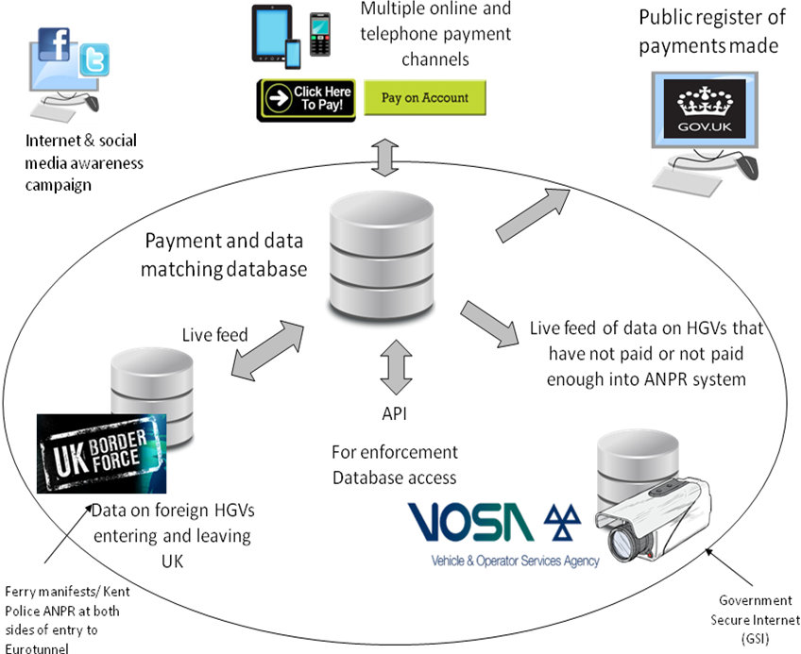
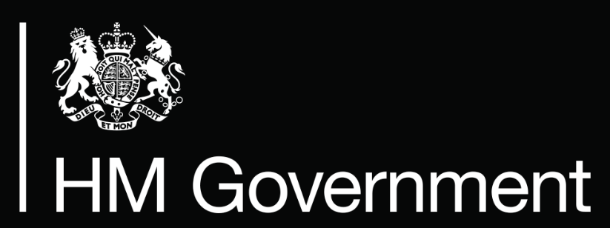
Current Solution overview
Multiple Payment Channels
Communications
Public Register
Payment Database
Live Feed
ANPR Live Feed
API
(Enforcement Database access)

Slide 7
Enforcement Requirements
Provide an on-line platform to enable DVSA examiners access to LEVY payment records.
Provide live payment information to facilitate targeted enforcement (via ANPR cameras).
Accurate feed of LEVY status in real time, with National ANPR integration
API for live lookups for the DVSA Search app (bespoke app accessed via iPhone which interrogates various databases).
Quick access to report faults or inaccurate information either via service desk or portal.

