Slide 1
Increasing Sustainable Bioenergy Feedstocks – Early Supplier Engagement Event
Science and Innovation for Climate and Energy 22nd February 2019
Notes:
Cover style

Slide 2
Agenda
Welcome – Nicola Hamilton
Pre-Market Engagement – Julie-Anne De Thomasis & Ben Brenton
Energy Innovation Portfolio – Nicola Hamilton
Bioenergy Feasibility Study – Peter Coleman
HELGA – Adam Garbutt
Q&A

Slide 3
Procurement Pre-Market Engagement Session:
Increasing Sustainable Bioenergy Feedstocks Presented by: Ben Brenton

Slide 4
Why we are holding the Pre Market Engagement Day
The outcome of today’s pre-market engagement day is for for both the suppliers and BEIS to have received greater information and knowledge for this requirement before we go to market.

Slide 5
Why we are holding the Pre Market Engagement Day?
The outcome of today’s pre-market engagement day would be for both the suppliers and BEIS to have received greater information for this requirement before we go to market. Both parties should have gained further knowledge for this requirement.

Slide 6
What BEIS would like to achieve today
Suppliers have further knowledge of this requirement and can ask questions anytime. Suppliers can plan ahead for this requirement and the procurement process.
BEIS have better understanding and further information for this requirement.
Suppliers offer innovation / tell us previous lessons learned. Help – fill in the blanks of the specification. Make recommendations tell us expectations that seem unrealistic. Tells us any risks that may occur and mitigations explored.
The presentation, any minutes and Q&A for today will also be published when the ITT is advertised. There will be an opportunity to ask additional questions at a later stage in the tendering process but timelines will be restricted and communications shared throughout the tendering community.

Slide 7
Procurement Route: Heat Networks and Electricity Generation Asset (HELGA) RM3824
Product types:
Service 1 - Energy Advisory, Design and Technical Services: Technical services relating to the advice and design of any demand management or generation type
Service 2 - Delivery Services: Delivery services to install, manage and maintain any demand management or generation type
Service 3 - Energy Purchase Agreement: Provision of Energy Purchase Agreements through direct or indirect opportunities
Service 4 - Commoditised Products: Access to commoditised products through bulk purchasing
Service 5 - One Stop Shop: One stop shop solution to deliver full end-to-end advisory, design, delivery, energy purchase agreements, and commoditised products.
Where opportunities will be advertised on HELGA, suppliers must register. It can take CCS up to 15 working days to register a supplier, so please build this into your timeline as necessary. Registration link here: https://supplierregistration.cabinetoffice.gov.uk/dps

Slide 8
Procurement Timeline for this requirement
Please note dates may be subject to change:
ITT to be advertised: 7 March 2019
Questions Received: 15 March 2019
Answers Uploaded: 26 March 2019
Tender Deadline: 1400 8 April 2019
Suppliers alerted of outcome: w/c 29 April 2019
Contract issued: w/c 29 April 2019
Contract Start Date: 13 May 2019
TO BE ELIGIBLE TO BID INTO THIS PROJECT, YOU MUST BE A REGISTERED SUPPLIER ON HELGA BY 6TH MARCH 2019

Slide 9
Terms and Conditions for this requirement
BEIS standard terms and conditions will be applied to this requirement. Except the Liability will be amended from £4,000,000 to £2,000,000.
The Terms and Conditions will not be amended after ITT publication. Therefore, potential service providers should raise any concerns today so that any changes can be made before the ITT is issued.
Suppliers should not amend the T&Cs and submit changes with their proposal. This is effectively submitting a non-compliant proposal and will result in self-deselection.

Slide 10
ANY QUESTIONS?

Slide 11
Increasing Sustainable Bioenergy Feedstocks Feasibility Study
Nicola Hamilton and Peter Coleman

Slide 12
Energy Innovation Support Landscape – Policy Drivers: Clean Growth Strategy
We will maximise the advantages for UK industry from the global shift to clean growth – through leading the world in the development, manufacture and use of low carbon technologies, systems and services that cost less than high carbon alternatives
‘Clean fuels such as hydrogen and bioenergy could be used for transport, industry, and to heat our homes and businesses. We need to test how they work…and how they could be used... These options need to work as well and as cheaply as current technologies.’
‘To support greater productivity of agricultural land, we need to: increase carbon storage through fertilising crops more effectively, develop new animal and plant breeding technologies, use precision farming technologies on smaller scale farms, and develop robotics and new sensor technologies.
We will develop a new incentive structure to harness the potential for growth in forestry and renewables being supplied from within the UK, including on bioenergy, as part of our ambitions for strengthening the rural economy and encouraging diversification of farm businesses.’
We will:
increase our support for innovation so that the costs of clean technologies, systems and services are reduced across all sectors,
align our policies, regulations, taxes and investments to grow the markets for these new innovations so that they are successfully commercialised in the UK.
Our long-term goals are to make clean technologies cost less than high carbon alternatives, and for UK businesses to take the lead in supplying them to global markets.

Slide 13
BEIS Energy Innovation Programme
The overall aim of the £505m BEIS Energy Innovation Programme is to accelerate the commercialisation of innovative cheap, clean, and reliable energy technologies by the mid 2020s and 2030s.
Within each theme the budget is allocated to a mix of development and demonstration projects focused on specific objectives, underpinned by a programme of open, cross-cutting support
£180m Nuclear
Driving down costs and building new UK supply chains and skills
£15m
Renewables
Driving down the cost of low carbon electricity at scale
£100m
Industry
£90m Built Environment
£70m Smart Systems
Low carbon options for industry, lowering energy costs
More cost effective energy efficiency and low carbon heating
Cost effective flexibility, including new storage options
£50m Cross Cutting Supporting disruptive innovations (particularly for SMEs), including using innovative finance.
Notes:
BEIS theme: Title and content slide

Slide 14
Context
Projects on bioenergy innovation within our portfolio have focused on the Bioenergy Sustaining the Future (BESTF) initiatives
Current spending review period is agreed until March 2021
Recent work: ‘Innovation Needs for Biomass Heat’, ‘The Role for Bioenergy in Decarbonising the UK Energy System: Findings from the ETI bioenergy programme’, ‘Biomass in a Low-Carbon Economy’
Will build on, and go beyond, the Energy Innovation Needs Assessment currently underway.
Still an evidence gap to fill before we know where is best to focus innovation spending
IPCC Special Report on 1.5 degrees - significant difference between 1.5 and 2°C, and the risks are progressively higher. Achieving 1.5°C requires unprecedented transitions and negative emissions.
Committee on Climate Change asked to provide advice on when the UK should reach net zero emissions of carbon dioxide and/or greenhouse gases, if the target should be set now, the implications for emissions in 2050, how reductions can be achieved and what the costs/benefits are in comparison to current targets. This advice is due to be published on 2nd May.

Slide 15
What we’re looking for
Feasibility study – five months, £200-250,000
Evidence gap – which innovation activities would be the best value for money in terms of reducing the costs, reducing the greenhouse gas emissions, and improving the profitability for land managers
Scope – identification of new cultivars to post-harvesting treatment (not including transport)
Supply chain scope – long rotation forestry, energy forestry, energy crops, crop residues

Slide 16
Tasks and outputs
Tasks
Task 1: Establish a baseline of current bioenergy feedstock supply chain activities, with the associated costs and greenhouse gas emissions per process step
Task 2: Using a suitable metric such as pound (£) per tonne of carbon abated, define the range of possible business models and associated innovation activities, with a cost/trade off analysis, for each specified supply chain
Task 3: Propositions for potential innovation competitions, with an accompanying analysis of UK industrial capability to deliver innovation
Output
Report 1: literature review
Report 2: feasibility study report with chapters on:
A chapter setting out the project scope, method, assumptions and a summary of key findings
Bespoke chapters with analysis on each of the four supply chains, and estimates of the possible savings from innovation at each process step. This includes analysis of UK innovation capability and key commercial actors.
Chapter on proposed innovation competitions

Slide 17
Evaluation criteria [tbc]
Accepting BEIS Terms and Conditions – pass/fail
Understanding of requirements – 10%
Methodology and delivery plan – 25%
Risk management and conflicts of interest – 20%
Skills and experience of staff – 20%
Price – 25%

Slide 18
Heat Networks and Electricity Generation Assets (HELGA) DPS
Supplier Presentation
Presented by Adam Garbutt
22nd February 2019

Slide 19
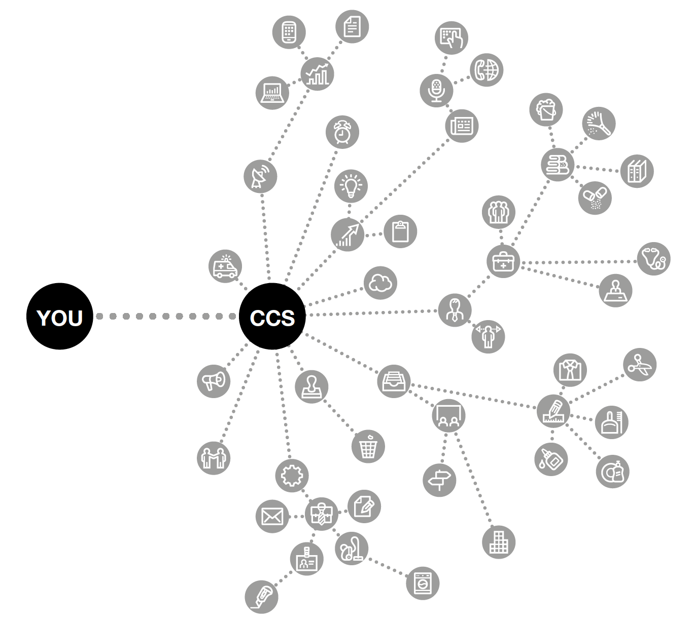
Agenda
Introduction to HELGA
Scope
Customer Journey
Benefits
Roles and responsibilities
Q&A opportunity
CCS
CC

Slide 20
Introduction to HELGA
What is HELGA?
HELGA stands for Heat Networks and Electricity Generation Assets
The agreement allows public sector bodies to procure a range of Energy Demand Management and Generation Products and Services through a flexible, easy-to-use and regulation-compliant process.
Designed to be flexible enough to allow customers to define their own requirements, the HELGA agreement provides access to the full range of demand reduction and energy generation services. This can range from a simple energy audit to a multi-million pound installation.
Users of the HELGA agreement have access to a wide range of market-leading suppliers. This drives value for money and, customers benefit from a streamlined procurement process which reduces the cost of the tender and ensures compliance to public procurement regulation.

Slide 21
Introduction to HELGA
The HELGA Products/Services covering the full journey of energy demand management and generation are as follows:
Energy Advisory, Design and Technical Services | Delivery Services | Energy Purchase Agreement | Commoditised Products | One Stop Shop
Technical services relating to the advice and design of any demand management or generation type | Delivery services to install, manage and maintain any demand management or generation type | Provision of Energy Purchase Agreements through direct or indirect opportunities | Access to Commoditised Products through bulk purchasing | One-stop-shop solution to deliver full end to end advisory, design, delivery, energy purchase agreements, and commoditised products.

Slide 22
Dynamic Purchasing System (DPS)
Why are we using a DPS for HELGA?
Every energy demand management or generation project is unique, so a traditional framework would not be suitable for many potential customers
The DPS is a more flexible approach which allows:
Individualised projects tailored to each customer’s needs
A wide range of specialist suppliers, including SME and regional suppliers for appropriate projects
An evolving list of available technologies as advances in energy management are made
N.B Even as part of the registration process a supplier indicated they are involved in ‘Virtual Power Plants’ so the offering could develop

Slide 23
Scope of the HELGA agreement
The duration of the HELGA DPS agreement is 4 years with the option to extend for a further 1 year, with the value estimated at £800m across its lifetime
Customers may enter into a contract with a supplier for a period of their determining, which may exceed the duration of the HELGA DPS Agreement.
The flexibility of the contracting period allows the customer to determine appropriate contracting timelines required in order that the supplier can meet the needs of the customer for large and complex projects.
One advantage of the DPS is that suppliers register on the platform anytime throughout the term once they have gone through a process to on-board to enable a constant competitive supplier base throughout the term
There is no direct award option, each procurement exercise will need to be a competitive process

Slide 24
Scope of the HELGA agreement
HELGA has been developed with energy demand management and generation in mind, and offers access to a range of suppliers for:
Electricity generation from e.g. solar panels, wind turbines or generators
Heat supply from e.g. heat pumps or biofuels
Heat networks
Combined Heat and Power generation
Heat and Power Purchase Agreements
Energy Efficiency and Demand Management in buildings, including energy storage technologies such as batteries

Slide 25
Offering
Who can use the agreement?
Products/Services available?
Customer Journey
Benefits
Access to specialist suppliers
Free to access
Expert guidance
Range of technologies
OJEU compliant
Flexible
Central Government
Local Government
Health
Devolved Administrations
Education
Emergency Services
Not for Profit
Housing Associations
Energy Advisory, Design and Technical Services
Delivery Services
Energy Purchase Agreement
Commoditised Products
One Stop Shop
Register on DPS
Export Supplier List
Define Requirement
Call for Competition
Evaluation
Award
Publish

Slide 26
Customer Journey
Define your Products / Service requirements
Create high level Specification with key requirements
Create initial supplier shortlist for pre-market engagement to assist requirement
Finalise specification incorporating any responses from pre market engagement, if used
Identify evaluation criteria, panel and any special requirements
Request evidence of works carried out if required
Evaluate all written proposals received against evaluation criteria and scoring
Publish specification to all shortlisted suppliers, including timescales, deliverables and evaluation criteria
If required carry out Capability Assessment
Export a refreshed supplier shortlist from the DPS
Proceed to award. Inform CCS of contract award via HELGA DPS
Provide feedback to all suppliers who participated
Issue Contract Award

Slide 27
Customer Charter
CCS’ role is to provide customers with advice and guidance to help them get the best out of the HELGA DPS.
We can help with any queries such as the best way to appoint a supplier and advice on structuring evaluation criteria.
CCS manages the overarching HELGA DPS and the suppliers at agreement level.
Customers are responsible for managing the contract with your appointed supplier. CCS is able to help with any issues that may require escalating.

Slide 28
Roles and Responsibilities
Customer
Supplier
CCS
Management of supplier at contract level – including issues
Provide a clear specification
Act in a fair and transparent way
Pay suppliers within 30 days
Regular communication
Provide feedback
Provide expert advice and consultation
Submit management information in timely manner
Ensure DPS agreement obligations are met
Adhere to KPI requirements
Management of DPS system
Management of suppliers at agreement level
Provide help and guidance
Act as escalation point
Supplier compliance

Slide 29
Benefits
The HELGA DPS offers a number of key benefits for customers:
Dynamic – customers can build specifications, competitions and contracts to suit their needs
Easy to Use – simple electronic process using widely available systems
Market access – access to a wide range of suppliers, driving competition and offering an increased scope of services
Supplier filtering – quickly find relevant suppliers for competitions, including local and SME suppliers to suit customer’s requirements
Compliance - Fully compliant with UK and EU regulations

Slide 30
Q&A Opportunity
Questions?

Slide 31
Keeping in touch
info@crowncommercial.gov.uk
0345 410 2222
www.gov.uk/ccs
@gov_procurement
Crown Commercial Service

Slide 32
Questions
Industry.innovation@beis.gov.uk

