Slide 1

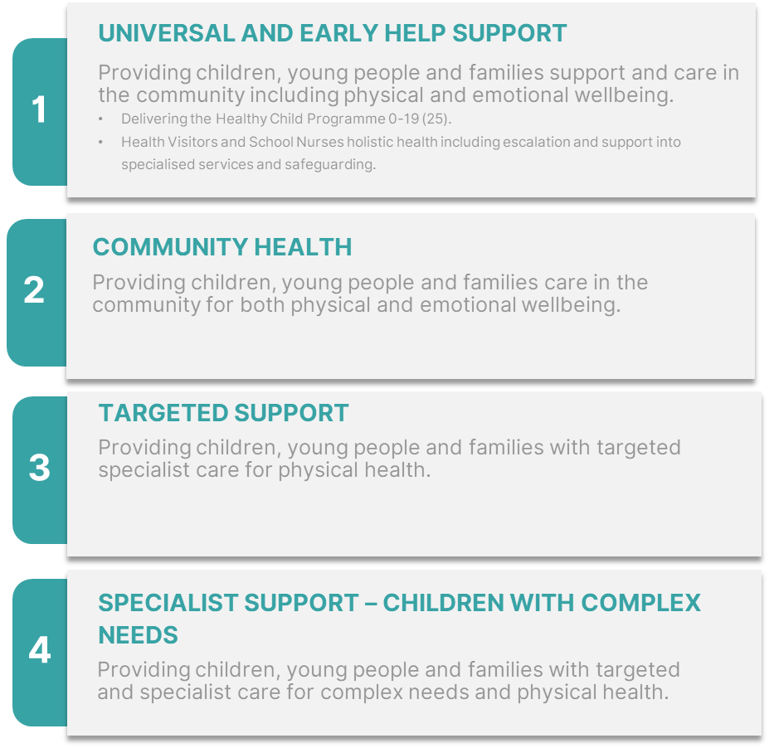
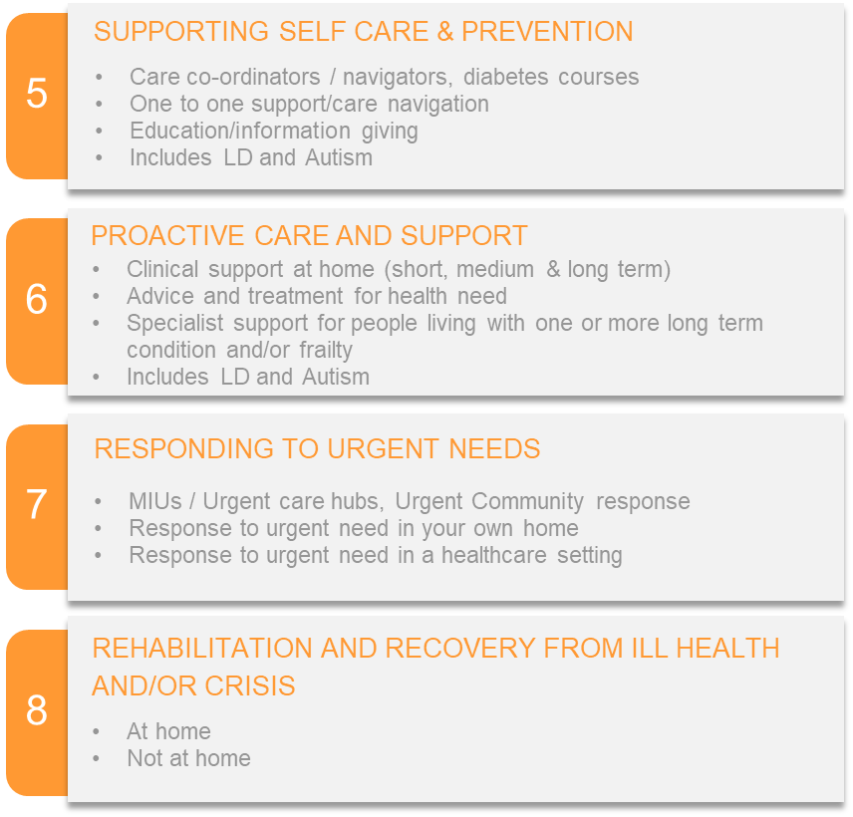
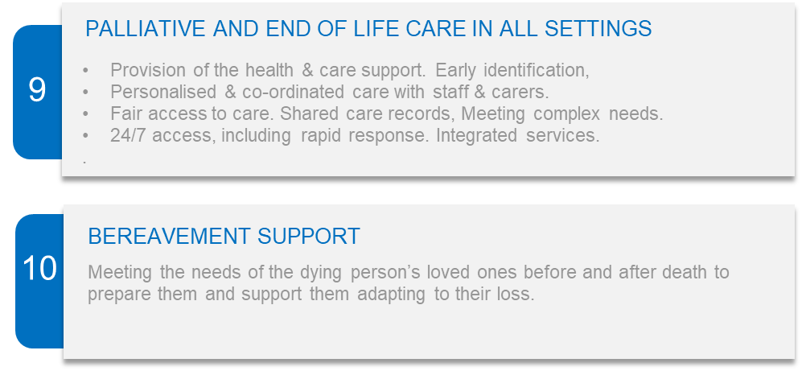

Life Stage Groupings
Each of the numbered areas within the Life Stages are being treated as a ‘discrete bundle’
STARTING WELL
LIVING/AGEING WELL
DYING WELL
LIFE STAGES / ICBC BUNDLES

