Slide 1
The Framework for Integrated Care (SECURE STAIRS)
February 2021

Slide 2
The Framework for Integrated Care (SECURE STAIRS)
SECURE STAIRS is being delivered in partnership:
NHS England and NHS Improvement (NHSE&I)
Her Majesty’s Prison and Probation Service (HMPPS) Youth Custody Service (YCS)
Department for Education (DfE)
The Framework for Integrated Care. A Revised Approach:
A whole system approach to integrated care within the CYPSE
Embedded (rather than ‘in-reach’) mental health staff
Consistency of staffing on residential units
Multi-disciplinary working through the unit based Support Teams, including Education as a core member
Young people co-produce their formulation (my story)
Front line staff as primary facilitators of change
Collaboratively developed formulations recorded on a shared care record, used by all professionals within the multi-disciplinary Support Team and underpinning all Plans.

Slide 3
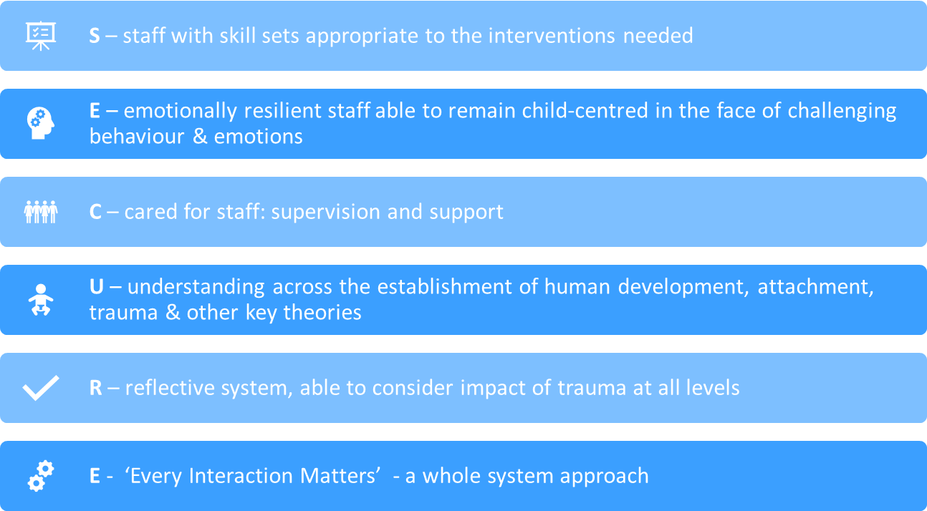
SECURE Foundations

Slide 4
STAIRS – Shared Understanding
S – Scoping the presenting situation – clarity re presenting problems, AND resources (inc where is / who is ‘home’?)
T – Targets identified that key stakeholders (staff, YP, ‘home’) agree on, that are ‘destination’ rather than ‘intervention’ targets, and that are measurable
A – Activators: Interventions driven by a multi-factorial/multi-systemic formulation (not predicated on diagnosis/offence) that identifies the activators for this particular problem for this particular young person/family
I – Interventions aimed at the activators as identified above. ‘Specialist’ and core interventions tailored to each YP’s risks/needs
R - Review progress towards agreed targets regularly, both in unit and with ‘home’, and revision of plans if no evidence of progress
S - Sustainability always in mind, once activators of positive changes identified, main work is how to replicate/sustain these activators.

Slide 5
SECURE STAIRS Key Principles
SECURE - Foundations of a whole system approach, based on trauma/attachment model that promotes residential staff as primary facilitators of change (‘therapeutic parents’).
Training
1:1 Guided Reflective Practice
Group Reflective Practice (Support Team)
Every Interactions Matters
STAIRS - Psychologically informed, developmentally attuned approach to each child and young person. underpinned by a framework that draws upon a multiple theoretical base.
Collaborative, trauma and psychologically informed care
Formulation: all understanding the child’s narrative/ story
Formulation based care planning.

Slide 6
What is Formulation?
‘Team formulation is the most powerful strategy for shifting cultures… Understanding… the person behind the diagnosis and allowing individual stories to be heard.’ (Lucy Johnstone – clinical psychologist)
‘Team formulation can provide the structure, containment and emotional support that enables staff to acknowledge the emotional pain and trauma behind the labels’
(Clarke, Johnstone et al)
‘The perfect composition:
The theoretical heads, the empathic hearts and the hands of all those involved in the person’s care’. (Steve Onyett, 2012)

Slide 7
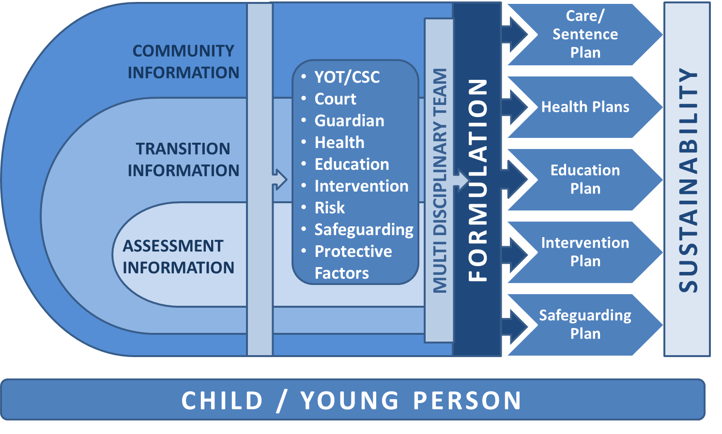
Whole system approach to formulation based care planning

Slide 8
What will the Framework for Integrated Care look like?
A Framework (not a model)
A local implementation plan in each site, based on the differing needs of the population and the nature and scale of the environment but based on universal principles;
A system-wide approach across the whole site.
Processes in place to promote resilience through the system (training, support, supervision, reflective practice).
Emphasis on importance of primary care givers.
Multidisciplinary working (including MDT Formulation meetings) on each unit or residential area.
Embedded mental health provision on each unit.
Robust internal and external communication processes including a shared recording process used by all professionals

Slide 9
What will the Framework for Integrated Care look like?
If you go on a unit/ residential area:
Consistency of staff in unit based multi-disciplinary Support Teams with core membership from:
Custodial Manager
CuSP Officer
Caseworker/ Resettlement Practitioner
Education
Mental Health Practitioner
Forensic Psychology
The Support Team will be frequently visible and available on the unit (informal as well as a formal resource/ support) and staff and young people will know who “their” mental health and education link workers are.
Staff will feel:
Empowered – involved in the formulation based care planning process
Supported – both formally and informally
Informed – understand what they are doing and why.
Young people will feel involved in a co-ordinated care planning process that includes broader life goals (not just sentence/welfare requirements).

Slide 10
Training
A Health and Operational partnership collaboratively delivering SECURE STAIRS training across the secure setting, encompassing the following principles:
The SECURE STAIRS Framework
Attachment & Developmental Trauma.
Every Interaction Matters: Applying this theory in a secure setting
Child and Adolescent Development
Understanding Complex Behaviour
Resiliency and Blocked Care
Trauma Informed Leadership. Understanding Trauma in Organisations
Trauma Informed Care

Slide 11
Expected Outcomes and Benefits
There are a number of practical examples of what successful implementation of SECURE STAIRS may look like within the Child and Young Person Secure estate. These include:
An increase in…
staff recruitment and staff retention
increased CYP resilience and wellbeing.
Improved…
staff Confidence and morale
staff satisfaction
staff resilience and wellbeing
relationships and communication between staff and CYP
emotional regulation
Consistency of…
staff on residential areas
A Reduction in…
caregiver/system anxiety
staff sickness
the number of staff injuries
placement/ unit moves for CYP
frequency and severity of high risk behaviours
the number of incidents
the number of restraints
the number of safeguarding referrals
the number of self-harm incidents
mental health concerns.

Slide 12
Promising Practice in the YOIs to date…
YOI Cookham Wood - Staff
Healthcare staff appreciating the framework approach “No-one is telling us we have to do it a specific way…. We’ve been given guidance and support but the autonomy to deliver… the culture into something more therapeutic”
Operational staff feeling empowered “I started as a Prison Officer 15 years ago and now I’m on Cedar I’m more than that.”
Buy-in from the highest levels “It filters down from the top. The more I feel trusted and supported, the more I can trust and support the boys.”
YOI Cookham Wood – Young People
YP’s buying into SECURE STAIRS “it’s the best step forward to help everyone else”
YP’s developing relationships “we come together as a community and we are friends now”.

Slide 13
Promising Practice in the YOIs to date…
YOI Feltham – Young People
YP feedback from formulation booklet “it will help officers understand [us]”
YP feedback from the ESU “The ESU is caring, supportive and staff are willing to talk about issues if you are… they are trusting people”
YOI Feltham - Staff
Officer feedback from guided reflective practice:
“I got the chance to offload”
“It helped to learn from different people’s experiences”
“It helped me to see things in a different light”
Officer feedback from the ESU:
“for the first time in 23 years I know what I’m doing is making a difference and I believe in it”
“it can be daunting at times… but I know I’m doing the right thing”
Feedback from specialist training:
“It helped me to understand the reason behind the behaviour of YPs”
The training will “help me to learn to be more patient when dealing with YP”

Slide 14
Promising Practice in the YOIs to date…
YOI Werrington – Former Governing Governor
‘Getting the resources we need’
‘Good to see the culture beginning to change and everyone using the same language’
I was told ‘No Governor, that’s not in the Plan’. They were prepared to challenge me and stay with the formulation which had been developed collaboratively for that individual.

Slide 15
The voice of staff and children and young people from the AFNCCF Independent Evaluation
Relationships between staff and children and young people:
Trust and consistency of staff seemed to be discussed in an intrinsic way
Feeling safe was also a key feature of trust in relationships between CYP and staff
Consistency and staff job satisfaction were often referenced together.
Understanding the children through Formulation:
“I went to last week and I found that absolutely fascinating because what I thought I knew about that young person and then what they were voicing weren’t the same thing. So I did actually learn so much more with that young person being in the room and taking part in it.” (SCH)
“Young people by coming to the [formulation] meeting can actually see that staff do care and are actually interested in listening to their story and their journey. (SCH)
Formulation Based Care Plans:
“I think we see a lot more individualised education plans for example, which maybe me, personally, I didn’t see as much. Not just education, but management plans, behaviour support plans, I think it’s a lot more collaborative, it’s a lot more individualised towards the young person.” (YOI/STC)
Consistency of staffing:
“We're [healthcare team] embedded on units, so I think that definitely, from my personal opinion, has improved my relationships with young people on my residential unit.” (YOI/STC).
“I’ve noticed a general warming up of relationships from getting to know people […] and colleagues have said the same thing” (YOI/STC)

