Slide 1





RM6235 Space-Enabled & Geospatial Services DPS
On-boarding – for new and prospective suppliers
26.11.2021

Slide 2

Introducing our solution…
The CCS Fulfilment Channel
Hosted on the DPS Marketplace
Suppliers
Customers
Identify capabilities
Agree framework terms
Respond to call-off competitions
Bid proposals
Shortlist suppliers
Compete opportunities
Evaluate proposal quality and price
Award contracts
Dynamic Purchasing System
RM6235
Space-Enabled & Geospatial Services
… as seen in the UK National Space Strategy – Pillar One: Unlocking growth in the UK space sector

Slide 3


Breaking it down – a DPS (Dynamic Purchasing System)
Standard Public Sector Contract terms
Further competition procedure
Always open to new suppliers
Quality evaluation required at call-off
Filters enable supplier shortlisting
Special Terms bespoke for this agreement cover the sharing of blended ‘joint development’ IPR created through this agreement

Slide 4

Alignment to government policy as standard
PPN 06/21 – Carbon Reduction
PPN 06/20 – Social Value
Small Medium Enterprises (SMEs)
Modern Slavery
Digital Inclusion & Accessibility
Prompt Payment

Slide 5

What you can sell
through RM6235 Space-Enabled & Geospatial Services Dynamic Purchasing System
Category of Requirement
An innovative filter system breaks up supplier capabilities into 4 filters and 3 levels
Service/Product
Specialist Capabilities
1
2
2
Commercial Model
3
3
3

Slide 6
What you can sell
through RM6235 Space-Enabled & Geospatial Services Dynamic Purchasing System
Satellite & Space-Enabled Communication
Geospatial & Remote Sensing
Unmanned Autonomous Vehicles
Upstream (professional services only)
Category of Requirement

Slide 7
What you can sell
through RM6235 Space-Enabled & Geospatial Services Dynamic Purchasing System
Turnkey Solutions including Bandwidth & Capacity
Hardware & Platforms
Data Acquisition /capture, Products & Services
Software, Applications and Solutions
Advisory, Consultancy, and Training
Service/Product

Slide 8
What you can sell
through RM6235 Space-Enabled & Geospatial Services Dynamic Purchasing System
Specialist sector
Data
COTS/Software
Locational
Specialist Capabilities

Slide 9
What you can sell
through RM6235 Space-Enabled & Geospatial Services Dynamic Purchasing System
Project/Milestone
‘XaaS’
Commercial Model

Slide 10

Forecasts for RM6235
22/23
CCS Spend - £19.1m
CCS Market Share – 3.0%
23/24
CCS Spend - £43.0m
CCS Market Share – 6.5%
24/25
CCS Spend - £50.3m
CCS Market Share – 7.3%
April 2022
April 2023
April 2024
April 2024
11 October 2021
October 2022
October 2023
10 October 2024
10 October 2025
Agreement initial term runs to October 2024, with a 1 year extension available.
Initial year spend 21/22 estimated at £3.3m (0.5% of UK Public Sector Market).
Legacy Spend in 25/26 could reach £90m.
20 suppliers so far, expected to grow to around 100
Open to the public sector UK-wide
First agreement to cover this market
Published FTS value of £216m

Slide 11

The end-to-end process – for appointed suppliers

Slide 12
An overview of the fulfilment channel
Multiple Suppliers Request to Participate (RtP) in the DPS
Multiple Customers Call for Competition through the DPS
Suppliers accepted to the DPS – DPS Agreement executed
Supplier(s) Awarded a Contract
Suppliers can apply to join DPS at any point
DPS Selection criteria satisfied
DPS Agreement Terms & Conditions accepted
Publish Call for Competition
Capable DPS Suppliers respond
Customers evaluate Supplier responses

Slide 13

The appointment process
Estimated 1-2 days
Up to 15 days, often less
Register for the Supplier Registration Service (SRS) platform
Complete the Selection Questionnaire (SQ)
Completed the DPS Questionnaire (DPSQ) parts 1 & 2
Pass the assessing stage
Appointment to the DPS
(completed by CCS)
Supplier appointment is completed entirely within the SRS / DPS Marketplace
Before reviewing the DPS Questionnaire (DPSQ) - it is important that you familiarise yourself with the Terms and Conditions of this agreement – these are divided into the DPS Schedules, Joint Schedules and Order Schedules
The SRS and DPS Marketplace are part of the same Gov.UK platform
All published documents and guidance available on the DPS Marketplace
Supplier registration open
Call-off available from 11 October 2021

Slide 14
The buying process
We recommend a total of 8-12 weeks
Use DPS Marketplace to shortlist capable suppliers & access DPS schedules
Further Competition - invite and receive bids from all shortlisted suppliers
Evaluate all suppliers' proposals for quality, price & cultural fit
Get approval to buy & prepare draft requirements
Award to the chosen supplier
Part 1 – Planning & Shortlisting
Part 2 – Evaluation & Award
After shortlisting, create competitions on the buyer’s chosen eProcurement / tendering system (or the free CCS eSourcing tool). Guidance at Gov.UK
The buyer outlines the specification, evaluation criteria and contract format
All published documents and guidance available on the DPS Marketplace
Shortlisting can be as quick as a few minutes
Supplier registration open
Call-off available from 11 October 2021

Slide 15
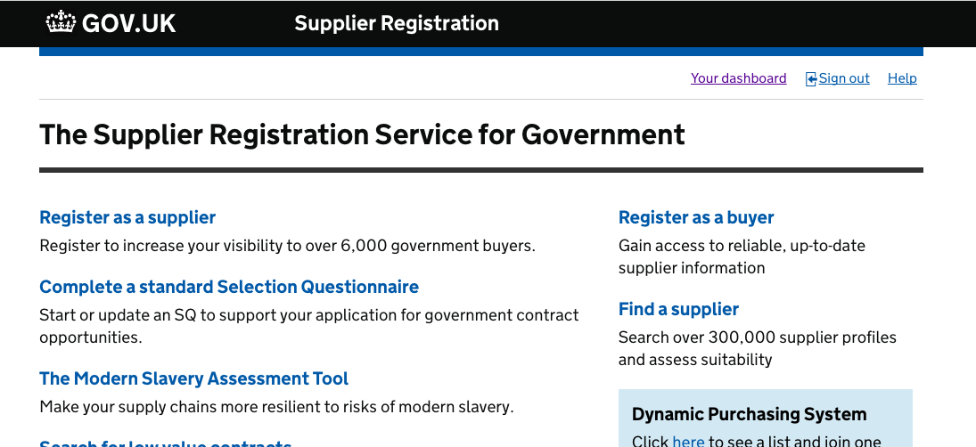
The Digital Platforms Register for the Supplier Registration Service (SRS) platform
1.
3.
2.

Slide 16
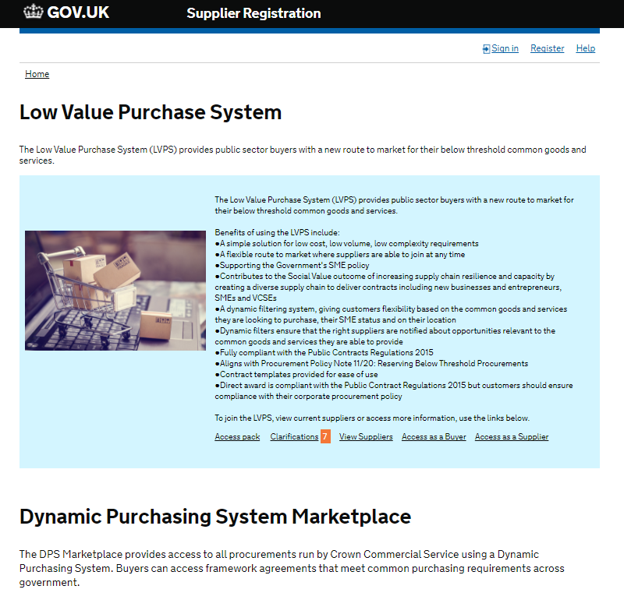
The Digital Platforms
3.
1.
2.

Slide 17
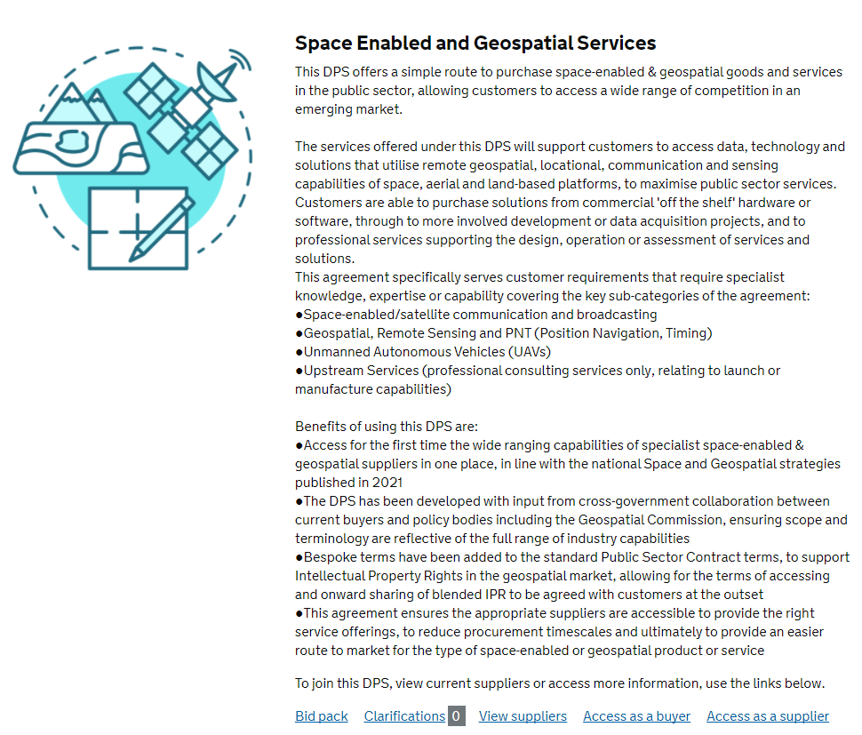
The Digital Platforms
3.
1.
2.

Slide 18
Minimum requirements for suppliers
Insurances:
Employer’s (Compulsory) Liability Insurance of £5m minimum
Public Liability Insurance of £1m minimum
Professional Indemnity Insurance of £1m minimum
Cyber Essentials or Plus
Compliance with PPN06/21 and Carbon Reduction
Supplier Code of Conduct
Compliance with the Modern Slavery Act
Equality & Diversity compliance

Slide 19

How we will work together

Slide 20

Supplier Relationship Management
Buyer Accounts & Customer Relationship Management
Communication methods:
  Regular, all-supplier general updates
  Business as usual communications
  Supplier review meetings
Key considerations:
  KPI monitoring
  MI reporting
  Opportunities pipeline
  Marketing and Case Studies
  Areas to improve the DPS
Iterative review and agreement redesign
Supplier Relationship Management

Slide 21

Management Information (MI)
Why collect MI?
To detail buyer activity within the DPS for government monitoring
To understand where the public sector is spending its money
To demonstrate best price and value for money
To ensure Government Procurement Policy and DPS obligations are upheld
How do we collect MI?
Using the MI Template

Slide 22
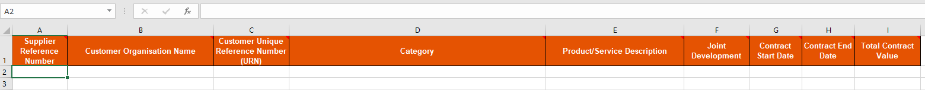
Management Information (MI)
Why collect MI?
To detail buyer activity within the DPS for government monitoring
To understand where the public sector is spending its money
To demonstrate best price and value for money
To ensure Government Procurement Policy and DPS obligations are upheld
How do we collect MI?
Using the MI Template

Slide 23
Management Charge
We are a Trading Fund – not funded from the taxpayer directly, but via the management charge or levy
The Supplier will pay, excluding VAT, 1% of all the Charges for the Deliverables invoiced to the Buyer under all Order Contracts
Payable to CCS within 30 days of the date of the invoice and is calculated based on the monthly MI returns
MI Reports shall be completed electronically and uploaded to the CCS data submission service available at https://www.reportmi.crowncommercial.gov.uk/

Slide 24


Marketing your products & services
Marketing – use our Supplier marketing toolkit (case studies, promotion, press releases etc)

Slide 25






The team
Neal Smith
Strategy Lead
neal.smith@crowncommercial.gov.uk
Jennifer Squire
Commercial Agreement Manager
jennifer.squire@crowncommercial.gov.uk
Laura Hayward
Commercial Support
laura.hayward@crowncommercial.gov.uk
If you have a general enquiry about onboarding please contact Crown Commercial Service Customer Desk on 0345 410 2222 or email info@crowncommercial.gov.uk
@gov_procurement
Crown Commercial Service
info@crowncommercial.gov.uk 0345 410 2222 www.crowncommercial.gov.uk

