Slide 1
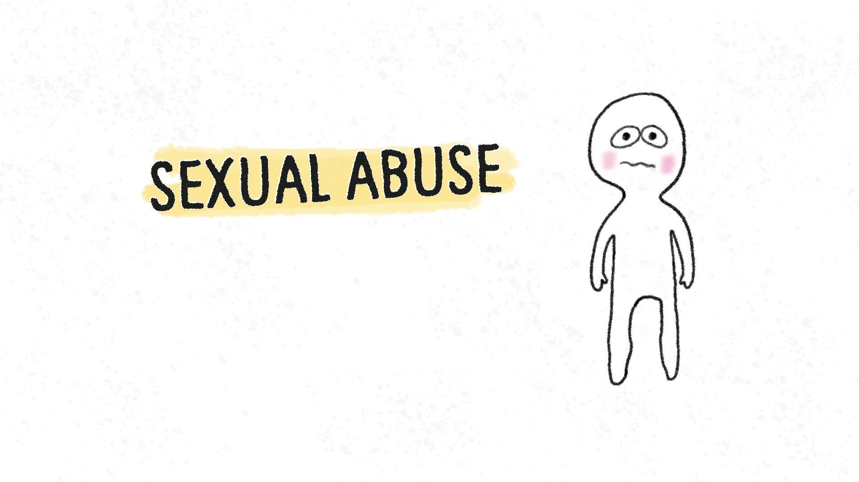
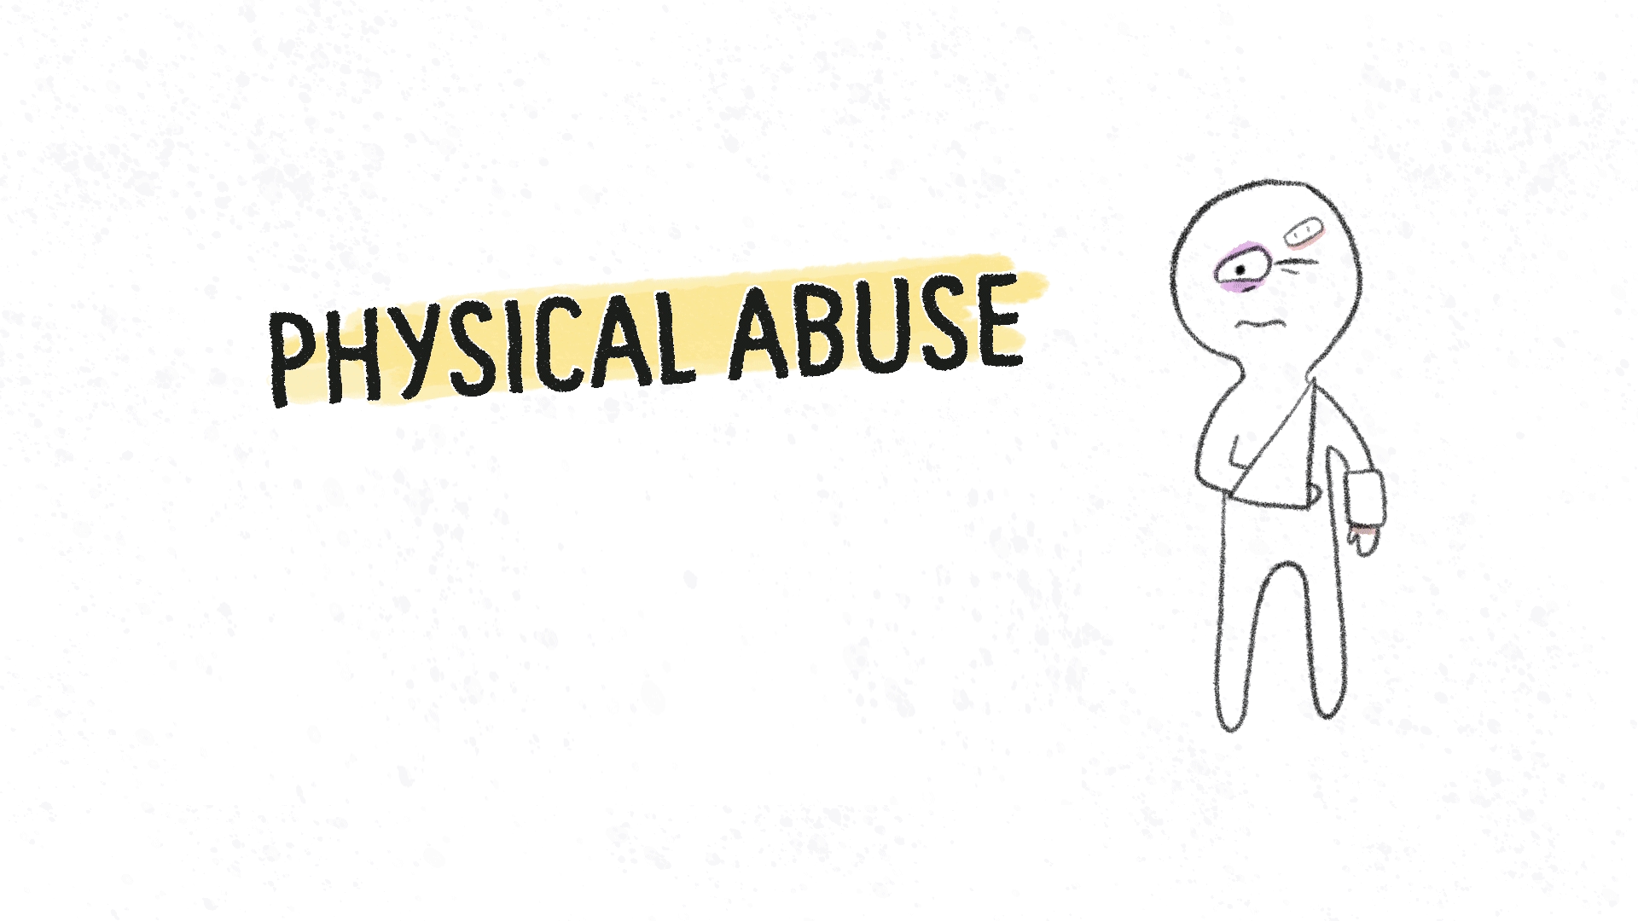
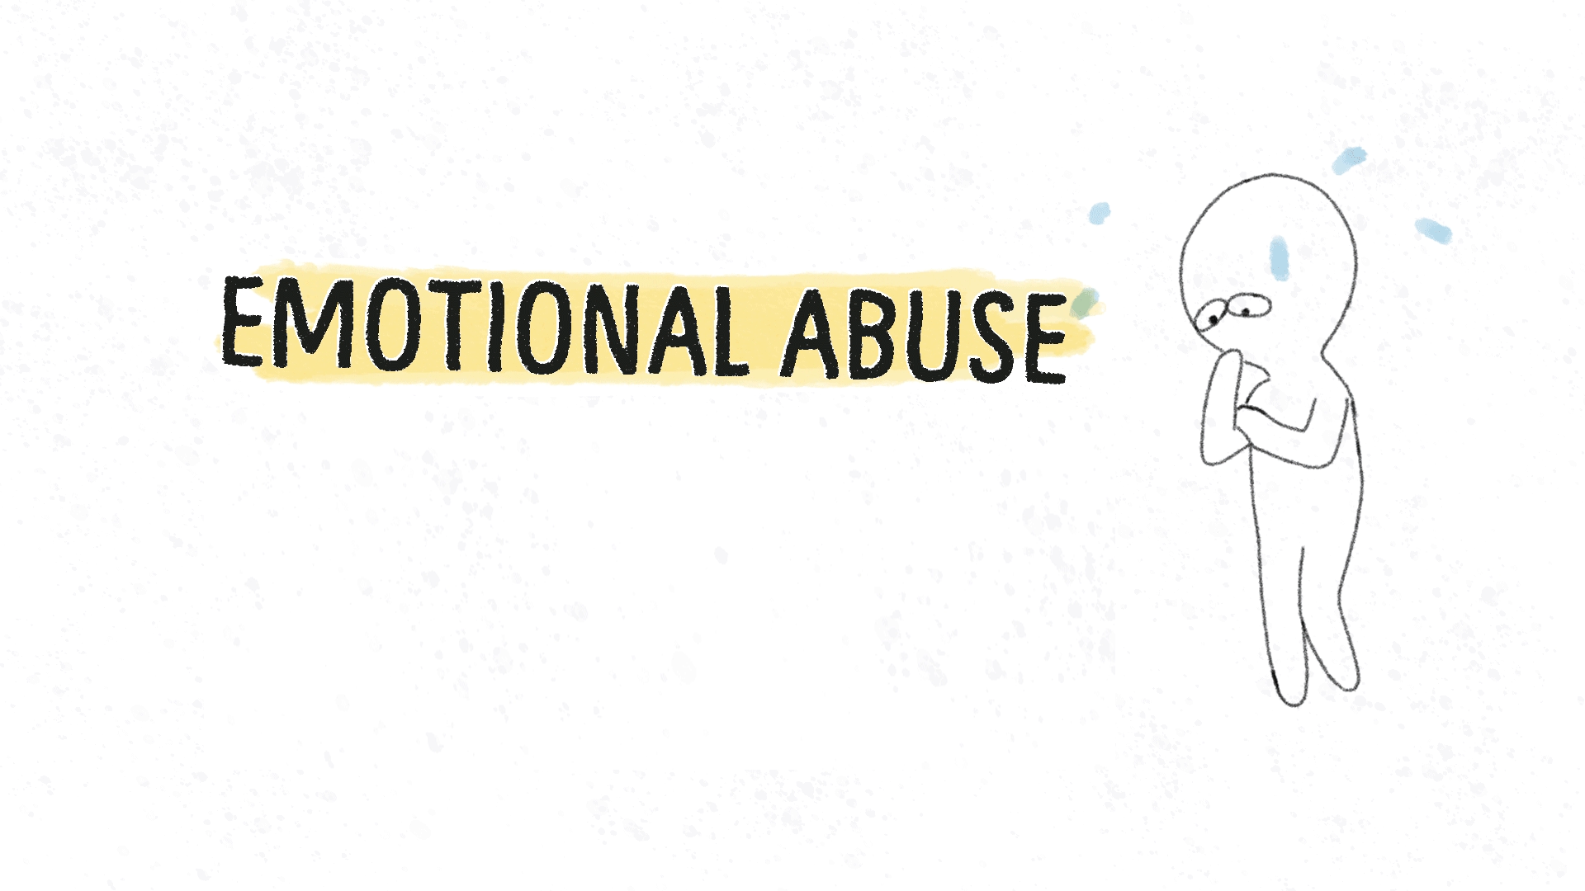
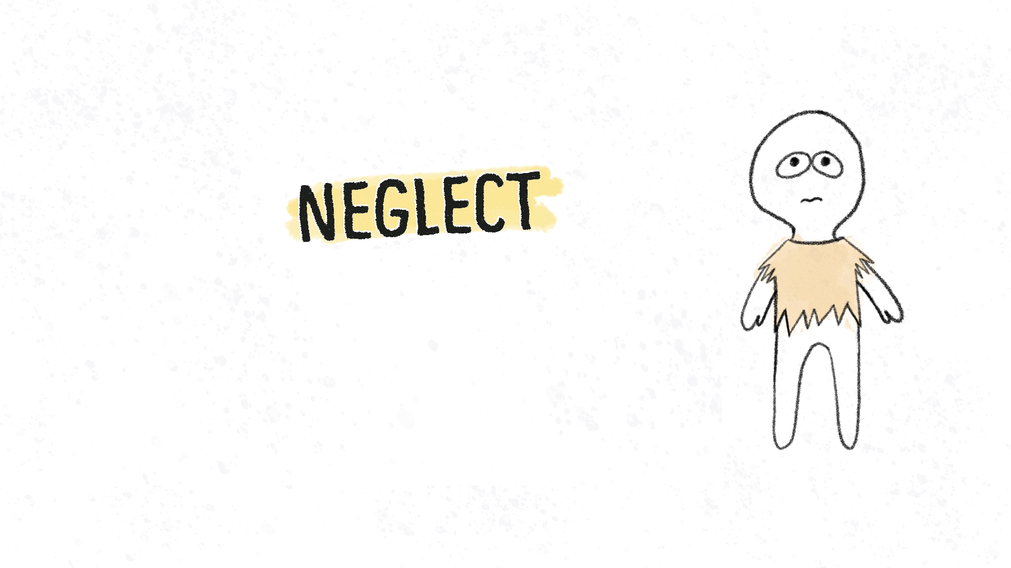
Child Protection and Safeguarding Division
Child Protection Adult helpline Market Engagement Event
7th October 2021
October 2021

Slide 2
Agenda
11:00 – 11:10 | Introduction and aims of session
11:10 – 11:20 | Presentation Background Current system and aims & objectives
11:20 –11:40 | Group discussion: how best to meet the needs of service users, i.e. adults and professionals, in today's digital world?
11:40 – 12:00 | Group discussion: how service user needs might evolve in the next 5 years and how might the market respond?
12:00 – 12:20 | Group discussion: what are the challenges (policy and commercial) of delivering these service objectives?
12:20 – 12:30 | Questions and close
Notes:
Kathryn to press record.
Angie to lead.
Good morning all.
So firstly, thank you so much for coming to this event. I’m Angela Windle I lead on the Reporting and Acting Team within the Child Protection and Safeguarding Division. I will say something about my team next but to start with some housekeeping, just so you are aware we are recording this session to help with note taking and for the benefit of those who couldn’t make the session today.
Today’s agenda is basically in two halves. The first half is us sharing information and the second is us listening to you. As you can see the session is scheduled to last 1.5 hour but we may not need that long.
Just reiterate today's session is about early market engagement activity which will allow us to test our thinking and assumptions and seek feedback from you all. So for most of it we will be in listening mode.
We really value your input today which will help us refine and develop our requirement and plans for this work.
So some of the areas my team work on include
Promoting identification and reporting of child abuse.
Improving multi-agency information sharing (e.g. updating Information Sharing Guidance – Autumn 2021 and working with DHSC to ensure delivery of Phase 2 of the Child Protection Information System (CPIS – March 2023)
Responding to Independent Inquiry into Child Sexual Abuse (IICSA) (final report, 2022)
Reviewing the current policy on mandatory reporting in light of IICSA (ongoing)
Reviewing and updating the statutory guidance ‘Working Together to Safeguard Children (TBC)
Addressing safeguarding concerns/ risks in elective home education, unaccompanied minors from red list countries and Afghan resettlement (ongoing)
Together Campaign which aims to help people spot the signs of abuse
Now you know me but also on the call I've a couple of colleagues :
Tabitha Waite, Grant Manager for the NSPCC
Kathryn Farquar, the Category Manager on our Commercial Delivery Team ( can you give a bit of background about your role – Angie may ask you to introduce yourself)
who not only will answer your commercial related questions but has kindly helped with registrations and recording of this session including note taking.
Think there around 13 attendees so please can we have a quick run round of intros – name and company will be great - feel free to pop cameras on !
Next slide please.

Slide 3
How will the session run?
We will shortly have a presentation which will be delivered by the DfE Policy team
This session will be recorded.
Copies of the presentation, a summary of questions and answers from the session and any other additional documents will be made available on Contracts Finder after the event.
If you have any commercially sensitive questions, please email us at lorna.jackson@education.gov.uk by 22 October.
For the presentation, please could you put yourselves on mute with cameras off.
If you have any questions in the chat, we will have some time to answer questions at the end. Any that we don’t get to, we are happy to answer over email.
There are no wrong questions and we may not have all the answers.
Notes:
Angie to lead
So for the presentation, please could you put yourselves on mute with cameras off.
The presentation along with the information from the breakout groups and any questions/answers from today along with any Q&As that are not commercially sensitive will be posted on Contracts Finder.
Just to stress there are no wrong questions and we will try our best to answer them, however, we may not have all the answers today but we will ensure that we come back to you with a response as soon as we can.
For anyone who has a commercially sensitive questions, could you please email Lorna by 22 October.
Next slide please.

Slide 4
Aims of the session
The Department is considering future plans for how we support people to report concerns about Children and Young People. We want to use this market engagement session to:
Gain feedback from the market to support our thinking regarding how best we can remove barriers and encourage adults to report concerns
Gain feedback from the market if the current model is the most effective way to achieve our aims
Identify market barriers and ways the department can support the market to overcome barriers.
Notes:
Angie to read out the above.
I will now pass you over to my colleague Tabitha who will provide you with some background.
Inform our thinking
Then ask for next slide.

Slide 5
Background
B
Statutory guidance: Working Together to Safeguard Children 2018.
Power to intervene: where there is a risk to the life of a child or a likelihood of serious immediate harm, local authority social workers, the police or NSPCC should use their statutory
protection powers to act immediately to secure the safety of the child.
Acting early: results in better outcomes for children and young people and may relieve pressure on services
Notes:
Good morning all. So over the next 4 slides I’m going to talk you through a bit of background and our aims.
So we are clear in the statutory guidance ‘Working Together to Safeguard Children 2018’ that nothing is more important than children’s welfare.
Whilst it is parents and carers who have primary care for their children, ocal authorities (LAs), working with partner organisations have specific duties to safeguard and promote the welfare of all children in their area these duties include:
• protect children from maltreatment;
• prevent impairment of children's mental and physical health or development;
• ensure that children grow up in circumstances consistent with the provision of safe and effective care; and
• take action to enable all children to have the best outcomes.
So on that action - Power to intervene - For children who are in need of immediate protection, Action must be taken by the social worker, or the police or the NSPCC if removal is required.
So this is why NSPCC is included in the guidance as they are currently the only independent charity with statutory powers, who along with LAs, have been given authorised person status which enable them to make a request to the courts to make a care and protection order.
Acting early, reporting concerns - so not only will this help to stop the abuse or neglect which is clearly the ultimate goal It also provides some other key benefits
These include
Reducing negative effects on a child’s health, relationships and education are reduced
adults who were abused as children may find it harder to cope with life's stresses, get a good job, or be a good parent – so acting early may help them to better participate and contribute to society
mental health problems, drug or alcohol issues, criminal behaviour – or showing signs of harmful behaviour themselves and these behaviour can be repeated in families
Reporting early may also help reduce the pressure on acute services and children becoming looked after, It also achieves wider cross government outcomes such as increased attendance at school, reduced crime, and a fall in benefits claimants.
Next slide please

Slide 6
Background data
The Crime Survey for England and Wales (CSEW) estimated that one in five adults aged 18 to 74 years experienced at least one form of child abuse before the age of 16.
1 in 100 adults aged 18 to 74 years experienced physical neglect before the age of 16 years
An estimated 3.1 million adults aged 18 to 74 years were victims of sexual abuse before the age of 16 years; this includes abuse by both adult and child perpetrators.
Around one in seven adults who called the National Association for People Abused in Childhood’s (NAPAC’s) helpline had not told anyone about their abuse before.
Childline delivered 19,847 counselling sessions to children in the UK where abuse was the primary concern in the year ending March 2019; sexual abuse accounted for nearly half (45%) of these and has become the most common type of abuse counselled by Childline in recent years.
At 31 March 2019, 49,570 children in England and 4,810 children in Wales were looked after by their local authority because of experience or risk of abuse or neglect
Notes:
So, in this slide we showing a few key facts on the prevalence of child abuse and neglect .
Before I move onto the facts a bit about data more generally.
There is no single source that measures the scale and nature of abuse experienced by children in England.
Statistics related to child abuse are produced separately by a number of different organisations in England, but each provides only a partial picture.
Here I have used data from the ONS Child abuse in England and Wales: March 2020 report. Here they have compiled a range of indicators from different data sources to enable better understanding of the extent and circumstances of child abuse. These include data from DfE, MOJ, HO and NHS and voluntary sector to name a few.
This data also has some limitations, for instance on prevalence, the report recognises that the figures are likely to be underestimate for certain ages or types of abuse.
Also, just to caveat that this data is pre - covid 19 and we don’t know for sure what impact this has had as most of our data sets are time lagged.
So what does this data show.
So shockingly The Crime Survey for England and Wales estimate 1 – in 5 adults experience 1 form of abuse – whether emotional abuse, physical abuse, sexual abuse, or witnessing domestic violence or abuse, before the age of 16 years (which is around 8.5 million people).
In addition, an estimated 1 in 100 adults aged 18 to 74 years experienced physical neglect before the age of 16 years (481,000 people); this includes not being taken care of or not having enough food, shelter or clothing, but it does not cover all types of neglect.
The report also shows that prevalence was higher for females than males for each type of abuse, with Around one in four women (5.1 million) and around one in six men (16%; 3.3 million) experienced abuse before the age of 16 years.
Many cases of child abuse remain hidden and do not enter the criminal justice system; around one in seven adults who called the National Association for People Abused in Childhood’s (NAPAC’s) helpline had not told anyone about their abuse before.
Childline delivered 19,847 counselling sessions to children in the UK where abuse was the primary concern in the year ending March 2019; sexual abuse accounted for nearly half (45%) of these and has become the most common type of abuse counselled by Childline in recent years.
At 31 March 2019, 52,260 children in England were the subject of a child protection plan (CPP) because of experience or risk of abuse or neglect; neglect was the most common category of abuse in England.
At 31 March 2019, 49,570 children in England and 4,810 children in Wales were looked after by their local authority because of experience or risk of abuse or neglect.
Next slide please

Slide 7
Barriers to reporting
Many victims do not disclose their abuse to anyone.
We all have a role to play in protecting children and young people from child abuse and neglect.
Many people do not act because they’re worried about being wrong.
Feel they the information isn’t significant enough
Worried about child being taken into care
Distrust of statutory services
Notes:
So in this slide I’m going cover some of the barriers for reporting concerns. I think for many of you these will be kind of obvious and I sure you can think of many more.
We know that many victims do not disclose their abuse to anyone. The Crime Survey for England and Wales (CSEW) data on adults’ experience of sexual abuse before the age of 16 years provides a good indicator of how much abuse remains hidden.
This is why it is essential that everyone understands that they each play a vital role in protecting children and young people, that they recognises the signs of abuse and neglect and knows how to report concerns.
We know that many people do not act on their concerns. So what are the barriers Some of the reasons include
They may not be sure they know enough about the situation,
they may feel they need the whole story or lots of facts,
they may feel or be worried they won’t be listen too or judge.
They may view their concern isn’t serious or valuable enough not realising that what they see as small or minor bit of information may be the missing bit of jigsaw.
or worried that it could lead to child being taken into care, breaking up a family they possible know well or live next to.
We also know that many people either don’t feel confident to speak to or may have a deep distrust of statutory services like children social care or police.
This is why we feel having an intermediary who can provide an accessible point of contact for the public, who are viewed as independent to government
and are equipped the skills and expert knowledge and safeguarding systems to be able to identify when to escalate for emergency intervention or
report concerns for further investigation or
know where they can handle directly (or signpost to another VCS organisation) which hopefully leaving statutory services to focus their resources in dealing in more critical cases of concern
Next slide please

Slide 8
Current system and aims/objectives
Where we are:
Since 2007, The department has been providing a small contribution to the running costs of the NSPCC Helpline.
Funding for the current model is approved to the end of March 2022.
This service provides adults and professionals across the UK with free, impartial and expert advice and support.
Our aim:
To help prevent children and young people from suffering from abuse and/or neglect.
Our objectives:
To encourage adults to share and report concerns and/or seek expect safeguarding advice and support to better protect vulnerable children and young people.
Ensure that children and young people at immediate risk of harm are identified and alerted to statutory services
Support statutory services so they can use the resources to the best effect
Notes:
As you can see this slide set out where are now and our aims an objectives.
So I think the main points are
That in order to help prevent children and young people from suffering from abuse and/or neglect the government has contributed funding towards the NSPCC helpline since 2007.
This service provides adults and professionals across the UK with free, impartial and expert advice and support. People can contact the helpline via the phone, online chat, email or via online form. They also offer a callback service for queries where a child is not at risk.
All contacts are assessed and if a child is at risk, a referral will be made.
Service user needs and the market have evolved since 2007 and so we’re using this opportunity to further the scope how we can best achieve our aim and objectives.
The aim remains same in that we want to ensure that we help prevent children and young people from suffering from abuse
So I’m in danger of being a bit repetitive as I touched on this in prior slide but we think to help achieve this that the system benefits from having a an organisation who can not only provide advice and support but be skilled to know when to intervene to safeguard children without overwhelming the system.
So with LA and Police budgets being constrained, it important that this also adds value to the overall system as well as to the direct service users.
So with this in mind I will now pass you back to Angie to kick of the group discussion.
Next slide please.

Slide 9
Group discussion
How do we best meet the needs of service users - i.e. adults and professionals - in today's digital world
Notes:
Angie to facilitate
This next session for us is the exiting bit as this is where we get to hear your views on the PIN, specifically the 3 questions we posed. Plus a new one.
So we don’t talk over each other could you please raise the virtual hand or if you prefer comment in the side chat bar and I will bring you into the conversation.
How do we best break down those barriers to getting adults to report concerns
Is digital the solution?
We know some adults use digitial more – but some people aren't tech savvy – what do you think ? the world is moving on digitally - Is digital a solution or the key to removing barriers?
Lets get started – read out question.
Others views on this... ?
Keep in mind the following
Gain feedback from the market to support our thinking regarding how best we can remove barriers and encourage adults to report concerns
Gain feedback from the market is the current model is still the most effective way to achieve our aims
Identify market barriers and ways the department can support the market to overcome barriers

Slide 10
Group discussion
2. How might service user needs evolve in the next 5 years and how might the market will respond?
Notes:
keep in mind the following
How might needs change over time – say the next 5 years

Slide 11
Group discussion
3. What are the key challenges (policy and commercial) of delivering these service objectives?
Notes:
eep in mind the following
So if our aim is to prevent children and young people from suffering from abuse and/or neglect and for gen public to report any concerns we ask :
.Is the current helpline model the most effective way to achieve our aims?
Would it confuse the general public/professionals if alternative services/mechanisms for reporting concerns were introduced?
Service obj – accessible 24/7 and accesible via mutiple platforms -
Policy wise – would we need to change any stat guidance guidance
By service objectives we assume it’s a helpline - do we think the current helpline model the most effective way to achieve our aims?
Would it confuse the general public/professionals if alternative services/mechanisms for reporting concerns were introduced?
Is the model the right model ? Yes
If no what do we need to do policy wise and commercial wise to support the change
our objectives:
To encourage adults to share and report concerns and/or seek expect safeguarding advice and support to better protect vulnerable children and young people.
Ensure that children and young people at immediate risk of harm are identified and alerted to statutory services
Support statutory services so they can use the resources to the best effect

Slide 12
Questions
Notes:
Thanks to everyone for taking part in the breakout groups.
If anyone has any questions you can either add them to the team chat or raise your hand.
Lets have a look at the chat.

Slide 13
Next Steps
We'll be using insight from the session to inform recommendations with senior managers about the future service delivery.
Copies of the presentation, a summary of questions and answers from the session and any other additional documents will be made available on Contracts Finder after the event.
If you have any commercially sensitive questions, please email us at: lorna.jackson@education.gov.uk by 22 October

Slide 14
Notes:
Angie to say thanks to attendees.
LORNA to end recording

