Slide 1
Department for Education
Schools Water Strategy
Early Supplier Engagement

Slide 2
Schools Water Strategy Background
1
Making every pound count
The Schools Water Strategy (SWS) is an invest to save strategy aimed at reducing the risk of flooding in schools.
In April 2022 the Department for Education (DfE) Sustainability and Climate Change Strategy (SSCS)1 was announced. Two of the Strategic aims in this strategy are:
Resilience to climate change: adapting our education and care buildings and system to prepare for the effects of climate change as well as a better environment for future generations
Enhancing biodiversity, improving air quality and increasing access to, and connection with, nature in and around education and care settings.
The current SWS goal is to reduce the risk of flooding in 800 schools by 2026, which we have been working towards for a number of years.
One element of the strategy is to deliver Property Flood Resilience at a school level via various funding mechanisms, including grants to larger schemes of work and targeting individual high flood risk schools in response to climate change, increased costs and risk to the department as well as meet the SSCS goals.
The aim of this notice is to gather initial information around the capability and interest of Property Flood Resilience providers in the market to inform delivery of future Schools Water Strategy Schemes.
2

Slide 3
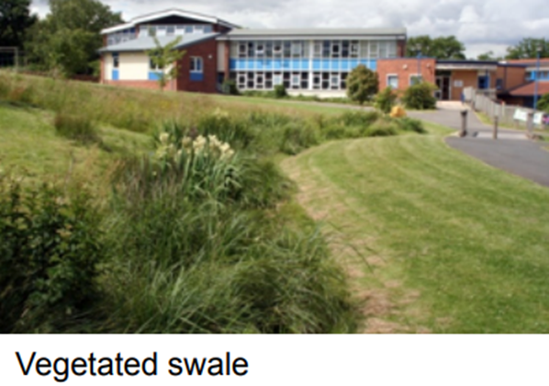
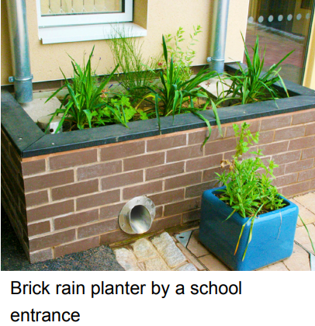
Examples of PFR Measures
1
Making every pound count
Grey solutions:
Green solutions:
Flood Barrier
Flood Gate
Vegetated Swale
Brick rain planter by a school entrance
3

Slide 4
Property Flood Resilience Measures
1
Making every pound count
Property Flood Resilience includes Grey (Doors, barriers, walls etc) and Green (nature based/ SuDS) solutions to mitigate all types of flood risk.
Potential scope of the DfE requirements:
Flood Risk Assessments
Design and Optioneering of solutions
Construction/Installation of Property Flood Resilience Measures
Technical Assurance
Project Management
*Nb: the final scope of requirements have not yet been confirmed. If any procurement activity does arise the requirements will be refined pending the results of market research.
4

Slide 5
Response Required
1
Making every pound count
If your organisation has capabilities or interest in delivering Property Flood Resilience within schools, the Department would welcome your response to the set questions in the Microsoft Teams form linked below. Please submit your response following the below process, any responses submitted outside of the below process may not be reviewed.
Review the questions in the Microsoft Form (linked below)
Collate your answers to submit via the Microsoft Form
Any queries must be submitted to the SWS mailbox below by 05.08.24 date
Final responses must be submitted via the Microsoft form below by 12.08.24 date
Where attachments are requested, please submit these to the SWS mailbox (details below)
Microsoft Forms questions to answer: https://forms.office.com/e/7Mam9Jsp62
Q18 PFR Average cost exercise:
Attachments cannot be submitted to the department via the Microsoft Forms, there are certain questions in the Microsoft Form that require attachment submissions and these attachments should be sent by email submission to the following mailbox: SWS.Commercial@education.gov.uk. Please state your ‘PFR –’ and then your company name as written in question 3 of the Microsoft form as the subject of the email.
5

Slide 6
To note
1
Making every pound count
This notice and document do not constitute a call for competition to procure any services for the Department. The procurement of any services will be carried out in accordance with the provisions of the relevant Government Procurement Regulations. The purpose of this PIN is to gather feedback from interested and capable parties, future market engagement and/or opportunities will be advertised accordingly.
Please submit any queries to the SWS mailbox – SWS.Commercial@education.gov.uk
6

