Slide 1
T1098 Identifying mitigations for the risk of unplanned movement of wheelchairs and pushchairs on station platforms
Market Engagement Supplier Day

Slide 2
Background

Slide 3
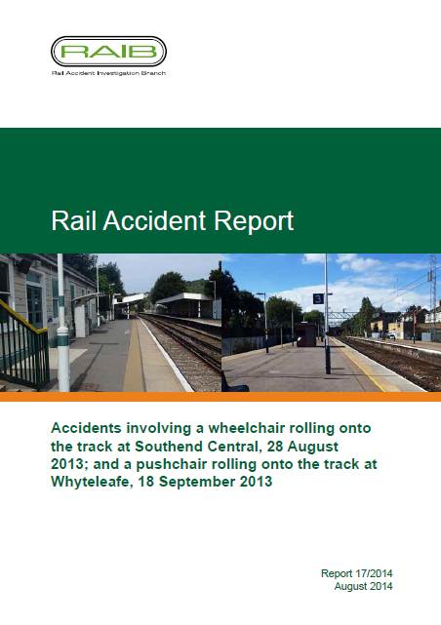
Background (1 of 7)
In August 2014, RAIB issued a rail accident report following two similar incidents:
Wheelchair rolling onto track at Southend Central station (28 August 2013);
Pushchair rolling onto track at Whyteleafe station (18 September 2013).
In both incidents, RAIB identified the immediate cause by stating that ‘the wheelchair and pushchair… were able to roll because the brakes were not applied and there were slopes present on both platforms’ .

Slide 4
Background (2 of 7)
RAIB issued four recommendations to industry, of which the following recommendation (Recommendation 2) triggered T1098’s proposal:
‘Network Rail in consultation with the Association of Train Operating Companies, RSSB and the Department for Transport, should (as part of the national strategy for managing the platform train interface risk) arrange for work to be undertaken to determine when a slope towards the railway could become a significant hazard, and ways of mitigating the risk’ The scope of the exercise should consider:
All slopes on platforms including those that have been installed intentionally (for example to accommodate changes in level along the platform length);
At what point a slope towards the railway makes it more likely than not that a wheelchair or pushchair without brakes applied could roll away, taking account of modern designs of such equipment; and

Slide 5
Background (3 of 7)
Other factors such as how individuals perceive a slope hazard, the most appropriate way to highlight the hazard, appropriate methods to influence public behaviour, and other ways of mitigating the risk.
Once the work is complete the industry should publish appropriate guidance, including consideration of standardisation in the contents of signage, announcements, etc…’

Slide 6
Background (4 of 7)
Recommendation 3 made by the RAIB was directed at Rail Delivery Group (formerly Association of Train Operating Companies) and required:
‘As an interim measure, pending the outcome of the research identified in recommendation 2, and in consultation with passenger groups including those representing the interest of disabled passengers, to review the findings of the report and seek to understand the ways in which the risk of wheelchairs and pushchairs rolling onto the track can be more effectively managed by operators. This review should include consideration of:
Locations where passengers may need to remove both their hands from a pushchair or wheelchair because of the nature of another task to be performed (e.g. at a ticket machine or shop/kiosk);
Reference to any existing good practice in this area; and
Measures that could most effectively influence the behaviour of passengers using wheelchairs and pushchairs on station platforms.
The output of the review should be consolidated into suitable guidance for train operators…’

Slide 7
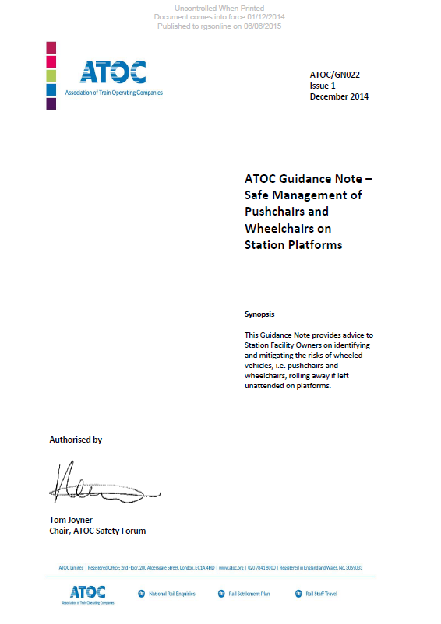
Background (5 of 7)
In response to the above, RDG issued a guidance note in December 2014 (ATOC/GN022 - Safe Management of Pushchairs and Wheelchairs on Station Platforms). The stated purpose of this document was to provide advice to station facility owners on identifying and mitigating the risks of wheeled vehicles (i.e. pushchairs and wheelchairs), rolling away if left unattended on platforms.
The content drew on emerging industry good practice but no attempt was made to compare or quantify the effectiveness of the various mitigations identified.
Notes:
ATOC/GN022 is 23 pages in length

Slide 8
Background (6 of 7)
Recommendation 1 made by RAIB was directed at Network Rail and Station Facility Operations to:
‘implement processes for managing the risk of wheelchairs and pushchairs rolling onto the track. These should include:
the inclusion of platform slopes as a factor to be considered when assessing the risk to passengers on platforms;
guidance to risk assessors on factors likely to exacerbate any risk of roll away (such as the presence of ticket machines, help points and shops/kiosks where people are more likely to release their hold on pushchairs and wheelchairs);
consideration of measures to manage the risk (taking account of the work arising from the implementation of recommendation 3 in the short-term and recommendation 2 in the longer term);
specific consideration of the impact on platform slopes of any works that are to take place at the station and methods of ensuring that those works will, as a minimum, not worsen the slope (and reduce or eliminate it if reasonably practicable to do so); and
the sharing of information concerning any residual risk at the conclusion of works (paragraphs 73a and 75c).’

Slide 9
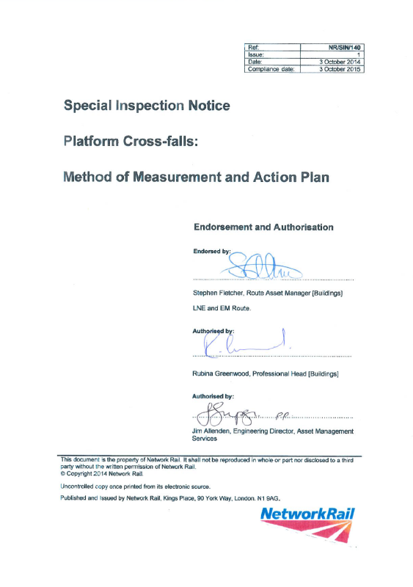
Background (7 of 7)
In response, Network Rail produced NR/SIN/140 Special Inspection Notice (Platform Cross-falls: Method of Measurement and Action Plan).
Notes:
NR/SIN/140 is 13 pages in length

Slide 10
Project background

Slide 11
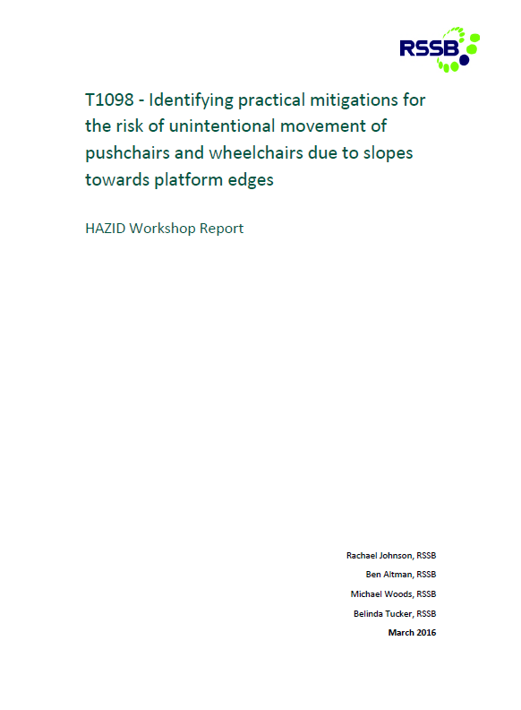
Project background (1 of 2)
The first phase of work (T1098-01) was undertaken by RSSB. Two HAZID stakeholder workshops were held in October 2015 and January 2016 to detail all known contributory factors and mitigations associated with the unintentional movement of wheelchairs and pushchairs on station platforms towards, or onto, the track.
RSSB produced a draft HAZID report and identified key mitigations to be taken forward for industry consideration.
Notes:
Draft HAZID report is 25 pages in length

Slide 12

Project background (2 of 2)
Following discussions with the Office of Rail and Road (ORR), it was agreed that the wide range of different pushchair and wheelchair types and external factors would make determining a threshold slope very dependent on such a wide range of influences.
As such, it was agreed that the second phase of work (T1098-02) would build upon T1098-01’s findings in order to (once completed) “implement” the RAIB recommendation “by other means.” The agreed project objectives are listed in the following slide.
T1098 contributes towards the objectives of the Platform train interface strategy.

Slide 13
Project objectives

Slide 14
Project objectives
Carry out a formal review of the content and fitness for purpose of:
NR/SIN/140 Network Rail Special Inspection Notice (Platform Cross-falls: Method of Measurement and Action Plan)
ATOC/GN022 ATOC Guidance Note - Safe Management of Pushchairs and Wheelchairs on Station Platforms
This part of the research should cover work planning, method of inspection and risk assessment matrix and should be aligned with the ‘Taking Safe Decisions’ and as low as reasonably practicable (ALARP) approach.
Identify how individuals perceive a cross fall and gradient slope hazard;
Identify the most appropriate ways to highlight the hazard and mitigate the associated risks by influencing public behaviour;
Investigate infrastructure options which might increase or decrease the risk of a wheelchair or pushchair without brakes applied rolling away.

Slide 15
Project scope

Slide 16
Project scope (1 of 2)
In scope | Out of scope
Risk assessment of platform cross fall and gradient; Station staffing (e.g. staff availability, task procedures, competence and communication skills for managing cross fall and gradient risk); Public awareness of contributory factors that can lead to the unplanned movement of wheelchairs and pushchairs on station platforms towards or onto the track (e.g. platform signage, station announcements and social media campaigns); Platform design (eg features leading to lack of supervision of wheeled vehicles and distractions, topography and platform aerodynamics); Wheelchair users and ‘pushchair and wheelchair supervisors’ (e.g. task reliability (capability) for securing and supervising wheeled items). | Mitigations related to the use of mobility scooters, station trolleys and any other wheeled items such as suitcases on station platforms; Mitigations related to the design of wheelchairs and pushchairs; Mitigations at the platform train interface not associated with wheelchairs/pushchairs rolling unintentionally towards the platform edge, e.g. boarding and alighting. Identifying contributory factors that can have an effect on the unplanned movement of wheeled transport on station platforms towards or onto the track (work undertaken in T1098-01);

Slide 17
Project scope (2 of 2)
Suppliers should consider practical mitigations to ensure that mitigation cost/disruption implications are not disproportionate to the risk.
Further to this, new mitigations considered may not necessarily be limited to traditional information provision or accessibility based approaches, but could include for example implicit guidance; influencing passenger behaviour indirectly through a ‘self-explaining environment’ approach (comparable to the self-explaining roads concept originally developed in The Netherlands).

Slide 18
Project deliverables

Slide 19
Project deliverables
Proposed update to ATOC/GN022
Undertake a review of the content and fitness for purpose of ATOC/GN022 and provide a proposed update to be implemented by RDG
Proposed update to NR/SIN/140
Undertake a review of the content and fitness for purpose of NR/SIN/140 and provide a proposed update to be implemented by Network Rail
Final report
Describe in detail the background to the research (including T1098-01), the methods used and findings (guidance)
Draft research brief
Summarise the aim, findings, impacts and benefits, background and methodology of the project
C. Four pages in length

Slide 20
Project delivery

Slide 21
Project delivery
Tender to be advertised on Contracts Finder by end of November 2016
Bids will be required prior to Christmas break (2016)
The tender evaluation meeting will be held on 26 January 2017.
A decision is expected by the end of January 2017.
The project kick off meeting will be held at RSSB on Thursday 16 February 2017 (13:00 - 16:00).
Suppliers must ensure that they can attend the meeting on this date and be available either 30 minutes before or after the meeting to discuss project management aspects with the Delivery Manager.
A T1098 launch event is anticipated to be held at RSSB to disseminate the project’s findings (February 2018). The supplier will be expected to present at this event.

Slide 22
Any questions?

