Slide 1
CAREERS BRAND PROPOSAL

Slide 2
THE BRIEF
To develop a brand identity for our careers offer, to help attract new talent and skills to Team Salford and stand out as the employer of choice in a competitive market.

Slide 3
OUR STRATEGIC PRIORITIES
PREPARING OUR STUDENTS FOR THE FUTURE
LOCAL ROOTS, GLOBAL AMBITION
EQUALITY, DIVERSITY AND INCLUSION
INNOVATION - INTENSIFYING INDUSTRY COLLABORATION
ENVIRONMENTAL SUSTAINABILITY
PEOPLE, DIGITAL, CAMPUS
FINANCIAL RESILIENCE

Slide 4
OUR VALUES IN CONSULTATION
Respect. We operate with integrity and hold ourselves to the highest ethical standards, creating inclusive and sustainable environments.
High Standards. We do not stop at ‘good enough’ and strive to become unstoppable in everything we do, ensuring the best possible outputs for everyone.
Kindness. We do the right thing, in the right way, at the right time, not only when it’s easy, but when it’s hard.
Improving. We work collaboratively to share knowledge, create opportunities, encourage contribution and drive innovation, for greater impact locally and beyond.
Curiosity. We are always learning, with an inquisitive and positive mindset, to help us ‘be at our best’ and find new creative ways of doing things better.

Slide 5
OUR BRAND VALUES
INDUSTRY
We form partnerships that bring real-world experience to our students, allow our teaching staff to advance their knowledge, and bring tangible benefits to communities around us
INTEGRITY
We do the right thing, in the right way. We are proud of our heritage and achievements. We value our diversity and commitment to widening participation
INITIATIVE
We recognise opportunity and are courageous in its pursuit. We’re not afraid of a challenge or of doing things differently; we’re resourceful and independent, approaching problems from a fresh perspective to find innovative solutions

Slide 6
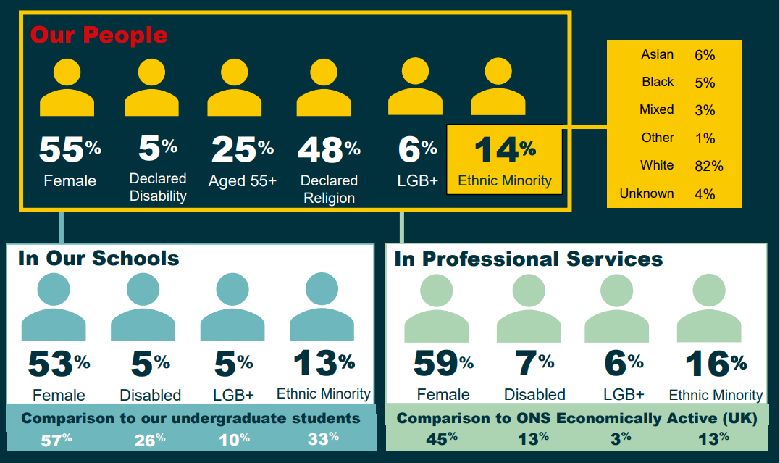
OUR DEMOGRAPHICS

Slide 7
WHERE WE ARE NOW
Strong external brand for students, not colleagues
Our people plan – we need to tell our external audience what we have to offer
Gaps in diversity of colleague community ((DIFF AIMS BY ACADEMIC SCHOOLS AND PROF SERVICES)
Want to grow and diversify skills to meet demand
Candidate experience not always consistent or positive
Losing great people – turnover and candidates
Our people are what make us great – are we showcasing them?

Slide 8
WHY PEOPLE DO AND DON’T CHOOSE US …. ‘The Golden and Brutal Truths’

Slide 9
WHY PEOPLE DON’T CHOOSE US
PROCESSES TAKING TOO LONG / OFFER NOT TIMELY
ACADEMICS – CHOOSE REDBRICK OVER US
SALARIES IN PROFESSIONAL SERVICES (COMPETING WITH PRIVATE SECTOR)
CAREER PROGRESSION (LIMITED IN SOME AREAS)
INTERVIEW EXPERIENCE – MIXED REVIEWS
DON’T CONSIDER US AN EMPLOYER OF CHOICE
NEVER WORKED IN HE – MAYBE THINK THEY CAN’T OR IS DAUNTING

Slide 10
WHY PEOPLE DO CHOOSE US
BENEFITS – PENSION, PERKS, LEAVE, HYBRID WORKING
CAMPUS AND ENVIRONMENT – IMPRESSIVE FACILITIES, LOCATION AND SETTING
AMBITIONS – BEING PART OF OUR EXCITING JOURNEY
CULTURE – SENSE OF BEING WELCOMED AND BELONGING
INTERVIEW EXPERIENCE – WHERE GREAT, IT’S GREAT!
EMPHASIS ON WELLBEING
REPUTATION – GREAT PLACE TO WORK
WORKING IN HE – PROSPECTS
81% employees would recommend
240 reviews Glassdoor
TOP 5 REASONS
Work life balance
Pay and benefits
3. Job security and advancement
4. Management Style
5. Culture
Glassdoor
4.1 out of 5
Indeed
3.9 out of 5
Glassdoor

Slide 11
WHERE THEY COME FROM
WEBSITE
31.4%
LINKEDIN
23.6%
JOBS BOARD
21.2%
OTHER
23.8%
MAINLY
INDEED
JOBS.AC.UK
TOTAL JOBS
FAMILY OR FRIEND REFERRAL
INDEED
40.4%
JOBS.AC.UK
45.2%
11,292 CANDIDATES

Slide 12
WHO ARE WE TALKING TO?
PASSIVE CANDIDATES
Not actively looking. Would consider us
for the right
opportunity
DON’T THINK WE’RE FOR THEM
Haven’t or wouldn’t consider us. Hard to reach communities or groups or those who don’t consider us an employer of choice
THOSE WHO ENGAGED BUT DIDN’T CHOOSE US
Bad experience or lost to competitors
JOB SEEKERS
Actively looking, both employed and unemployed
Attraction
Job searches
Advertising
Storytelling
Candidate experience
Engagement
Active sourcing
Interaction
Targeted advertising
Interaction
Face to face
Community networks and influencers
Brand Champions
Interaction &
reengagement
Face to face/direct contact
Remarketing
External / Internal / Alumni

Slide 13
WHAT WE HAVE TO OFFER
CULTURE
Our values and behaviours
Flexible – ways of working to suit you
Collaboration and autonomy
OUR APPROACH
Innovate and collaborate, partnerships
Leading the way
COMMUNITY
Sense of belonging
Celebrate and value diversity
WELLBEING
Focus on mental and physical health
Access to networks, services and facilities
YOU
Individual needs and experiences
ENVIRONMENT
Campus
Facilities
Location
DEVELOPMENT
Training and development
Progression opportunities
Support and networks
LEGACY
Be proud, part of it
At the heart of our community
Impact on people’s lives and society
Why Salford?
The Package
BENEFITS
Rewards and recognition
Lifestyle benefits and offers
Competitive package
What it feels like to work here

Slide 14
OUR PROPOSITION
A WORKPLACE TO BE INSPIRED, CONNECT AND THRIVE.

Slide 15
REASONS TO BELIEVE
IMPACT OF OUR PEOPLE AND DELIVERY – TEACHING EXCELLENCE, STUDENT OUTCOMES, WORLD CLASS RESEARCH, INDUSTRY PROJECTS, DIGITAL CHAMPIONS, SUBSTAINABILITY LEADS, COLLEAGUE SUCCESSES, ACCOLADES
ENVIRONMENTS – INNOVATIVE FACILITIES AND A UNIQUE CAMPUS SETTING (PEEL PARK), MEDIACITYUK, SUSTAINABLE SALFORD AND OUR GREEN AGENDA, OUR CAMPUS MASTERPLAN
OUR PEOPLE AND THEIR STORIES – SPOTLIGHT ON PROGRESSION, EXPERTISE, ACHIEVEMENTS, DIVERSITY AND INCLUSION, INFLUENCERS
OUR LEGACY AND AMBITIONS – BEING PART OF THE JOURNEY AND SHARING IN THE SUCCESS
BE INSPIRED

Slide 16
REASONS TO BELIEVE
INDUSTRY PARTNERSHIPS AND PROFESSIONAL NETWORKS – IMPACT AND OPPORTUNITY, KNOWLEDGE SHARING AND EXPERTISE
COLLABORATION – WORKING WITH DIVERSE STAKEHOLDERS TO GET THE BEST RESULTS
OUR COMMUNITY – SENSE OF BELONGING, VALUE DIVERSITY, TEAM SALFORD
AT THE HEART OF SALFORD – DEEP ROOTED LINKS, OUR IMPACT ON LIVES AND SOCIETY, BEING PART OF IT – OPPORTUNITIES TO VOLUNTEER AT UNI EVENTS
CONNECT

Slide 17
REASONS TO BELIEVE
HOW WE DO THINGS - WORK AUTONOMOUSLY
OUR VALUES – A CULTURE THAT SUPPORTS PEOPLE TO SUCCEED
OPPORTUNITIES – CAREER PROGRESSION, TRAINING AND DEVELOPMENT
INCLUSIVITY – PEOPLE LED
WELLBEING - SUPPORT YOU TO BE YOUR BEST
WAYS OF WORKING TO SUIT YOU – FLEXIBILITY, HYBRID WORKING, WORK LIFE BALANCE
RECOGNITION AND REWARD – BENEFITS AND PACKAGES, CELEBRATE ACHIEVEMENTS
THRIVE

Slide 18
HOW WE GOING TO COMMUNICATE IT?
CREATIVE STORYTELLING AROUND OUR PEOPLE AND REASONS TO JOIN

Slide 19
SPOTLIGHT ON OUR UNSTOPPABLE PEOPLE
VIDEOS
Our experts in action, their stories, expertise and achievements
ADVERTISING
Using testimonials and faces in our ads – ‘reasons to believe’
SOCIAL
‘Behind the scenes’, content.
Social sharing – our influencers and via colleague networks
PROFILES
Inspiring testimonials from our community
AWARDS
To recognise excellence and individuals. Local, regional and national impact
Celebrating Diversity

Slide 20
OUR MESSAGING
HOW WE ATTRACT AND ENGAGE
WHY SALFORD?
Our legacy and ambitions
Our impact and expertise
Location and environment
WHAT IT FEELS LIKE TO WORK HERE
Culture, community and people
Our values
THE OFFER
Package and benefits
Professional development and opportunities
Wellbeing and ways of working
BE INSPIRED, CONNECT AND THRIVE

Slide 21
CHANNELS
ADVERTISING
Social and digital
Job sites
Radio and press
SOCIAL MEDIA
Content creation and sharing
Proactive sourcing
(LINKEDIN)
WEBSITE
Reasons to choose us and vacancies
Partner websites
MATERIALS
Candidate packs
School Brochures
New Starter Pack
COMMS
Candidate journey
Targeted (alumni and graduate)
Remarketing
COMMUNITY ENGAGEMENT
Brand champions and outreach team
Community comms channels
EVENTS
Networking
Recruitment events
Exhibitions
AWARDS
Local, regional and national

Slide 22
WHAT WILL OUR BRAND LOOK AND FEEL LIKE? The university already has a strong brand identity. Let’s make the most of it!

Slide 23
BECOME UNSTOPPABLE
OUR STRAPLINE

Slide 24
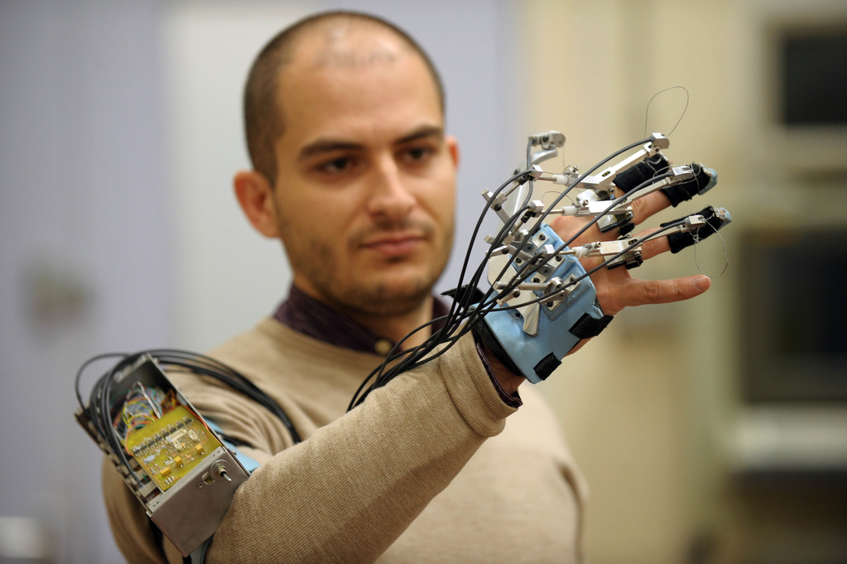
OUR RESEARCH IS CHANGING LIVES BE PART OF IT ROLES AVAILABLE. APPLY NOW SALFORD.AC.UK/JOBS #BEUNSTOPPABLE
EXAMPLE

Slide 25
‘I’M DEVELOPING THE HEALTH PROFESSIONALS OF THE FUTURE’ JOIN OUR TEAM. APPLY NOW SALFORD.AC.UK/JOBS #BEUNSTOPPABLE
EXAMPLE

Slide 26
Watch your language!
Colleagues, not staff
Candidate, not applicant
Careers, not jobs
We are Team Salford! Other references, ‘our colleague community’

Slide 27
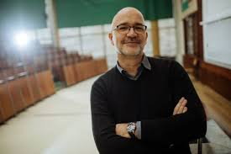
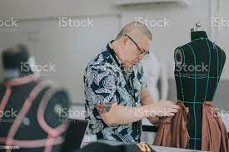
IMAGERY
Should be genuine and authentic, featuring our colleague community and fields of expertise. Showcasing working environments. It should be action focus, have personality and celebrate diversity.

Slide 28
COLOURS
Taken from the brand’s secondary colour palette, a yellow/white/black colour palette is bold, contemporary, engaging and welcoming.

Slide 29
WHAT NEXT?
Brand ‘look and feel’ defined
Messaging Refinement and application
Brand collateral – imagery and videos, materials and assets
Brand guidelines and advert toolkit
Website DEVELOPMENT
Marketing delivery plans
Edi goals

Slide 30
WHAT WE NEED TO DELIVER THIS
BUDGET PHASE 1 – BRAND DEVELOPMENT AND ASSETS
ONGOING – OUTSOURCING SUPPORT FOR DESIGN AND VIDEOGRAPHY
FUTURE PROOFING – WEBSITE AND LINKEDIN DEVELOPMENT
FUTURE INVESTMENT FOR CONTENT DEVELOPMENT AND INVESTMENT INTO NEW CHANNELS

Slide 31
BECOME UNSTOPPABLE

